Slide 1
COMP265
After the textbook

Slide 2
After the textbook, what should we learn?
One goal of learning Python is for machine learning
Machine learning needs to make use of a lot of python packages
If we are still using Google Colab, in most cases we do not need to install packages
But if we are using PyCharm, we then need to install some packages

Slide 3
Packages I once used
pandas
numpy
matplotlib
scikit-learn
xlrd
mlxtend
finplot
yfinance
seaborn
spacy
scikit-image
wordcloud
textblob
mplfinance
nltk

Slide 4
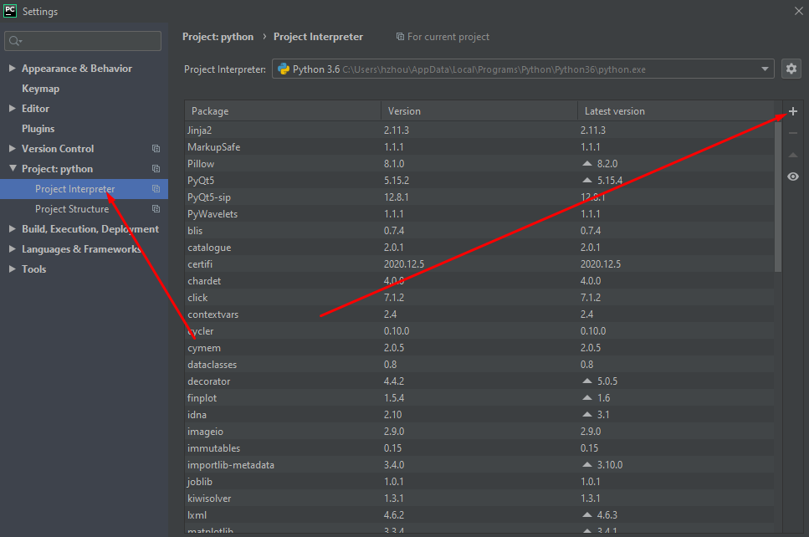
Let’s install pandas, numpy, etc
Click File → Settings → +

Slide 5
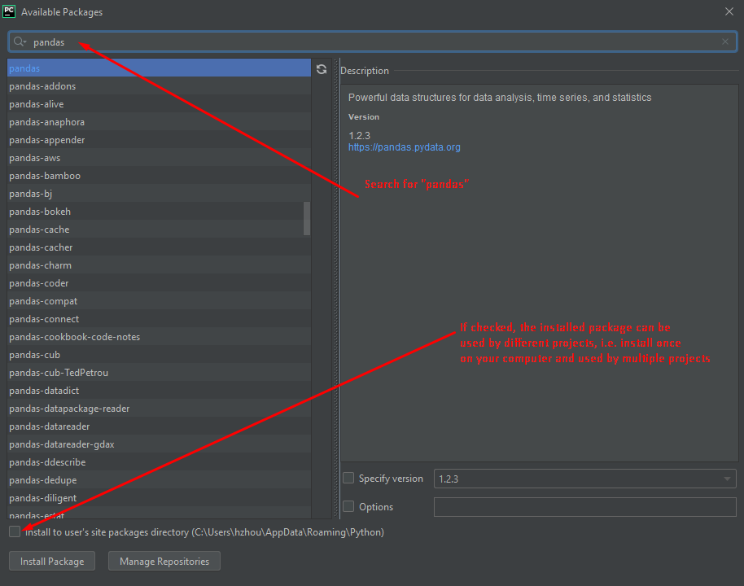

Slide 6
NumPy
A powerful N-dimensional array object
Functions for performing array computations
Linear algebra operations

Slide 7
Pandas
Rich data structures and functions for analyzing data
Developed by the PyData Development Team
Data libraries
  Labeled array data structure: Series, DataFrame, Panel
  Indexing objects: axis indexing and multilevel/hierarchical axis indexing
  Aggregating and transforming datasets
  Input/Output tools
  Moving window statistics

Slide 8
Matplotlib
The single most used Python package for 2D-graphics
Visualize data from Python
Provide publication-quality figures in many formats:
  Line plots
  Scatter plots
  Contour plots
  Etc.

Slide 9
The scikit-learn library
An open source machine-learning library using the Python programming language.
Supports various machine learning models, such as
  Classification
  Clustering
  Regression

Slide 10
PyMongo
I haven’t used this package
Heard that it is a type of NoSQL database.
Highly scalable, robust
Work with JavaScript-based web applications
Can store data as JSON documents

Slide 11
NumPy Arrays and Vectorized Computation
NumPy is a good starting package to get familiar with arrays and array-oriented computing in data analysis.
Why using NumPy?
  People said that it provides high-efficiency compared to the original python array
  Dr. Hong has not used this package that much
  But let’s learn some basics, just in case
Let’s review how to use the original python array

Slide 12
1-D array
A = [0] * 20
A = [i for i in range(10)]
Accessing each element by indexing as: A[0], A[5], etc

Slide 13
Python’s 2-D array
A = [ [0] * 5 ] * 8
A = [ [ i for i in range(10)] for j in range(20) ]
Accessing: A[i][j]

Slide 14
NumPy Arrays
import numpy as np # usually as np
p = np.array(range(10))
p.ndim # tells the number of dimension, either 1-D, 2-D, etc
Note, if you do:
p = np.array([range(10)])
p.ndim # this will give you 2-D
P = np.array([45,23]) # this is 1-D
p.shape # tells the size of each array dimension
len(p) #
p.dtype # data type. Note, python has a built-in function ‘type’, too

Slide 15
Numpy array creation
np.empty([5,6], dtype=np.int) →5x6 2-D array, data type: int. default values = 0
np.ones([5,6]) → 5 x 6 2D array, all 1
Pay attention to:
np.ones_like(an-existing-array)

Slide 16
Numpy array creation
np.zeros
np.zeros_like
np.arange(4, 12, 2)
np.array([[1,2,3,4], [5,6,7,8]])
And many other ways …

Slide 17
Numpy array indexing and slicing
Similar to python original array’s indexing and slicing
A=np.array([[1,2,3,4], [5,6,7,8]]
A[0][1] → 2, similar to original indexing
A[0,2] → 3, numpy’s unique indexing.
A[0] → the first row
A[1] → the second row
A[:1]
A[:2]
B = A[1]
B[0] = 20
Will this change the original A?
Let’s try it

Slide 18
Got a specific column
a = [i for i in range(20)]
a = np.reshape(a, [4,5])
a[:2]
#got the column 2
a[:,2]
array([ 2, 7, 12, 17])
a[:,1:3]

Slide 19
Fancy Indexing
a = np.array([3,7,2,9])
b = a % 3 == 0
b
array([ True, False, False, True])
c = np.array([[4,5],[3,1],[0,5],[7,8]])
c[b]
a = np.array([[1,2,3,4],[5,6,7,8],[9,10,11,12],[13,14,15,16]])
a[2,1]
10
a[[2,1]]
array([[ 9, 10, 11, 12],
[ 5, 6, 7, 8]])

Slide 20
Numpy scalar operations
Notice the difference from original array’s repetition operator *
Find the patterns …
a = np.ones(4)
b = a * 2
b
array([2., 2., 2., 2.])
c = a + 3
c
array([4., 4., 4., 4.])
a = np.ones([2,3])
b = a + a
c = b * b
d = b * c

Slide 21
Array functions
What is dot product?
Sort
a = np.array([[1,2,3],[4,5,6]])
b = a.reshape(3,2)
a.T
C = np.dot(a.T, a)
a = np.array([[6,34,1,6], [0,5,2,-1]])
np.sort(a)
np.sort(a, axis=0)
array([[ 0, 5, 1, -1],
[ 6, 34, 2, 6]])
When axis=0, pick the smallest of every column into the first row, i.e each column is sorted

Slide 22
Numpy functions
sum
prod
a = np.array([[6,34,1,6], [0,5,2,-1]])
np.sum(a, axis=0)
array([ 6, 39, 3, 5])
np.sum(a)
np.sum(a, axis=1)
array([47, 6])
a = np.array([[6,34,1,6], [0,5,2,-1]])
np.prod(a)
np.prod(a, axis=1)
np.prod(a, axis=0)

Slide 23
Numpy functions
diff
std
a = np.array([[6,34,1,6], [0,5,2,-1]])
np.diff(a)
array([[ 28, -33, 5],
[ 5, -3, -3]])
np.diff(a, axis=1)
array([[ 28, -33, 5],
[ 5, -3, -3]])
np.diff(a, axis=0)
array([[ -6, -29, 1, -7]])
a = np.array([[6,34,1,6], [0,5,2,-1]])
a.std()
10.652904533506343
np.std(a)
10.652904533506343

Slide 24
Numpy functions (many more are not mentioned)
mean
unique
a = np.array([[6,34,1,6], [0,5,2,-1]])
a.mean()
6.625
a.mean(axis=0)
array([ 3. , 19.5, 1.5, 2.5])
a.mean(axis=1)
array([11.75, 1.5 ])
a = np.array([[6,34,1,6], [0,5,2,-1]])
np.unique(a)
array([-1, 0, 1, 2, 5, 6, 34])
a.unique() → this does not work!

Slide 25
Convert regular array into numpy array
To numpy array
From numpy array
a = [[1]*5]*2
a
[[1, 1, 1, 1, 1], [1, 1, 1, 1, 1]]
b = np.array(a)
b
array([[1, 1, 1, 1, 1],
[1, 1, 1, 1, 1]])
a = [[1]*5]*2
b = np.array(a)
b
array([[1, 1, 1, 1, 1],
[1, 1, 1, 1, 1]])
c = b.tolist()
c
[[1, 1, 1, 1, 1], [1, 1, 1, 1, 1]]

Slide 26
Numpy, change data type
a = [[1]*5]*2
a = np.asarray(a, np.float64)
a = np.random.randint(1,100, 20)
b = a.reshape(4,5)
b[b<20] = 0
np.place(b, b==0,100)
a[(a>=20) & (a<=30)] = 0

Slide 27
Loading and Saving Data using numpy
saving
loading
a = [i for i in range(100)]
a = np.reshape(a, [5,20])
np.save('sample.npy', a)
Note, .npy file format is binary, you can try to view it using editors such as wordpad, etc, but cannot tell the content.
We can use the simple ‘load’ function to load the .npy data
a = [i for i in range(100)]
a = np.reshape(a, [5,20])
np.save('sample.npy', a)
#Now load the saved data
b = np.load('sample.npy')

Slide 28
Leave in blank on purpose

Slide 29
Pandas
There is no way that we can escape Pandas when we try to work with data in Python.
The most commonly used data structure in Pandas is DataFrame, similar to what R has (in my view)
Series is also very popular
Labeled axes
Flexible handling of missing data
Smart slicing, fancy indexing, subset creation
Arithmetic operations
Statistic computations
Easy Read and write

Slide 30
Pandas Series
import pandas as pd
s1 = pd.Series(np.random.randint(1,100,8))
s1
0 66
1 70
2 40
3 6
4 18
5 60
6 91
7 50
dtype: int32
Look at what is on the left. What do you get?
Usually people use it as ‘pd’
Series → capitalized
np.random.randint(1,100,8) → from 1 to 100, 8 random integers
A Series is a 1-D object (similar to Array, list, or column in table)
Each item in Series is assigned to an ‘index’. By default, the index is numbered as a Python list
s1[2] = ?

Slide 31
Series index can be more meaningful
import string
abt = string.ascii_lowercase
abt = list(abt)
s1 = pd.Series(np.random.randint(1,100,8), index=abt[0:8])
What about reset_index? i.e. change the index?
This is a little bit confusing.
There are two functions: reindex and reset_index
Let’s talk about reindex first.
Note, we are going to use the list abt often!

Slide 32
Reindex (this applies to both Series and DataFrame)
reindex → means ‘reorder’ indeed!
s1 = pd.Series(range(2,8)) → the default index is 0-5
0 2
1 3
2 4
3 5
4 6
5 7
s1.reindex(range(4,10)) → the indexes are 4-9. Note, the original indexes are 0-5, so the indexes 4, 5 existed in the original, but 6-9 do not. Now, the two values
4 6
5 7
Will be reordered in the beginning, but since 6-9 do not exist, they will have NaN.

Slide 33
Reindex (this applies to both Series and DataFrame) (2)
Important!
The indexes should be monotonically increasing or decreasing.
The reindex() will generate a new object by default (a copy), not change on the original Series. However, you can set copy=False. Even you set copy=False, no change on the original.
s1 = pd.Series(range(2,8))
s1.reindex(range(4,10))
4 6.0
5 7.0
6 NaN
7 NaN
8 NaN
NaN
s1.reindex(range(4,10), copy=False, fill_value=0)

Slide 34
reset_index: change the index to default
s1 = pd.Series(range(2,8), index=abt[0:6])
s1
a 2
b 3
c 4
d 5
e 6
f 7
s1.reset_index()
index 0
0 a 2
1 b 3
2 c 4
3 d 5
4 e 6
5 f 7
However, the original is not changed

Slide 35
reset_index: change the index to default
s1=s1.reset_index()
s1
index 0
0 a 2
1 b 3
2 c 4
3 d 5
4 e 6
5 f 7
type(s1)
<class 'pandas.core.frame.DataFrame'>
Note, when we do
s1=s1.reset_index()
We change the Series to be DataFrame

Slide 36
Access Series
s1 = pd.Series(range(2,8), index=abt[0:6])
s1['a']
2
s1[0]
2
s1[0:2]
s1[['a','b']]
s1[abt[:2]]

Slide 37
Operations on Series
s1 = pd.Series(range(2,8), index=abt[0:6])
s1 * 2
s1= s1*2
s1 = np.sqrt(s1)
When we conduct operations on two Series, to obtain predicted results, the two Series must be of the same size and must have the same index! Otherwise, it is not going to be well ☹
s1 = pd.Series(range(2,8), index=abt[0:6])
s2 = pd.Series(range(1,7), index=abt[0:6])
s1+s2
s1*s2
a 2
b 6
c 12
d 20
e 30
f 42
dtype: int64

Slide 38
DataFrame: the hallmark
What is a DataFrame?
2-D array
Matrix
Ways to construct a DataFrame
From a file
From Dictionary
Manual creation

Slide 39
DataFrame from a Dictionary
data = {'Year' : [2020, 2021], 'Life_Span':[78,77], 'Density': [67.2, 35.9]}
df1 = pd.DataFrame(data)
df1
Year Life_Span Density
0 2020 78 67.2
1 2021 77 35.9
df1.reset_index(inplace=True)
index Year Life_Span Density
0 0 2020 78 67.2
1 1 2021 77 35.9
df1.reset_index(drop=True, inplace=True)
Year Life_Span Density
0 2020 78 67.2
1 2021 77 35.9
df1
Year Life_Span Density
0 2020 78 67.2
1 2021 77 35.9

Slide 40
Pandas DataFrame change column names
rename
Columns=
data = {'Year' : [2020, 2021], 'Life_Span':[78,77], 'Density': [67.2, 35.9]}
df1 = pd.DataFrame(data)
df1.rename(columns={'Year':'a'})
a Life_Span Density
0 2020 78 67.2
1 2021 77 35.9
data = {'Year' : [2020, 2021], 'Life_Span':[78,77], 'Density': [67.2, 35.9]}
df1 = pd.DataFrame(data)
df1.columns=abt[0:3]
df1
a b c
0 2020 78 67.2
1 2021 77 35.9

Slide 41
DataFrame remove unwanted column
data = {'Year' : [2020, 2021], 'Life_Span':[78,77], 'Density': [67.2, 35.9]}
df1 = pd.DataFrame(data)
df1
Year Life_Span Density
0 2020 78 67.2
1 2021 77 35.9
df1.reset_index(inplace=True)
index Year Life_Span Density
0 0 2020 78 67.2
1 1 2021 77 35.9
How to remove the column ‘index’?
del df1['index']
df1.drop(columns=['index'], inplace=True)
df1.drop(['index'], axis=1, inplace=True)
Remove multiple columns:
df1.drop(columns=df1.columns[0:2], inplace=True)

Slide 42
Pandas DataFrame change column names
set_axis
Change row index names
data = {'Year' : [2020, 2021], 'Life_Span':[78,77], 'Density': [67.2, 35.9]}
df1 = pd.DataFrame(data)
df1.set_axis(abt[0:3], axis=1, inplace=True)
df1
a b c
0 2020 78 67.2
1 2021 77 35.9
data = {'Year' : [2020, 2021], 'Life_Span':[78,77], 'Density': [67.2, 35.9]}
df1 = pd.DataFrame(data)
df1.set_axis(abt[0:3], axis=1, inplace=True)
df1.set_axis(abt[0:2], axis=0, inplace=True)
df1
a b c
a 2020 78 67.2
b 2021 77 35.9

Slide 43
Pandas DataFrame access columns
By name
By col number
data = {'Year' : [2020, 2021], 'Life_Span':[78,77], 'Density': [67.2, 35.9]}
df1 = pd.DataFrame(data)
df1['Year']
0 2020
1 2021
Name: Year, dtype: int64
df1[['Year','Density']]
Year Density
0 2020 67.2
1 2021 35.9
df1.iloc[:,0]
Year
0 2020
1 2021
df1.iloc[:,0:2]
Year Life_Span
0 2020 78
1 2021 77

Slide 44
loc vs iloc
loc by name for column
iloc by number → individual and rows
df1.loc[:,'Year']
0 2020
2021
df1.iloc[:,2]
df1.iloc[:,0:2]
df1.iloc[0][0]
df1.iloc[0]
Year 2020.0
Life_Span 78.0
Density 67.2
Name: 0, dtype: float64

Slide 45
loc vs iloc
Loc for rows
Compare
df1
Year Life_Span Density
0 2020 78 67.2
1 2021 77 35.9
df1.loc[0]
df1.iloc[0]
They got the same result because ……
df1.set_axis(abt[0:2], axis=0, inplace=True)
df1.iloc[0]
Year 2020.0
Life_Span 78.0
Density 67.2
df1.loc['a']
Year 2020.0
Life_Span 78.0
Density 67.2

Slide 46
Loc vs iloc
df1.set_axis(abt[0:2], axis=0, inplace=True)
df1.iloc[0]
Year 2020.0
Life_Span 78.0
Density 67.2
df1.loc['a']
Year 2020.0
Life_Span 78.0
Density 67.2
df1.loc['a']['Density']

Slide 47
DataFrame from / to .CSV files
df1 = pd.read_csv('data/sample.csv')
df1.head()
Elapsed_Time Time_in_Community ... Religious Support_Group
0 8.71 Short ... 0 0
1 5.24 Medium ... 1 1
2 4.22 Medium ... 0 0
3 4.81 Long ... 0 0
4 3.95 Long ... 0 1
[5 rows x 12 columns]
df1.columns
df1.to_csv(‘data/sample2.csv', index=False)
df1.to_excel(‘data/sampl2.xlsx’)
Index=False → avoid the row-indexes to be written into the file
Note by default, pd.read_csv() will read column names, but not row indexes. However, you can specifically define them
https://pandas.pydata.org/docs/reference/api/pandas.read_csv.html
Let’s do our experiments

Slide 48
Manually create pd.DataFrame
By nested Lists:
df2 = pd.DataFrame([['John', 34, 23456],['David', 18, 231231], ['Tommy', 20, 123213]], columns=['Name','Age','Salary'])
df2 = pd.DataFrame(np.arange(12).reshape(3,4), columns=['a','b','c','d'])
df2
a b c d
0 0 1 2 3
1 4 5 6 7
2 8 9 10 11
df2 = pd.DataFrame([['John', 34, 23456],['David', 18, 231231], ['Tommy', 20, 123213]], columns=['Name','Age','Salary'])
df2.set_axis(abt[0:3], axis=0, inplace=True)
df2
Name Age Salary
a John 34 23456
b David 18 231231
c Tommy 20 123213

Slide 49
Manually create pd.DataFrame
df2 = pd.DataFrame([[i*j for i in range(1,5)] for j in range(2,5)], columns=abt[0:4], index=['x','y','z'])
df2
a b c d
x 2 4 6 8
y 3 6 9 12
z 4 8 12 16

Slide 50
Binary Operations on DataFrame
Why not working?
Check this example, why not either?
df1 = pd.DataFrame(np.arange(12).reshape(3,4), columns=['a','b','c','d'])
df2 = pd.DataFrame([[i*j for i in range(1,5)] for j in range(2,5)], columns=abt[0:4], index=['x','y','z'])
df1 + df2
a b c d
0 NaN NaN NaN NaN
1 NaN NaN NaN NaN
2 NaN NaN NaN NaN
x NaN NaN NaN NaN
y NaN NaN NaN NaN
z NaN NaN NaN NaN
df1 = pd.DataFrame(np.arange(12).reshape(3,4), columns=['a','b','c','d'])
df2 = pd.DataFrame([[i*j for i in range(1,5)] for j in range(2,5)])
df1+df2
a b c d 0 1 2 3
0 NaN NaN NaN NaN NaN NaN NaN NaN
1 NaN NaN NaN NaN NaN NaN NaN NaN
2 NaN NaN NaN NaN NaN NaN NaN NaN
Notes:
Both row names and column names must match

Slide 51
Binary Operations on DataFrame(2)
Why partially not working?
Now it works well
df1 = pd.DataFrame(np.arange(12).reshape(3,4), columns=['a','b','c','d'])
df2 = pd.DataFrame([[i*j for i in range(1,5)] for j in range(2,7)], columns=['a','b','c','d'])
df1+df2
a b c d
0 2.0 5.0 8.0 11.0
1 7.0 11.0 15.0 19.0
2 12.0 17.0 22.0 27.0
3 NaN NaN NaN NaN
4 NaN NaN NaN NaN
df1 = pd.DataFrame(np.arange(12).reshape(3,4), columns=['a','b','c','d'])
df2 = pd.DataFrame([[i*j for i in range(1,5)] for j in range(2,5)], columns=['a','b','c','d'])
df1+df2
Questions: df1 or df2 changed? A new DataFrame generated?
Notes:
Both row names and column names must match

Slide 52
Binary Operations on DataFrame(3)
Why partially not working?
How to handle it? Two ways, results different!
df2 = pd.DataFrame([[i*j for i in range(1,5)] for j in range(2,7)], columns=['a','b','c','d'])
df1 = pd.DataFrame(np.arange(12).reshape(3,4), columns=['a','b','c','d'])
df3 = df1+df2
df3
a b c d
0 2.0 5.0 8.0 11.0
1 7.0 11.0 15.0 19.0
2 12.0 17.0 22.0 27.0
3 NaN NaN NaN NaN
4 NaN NaN NaN NaN
df3.fillna(0)
a b c d
0 2.0 5.0 8.0 11.0
1 7.0 11.0 15.0 19.0
2 12.0 17.0 22.0 27.0
3 0.0 0.0 0.0 0.0
4 0.0 0.0 0.0 0.0
Notes:
Both row names and column names must match

Slide 53
Binary Operations on DataFrame(4)
Way-2, results different!
eq | ==
df3=df1.add(df2, fill_value=0)
df3
a b c d
0 2.0 5.0 8.0 11.0
1 7.0 11.0 15.0 19.0
2 12.0 17.0 22.0 27.0
3 5.0 10.0 15.0 20.0
4 6.0 12.0 18.0 24.0
df1 = pd.DataFrame(np.arange(12).reshape(3,4), columns=['a','b','c','d'])
df2 = pd.DataFrame(np.arange(12).reshape(3,4), columns=['a','b','c','d'])
df2['a'] = [-1,-3,-2]
df1==df2
df1.eq(df2)
Examine what you view

Slide 54
Binary Operations on DataFrame(5)
Not equal, etc
Another way of writing
Not equal (ne)
Greater than (gt)
Less than (lt)
Less equal (le)
Greater than (ge)
Similar to LATEX symbols ☺
df1 != df2
df1 < df2
df1 >= df2
The outcome is a DataFrame of boolean values!

Slide 55
Functional Statistics
This is extremely important, why?
Because data science cannot live without statistics!
The supported statistics method of a library is critical in data analysis. Note, Excel has such a set of stat functions, one reason why it is so popular.
Let’s study a few of the statistic functions

Slide 56
SUM
SUM all, by columns, by rows
Prepare Data
sum(df1) → not working, because DataFrame has headers which are string. SUM is a Python built-in function, not Pandas
df1.sum() → each column
df1.sum(axis=0) → each column
df1.sum(axis=1) → each row
df1.sum().sum() → sum all
df1.iloc[0].sum() → sum first row
df1['b'].sum() → sum column ‘b’
df1.iloc[:, 0:2].sum().sum()
import string
abt = list(string.ascii_lowercase)
df1 = pd.DataFrame(np.reshape(range(20),[4,5]), columns=abt[0:5])
df3=df1.copy(deep=True)

Slide 57
On 4-20-2021, something interesting. Why?
df = pd.DataFrame(np.reshape(range(20), [4,5]))
df.iloc[0][0] = 20
--everything works fine.
data = {'Year' : [2020, 2021], 'Life_Span':[78,77], 'Density': [67.2, 35.9]}
df1 = pd.DataFrame(data)
df1.reset_index(inplace=True)
df1.iloc[0][0] = 2 #do not work!
<input>:1: SettingWithCopyWarning:
A value is trying to be set on a copy of a slice from a DataFrame

Slide 58
On 4-20-2021, something interesting. The reason
The reason is that, df1 is constructed from the dictionary data. Changing the value of df1 may or may not impact the dictionary data → Python is unpredictable at this.
So, what if we do want to change the value in df1?
data = {'Year' : [2020, 2021], 'Life_Span':[78,77], 'Density': [67.2, 35.9]}
df1 = pd.DataFrame(data)
df1.reset_index(inplace=True)
df1.iloc[0][0] = 2 #do not work!
<input>:1: SettingWithCopyWarning:
A value is trying to be set on a copy of a slice from a DataFrame

Slide 59
On 4-20-2021, something interesting. Solution
So, what if we do want to change the value in df1?
Force pandas to make a deep copy of df1 first, then change it.
df1 = df1.copy(deep=True)
df1.iloc[0][0] = 2 #It works now
data = {'Year' : [2020, 2021], 'Life_Span':[78,77], 'Density': [67.2, 35.9]}
df1 = pd.DataFrame(data)
df1.reset_index(inplace=True)
df1.iloc[0][0] = 2 #do not work!
<input>:1: SettingWithCopyWarning:
A value is trying to be set on a copy of a slice from a DataFrame

Slide 60
Working with missing data
Prepare Data
import string
abt = list(string.ascii_lowercase)
df1 = pd.DataFrame(np.reshape(range(20),[4,5]), columns=abt[0:5])
df3=df1.reindex(columns=abt[0:6])
df2 = df1.reindex([3,2,'a',0])
df2
a b c d e
3 15.0 16.0 17.0 18.0 19.0
2 10.0 11.0 12.0 13.0 14.0
a NaN NaN NaN NaN NaN
0 0.0 1.0 2.0 3.0 4.0
Deal with missing data
dropna() → allow rows of NaN are dropped
df3.dropna(inplace=True)
2. dropna(axis=1) → drop columns of NaN
df3.dropna(axis=1, inplace=True)
3. Using fill_value
df3 = df1.reindex(columns=abt[0:6], fill_value=0)
4. fillna() function
df3 = df1.reindex(columns=abt[0:6])
df3.fillna(-1, inplace=True)

Slide 61
Hierarchical Indexing
This is from
https://pandas.pydata.org/pandas-docs/stable/user_guide/indexing.html#returning-a-view-versus-a-copy
dfmi = pd.DataFrame([list('abcd'),list('efgh'),list('ijkl'),list('mnop')],columns=pd.MultiIndex.from_product([['one', 'two'], ['first', 'second']]))
Type dfmi to take a look
This is, however, not usual, as far as I know at this time.

Slide 62
Hierarchical Indexing
s8 = pd.Series(np.random.randint(0,100,8),index=[list('aabbccdd'), [0,1,0,1,0,1,0,1]])
s8
a 0 55
1 94
b 0 90
1 97
c 0 21
1 27
d 0 62
1 72
The Series object has two index levels, which can be rearranged into a DataFrame using the unstack function. Function stack can be used for a reverse purpose.
s8.unstack() → note, the outer/upper level index becomes row-index while the inner one becomes columns
s9 = s8.unstack().stack()
df1 = pd.DataFrame(np.random.rand(12).reshape(4,3), index=[list('aabb'),[0,1,0,1]],columns=[list('xxy'),[0,1,0]])

