Slide 1
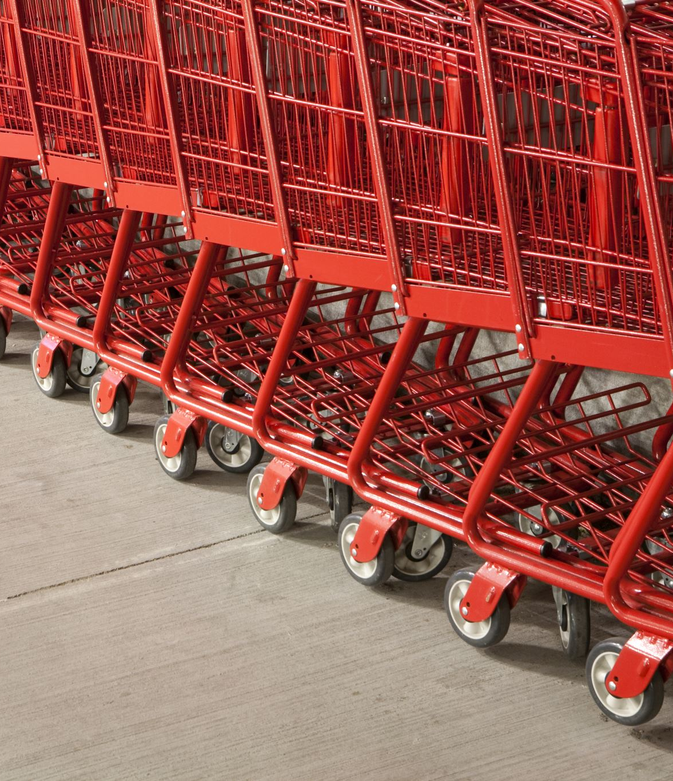
EDA for Supermarket_Sales

Slide 2
Source of Dataset
The dataset is from https://www.kaggle.com/aungpyaeap/supermarket-sales.
This is historical sales of a supermarket company, based on 3 different branches for 3 months.
Record available from January 2019 to March 2019
Dataset has a total of 1000 rows and 17 columns

Slide 3
EDA Objectives
GENDER
TO FIND out if there are any gender differences in terms of customers.
Product Line
To find out what product line generates more sales.
Promotion
To find out if there is a trend in period where more customers enter the store.
Payment Method
To find out what payment methods are more popular.

Slide 4
#1 Understand the data

Slide 5
Attribute Information
Invoice id <drop> : Computer generated sales slip invoice identification number
Branch <drop> : Branch of supercenter (3 branches are available identified by A, B and C).
City : 1.Yangon, 2.Naypyitaw, 3.Mandalay
Customer type : 1. MEMBER, 2. NORMAL
Gender : 1.Female, 2.Male
Product line : 1.Electronic accessories, 2.Fashion accessories, 3.Food and beverages, 4.Health and beauty, 5.Home and lifestyle, 6.Sports and travel
Unit price : Price of each product in $
Quantity : Number of products purchased by customer
Tax 5% <drop> : 5% tax fee for customer buying
Total : Total price including tax
Date : Date of purchase (Record available from January 2019 to March 2019)
Time : Purchase time (10am to 9pm)
Payment : Payment used by customer for purchase (3 methods are available – Cash, Credit card and Ewallet)
COGS : Cost of goods sold
Gross margin perc : <drop> : Gross margin percentage – Only 1 value - 4.761905
Gross income : Gross income
Rating : Customer stratification rating on their overall shopping experience (On a scale of 1 to 10)

Slide 6
Attribute CALCULATION
Unit price X Quantity = COGS
COGS + Tax = TOTAL
GROSS MARGIN PERCENTAGE X COGS = GROSS INCOME

Slide 7
#2 Clean the data

Slide 8
#2 Clean the data
Ensure there are no null values
DROP 4 Columns - Invoice ID, Branch, Tax 5%, gross margin perc

Slide 9
#3 Relationship analysis

Slide 10


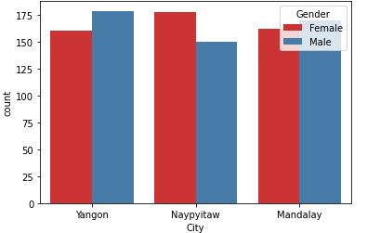
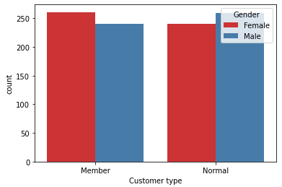
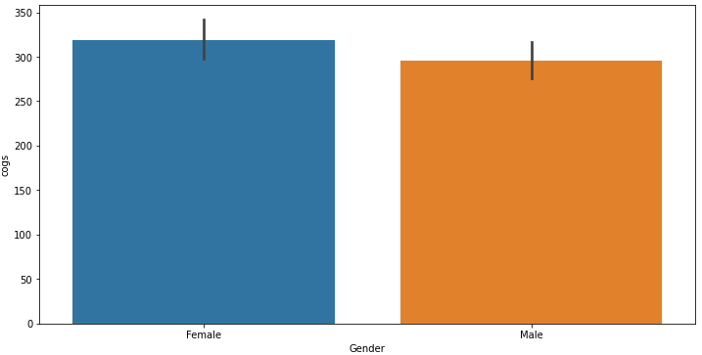
GENDER differences
Gender Ratio between Stores
Membership between Gender
From the visual analysis, we can see the following:
The stores in yangon has more male customers while in naypytaw has more female customers.
We have more female members.
More Female are spending here.
Spending Power between Gender

Slide 11
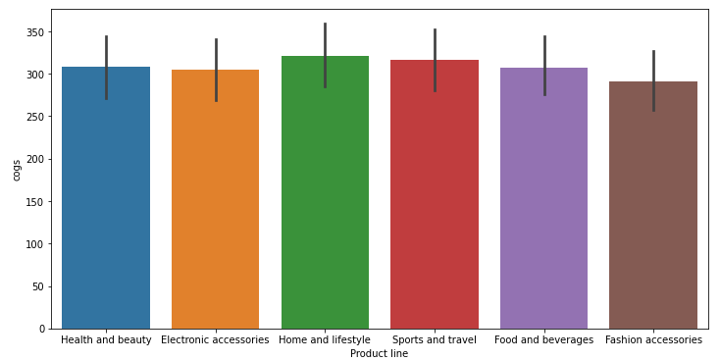
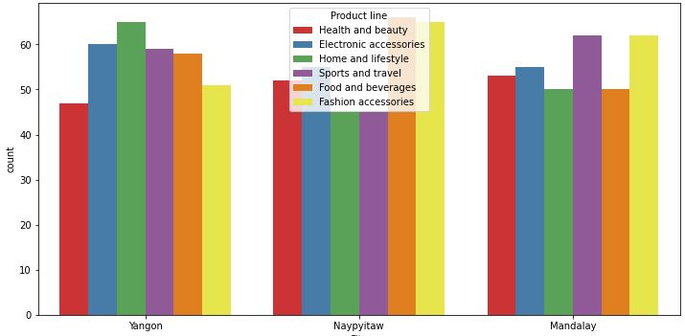
Product line trends
As Total Sales
From the visual analysis, we can see the following:
From all the sales, the product lines demand are quite balanced
When we dive into separate location, we see some trends.
E.g Yangon sells more home and lifestyle products, while Naypytaw demands more food & beverages and fashion accessories, and mandalay demands more on sports and travel, and fashion accessories.
Separate via Location

Slide 12
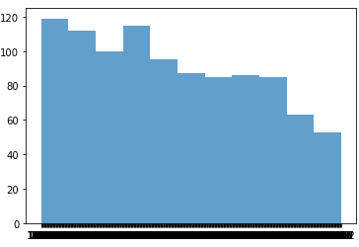
trend in period
Purchase time (10am to 9pm) 11hrs
From the visual analysis, we can see the following:
From the chart, we can see the first 4 hours, especially the 1st hour of the store opening has the highest store demand.

Slide 13
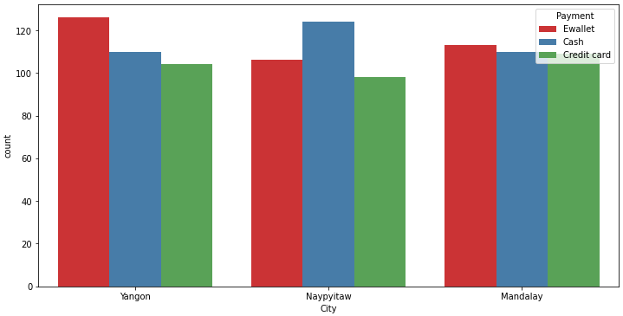
Payment method
Payment Used at Different Stores
From the visual analysis, we can see the following:
WE can see that for yangon has more preference on ewallet, naypytaw is more traditional and prefer cash, and mandalay prefer the more global method which is credit card.

Slide 14
end

