Slide 1

Commodities in Action
Rebecca Davidson
Chibuzor Ejiaga
Dylan McGullam

Slide 2
Commodities in Action
What affects commodity prices?
How volatile can commodity prices be?
How susceptible are commodity prices to local or global events?
What effect does war on commodity prices?
Invasion of Iraq (March 2003 – December 2011)
What effect does an economic crisis have an commodity prices?
2008 Recession (December 2007 – June 2009)
What effect does a health crisis have on commodity prices?
COVID-19 (January 2020 – August 2021)

Slide 3
Commodities List
Energy
Natural Gas
WTI Crude
Brent Crude
ULS Diesel*
Low Sulphur Gas Oil
Gasoline*
Metals
Copper
Aluminum
Zinc
Nickel
Gold
Silver
Agriculture
Corn*
Soybeans*
Wheat*
Soybean Oil
Soybean Meal
HRW Wheat
Live Cattle
Lean Hogs
Softs
Sugar
Coffee*
Cotton
*price values skewed by factor of 100

Slide 4
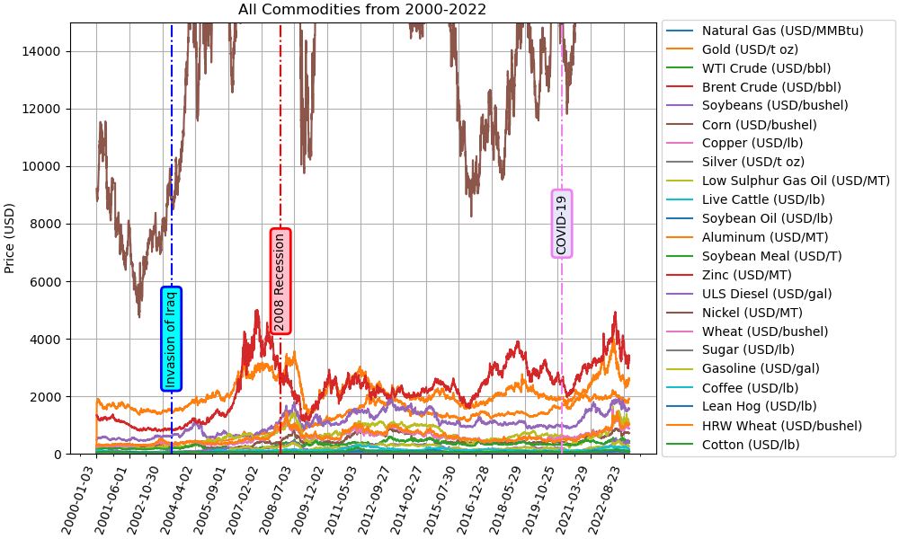
All Commodities from 2000-2022

Slide 5
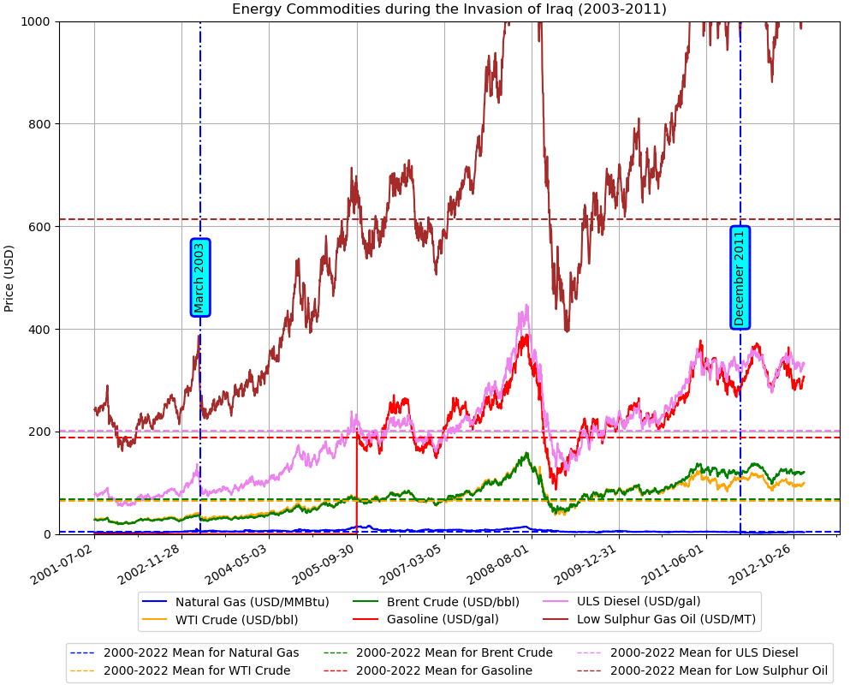
Energy Commodities during the Invasion of Iraq (2003-2011)

Slide 6
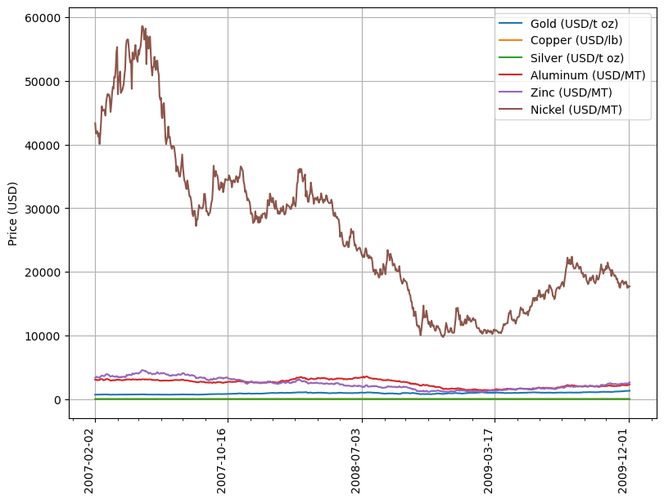
Metal Commodities during The Great Recession (2007-2009)

Slide 7
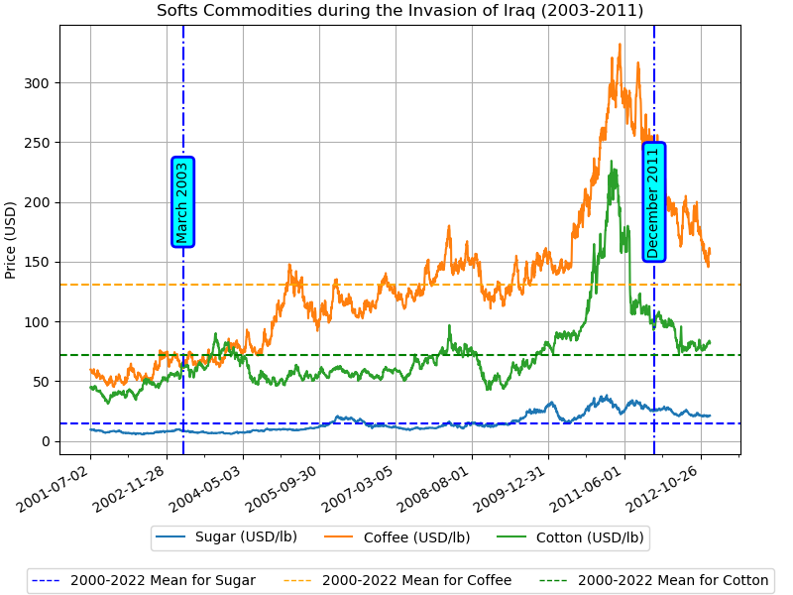
Soft Commodities during the Invasion of Iraq (2003-2011)

Slide 8
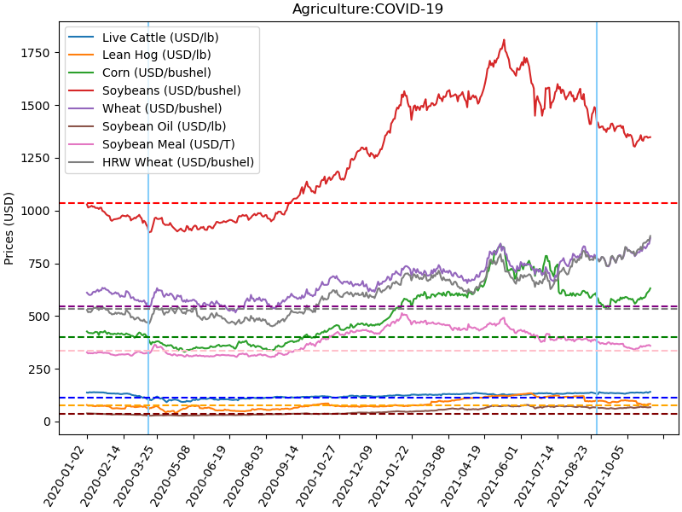
Agriculture Commodities During COVID-19 Pandemic (January 2020-August 2021)

Slide 9
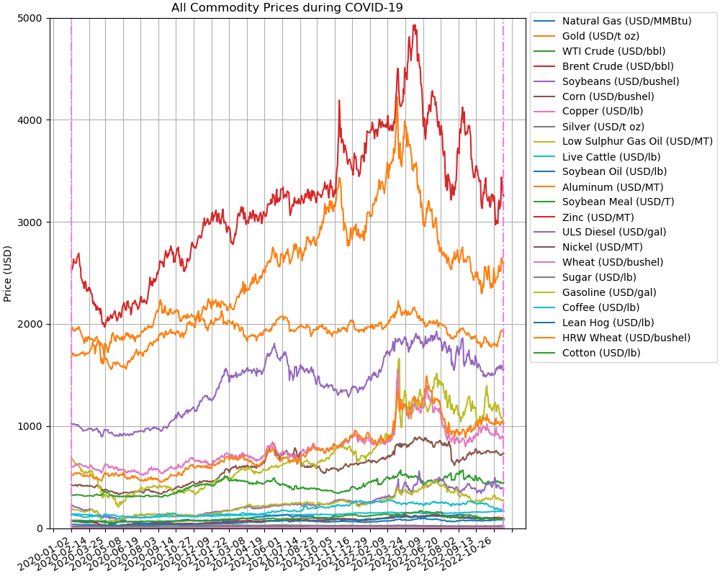
All Commodities During COVID-19 Pandemic (January November 2022)

Slide 10

Thank you!
Questions?

