Slide 1
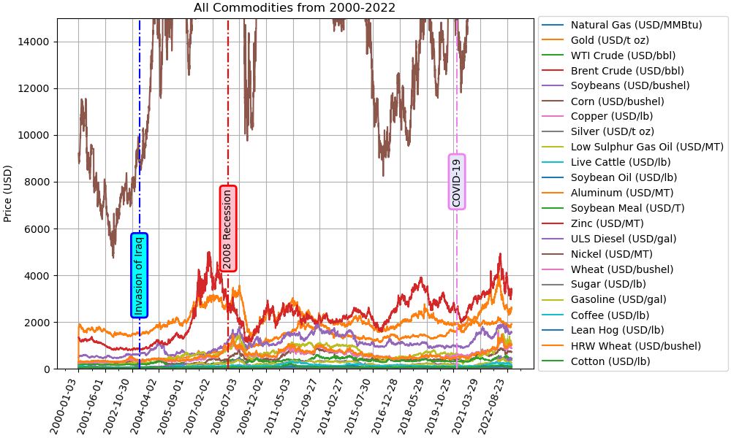
All Commodities from 2000-2022

Slide 2
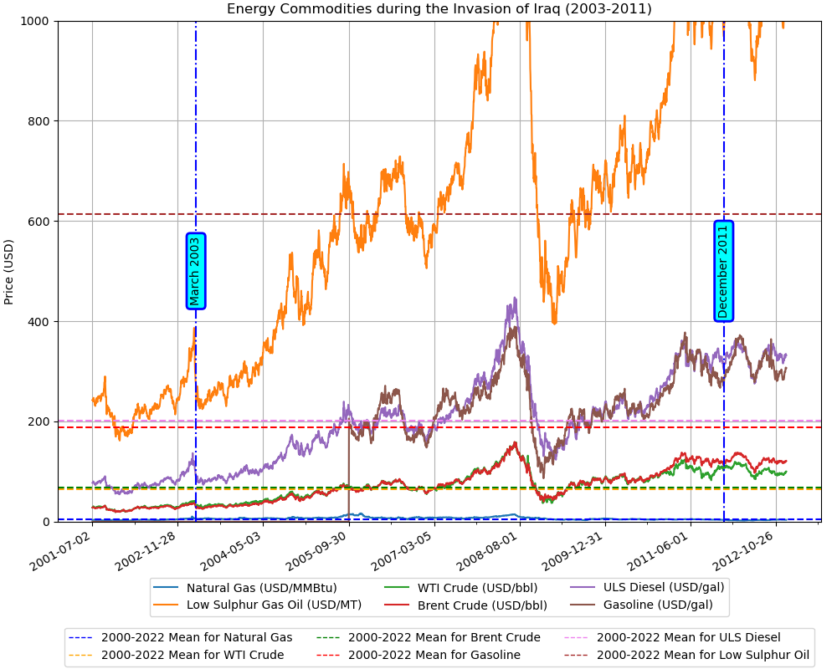
Energy Commodities during the Invasion of Iraq (2003-2011)

Slide 3
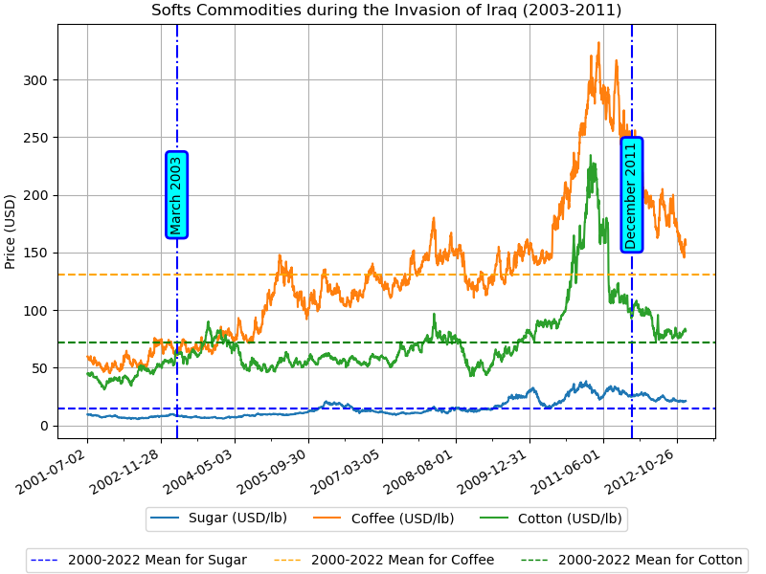
Soft Commodities during the Invasion of Iraq (2003-2011)

