Slide 1

California Leading the Way in Solar Panel Installations
Adriana Rubalcaba, Dylan Kaiser, Anna Miller
University of Southern California Data Analytics Program
March 2019

Slide 2
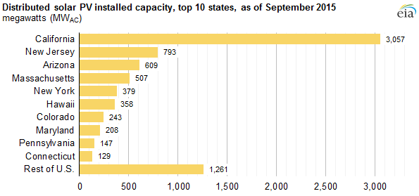
California Leading Solar Installations in the US
Source:https://www.eia.gov/todayinenergy/detail.php?id=23972

Slide 3
Questions or Curiosity
What areas of California have the most installations and why?
Is there a trend of installations due to Temperature in each Climate/Location Zone?
Why is California leading the way in Solar Installations?
Notes:
Describe the questions you and your group found interesting, and what motivated you to answer them

Slide 4
Data Gathering and Cleanup
DATA
Number of Solar Installations: https://openpv.nrel.gov/search
Climate Zone Data: California Energy Commission. California Climate Zone Descriptions for New Buildings. July 1995
Climate Zone Details: California Energy Commission. California Climate Zone Descriptions for New Buildings. July 1995.
Sunny Days: https://www.currentresults.com/Weather/US/average-annual-sunshine-by-city.php
Population data: https://factfinder.census.gov/faces/tableservices/jsf/pages/productview.xhtml?src=CF
Electricy Consumption by County: http://ecdms.energy.ca.gov/elecbycounty.aspx
Google maps API
www.currentresults.com
Notes:
Summarize where and how you found the data you used to answer these questions

Slide 5
Cont. Lessons Learned from Data
Clean Up
First Step
To prove or disprove whether there is correlation between California climate zones and the size of the solar panel installations.
Merged data from the websites listed above
Used unique function and for loops to select unique zip codes and
Looking for the resources about solar energy job market, but the Solar Foundation (they own national data set about this topic) didn’t want to cooperate.
Notes:
Summarize where and how you found the data you used to answer these questions

Slide 6
Cont. Lessons Learned from Data
Next Steps
Data gathered from the different websites in CSV
Started with the Number of Installations data and made sure we only picked up the information for residential and clean up the NaN
Merged CSV one by one making sure when merging that all headers matched
Made two dataframes with all of the information that was needed
Notes:
Summarize where and how you found the data you used to answer these questions

Slide 7
Lessons Learned from Data Gathering and Cleanup
The Data was not easy to find in one place and had to patch together from different government websites which is another can of worms
Surprise there is no data from the government as of 2016 due to current administration stance on Climate Change
We decided we were only going to focus on 2015 as gathering data for multiple years would have required us to hire people
We were able to find that Solar Energy Industries Association will sell all of this lovely information for $4000
Notes:
Summarize where and how you found the data you used to answer these questions

Slide 8

Global Warming is FOR REAL
United Nations panel warns that the world might be on a path toward catastrophic climate change if greenhouse gas emissions aren’t cut dramatically by 2030
Electricity generated in the U.S. comes from fossil fuels like coal and natural gas which produces (CO2) produced when fossil fuels are burned
This leads to rising global temperatures and climate change
World leaders would need to take “unprecedented” actions in order to keep global warming below 1.5 degrees Celsius, a level that scientists believe would avoid many of the worst effects of climate change
Story for illustration purposes only

Slide 9
Focus of Analysis:
California Geography and the Impact on Solar Installations in 2015
Notes:
Describe the core message or hypothesis for your project

Slide 10
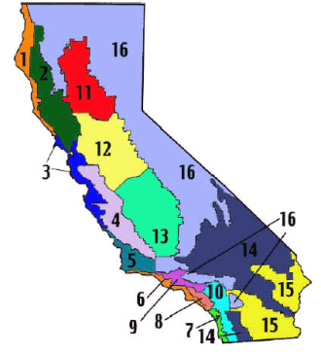
Climate Zones
California Energy Commission established 16 climate zones
Based on how much Energy they are allowed to use (budget)
Building Standards were established to set maximum amount of energy a building, or portion of a building can be designed to consume per year
Zones shown in this map are not the same as what we commonly call climate areas such as "desert" or "alpine" climates
Zones based on energy use, temperature, weather and other factors
For purpose of analysis we also used these zones for location purposes

Slide 11
Hypothesis
1. Climate Zone Temperatures will impact the amount of Installations and system size
2. Population will impact the amount of installations
3. Climate Zones with more Sunny Days will have a higher % of Solar Installations
Notes:
Describe the questions you and your group found interesting, and what motivated you to answer them

Slide 12
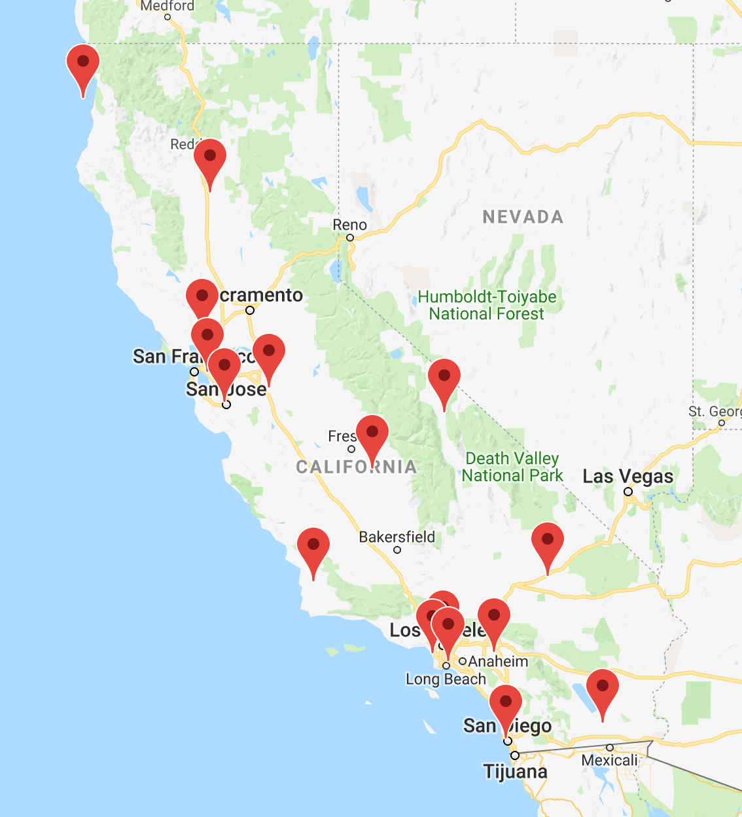
Climate Zone Map by Reference City
Climate Zone Reference City List
1-Eureka
2-Napa
3-Oakland
4-San Jose
5-Santa Maria
6-Los Angeles
7-San Diego
8-Long Beach
9-Los Angeles Civic Center
10-Riverside
11-Red Bluff
12-Stockton
13=-Fresno
14-Barstow
15-Brawley
16-Bisho

Slide 13
1. Climate Zone Temperatures will impact the amount of Installations and system size
Based on 2015 Solar Panels Installation Data Only
Notes:
Describe the coDescribe the core message or hypothesis for your projectre message or hypothesis for your project

Slide 14
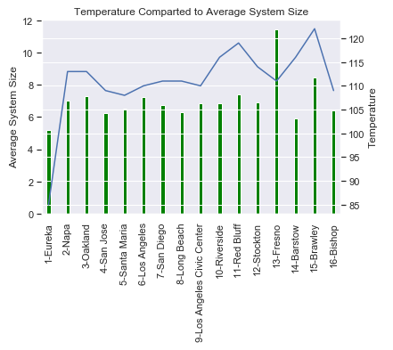
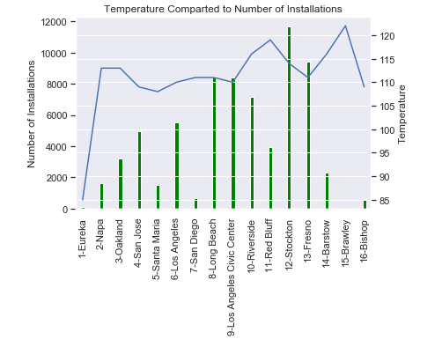
Analysis & Findings
High Temperature in Climate Zones do not produce higher number of installations
Ran a GOF Test and that is a big fat NO
We looked at different factors that may be driving the installations in Zones 12, 13
Notes:
Describe the coDescribe the core message or hypothesis for your projectre message or hypothesis for your project

Slide 15
2. Homes in the Central Valley of California Will Have a Higher % of Solar Installations
Based on 2015 Solar Panels Installation Data Only
Notes:
The idea here was that homes in the central valley are often in remote areas. These areas are often not connected to the grid.
Thus, homes need another source of energy, and solar energy seems like a viable alternative.
The Central Valley of California is one of the most productive agricultural regions in the world, and as such, we figured must receive enough sunlight to make solar installations cost effective, especially when paired with the fact that it is hard to connect the statewide electric grid to homes in remote regions.

Slide 16
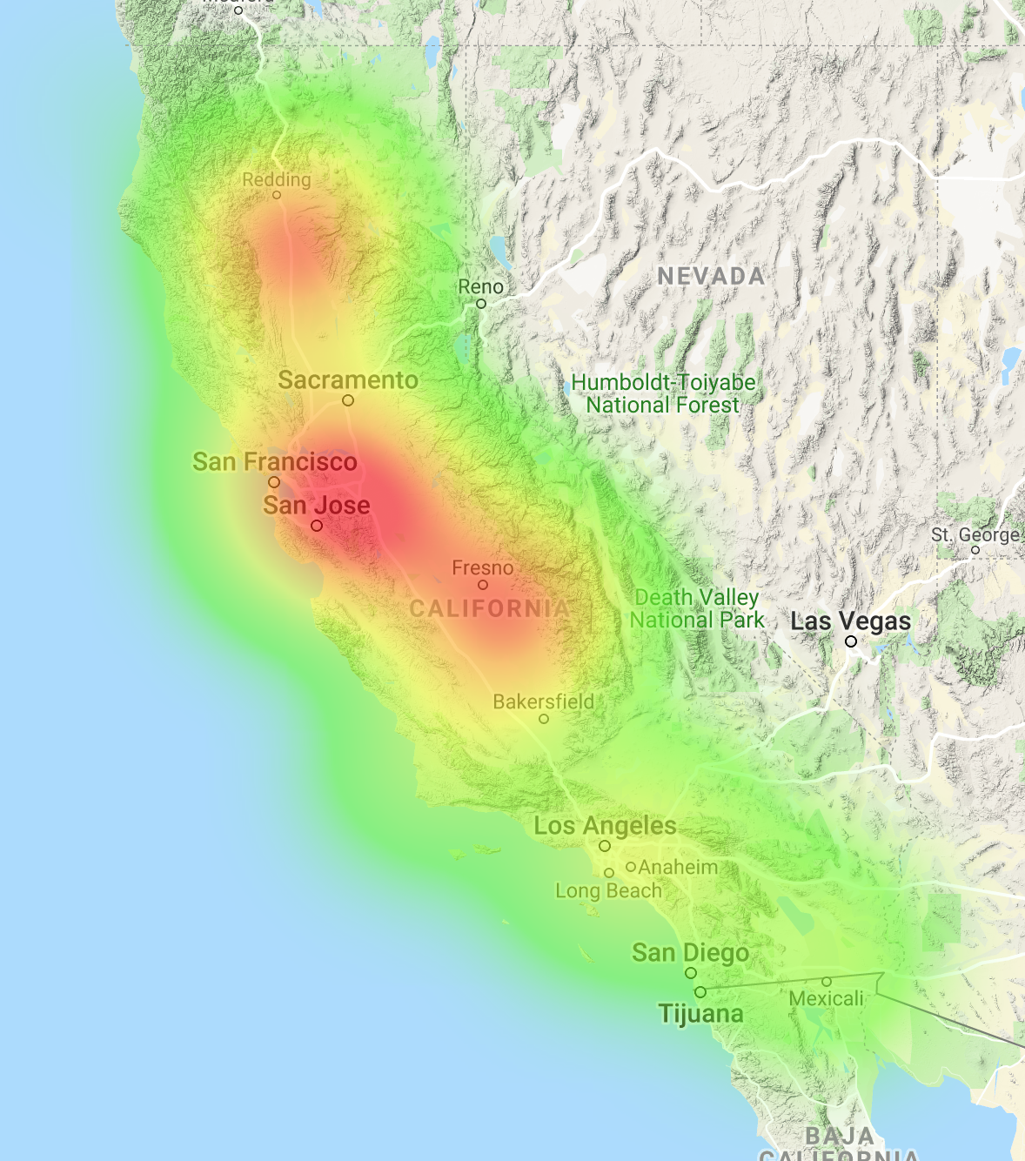
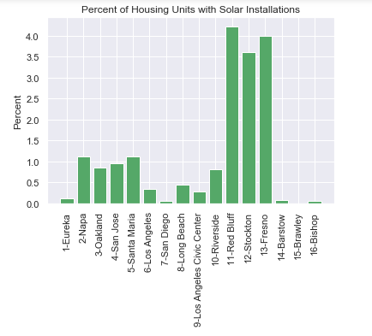
2. Analysis & Findings
Notes:
I used a combination of data from:
The Open PV project: a source of data for over 1 million residential and commercial solar installations across the US.
US Census: housing units data for each county in California
We merged the data for this using the County as the common factor
From this, I found 3 different Climate Zones: 11, 12, and 13, which include the cities of Red Bluff, Stockton, and Fresno, had by far the highest percentage of solar installations per number of housing units (3.5 - 4%)
The heatmap on the right visually shows that our hypothesis was true, since the red corresponds with the Central Valley of California.

Slide 17
3. Climate Zones with more Sunny Days will have a higher % of Solar Installations
Based on 2015 Solar Panels Installation Data Only
Notes:
Our hypothesis was that Climate Zones with more sunny days will have a higher % of solar installations.
This is a more specific look at one aspect of climate zones, which is the sunny days factor, and does not take into account other effects such as access to the grid.

Slide 18
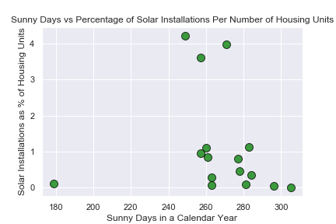
3. Analysis & Findings
Sunny Days vs Percentage of Solar Installations Per Number of Housing Units
Notes:
I graphed sunny days vs solar installations per number of housing units, and based off this graph there does not appear to be much correlation.
Two counties with some of the most sunny days actually have the lowest number of solar installations.
This leads us to believe that there are other factors that affect solar installations.

Slide 19
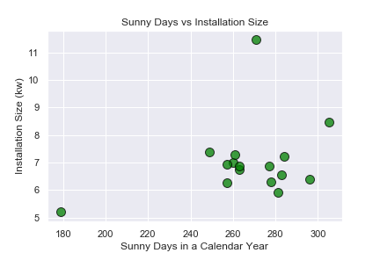
3. Cont. Analysis and Findings
Sunny Days vs Installation Size
Notes:
We also wanted to see if the number of sunny days affected the installation size. The idea here was that the more sun an area receives, the smaller the installation size, since the solar panels will be more effective at converting solar energy into electricity in these areas.
This graph again appears to disprove this hypothesis.

Slide 20
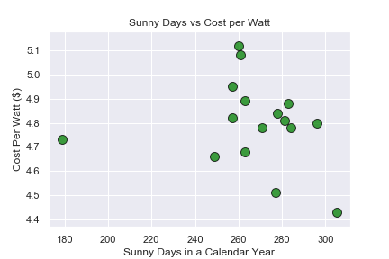
3. Cont. Analysis and Findings
Sunny Days vs Cost per Watt
Notes:
The final angle here was to see if areas with more sun had a lower installation cost per watt.
Again, this was disproved by the results on this graph. There does not appear to be much correlation between these two.

Slide 21
Summary
From the information we collected we could not find a conclusion the reason California has the largest installations besides the obvious California is awesome.
Based on the data we collected. The average Energy produced by Solar Panels per home is :
11,023 kwh which equals to 5.3 Metric Tons CO2 (aka Greenhouse Emissions) per home annually if it was using Electricity from fossil fuels
This means in 2015 the Solar Panels per home is saving having to plant approximately 200 trees to have to counteract the greenhouse emissions if using fossil fuels (according to EPA)
Notes:
Summarize where and how you found the data you used to answer these questions

