Slide 1
ENGI 301 Synthesizer Proposal
10/05/2021
Dylan Rivera

Slide 2
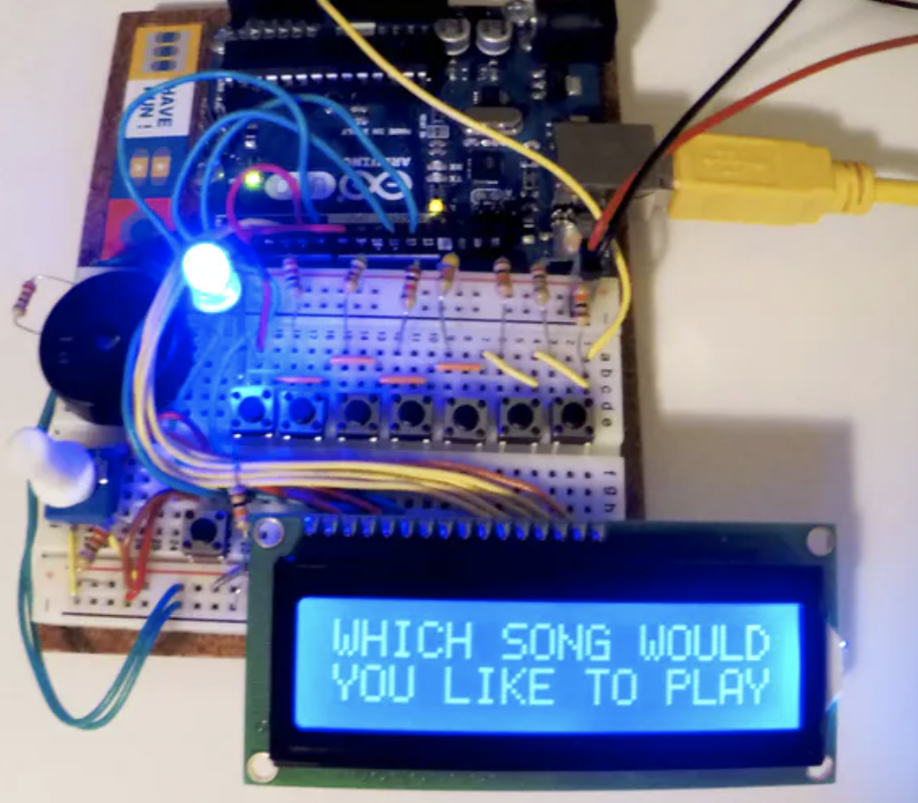
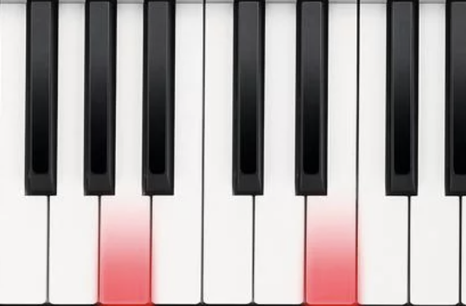
Background Information
Always been interested in music; wanted to combine my love of music with my journey in learning how to work with electronics
Primary instrument: piano, so I wanted to create a synthesizer that would mimic an electronic keyboard
Inspiration/existing projects:
https://beagleboard.org/p/jas21/pocketbeagle-synthesizer-10f638
https://create.arduino.cc/projecthub/lindsi8784/electronic-piano-keyboard-with-preset-songs-74ee7c?ref=tag&ref_id=piano&offset=0
Improvements/additions over existing projects:
Provide better casing/visual appeal
Program a visual display (keyboard?) to show the notes played on piano
Include preset songs
My main challenge would be trying to include all of these features simultaneously

Slide 3
System Block Diagram
5V Pocketbeagle Adapter
LCD Display
USB Adapter?
1.8 AIN
Potentiometer
USB Speaker
12 push buttons
GPIO

Slide 4
Power Block Diagram
LCD Display
5 V
1.8 AIN
1.8 V
Potentiometer
USB Speaker
3.3 V
12 push buttons
3.3 V
3.3 VOUT

Slide 5
Components / Budget
Component | Need to Buy | Cost
Resistors | No
Potentiometer | No
USB Speaker https://www.amazon.com/Computer-Speaker-Enhanced-Portable-Windows/dp/B086JXJ1LF/ref=sr_1_4?dchild=1&keywords=USB+speaker&qid=1633566700&sr=8-4 | Yes | $13.58
3.5" TFT 320x480 + Touchscreen Breakout Board w/MicroSD Socket - HXD8357D https://www.adafruit.com/product/2050 | Yes | $39.95
Push buttons | No

