Slide 1
Automated device for long-term investment portfolio
Author: Quang Dung Nguyen
Supervisor: Dr. Maria Polukarov
Student ID: 1622227
BSc Computer Science with Management

Slide 2
Contents
Introduction
Background
Requirements
Design and Implementation
Results and Evaluation
Conclusion
Future Work

Slide 3
Introduction
Motivation of the project.
Why an automated device?
Trend to automation in the financial industry(e.g. Goldman Sachs)
Better performance of trading agents vs human
Why long-term investment?
To take advantage of compound interest. For example: $10000 invested in S&P 500 30 years ago now turned into more than $144,000.(From Jan 1989 – Jan 2019) and if you invested $10,000 50 years ago, it turned to more than $655,000
Objectives:
To produce an automated trading algorithm on Quantopian platform, utilizing fundamental and technical indicators, and test the algorithm against other famous value-approach that have proved itself in the past.

Slide 4
Background
1.Fundamental Analysis: calculates the intrinsic value of the company to determine whether the company is undervalued or overvalued. Fundamental approach investors collects data from company’s financial balance sheet and its financial ratios to determine the future stock’s price of the company
2.Technical Analysis: concerns more about the price movement of the company. Its user believes that future stock’s price can be predicted by analyzed different trends of the stock using trend-following, momentum or volatility analysis, among others
3. Review of Relevant Literature: My reports concerns with combing both of these factors in an portfolio that rebalance every months. Previous value investing approach only can include:
Joel GreenBlatt ‘s“Magic formula” ROIC_Rank(management efficiency) + Earnings_Yield_Rank( cheap valuation compared to its profit)
Acquirer’s Multiples by Tobias Carlisle: Opposite of Earnings Yield Ranks : EV/EBIT
Piotroski’s F-Score : show the financial heath of the company by 9 categories.
Novy-Marx : To compare different results of many value algorithms.

Slide 5
Requirements
The project main aim is to create an automated algorithm on Quantopian platform, utilizing different financial ratios and momentum indicators to create a stock portfolio. The other aim of the paper is to compare the created algorithm to other famous quality algorithms in terms of many evaluation metrics, all developed on Quantopian.
Programming Language : Python 2.7
Platform: Quantopian Research: Notebooks and Algorithm Sections
Main libraries: quantopian.research, quantopian.algorithm, quantopian.pipeline

Slide 6
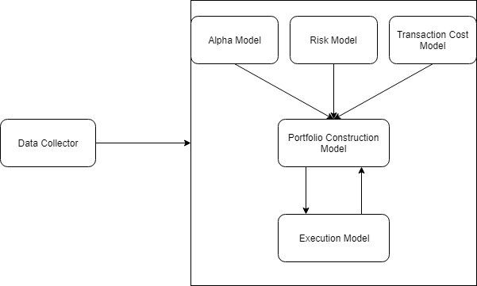
Design and Implementation
General Design of the program
Figure 4.1. The flow of a typical trading program. Source: Inside the Black Box: A Simple Guide to quantitative and frequency trading

Slide 7
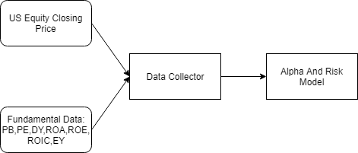
Data Collector Structure

Slide 8
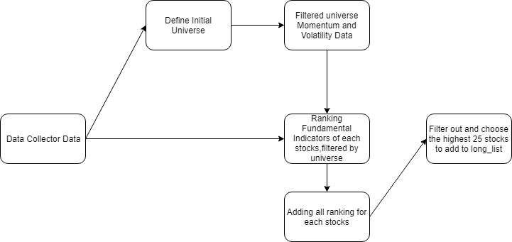
Alpha Model Structure

Slide 9
Risk model , Transaction Cost model and Portfolio Construction mode
Risk model defines the maximum leverage of the algorithm at 1( no leverage)
Transaction Cost model defines the cost of transaction using at Interactive Broker at 0.05 per share with minimum of $1 per transaction
Portfolio Construction Model defines the desired portfolio at equal weighting(e.g. 25 stocks 4% for each). It will then pass the desired portfolio to the execution model

Slide 10
Execution Model Structure

Slide 11
Results and Evaluation
Evaluation Metrics( 1st January 2003 -1st April 2019) | Magic Formula | Acquirer’s Multiple | Piotroski’s F-Score(Long-Short) | My Value Long-Only Algorithm
Cumulative Return | 176% | 596.7% | 963.1% | 1267.8%
Sharpe Ratio | 0.39 | 0.64 | 0.73 | 0.83
Max Drawdown | -69% | -55 % | -54% | -46.4%
Gross Leverage | 0.91 | 0.97 | 3.39 | 1.00
Beta | 1.05 | 1.09 | 0.24 | 1.04
Lehmann Brother’s Correlation | Yes | Yes | No | Yes
Compared to S&P 500(344.03%) | underperformed | outperformed | outperformed | outperformed

Slide 12
Advantages and Disadvantages of the algorithm
Advantages:
Outperformed the market during the testing period
Utilize the many different factors, so the algorithm doesn't’ t totally depend on one metrics like Magic Formula
Disadvantages:
Systematic Risk( The performance of the algorithm is highly correlated the to the performance of market)
Limited to scale to portfolio larget than 100 millions

Slide 13
Conclusion
The algorithm has shown some promising results by combing both of financial ratios and technical indicators.
However, long-only algorithm can have high correlation to the market performance, and if the market goes down, the algorithm is likely to goes down with it.
Even though some stock-picking method that have proved itself in the past(i.e. Magic Formula, Acquirer Multiples),it doesn’t mean it will continue to work in the future. These algorithms should include more filters to increase the performance.

Slide 14
Future Work
The algorithm can reduce its systematic risk to the market by adding shorts position to the portfolio, working with other neutral market strategy(or even negative beta strategy), adding more systematic risk constraints to the risk model(e.g. fixed sector and market exposure)
The algorithm can also expand its scalability by adding more positions, instead of 25(but it will offer lower return). If the portfolio is too big(e.g.100 million), the algorithm should be used alongside other trading practices(e.g. shorting)
The code mentioned in this project can be implemented in real-live trading using an open-resourced library called zipline-live ,which supports many libraries from Quantopian. Through this library, the algorithm can be executed in real broker’s account such as Robinhood or Alpaca.

Slide 15
Thank you

