Slide 1
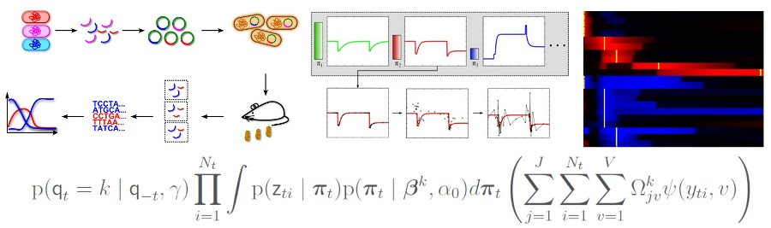


Basics of time-series analysis
Georg K. Gerber, MD, PhD, MPH
Assistant Professor of Pathology, Harvard Medical School
Member of the Harvard-MIT Health Sciences & Technology Faculty
Co-Director, Massachusetts Host-Microbiome Center
Chief, Computational Pathology
Brigham and Women’s Hospital
ggerber@bwh.harvard.edu
April 24, 2019, COMPSCI 109B: Advanced Topics in Data Science

Slide 2
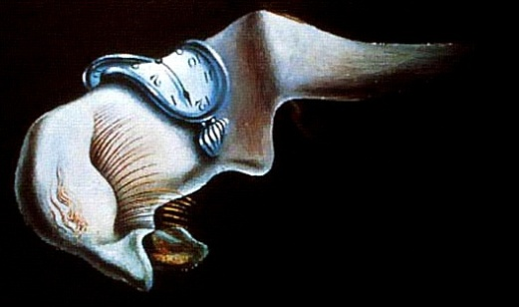
How not to do time-series analyses

Slide 3
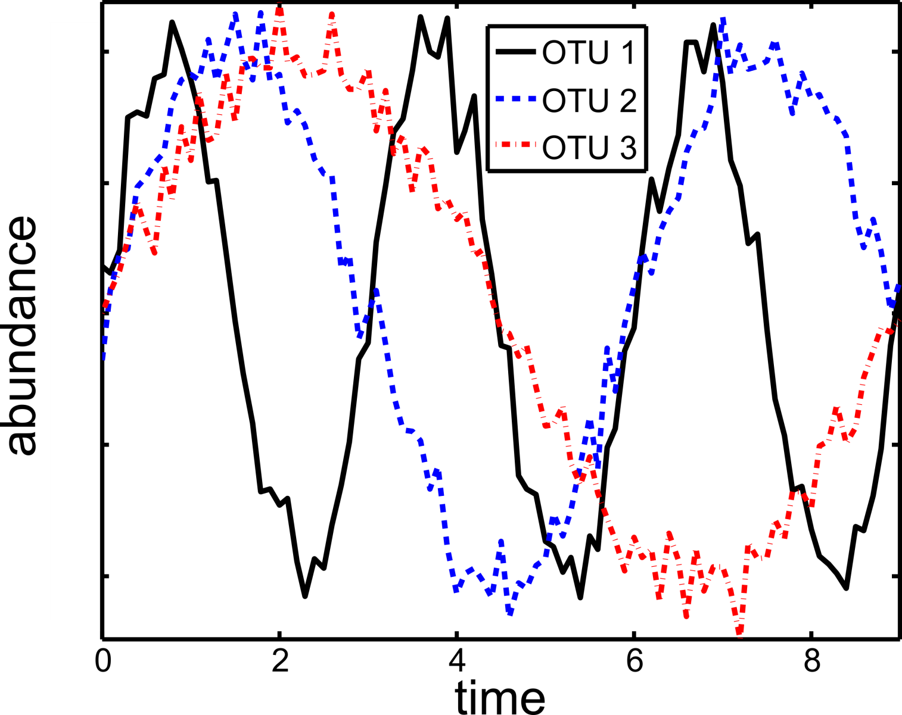
Bad idea #1: temporal aliasing/undersampling

Slide 4
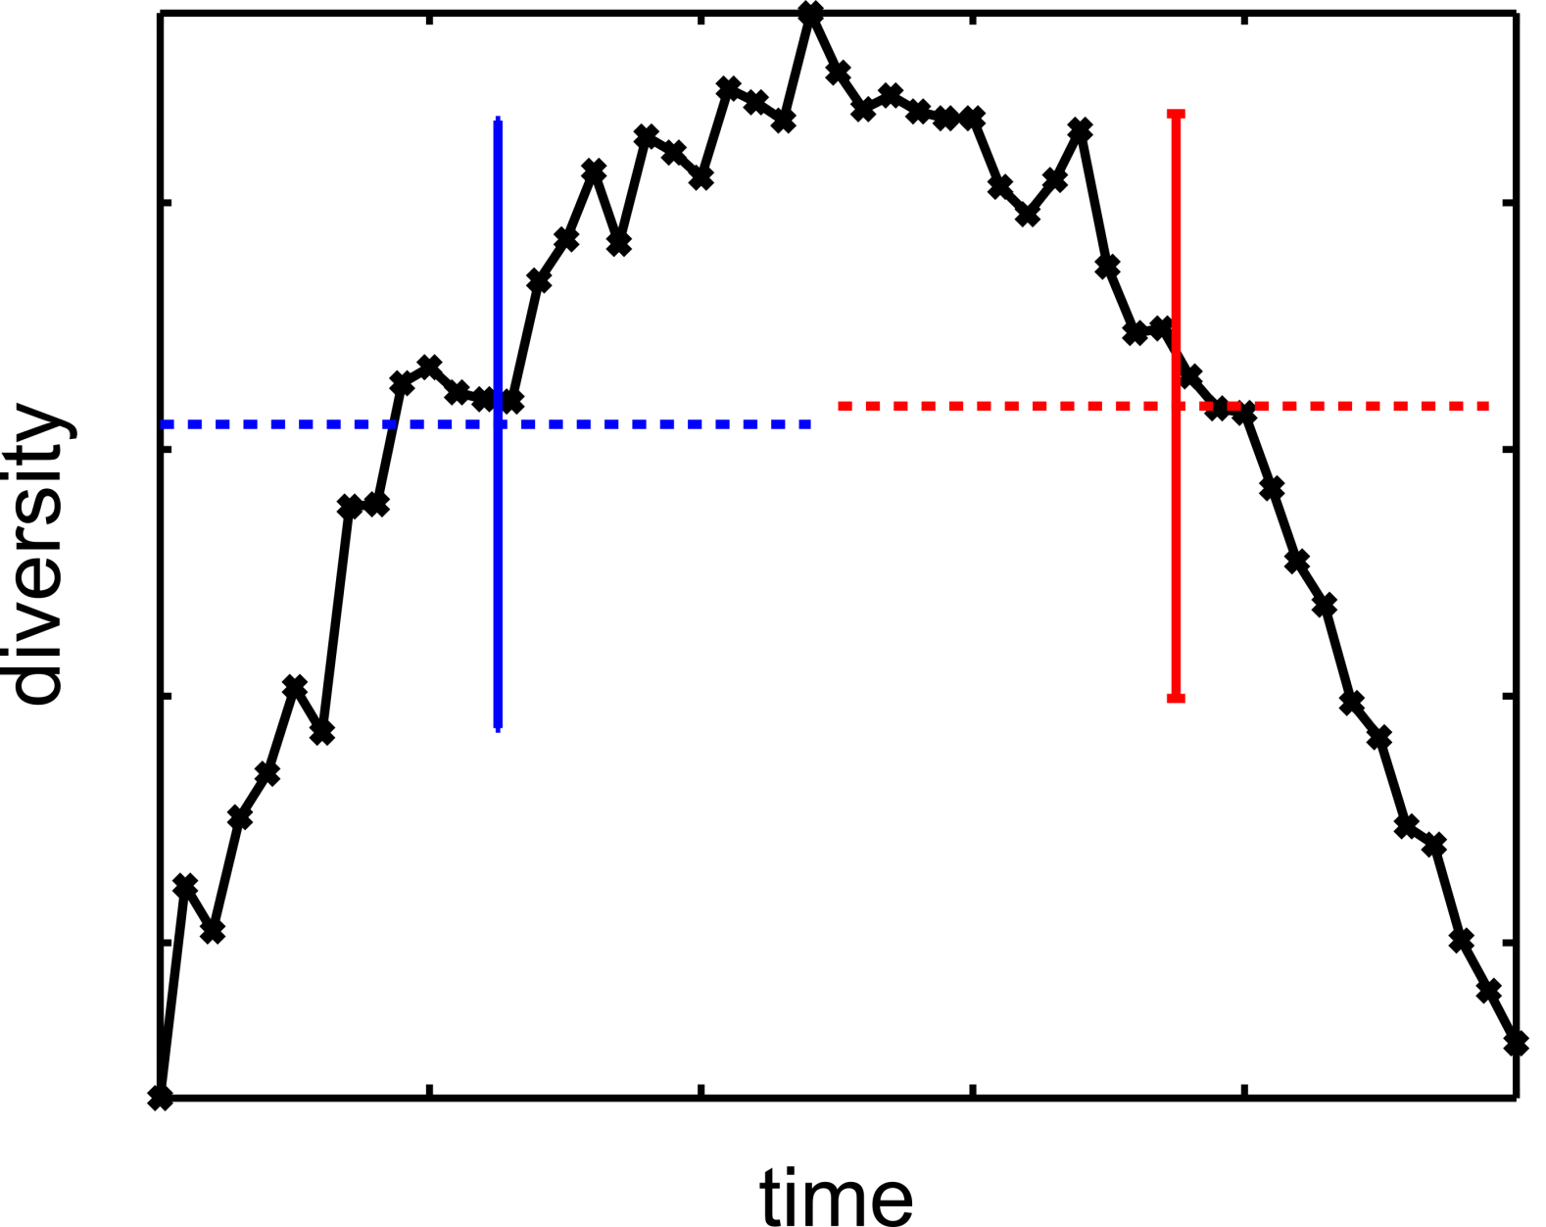
Bad idea #2 – aggregating time-points

Slide 5
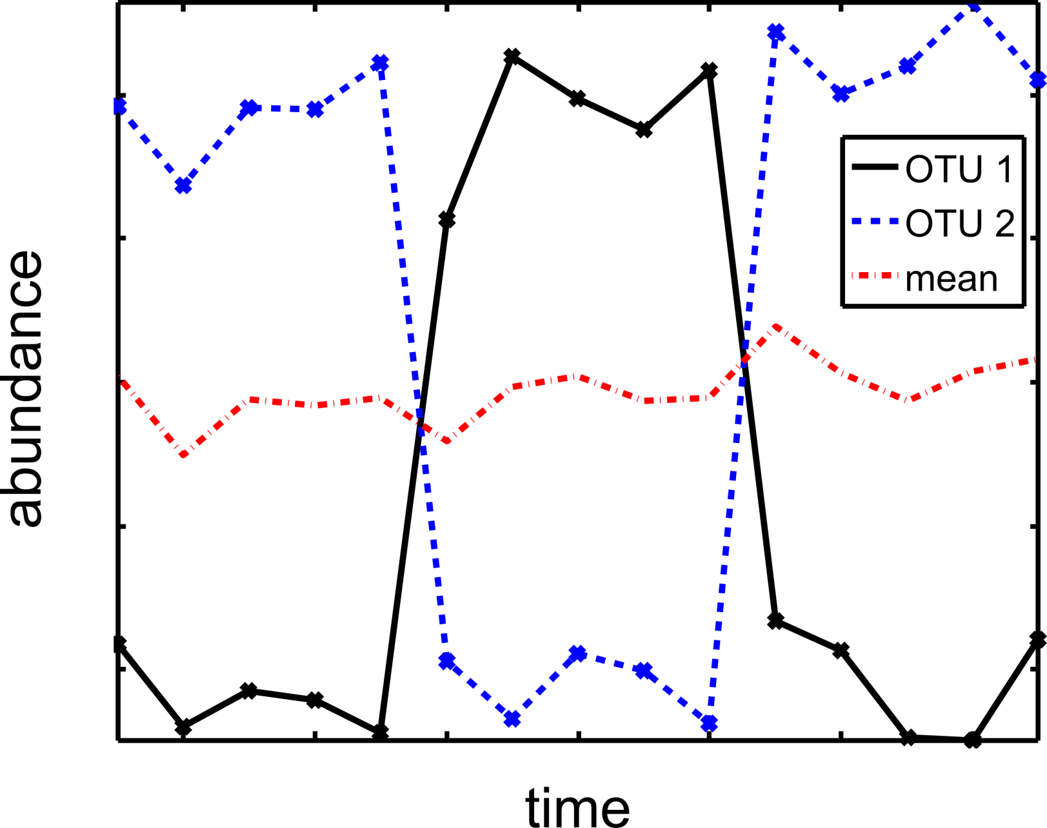
Bad idea #3 – aggregating variables

Slide 6
Types of time-series analysis models

Slide 7
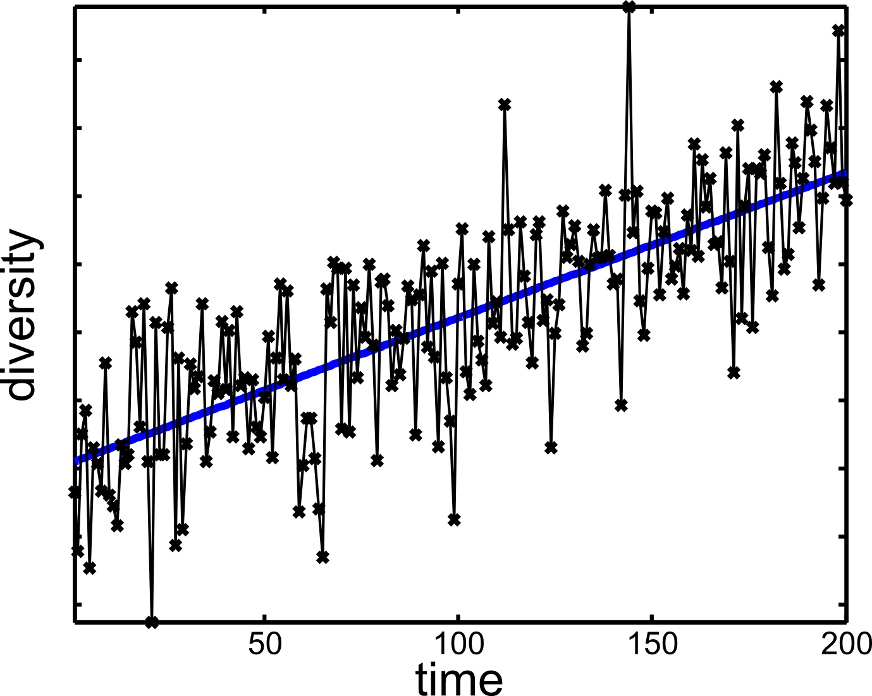
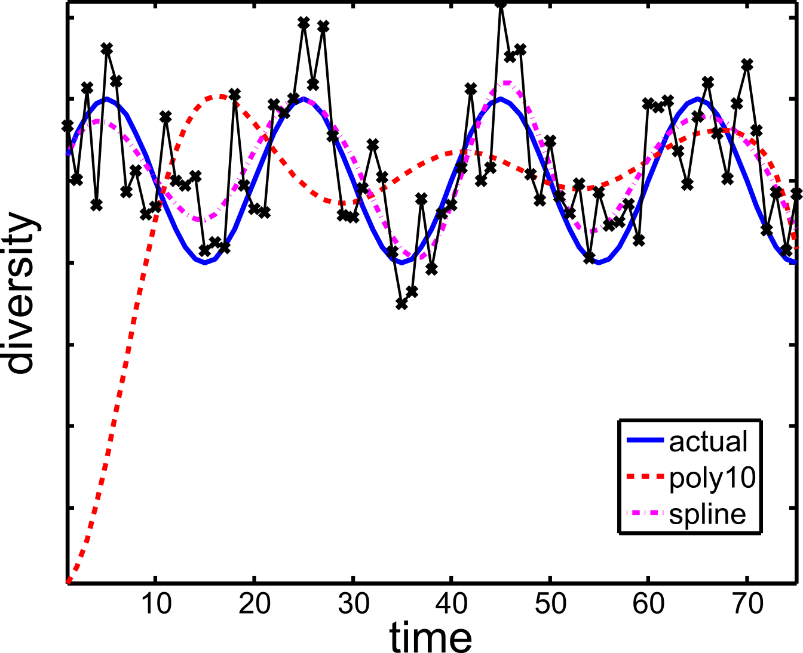
Regression with time as the covariate

Slide 8
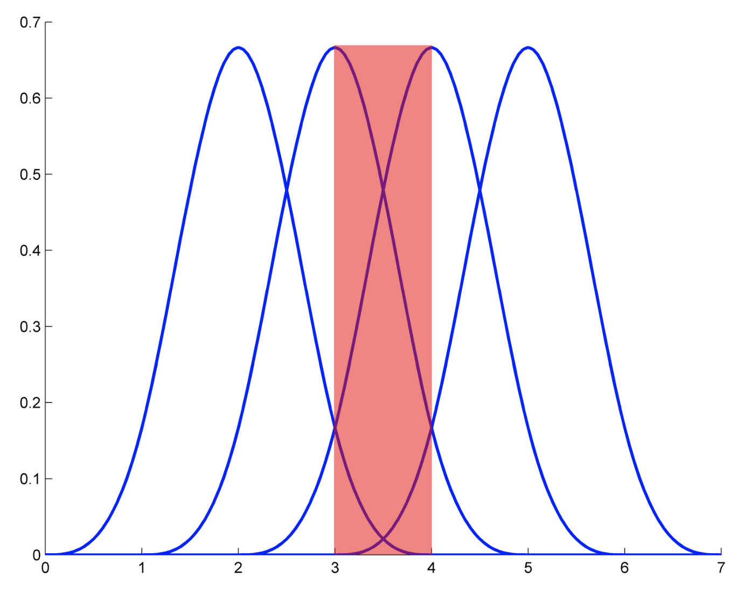
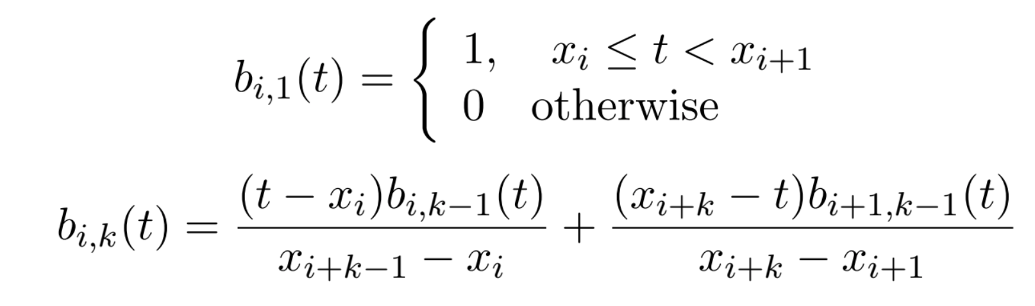
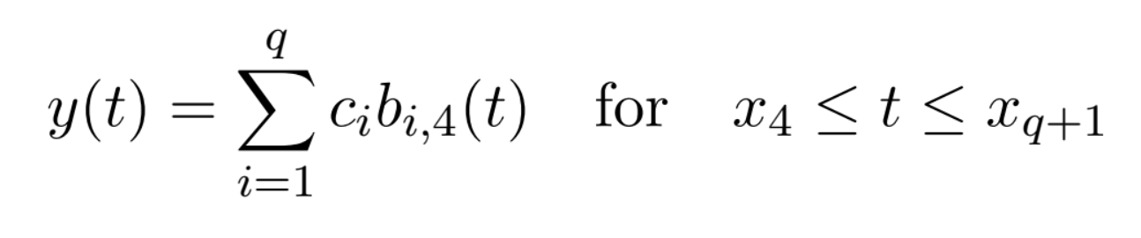
B-splines

Slide 9
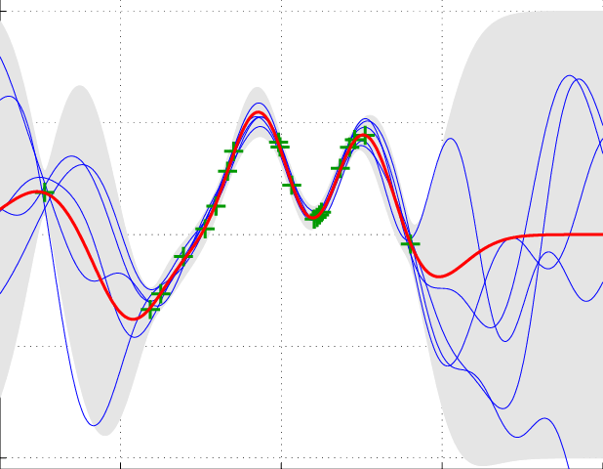
Gaussian processes

Slide 10
Markovian processes
The future depends only on a limited window on the past
Order m Markovian (discrete time) process:

Slide 11
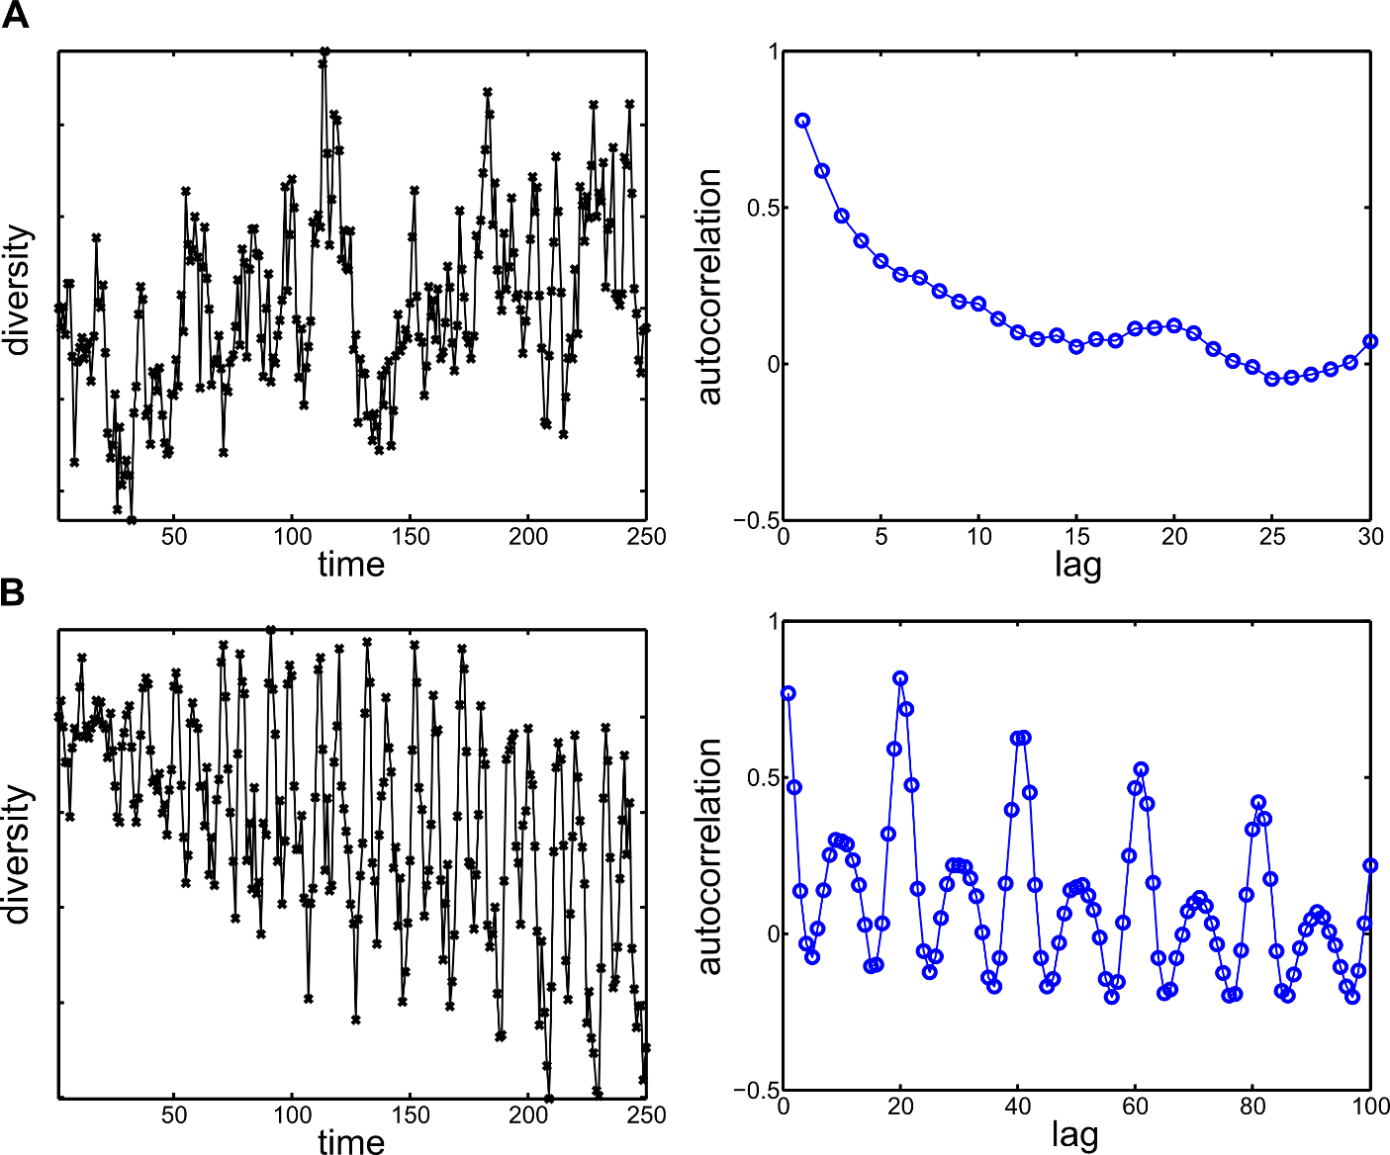
Autoregressive (AR) model
AR(1)
Autoregressive model of order m denoted AR(m):
AR(20)

Slide 12
Strict stationary process
Joint probability distribution of process doesn’t change when shifted in time
Notes:
AR model is only stationary if roots of characteristic polynomial are within the unit circle

Slide 13
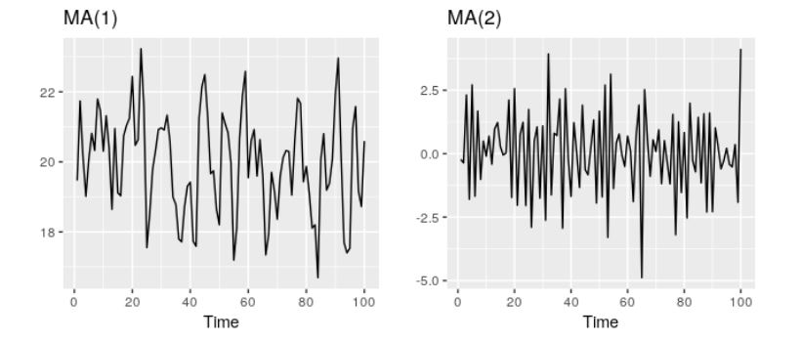
Moving average (MA) model
Moving average model of order m denoted MA(m):
“Shocks” effect values m time steps in the future for MA; in AR the effect is indefinite
MA always stationary; AR not always

Slide 14
State space models
Assumes the system has an underlying latent (unobserved) state that changes over time
could be discrete or continuous time
can be deterministic (i.e., if know initial condition, then know future of system) or stochastic
Observations of latent state are noisy
probabilistic model for generating observed data from underlying latent states

Slide 15
Discrete time state space model
Hidden state that evolves over discrete time generates observations

Slide 16
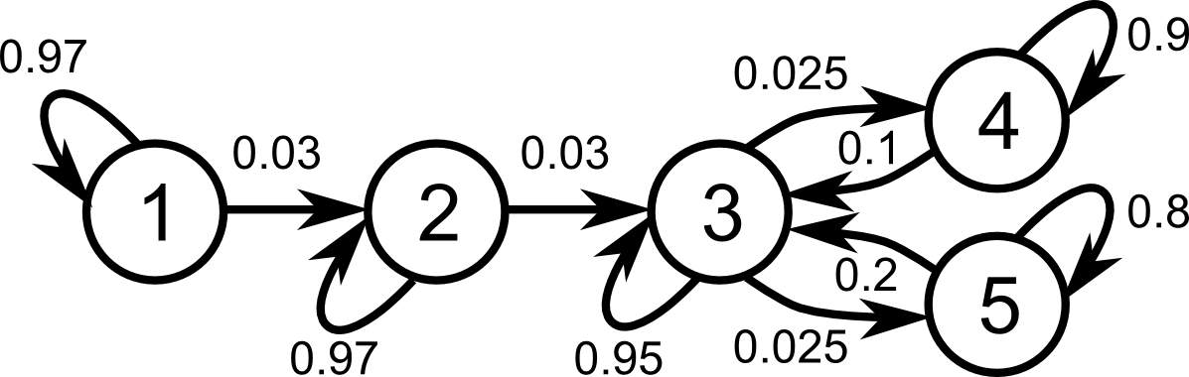
Hidden Markov Model (HMM) example
Transition model:
Observation model:

Slide 17
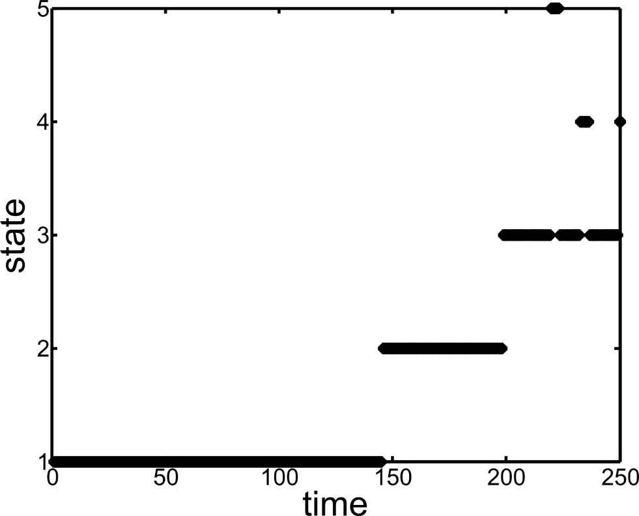
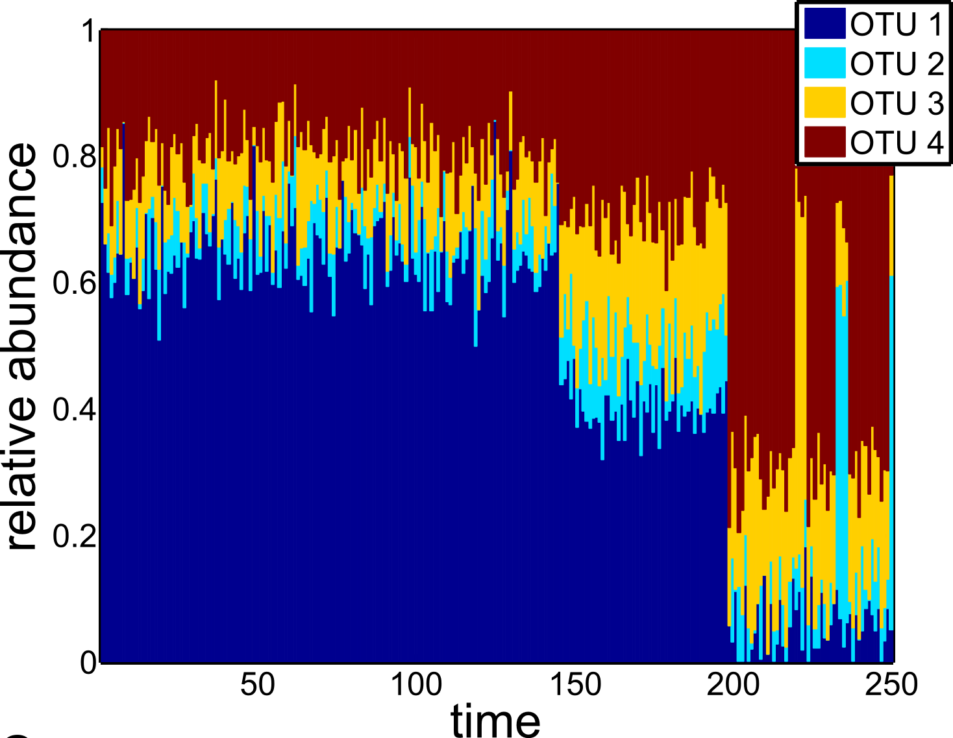
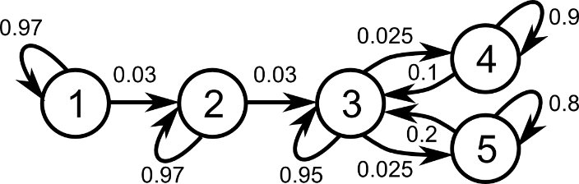
HMM (cont.)

Slide 18
Continuous time state space model (dynamical systems model)
Deterministic case: there exists an evolution function that maps every point (initial condition) in the state space S
Commonly express φ as the solution to an ordinary differential equation with x₀ as the initial condition
For a non-deterministic dynamical system, can think of there being multiple evolution functions that are randomly drawn for any given initial condition

Slide 19
Causality
Gold standard for determining real-world causality is a controlled, interventional experiment
Not always practical or ethical to perform interventional experiments
Can infer mathematical causality from purely observational time-series data
Mathematical causality is sometimes equivalent to real-world causality
Granger causality:
Intuition: Z => Y, if past information about Z adds explanatory power for predicting the present value of Y (relative to only past information about Y)

