Slide 1
Design Review – Low Noise Amplifier Design
Dylan Rosser
Dept. of Electrical and Computer Engineering
Carnegie Mellon University

Slide 2

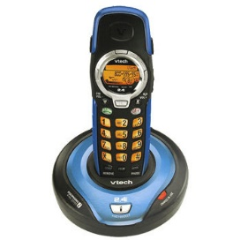
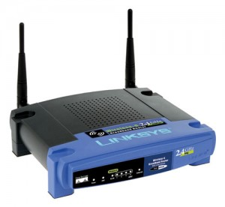
System
What systems run at 2.4GHz? (hint: everything)
Wifi (IEEE 802.11b/g/n)
Bluetooth
Wireless phones
ZigBee (IEEE 802.15.4)
Wireless Microphones
Baby monitors
Garage Opener
Blame your microwave
https://www.wired.com/2010/09/wireless-explainer/
ISM Band (2.4GHz is one of several)
Industrial, Scientific, Medical
Unregulated (unlicensed)
Source: https://www.wired.com/2010/09/wireless-explainer/
Notes:
Systems or applications for this design.
Microwaves are the reason so many devices are centered around 2.4GHz (2.45GHz is the standard for microwaves)

Slide 3
Motivations
RF Microelectronics, Razavi, Ch. 5
A 1.5-V, 1.5GHz CMOS Low Noise Amplifier
D. Shaeffer, T. Lee
A review of low noise amplifier for 2.4GHz frequency band
A 3-10 GHz LNA with wideband LC Ladder matching network
A Ismail, A. Abidi
Notes:
A 3-10 GHz LNA with wideband LC Ladder matching network
A Ismail, A. Abidi
A 2.4-GHz low-IF receiver for wideband WLAN in 0.6um CMOS architecture and front-end
F. Behbahani et al.
100-mV 44uW 2.4GHz LNA in 16nm FinFET technology
Y-t. Lu, J-D. Jin

Slide 4
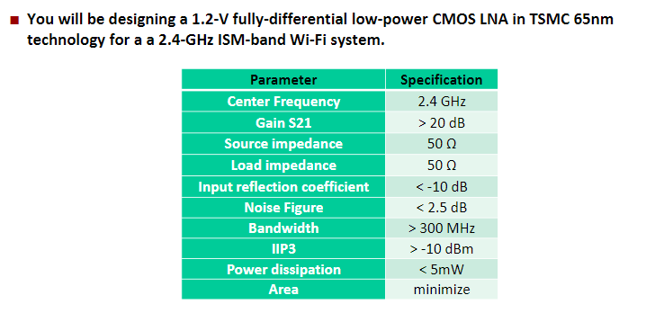
Specifications
Target specs for the project are only met with excessive power
My first goal is to redesign the current mirror and biasing scheme to avoid wasting any power

Slide 5
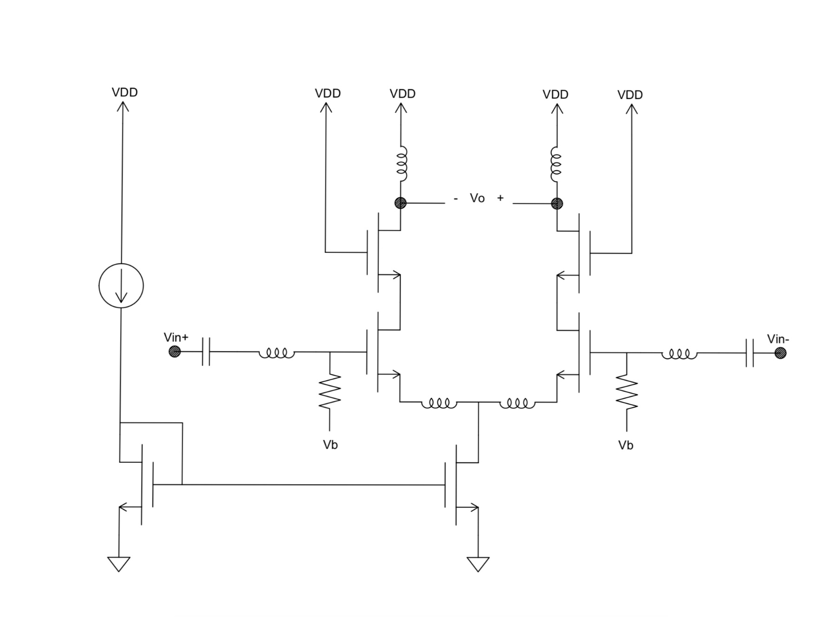
Proposed Topology

Slide 6
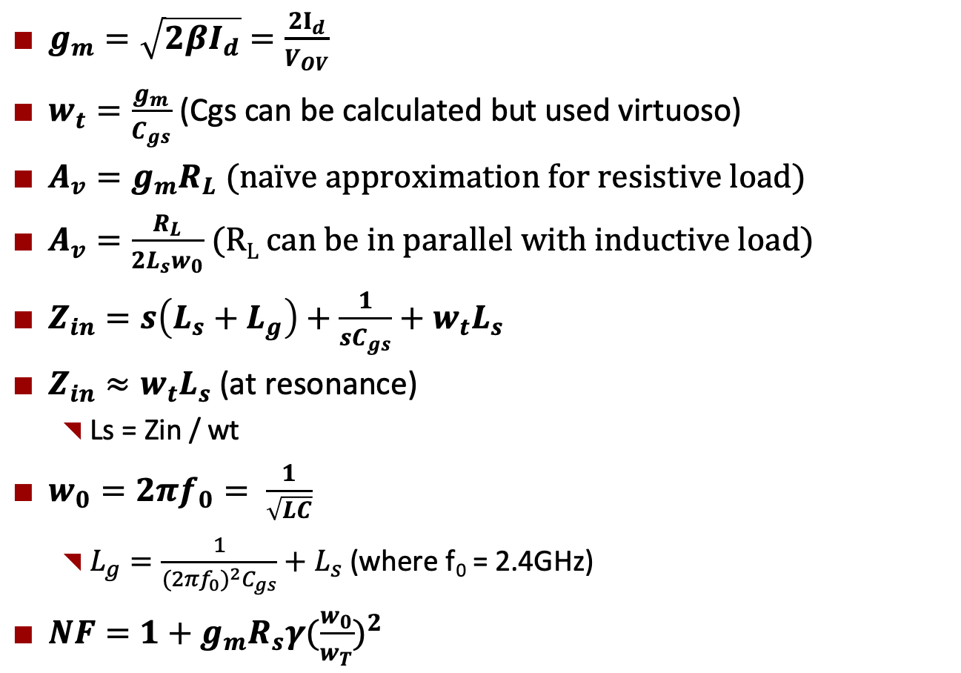
Analysis
$g_{m}=\sqrt{2βI_{d}}=\frac{{2I}_{d}}{V_{OV}}$
$w_{t}=\frac{g_{m}}{C_{gs}}$ (Cgs can be calculated but used virtuoso)
$A_{v}=g_{m}R_{L}$(naïve approximation for resistive load)
$A_{v}=\frac{R_{L}}{{2L}_{s}w_{0}}$ (R_{L} can be in parallel with inductive load)
$Z_{in}=s\left(L_{s}+L_{g}\right)+\frac{1}{{sC}_{gs}}+w_{t}L_{s}$
$Z_{in}≈w_{t}L_{s}$ (at resonance)
Ls = Zin / wt
$w_{0}=2πf_{0}= \frac{1}{\sqrt{LC}}$
$L_{g}=\frac{1}{{{(2πf}_{0})}^{2}C_{gs}}+L_{s}$ (where f₀ = 2.4GHz)
$NF=1+g_{m}R_{s}γ{(\frac{w_{0}}{w_{T}})}^{2}$

Slide 7
Analysis
Big transistors => large gm (but also large Cgs)
Reduced transit frequency
Necessary for high gain and also reduces the size of required Lg
Hurts my noise figure

Slide 8
Future work
FOM = IP3 – NF – Power
Sacrifice any ‘extra’ gain for improvements in these
Area not a factor in this FOM
I need to reduce power & redesign biasing
Perform analysis of bandwidth and output impedance
Include parallel C and/or R
Maximize Lg can minimize noise figure
Read through Razavi analysis again more closely
Study more research papers

