Slide 1
Design Review – 2.4-GHz Downconversion Mixer
Dylan Rosser
Dept. of Electrical and Computer Engineering
Carnegie Mellon University

Slide 2
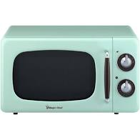
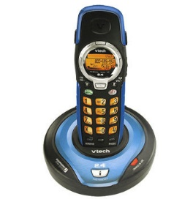
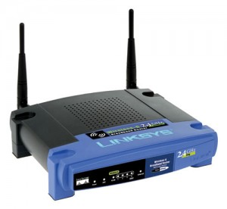
System
What systems run at 2.4GHz? (hint: everything)
Wifi (IEEE 802.11b/g/n)
Bluetooth
Wireless phones
ZigBee (IEEE 802.15.4)
Wireless Microphones
Baby monitors
Garage Opener
Blame your microwave
https://www.wired.com/2010/09/wireless-explainer/
ISM Band (2.4GHz is one of several)
Industrial, Scientific, Medical
Unregulated (unlicensed)
Source: https://www.wired.com/2010/09/wireless-explainer/
Notes:
Systems or applications for this design.
Microwaves are the reason so many devices are centered around 2.4GHz (2.45GHz is the standard for microwaves)

Slide 3
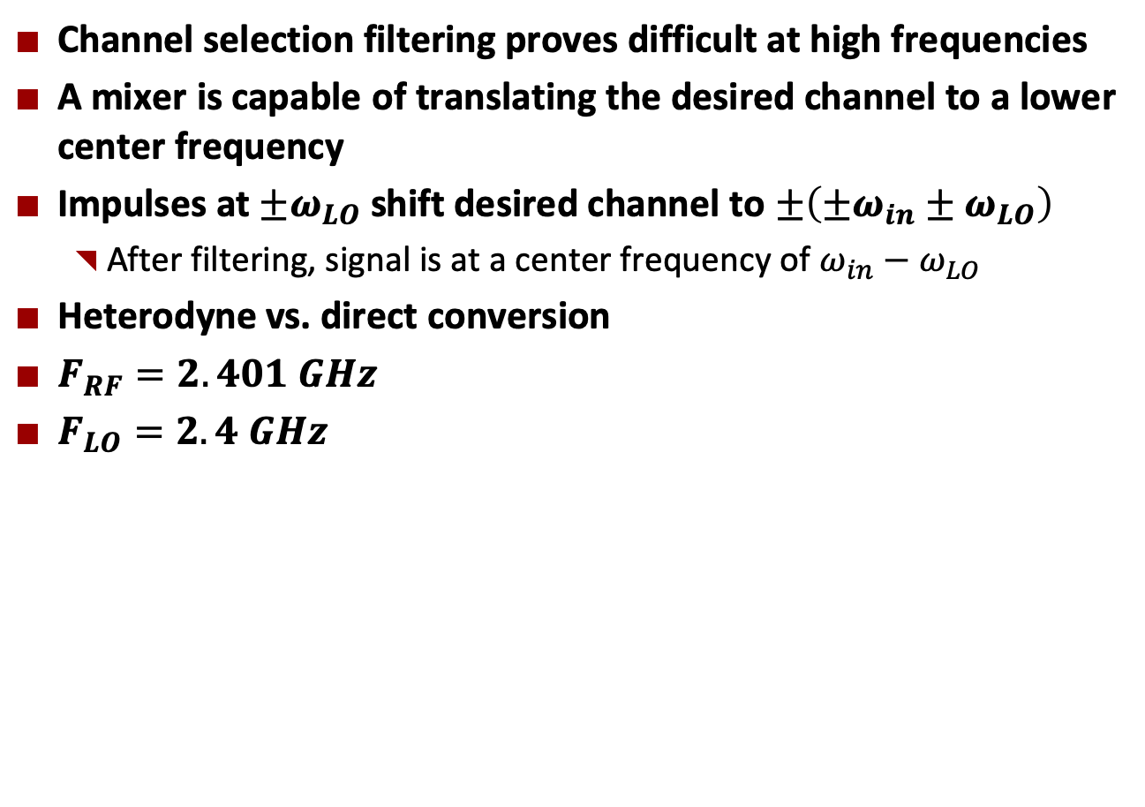
Motivation
Channel selection filtering proves difficult at high frequencies
A mixer is capable of translating the desired channel to a lower center frequency
Impulses at $±ω_{LO}$ shift desired channel to $±\left(±ω_{in}±ω_{LO}\right)$
After filtering, signal is at a center frequency of $ω_{in}−ω_{LO}$
Heterodyne vs. direct conversion
$F_{RF}=2.401 GHz$
$F_{LO}=2.4 GHz$

Slide 4
Motivations
RF Microelectronics, Razavi, Ch. 6
H. Darabi, A. A. Abidi, “Noise in RF CMOS mixers: a simple physical model,” IEEE J. of Solid-State Circuits, vol. 35, pp. 15-25, Jan. 2000.

Slide 5
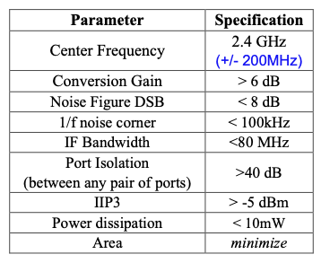
Specifications

Slide 6
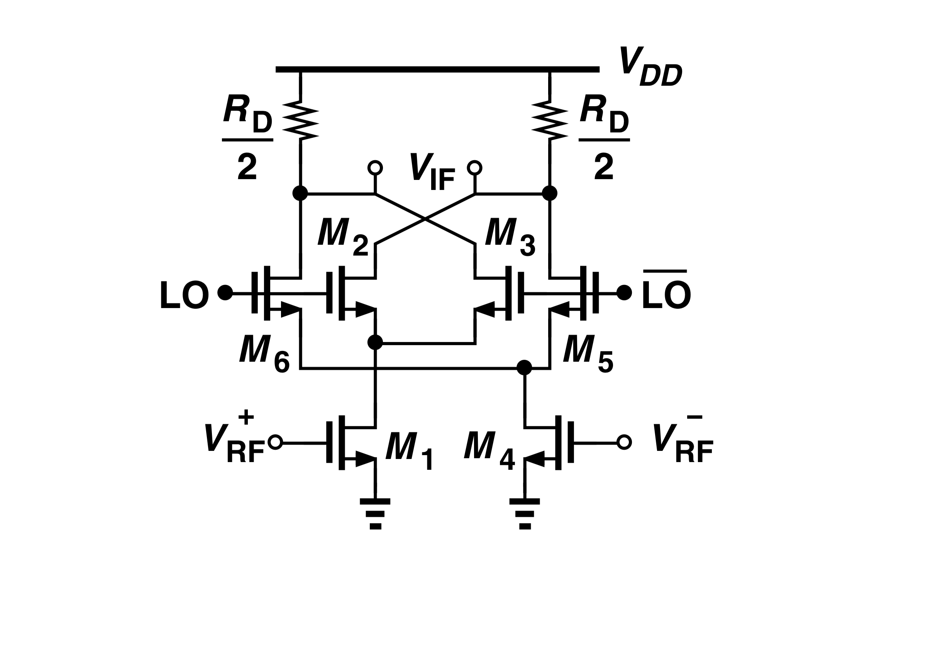
Proposed Topology
Double Balanced topology for differential RF input
Rejection of LO noise at the cost of input referred noise and power

Slide 7
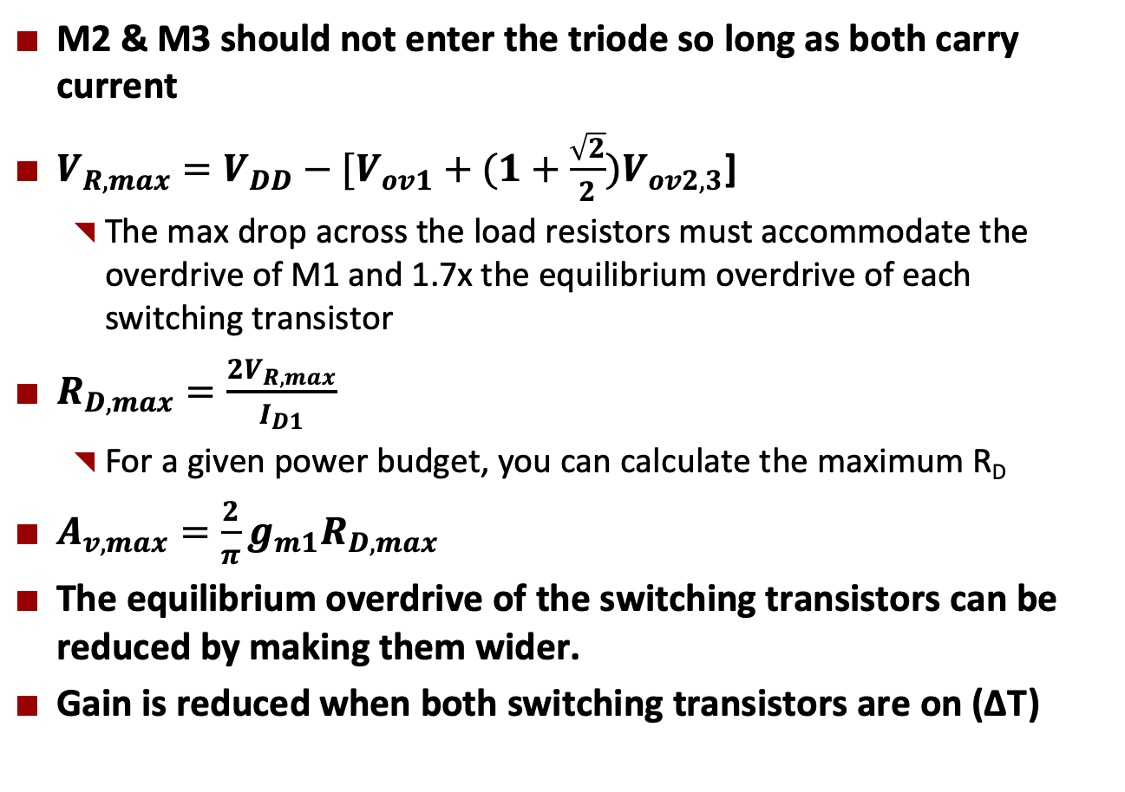
Analysis – Conversion Gain
M2 & M3 should not enter the triode so long as both carry current
$V_{R,max}=V_{DD}−[V_{ov1}+(1+\frac{\sqrt{2}}{2})V_{ov2,3}$]
The max drop across the load resistors must accommodate the overdrive of M1 and 1.7x the equilibrium overdrive of each switching transistor
$R_{D,max}=\frac{2V_{R,max}}{I_{D1}}$
For a given power budget, you can calculate the maximum R_{D}
$A_{v,max}=\frac{2}{π}g_{m1}R_{D,max}$
The equilibrium overdrive of the switching transistors can be reduced by making them wider.
Gain is reduced when both switching transistors are on (∆T)

Slide 8
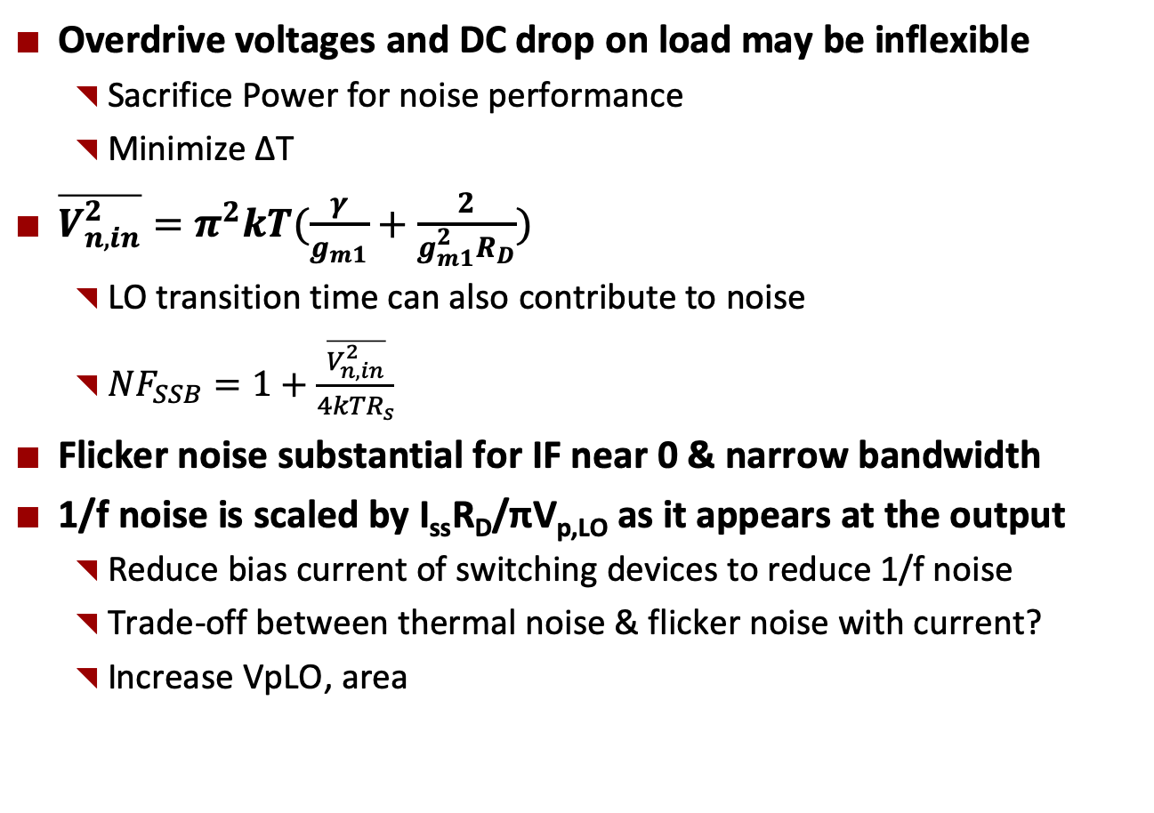
Analysis - Noise
Overdrive voltages and DC drop on load may be inflexible
Sacrifice Power for noise performance
Minimize ∆T
$\overline{V_{n,in}^{2}}=π^{2}kT(\frac{γ}{g_{m1}}+\frac{2}{g_{m1}^{2}R_{D}})$
LO transition time can also contribute to noise
${NF}_{SSB}=1+\frac{\overline{V_{n,in}^{2}}}{{4kTR}_{s}}$
Flicker noise substantial for IF near 0 & narrow bandwidth
1/f noise is scaled by I_{ss}R_{D}/πV_{p,LO} as it appears at the output
Reduce bias current of switching devices to reduce 1/f noise
Trade-off between thermal noise & flicker noise with current?
Increase VpLO, area

Slide 9
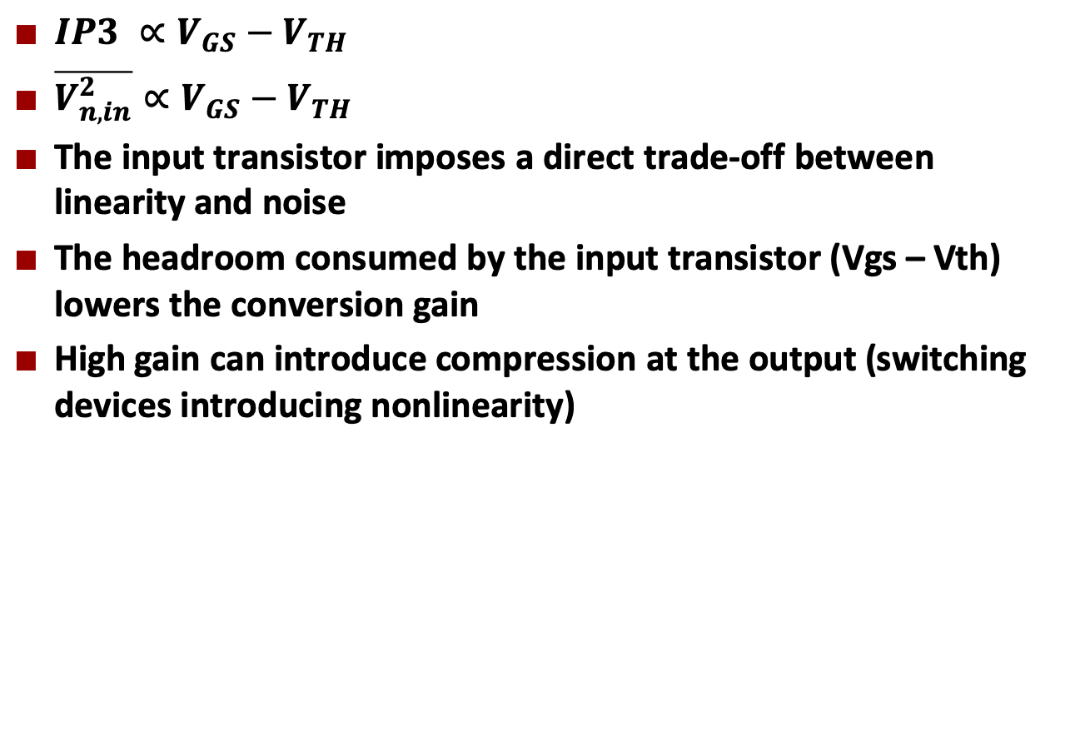
Analysis - Linearity
$IP3 ∝V_{GS}−V_{TH}$
$\overline{V_{n,in}^{2}}∝V_{GS}−V_{TH}$
The input transistor imposes a direct trade-off between linearity and noise
The headroom consumed by the input transistor (Vgs – Vth) lowers the conversion gain
High gain can introduce compression at the output (switching devices introducing nonlinearity)

Slide 10
Analysis - Excel
Mixer Design
Assuming a Power Budget for the mixer of |  |  |  |  | 8.00E-03 | W
At a VDD of |  |  |  |  | 1.2 | V
The tail current should be |  |  |  |  | 6.67E-03 | A
Design M1
M1 | Vth | Vov | gm |  | Id | Think about M1 Vov
 | 0.4 | 0.3 | 4.33E-02 |  | 6.50E-03 | gm/Id plot
Using a reference current of |  |  |  |  | 5.00E-04
The W/W ratio for the current mirror should be |  |  |  |  | 13.00
Make assumptions about M2&3
M2 &M3 | Vth | Vov | gm |  | Id | Lager W => easier to switch, if u can drive it
 | 0.4 | 0.2 | 0.03 |  | 3.25E-03
From Razavi, The max DC voltage drop across each load resistor is (6.64)
Vr_max |  |  |  | 0.55857864 | 0.55857864
Rd_max |  |  |  | 171.87 | 171.87
The maximum voltage Conversion Gain can now be calculated
Av_max |  |  |  |  | 4.74
Av_max (dB) |  |  |  |  | 13.5180637
Note the assumptions I made here, that the common mode voltage of the LO is 0.6, with Vth of M1&M2 = 0.4
Also I need to achieve 65mS of transconductance from M1
The conversion gain will be reduced because of the sinusoidal input according to (6.72)
The gain reduction is a function of the diff pair equilibrium overdrive voltage and peak voltage of LO
LO_peak |  |  |  |  | 0.3
Av_max_adj |  |  |  |  | 4.5401331
Av_max_adj(dB) |  |  |  |  | 13.1413717
To meet the gain spec (dB) |  |  |  |  | 10 | dB
Gain spec (V/V) |  |  |  |  | 3.16227766 | V/V
If R is |  |  |  |  | 200 | Ω
gm has to be at least |  |  |  |  | 2.48E-02 | S
To get this gm at an Id of |  |  |  |  | 4.00E-03 | A
Vov should be |  |  |  |  | 0.322 | V
UnCox is |  |  |  |  | 0.002
The corresponding W/L ratio is |  |  |  |  | 3.86E+01
at a length of |  |  |  |  | 0.06 | um
The width should be |  |  |  |  | 2.31 | um
Analysis must be modified for double-balanced topology

Slide 11
Future work
Continue to build intuition by reading through the textbook, papers, and lecture notes
Model in excel and verify in simulation
Simulations proceeding with ideal voltage sources for biasing mixer
Biasing will eventually be done with current mirrors
Buffer is initially ignored
I will try to use an ideal LO by adjusting the ideal source as needed
Buffer will later be used to create the ‘ideal’ LO

