Slide 1
Design Review – 2.4-GHz Oscillator
Dylan Rosser
Dept. of Electrical and Computer Engineering
Carnegie Mellon University

Slide 2
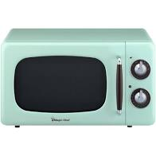
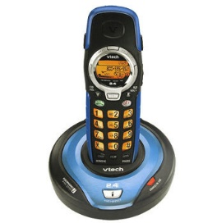
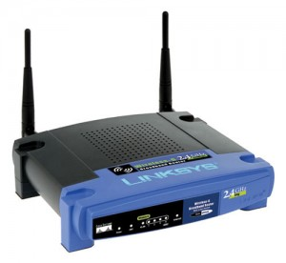
System
What systems run at 2.4GHz? (hint: everything)
Wifi (IEEE 802.11b/g/n)
Bluetooth
Wireless phones
ZigBee (IEEE 802.15.4)
Wireless Microphones
Baby monitors
Garage Opener
Blame your microwave
https://www.wired.com/2010/09/wireless-explainer/
ISM Band (2.4GHz is one of several)
Industrial, Scientific, Medical
Unregulated (unlicensed)
Source: https://www.wired.com/2010/09/wireless-explainer/
Notes:
Systems or applications for this design.
Microwaves are the reason so many devices are centered around 2.4GHz (2.45GHz is the standard for microwaves)

Slide 3
Motivations
RF Microelectronics, Razavi, Ch. 8
Ch 7.5: Varactor
CH 13 p. 869: Design Example
Lectures

Slide 4
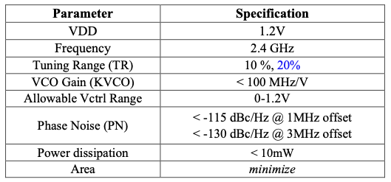
Specifications

Slide 5
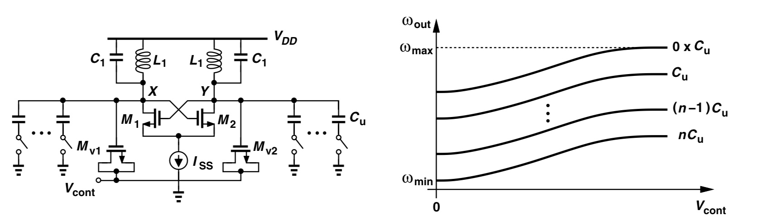
Proposed Topology

Slide 6
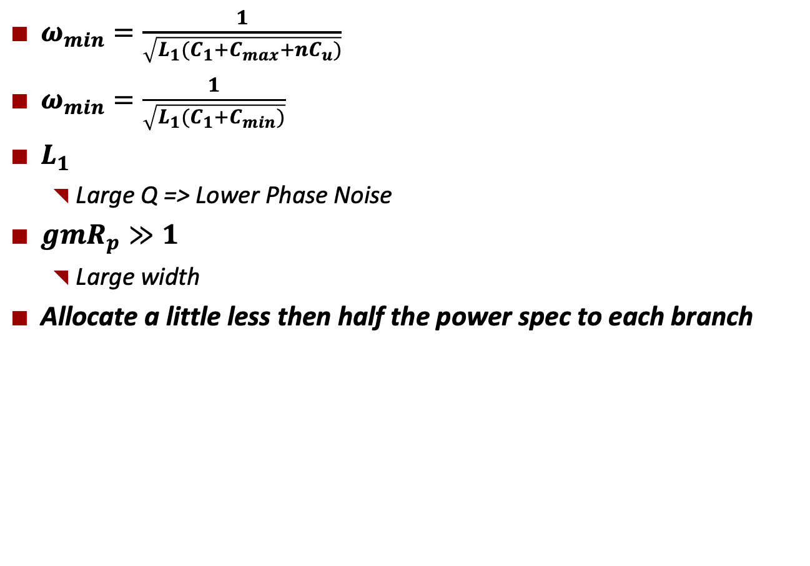
Analysis
$ω_{min}=\frac{1}{\sqrt{L_{1}(C_{1}+C_{max}+nC_{u})}}$
$ω_{min}=\frac{1}{\sqrt{L_{1}(C_{1}+C_{min})}}$
$L_{1}$
Large Q => Lower Phase Noise
$gmR_{p}≫1$
Large width
Allocate a little less then half the power spec to each branch

Slide 7

Future work
Continue to build intuition by reading through the textbook, papers, and lecture notes
Model in excel and verify in simulation

