Slide 1
Speed Dating
By Faryar

Slide 2
Dataset
Compiled by Columbia business school professor
Gathered from participants in experimental speed dating events from 2002-2004
Four minute ‘first date’ with every other participant of the opposite sex
Rate date on attractiveness, sincerity, intelligence, fun, ambition, and shared interests

Slide 3
Data
8378 rows
195 columns (a lot of info from questionnaire)
(attr1/sinc1/int1/fun1/amb1/shar1) => What do you look for in the opposite sex?
attr2 => What do you think the opposite sex looks for in a date?
attr3 => Please rate your opinion of your own attributes
attr4 => What do you think MOST of your fellow men/women look for in the opposite sex?
attr5 => How do you think others perceive you?
attr7 => Now, think back to your yes/no decisions during the night of the Speed Dating event. Try to distribute the 100 points among these six attributes in the way that best reflects the actual importance of these attributes in your decisions

Slide 4
Data
_1 => Time 1 => (signup) Survey filled out by students that are interested in participating in order to register for the event.
_2 => Time 2 => (follow-up) Survey is filled out the day after participating in the event. Subjects must have submitted this in order to be sent their matches
_3 => Time 3 => (follow-up2) Subjects filled out 3-4 weeks after they had been sent their matches.
_s => Half way through meeting all potential dates during the night of the event on their scorecard

Slide 5
Questions
use pf_o_att (partner’s stated preference) at Time 1 for all 6 attributes AND attr1 at Time 1 for all 6 attributes to predict match
use attr_o (rating by partner the night of the event for all 6 attributes) AND attr3 at Time 1 for all 6 attributes to predict match
use attr_o (rating by partner the night of the event for all 6 attributes) AND attr5 at Time 1 for all 6 attributes to predict match
use attr_o (rating by partner the night of the event for all 6 attributes) AND attr (rating for partner) to predict match

Slide 6
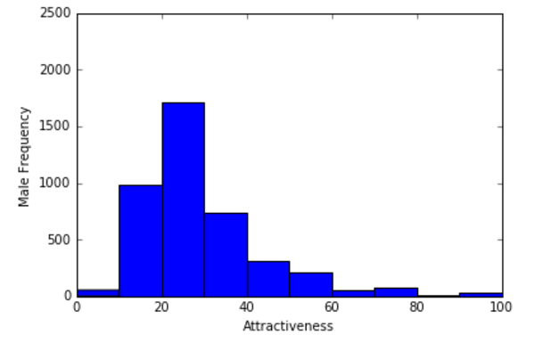
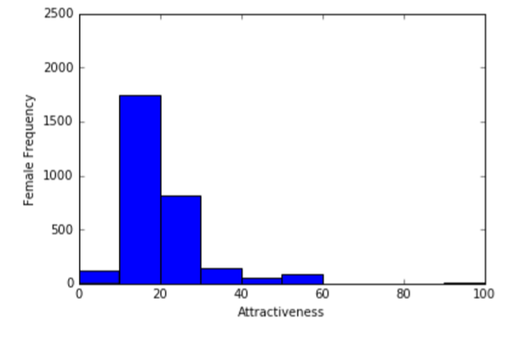
Attractiveness

Slide 7
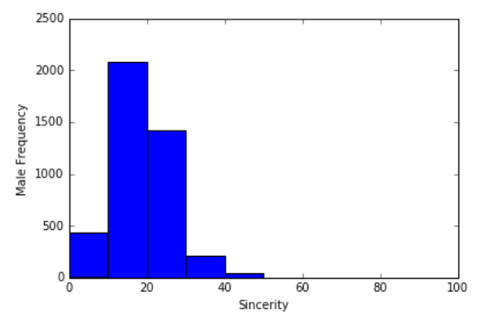
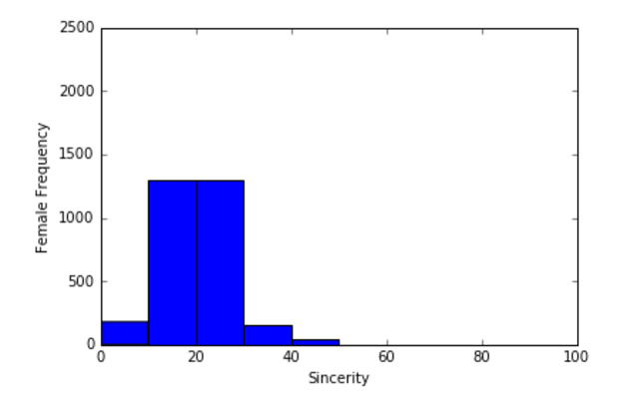
Sincerity

Slide 8
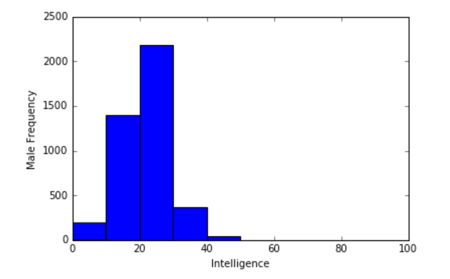
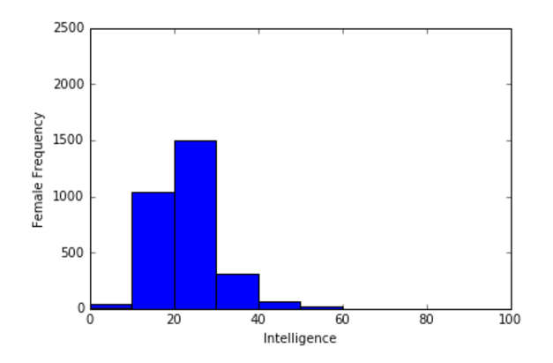
Intelligence

Slide 9
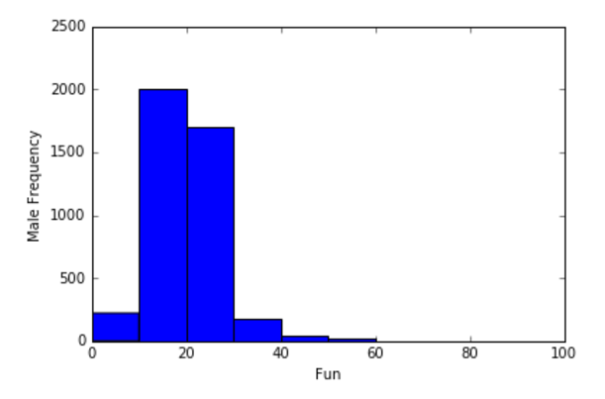
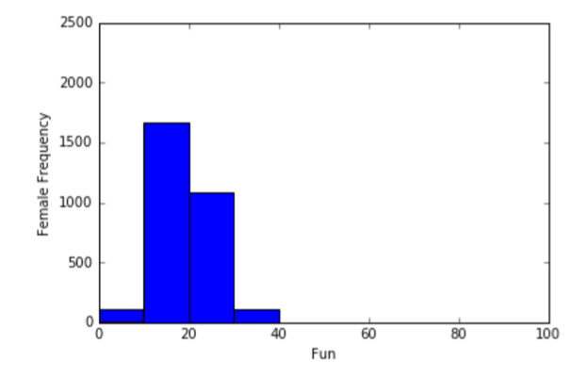
Fun

Slide 10
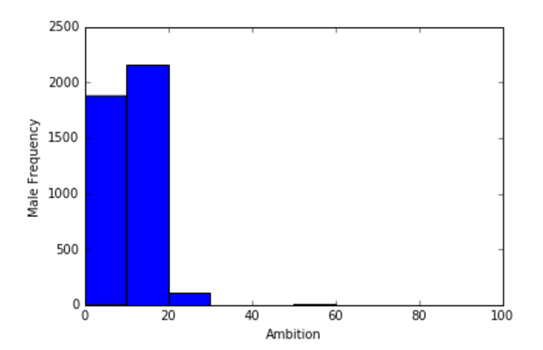
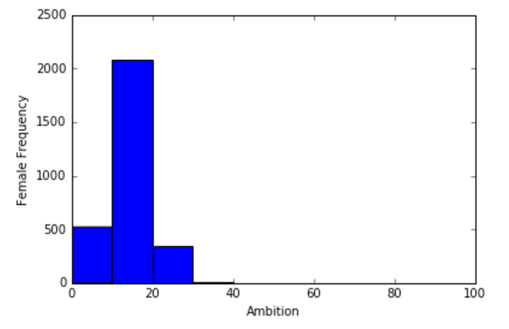
Ambition

Slide 11
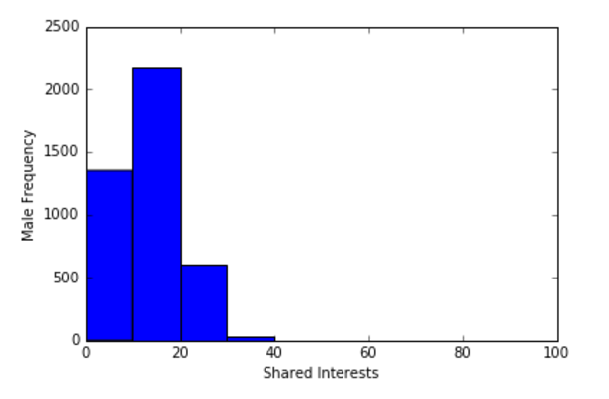
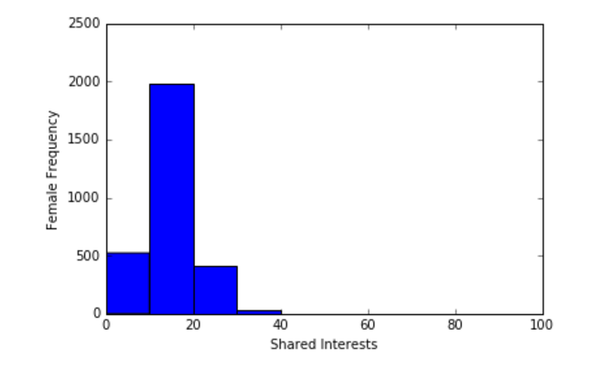
Shared Interests

Slide 12
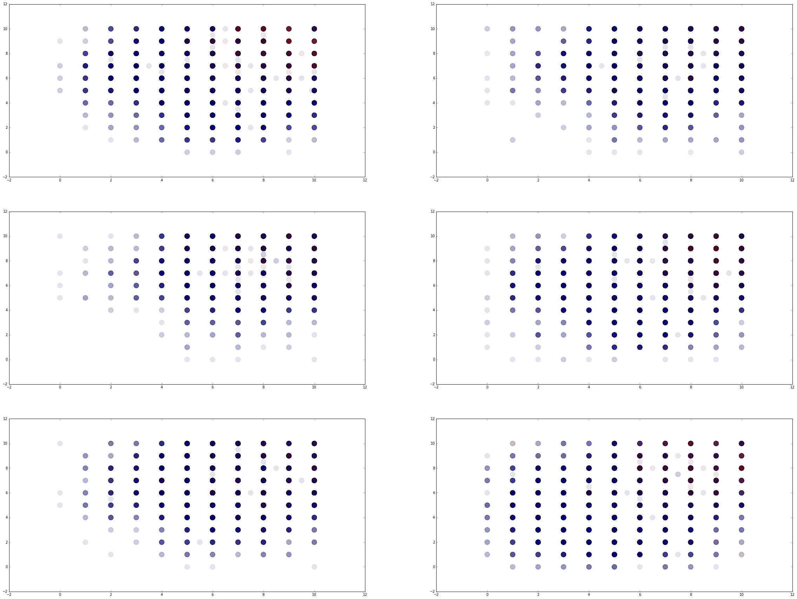
Match (attr_o <> attr)
Attr Sinc
Intel Fun
Amb Shar

Slide 13
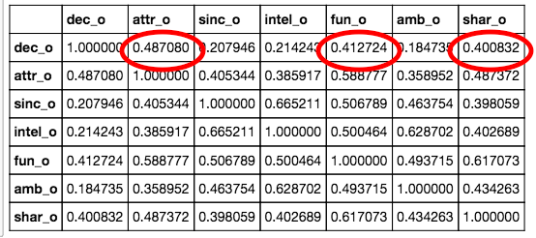
correlation between partner's decision and how they rated you

Slide 14
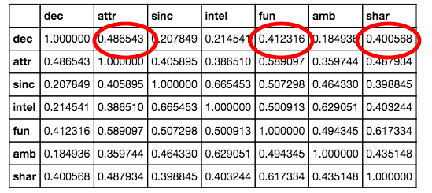
correlation between your decision and how you rated your partner

Slide 15
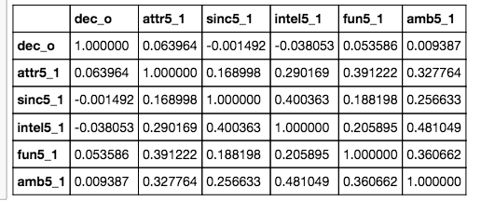
correlation between partner's decision and how you think others perceive you

Slide 16
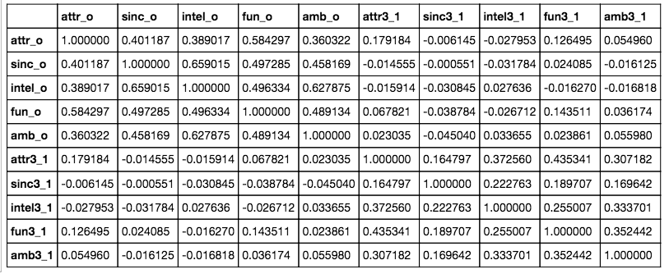
correlation between what partner rated you and how you would rate yourself

Slide 17
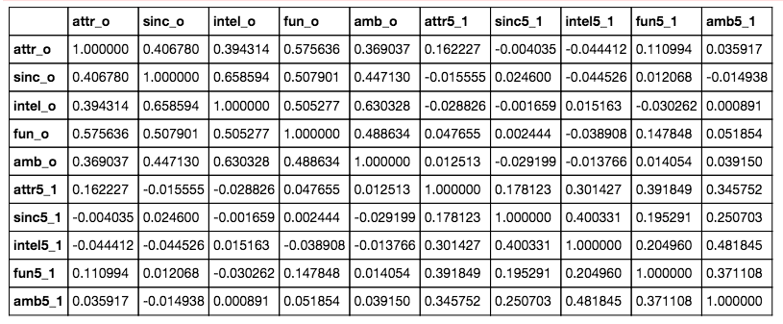
correlation between what partner rated you and how you think others perceive you

Slide 18
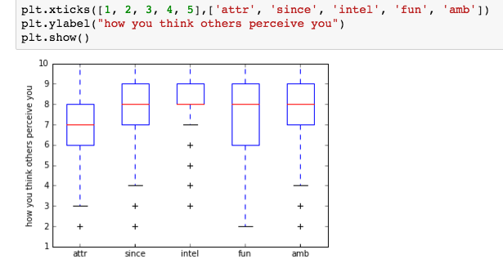
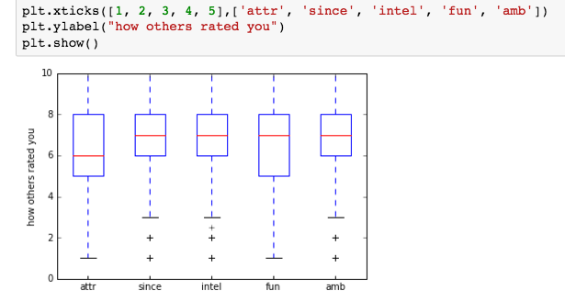
boxplots
Notes:
Should i take out the outliers?

Slide 19
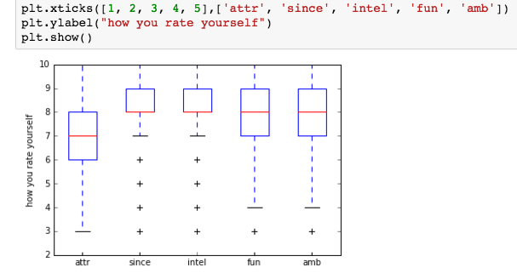
boxplots 2

Slide 20
after all that...

Slide 21
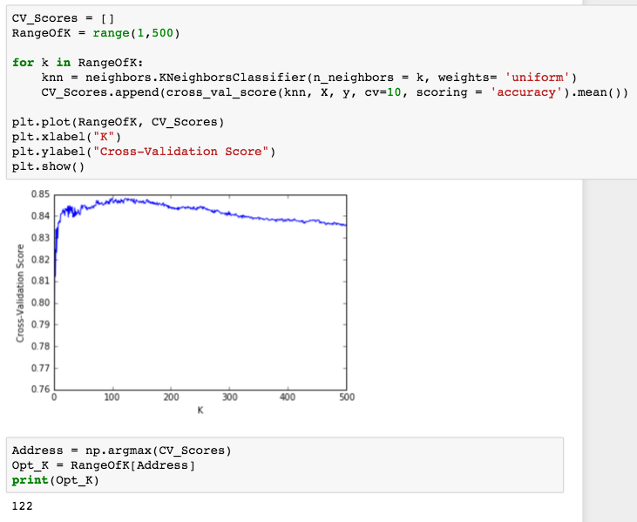
determine match based on your & partner’s rating
Match percentage = 17.6%

Slide 22
can we get a better score?

Slide 23
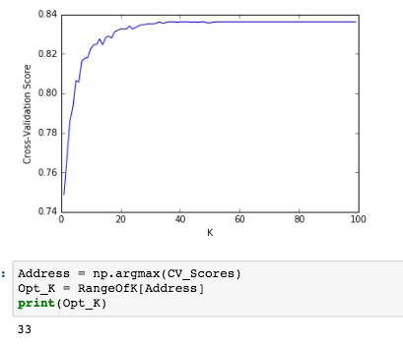
Predicting match with partner’s rating and how you perceive yourself

Slide 24
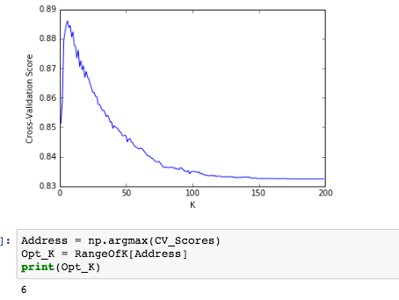
Predicting match with partner’s rating and how you rate yourself

Slide 25
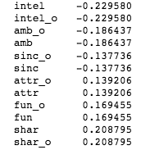
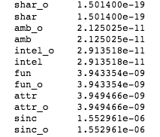
logistic regression
Coefficients p-values

Slide 26

Confusion Matrix (without tuning)

Slide 27
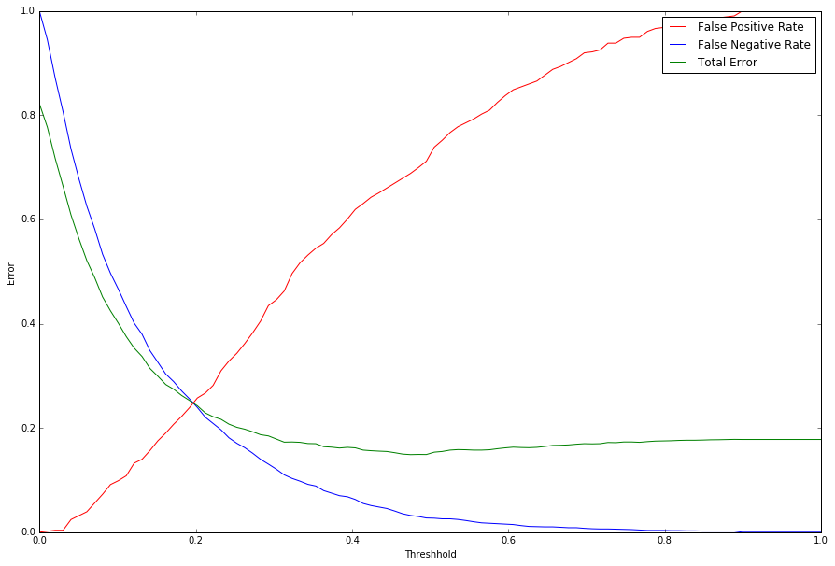
Thresholds

Slide 28

Threshold 0.2

Slide 29

Threshold 0.1

Slide 30
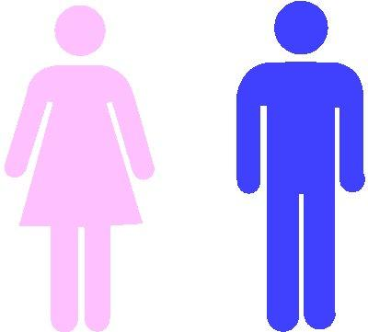
Next steps

