Slide 1

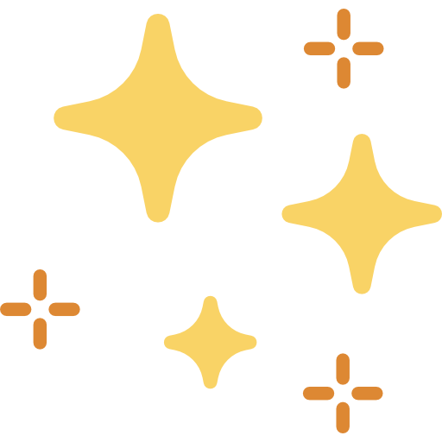

JavaScript Events Making Websites Interactive
Notes:
<p>Image sources: <a href=“https://commons.wikimedia.org/wiki/File:JavaScript-logo.png”>JavaScript Icon 1</a>, <a href=“https://www.flaticon.com/free-icon/interaction_1589513?term=interaction&page=1&position=47&origin=search&related_id=1589513”>Point and Click</a>, <a href=“https://www.flaticon.com/free-icon/magic_867875?term=magic&page=1&position=5&origin=search&related_id=867875”>Sparkles</a></p>

Slide 2

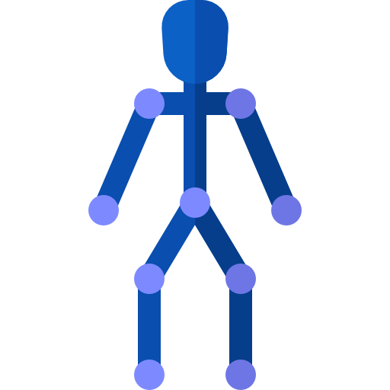
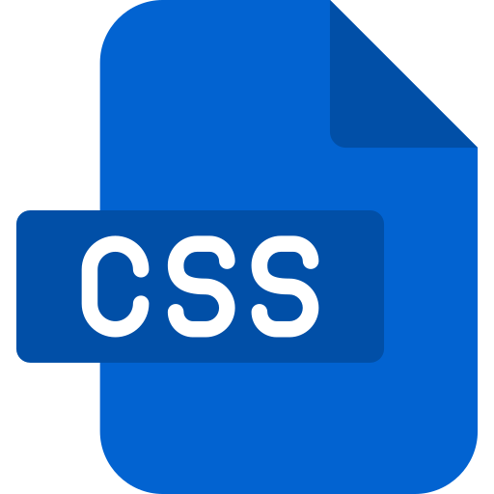
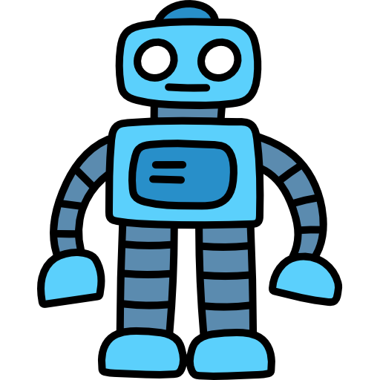

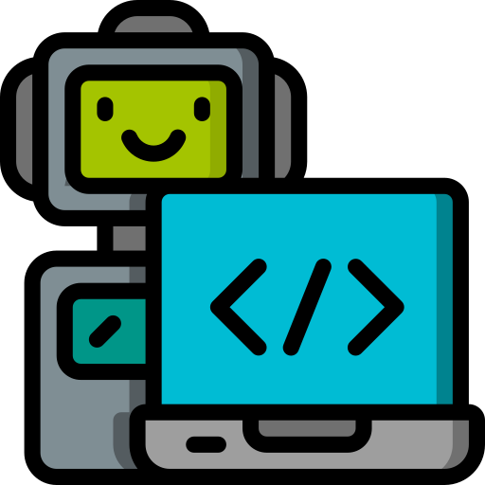
Quick Review: What Makes Websites Dynamic?
Today, we’ll look at
how JavaScript “listens” to users
We’ve already seen:
Now, with JavaScript, we will see:
1. HTML (Structure)
2. HTML + CSS (Pretty Structure)
3. HTML + CSS + JavaScript (Pretty Structure, Interactive)
Notes:
<p>Image sources:<a href=“https://www.flaticon.com/free-icon/joints_835231?term=robot+skeleton&page=1&position=1&origin=search&related_id=835231”>Robot Skeleton</a>, <a href=“https://www.flaticon.com/free-icon/html_9496578?term=html&page=1&position=11&origin=search&related_id=9496578”>HTML icon</a>, <a href=“https://www.flaticon.com/free-icon/css_9496599?term=css&page=1&position=4&origin=search&related_id=9496599”>CSS icon</a>, <a href=“https://www.flaticon.com/free-icon/robot_1395030?term=toy+robot&page=1&position=5&origin=search&related_id=1395030”>Toy Robot</a>, <a href=“https://www.flaticon.com/free-icon/robot_4248126?term=robot+laptop&page=1&position=4&origin=search&related_id=4248126”>Smart Robot</a>, <a href=“https://www.flaticon.com/free-icon/js-file_4726005?term=javascript+file&page=1&position=3&origin=search&related_id=4726005>JavaScript Icon 2</a></p>

Slide 3
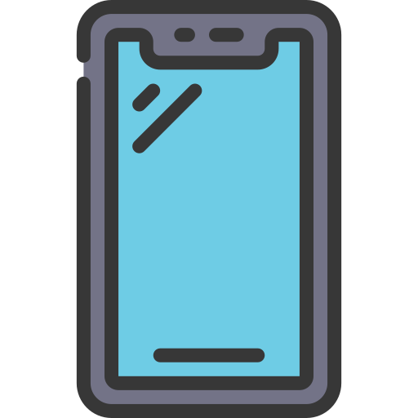
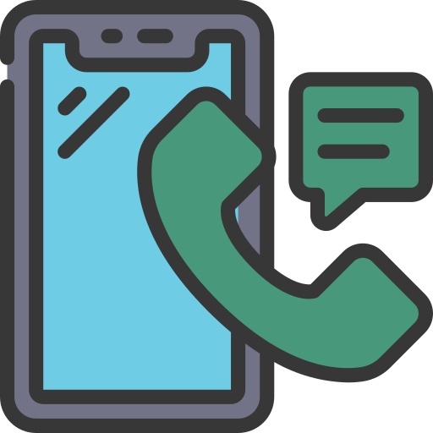
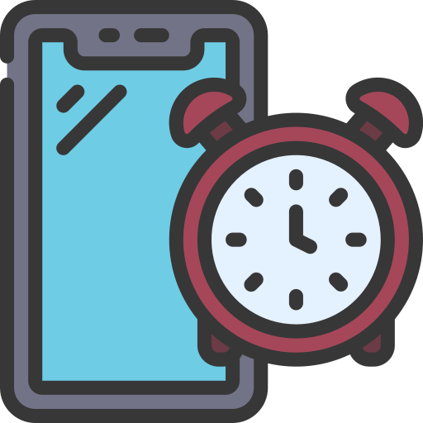
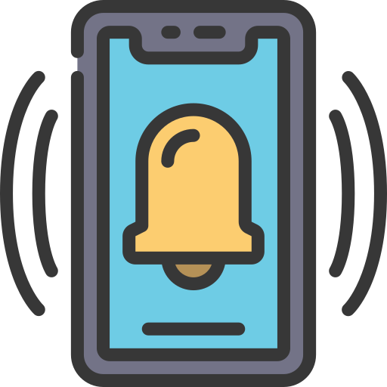

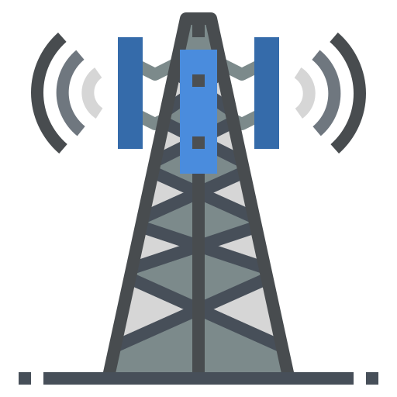
Events Everywhere: The Phone Analogy
What if websites could “listen” too?
Did you know? Your cell phone is always listening…
Not like a person does, though! It’s listening differently.
7:59 AM
8:00 AM
Clock
Apps
Calls
A minute passes by...
An alarm event was set for eight o’ clock, which told you that it’s time to get up!
Your friend just sent you something cool…
Now you know, thanks to a notification event lighting up your screen!
Someone’s dialing your cell phone…
You pick it up right away, because the call event set the buzzer off.
What would it do for us, if webpages could also listen for events? Let’s take a deeper look…
Notes:
<p>Image sources: <a href=“https://www.flaticon.com/free-icon/smartphone_5126042?term=phone&page=14&position=6&origin=style&related_id=5126042”>Phone Plain</p>, <a href=“https://www.flaticon.com/free-icon/satellite-tower_9424944?term=cell+tower&page=1&position=2&origin=search&related_id=9424944”>Cell Tower</a>, <a href=“https://www.flaticon.com/free-icon/mobile_15143733?term=smartphone+buzz&page=1&position=2&origin=search&related_id=15143733”>Phone Buzz</a>, <a href=“https://www.flaticon.com/free-icon/timer_5126931?term=phone+alarm&page=1&position=10&origin=style&related_id=5126931”>Phone Alarm</a>, <a href=“https://www.flaticon.com/free-icon/text_15143432?term=smartphone+text&page=1&position=5&origin=style&related_id=15143432”>Phone Text Messages</a>, <a href=“https://www.flaticon.com/free-icon/mobile_15143447”>Phone Call</a></p> “JavaScript Events, JavaScript Events Everywhere…“ --Buzz DevYear

Slide 4
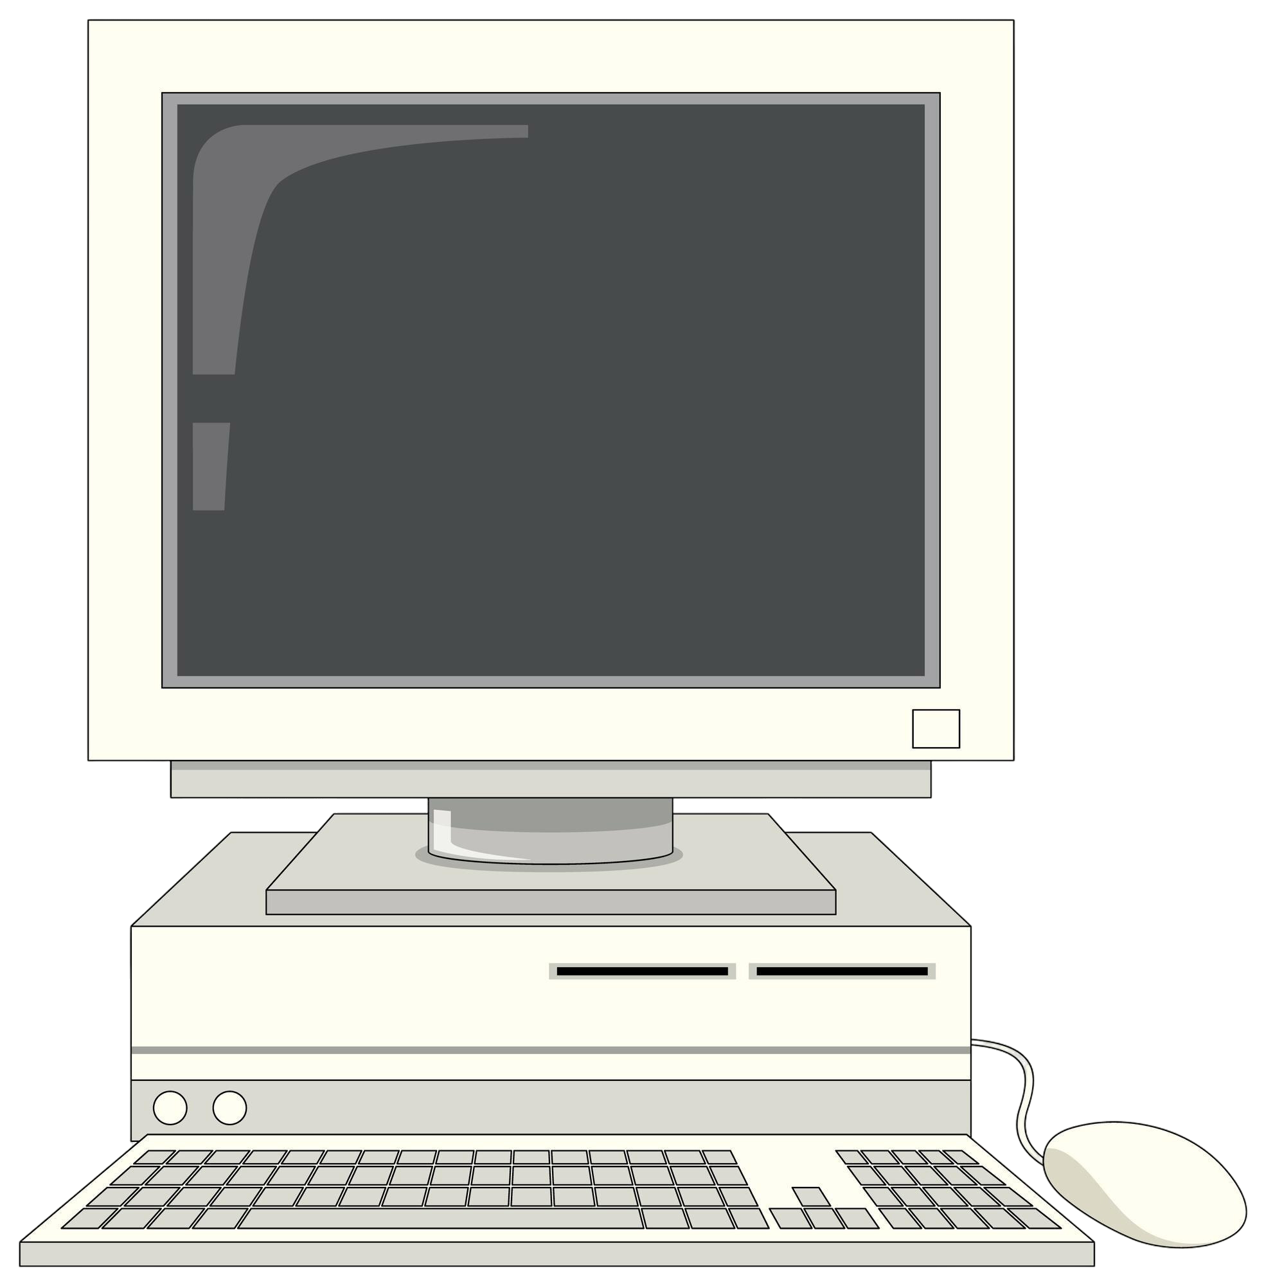
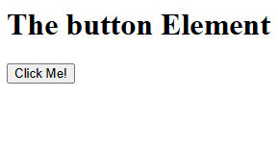
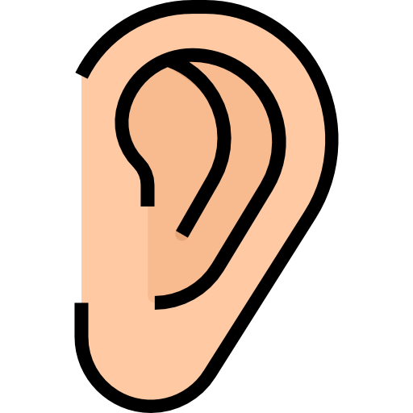
What Are JavaScript Events?
An Event = Something that happens on a webpage
Examples of events on a webpage:
JavaScript can “listen” for these events and respond, in the same way that we saw the phones listen and respond.
1. User clicks a button
The pointer just showed us a special type of JavaScript event, called a mouse event. More on this later…
2. User types in a text box
3. User moves their mouse
4. Page finishes loading
Notes:
<p>Image sources: <a href=“https://www.freepik.com/free-vector/retro-computer-device-isolated_37823089.htm#fromView=search&page=1&position=8&uuid=9a81178a-cc8f-4c8a-8fdb-a98b68695d10&query=old+computer+monitor”>Retro Monitor</a>, <a href=“https://www.flaticon.com/free-icon/ear_754500?term=ear&page=1&position=4&origin=search&related_id=754500”>Ear</a></p>

Slide 5
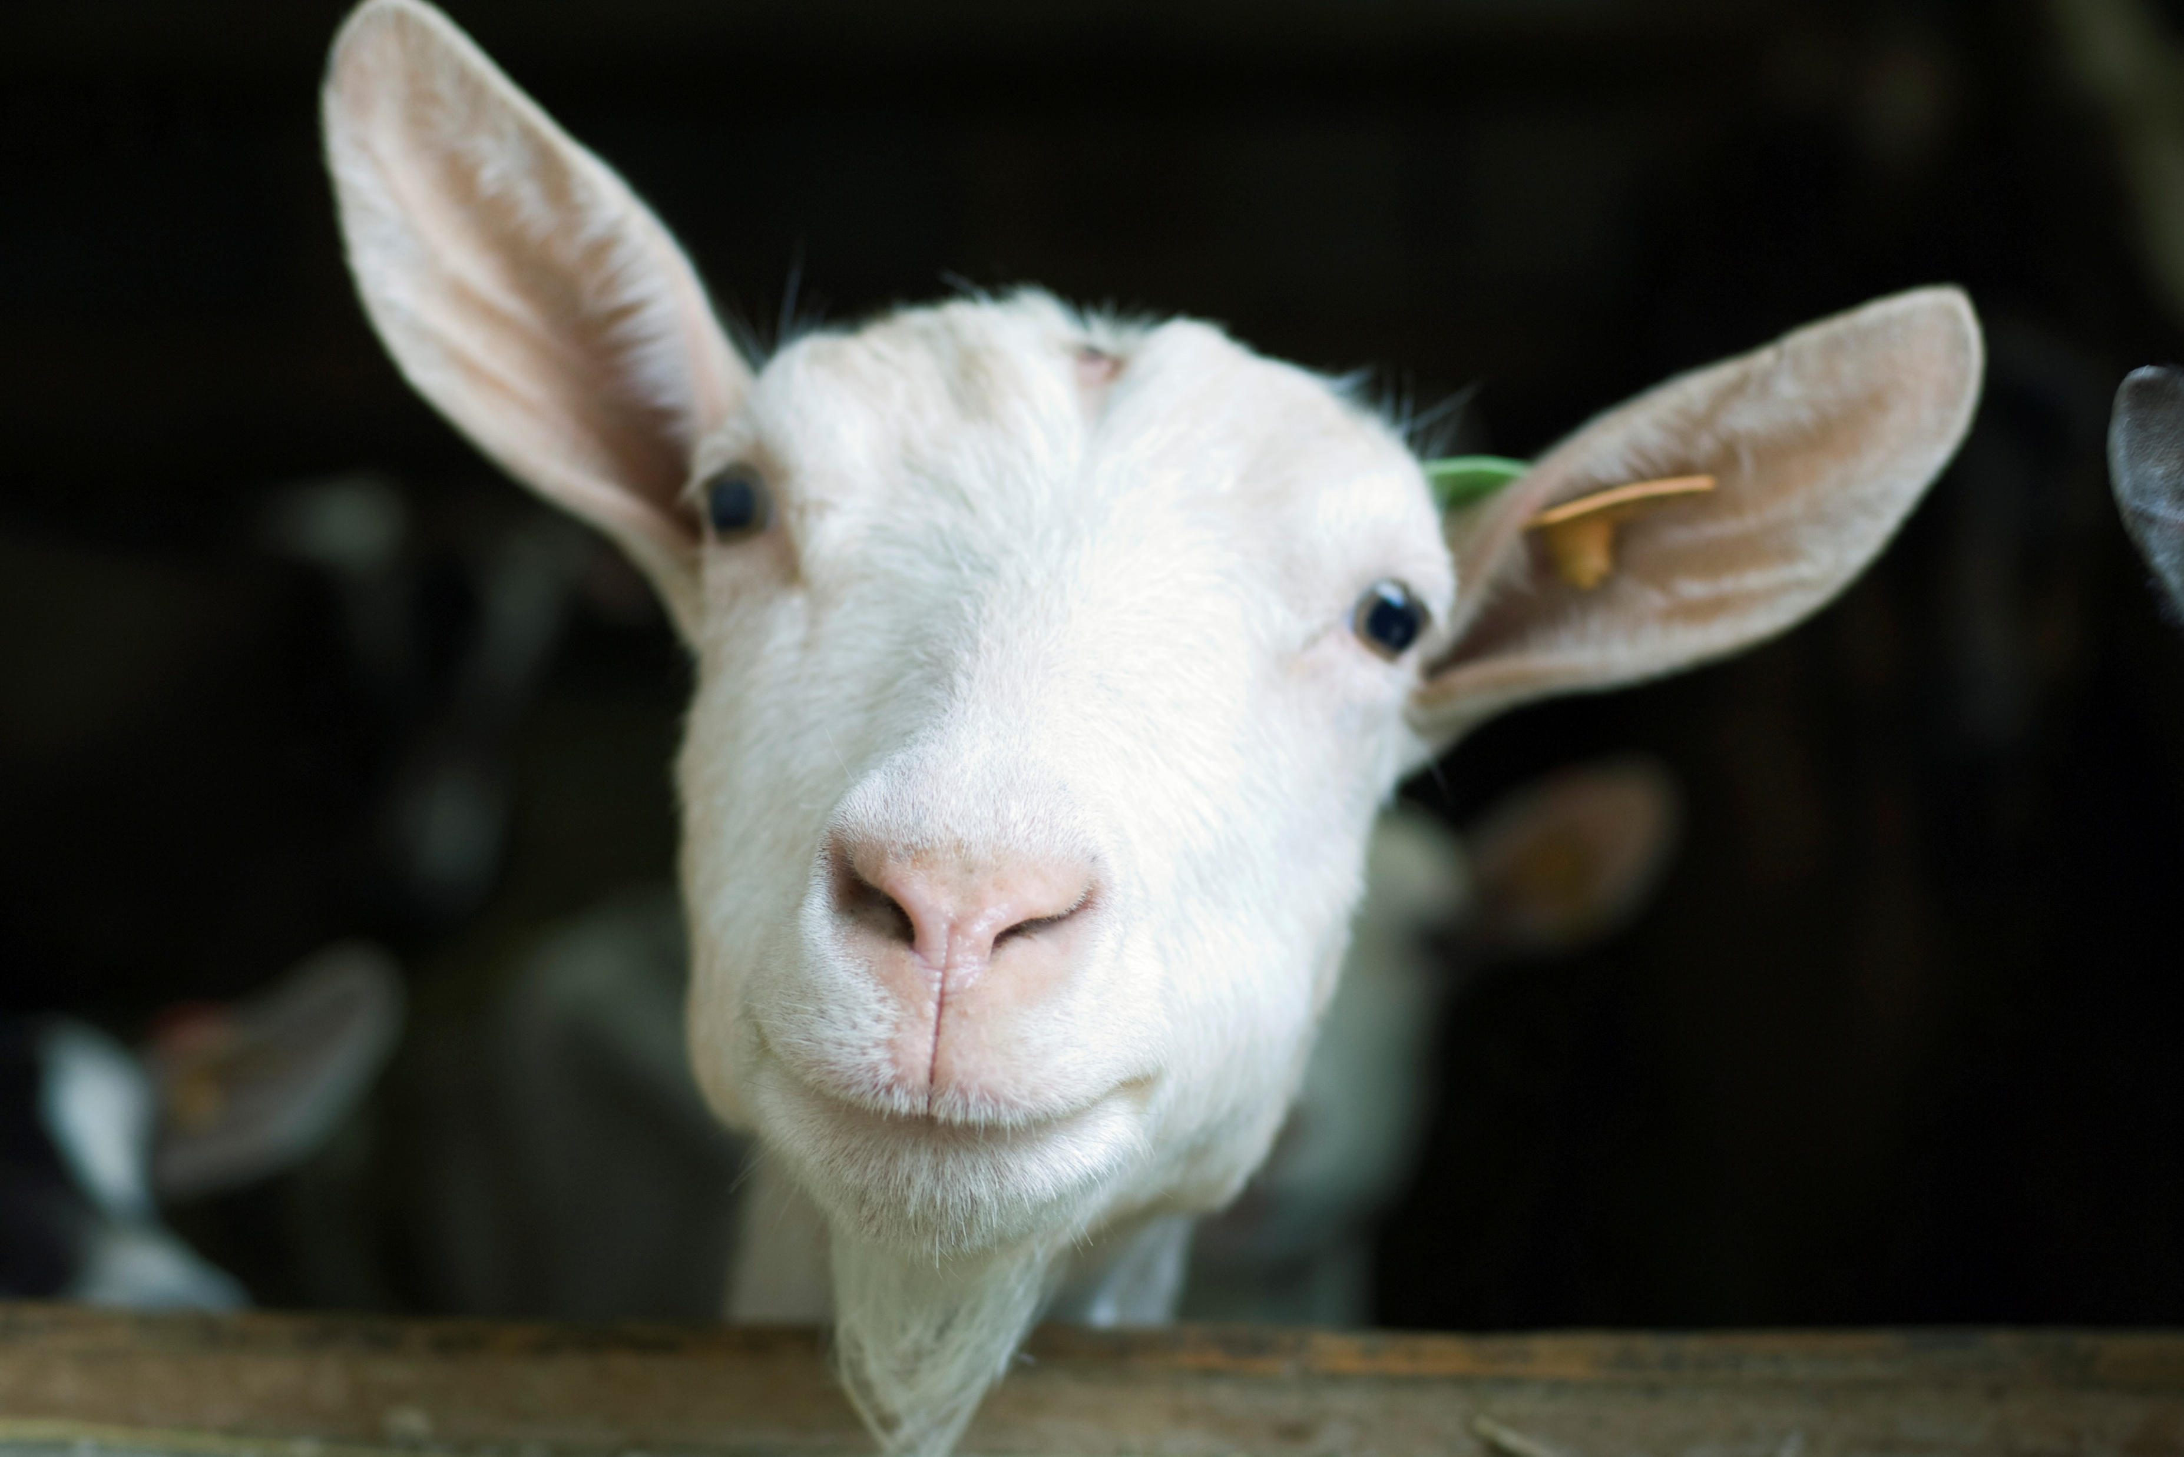

Real-World Event Examples
Think about your favorite social media app:
Click "Like" →
Heart turns red, count increases
Type comment →
Text appears as you type, app is responsive
Hover over profile →
Preview pops up, enabling further interaction
Scroll down →
More posts load, content is updated
All of these are JavaScript events!
Meow meow, meow. Meow. Meow? Meow meow meow. Meow! @meow200
AnimalBook
>
@goat101
@meow200
Notes:
Images sourced from Microsoft’s built-in suite of stock photos. These are known to be open for commercial use, solely when utilized within an OOXML file (or derivative thereof) created and edited within the Microsoft Office suite of products.

Slide 6



The Event-Response Cycle
“Event Happens → JavaScript Responds”
This concept is popular. According to a survey, 98.8% of all websites use JavaScript for webpage behavior in some capacity.
User Clicks Button
JavaScript Detects Click
Something Cool Happens!
Notes:
<p>Image sources: <a href=“https://commons.wikimedia.org/wiki/File:JavaScript-logo.png”>JavaScript Icon 1</a>, <a href=“https://www.flaticon.com/free-icon/target_3176324?term=target&page=1&position=2&origin=search&related_id=3176324”>Target</a>, <a href=“https://www.flaticon.com/free-icon/ux_15122114?term=hci&page=1&position=1&origin=search&related_id=15122114”>HCI</a>, <a href=“https://www.flaticon.com/free-icon/magic-wand_3230652?term=magic+wand&page=1&position=3&origin=search&related_id=3230652”>Wand</a></p>
Study from 2024: https://w3techs.com/technologies/details/cp-javascript

Slide 7
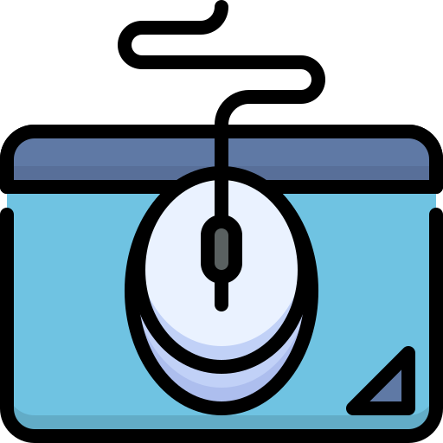
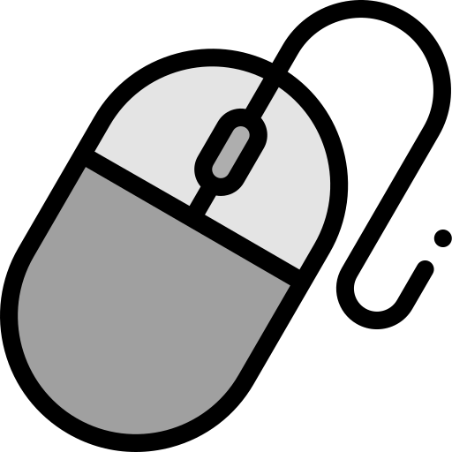
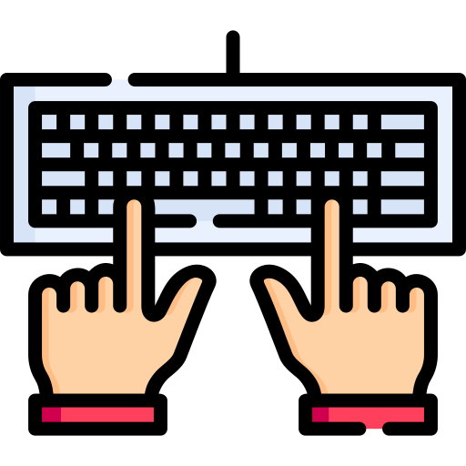
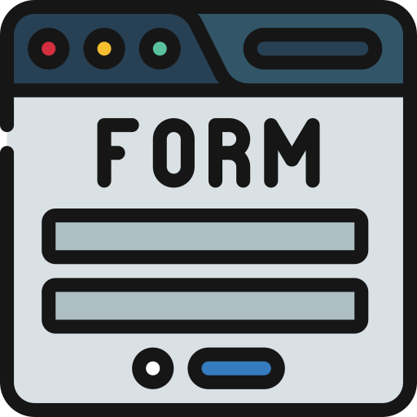
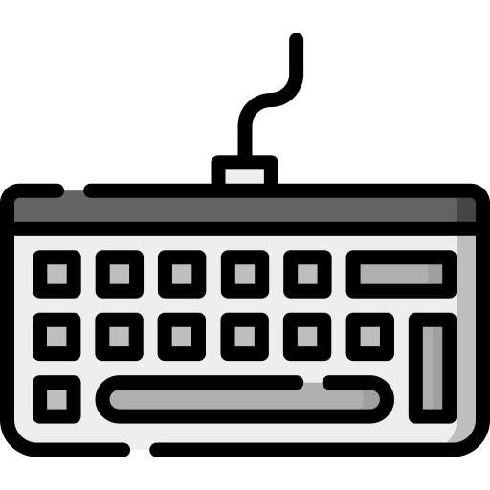
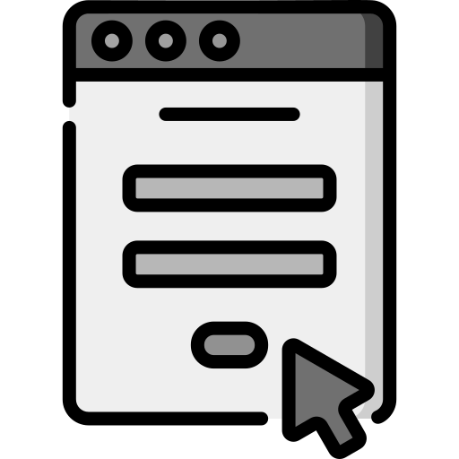
Three Main Types of Events
Mouse Events
Moving, Clicking, Scrolling
Keyboard Events
Pressing/Releasing Keys, Typing
#1
Form Events
Submitting, changing, focusing, validating
Don’t Worry!
We’ll only look at mouse events (#1) in full detail, since they’re very important.
#1
#2
#3
Notes:
Mouse icon: https://www.flaticon.com/free-icon/mouse-pad_6475193?term=computer+mouse&page=5&position=93&origin=search&related_id=6475193
Keyboard icon: https://www.flaticon.com/free-icon/input_5205407?term=keyboard&page=1&position=19&origin=search&related_id=5205407
Form icon: https://www.flaticon.com/free-icon/form_13330986?term=web+form&page=1&position=25&origin=search&related_id=13330986
Mouse icon (triad): https://www.flaticon.com/free-icon/mouse_1787045?term=mouse&page=1&position=25&origin=search&related_id=1787045
Form icon (triad): https://www.flaticon.com/free-icon/contact-form_1698579?term=form&page=1&position=62&origin=search&related_id=1698579
Keyboard icon (triad): https://www.flaticon.com/free-icon/keyboard_2824623?term=keyboard&page=1&position=10&origin=search&related_id=2824623

Slide 8

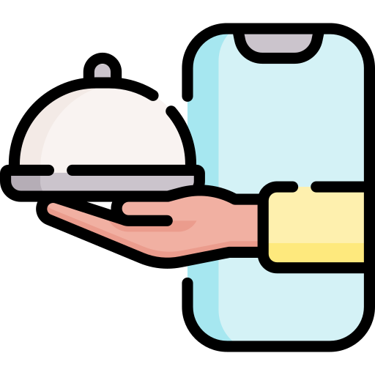
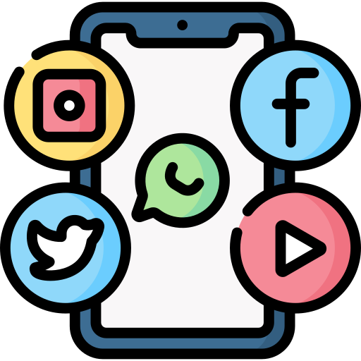

Mouse Events: Moving, Clicking, Scrolling
Hovering (mouseover): Over a video thumbnail → Preview plays
YouTube, for example, uses mouseover events to trigger previews of content
Clicking (click): Click order button → Pizza is delivered
If you’ve ordered food online, you can thank click events for that meal
Scrolling (mousewheel): Browsing social media → More posts load
Sites can run faster by tracking mousewheel, and loading only what is visible
Moving (mousemove): Web gaming → Character follows the cursor
Popular games like agar.io and slither.io wouldn’t work without mousemove
JavaScript recognizes specific event names:
'mouseover', 'click', 'mousewheel', 'mousemove'
Notes:
Clapperboard icon: https://www.flaticon.com/free-icon/video_1179069?term=video&related_id=1179069
Food delivery icon: https://www.flaticon.com/free-icon/food-delivery_5306589?term=online+food+delivery&related_id=5306589
Social media icon: https://www.flaticon.com/free-icon/social-media_4187336?term=social+media&page=1&position=9&origin=search&related_id=4187336
Online gaming icon: https://www.flaticon.com/free-icon/game_9423096?term=web+gaming&page=1&position=4&origin=search&related_id=9423096

Slide 9
Mouse Events: Example
1
2
3
4
5
6
7
8
9
10
11
12
13
14
15
// File: add-button-listeners.js
/* We'll explain this line in more detail later--
We're storing an HTML element in a variable. */
const button = document.getElementById('myButton');
// Make HTML <button> (ID `myButton`) listen for clicks
button.addEventListener('click', function() {
alert('Button was clicked!');
});
// Make HTML <button> (ID `myButton`) listen for hover
button.addEventListener('mouseover', function() {
button.style.backgroundColor = 'blue';
});
JavaScript
JavaScript to English translation:
“When the user’s mouse clicks or hovers, do something in response!”

Slide 10

Activity: Predict the Event
Look at each the provided scenarios below, and determine the correct JavaScript event types
User clicks on a menu item → ?
User types their email address → ?
User submits a contact form → ?
User presses the spacebar in a game → ?
Notes:
Visual Suggestion: Four scenario boxes with question marks
Box 1: Mouse cursor clicking on menu
Box 2: Keyboard with typing hands
Box 3: Form with submit button
Box 4: Spacebar key highlighted
Big "?" in each box initially

Slide 11


Predict the Event: Answers
The correct JavaScript event types are shown below. JS handles lots of user input types!
User clicks on a menu item → Mouse Event
User types their email address → Keyboard Event
User submits a contact form → Form Event
User presses the spacebar in a game → Keyboard Event
Notes:
Visual Suggestion: Four scenario boxes with question marks
Box 1: Mouse cursor clicking on menu
Box 2: Keyboard with typing hands
Box 3: Form with submit button
Box 4: Spacebar key highlighted
Big "?" in each box initially

Slide 12


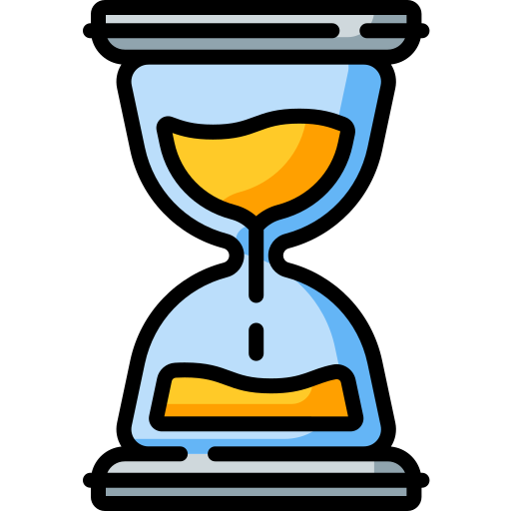
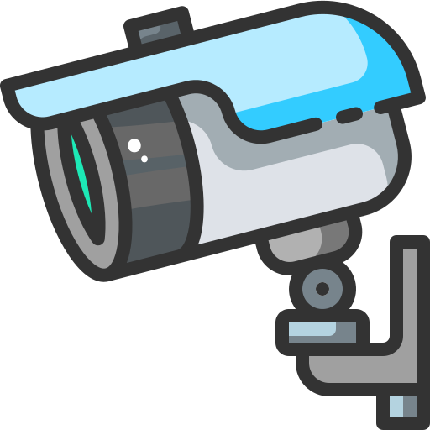
How Do Events Actually Work?
The JavaScript Event Listener Pattern
Highly important web programming concept
Add an event listener
Define what should happen
Wait for the event to occur
Conceptual Model for Event Listeners
Security camera that watches HTML elements
Notes:
JavaScript icon: <a href=“https://commons.wikimedia.org/wiki/File:JavaScript-logo.png”>JavaScript Icon 1</a>
Ear icon: <a href=“https://www.flaticon.com/free-icon/ear_754500?term=ear&page=1&position=4&origin=search&related_id=754500”>Ear</a>
Define icon: https://www.flaticon.com/free-icon/result_2554324?term=define&related_id=2554324
Wait icon: https://www.flaticon.com/free-icon/wait_1686925?term=wait&page=1&position=10&origin=search&related_id=1686925
Security Camera: https://www.flaticon.com/free-icon/cctv-camera_2642651?term=security+camera&page=1&position=4&origin=search&related_id=2642651

Slide 13

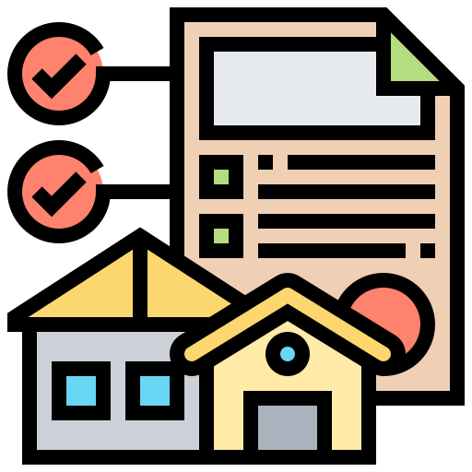

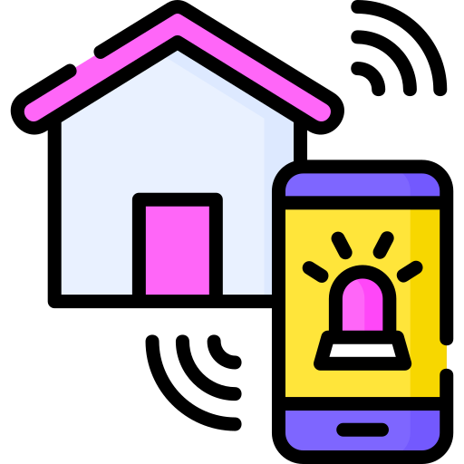
The Security Camera Analogy
Imagine, just for a moment, that certain events in JavaScript represent trespassers, who we want to catch. Bear with me.
If events are trespassers, your webpage represents all properties you own, and each (HTML element) is vulnerable.
If you want to keep track of trespassers on a certain property, you can set up security cameras (event listeners).
With security cameras in place on a property, you are now notified by the alarm system when trespassers enter!
Notice that we specifically said, "certain events". This is an important distinction!
Your security system can exclusively trigger for people you don’t trust, and similarly, event listeners can exclusively target specific types of events and ignore others.
Notes:
No entry icon: https://www.flaticon.com/free-icon/no-entry_1970683?term=no+entry&page=1&position=33&origin=search&related_id=1970683
Property icon: https://www.flaticon.com/free-icon/property_2243783?term=property+management&page=1&position=8&origin=search&related_id=2243783
CCTV icon: https://www.flaticon.com/free-icon/cctv-camera_2642651?term=security+camera&page=1&position=4&origin=search&related_id=2642651
Alarm icon: https://www.flaticon.com/free-icon/alarm_2668372?term=alarm+system&page=1&position=15&origin=search&related_id=2668372

Slide 14
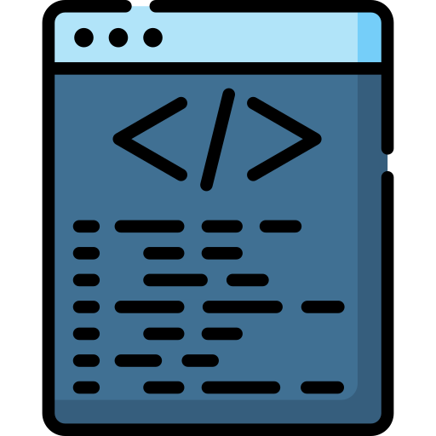
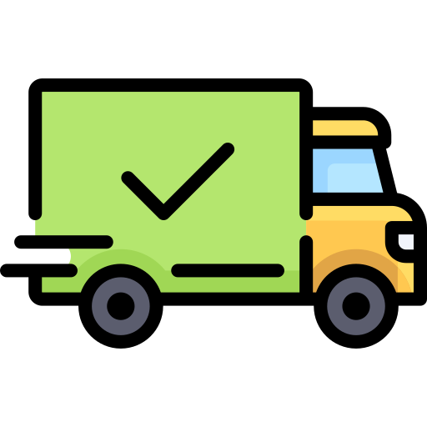
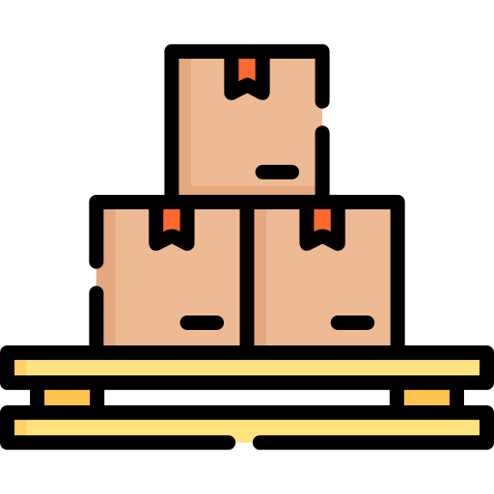
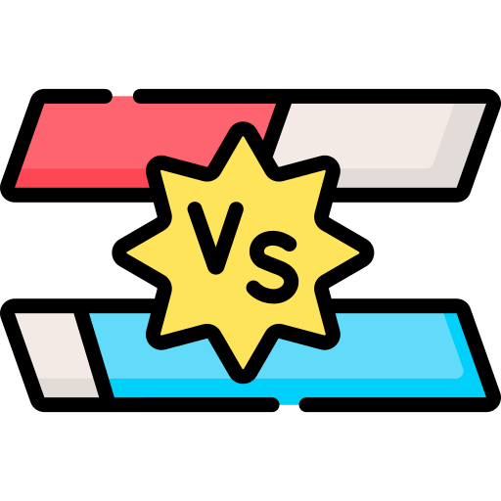
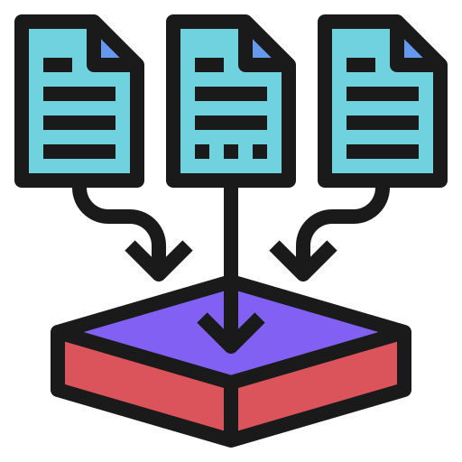
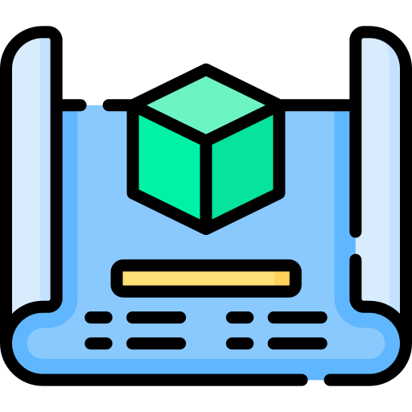
Event Attributes: Cargo
Event Attributes: Events in JavaScript have data. Often, an event’s attributes (data) are required to accomplish a task.
An event is also like a delivery truck. You can look at the truck’s company logo (event type) and get an idea of what cargo it might be carrying, but you won’t know for sure unless you open the back and look.
An event’s attributes are the truck’s cargo; it’s what you take, store, and use after the delivery arrives.
Truck: Truck arrives → Open cargo bay → Remove cargo → Put in warehouse → Use
Event: Listener detects event → Access attribute → Store in a variable → Use
How to Access: Use the dot operator (.) on an event object, followed by the name of the attribute you want to access!
General form:
event.someAttribute
Notes:
Metadata icon: https://www.flaticon.com/free-icon/coding_4861932?term=metadata&related_id=4861932
Shipped icon: https://www.flaticon.com/free-icon/shipped_411712?term=cargo&related_id=411712
Delivery box icon: https://www.flaticon.com/free-icon/delivery-box_4047412?term=cargo&page=1&position=47&origin=search&related_id=4047412
Versus icon: https://www.flaticon.com/free-icon/versus_9276248?term=versus&page=1&position=70&origin=search&related_id=9276248
Data collection icon: https://www.flaticon.com/free-icon/data-collection_2103581?term=data&page=1&position=54&origin=search&related_id=2103581
Blueprint icon: https://www.flaticon.com/free-icon/blueprint_12019650?term=blueprint&page=3&position=20&origin=search&related_id=12019650

Slide 15
The click Event
click
The most fundamental mouse interaction – triggered when a user presses and releases a mouse button on an element
1
2
3
4
5
6
7
8
9
10
// function to be executed upon detection of 'click' event
function handleClick(event) {
console.log("Clicked at: " + event.clientX + ", " + event.clientY);
console.log("Button pressed: " + event.button);
console.log("Element clicked: " + event.target.tagName);
}
element.addEventListener('click', handleClick);
JavaScript
clientX/clientY
X/Y-coordinate of mouse pointer (two separate attributes)
button
Which mouse button was pressed (0=left, 1=middle, 2=right)
target
The HTML object subjected to triggering event
timeStamp
Precise time when the event was detected
currentTarget
Element that the event listener is attached to

Slide 16
The dblclick Event
dblclick
Triggered when a user quickly clicks the same element twice in a row – good for actions like opening files
JavaScript
1
2
3
4
5
6
7
8
9
10
// function to be executed upon detection of 'dblclick'
function handleDoubleClick(event) {
console.log("Double-clicked at: " + event.clientX + ", " + event.clientY);
console.log("Time of event: " + event.timeStamp);
console.log("Target element: " + event.target.id);
}
element.addEventListener('dblclick', handleDoubleClick);
clientX/clientY
X/Y-coordinate of mouse pointer (two separate attributes)
button
Which mouse button was pressed (0=left, 1=middle, 2=right)
target
The HTML object subjected to triggering event
timeStamp
Precise time when the event was detected
currentTarget
Element that the event listener is attached to

Slide 17
The mousedown Event
mousedown
Fired when any mouse button is pressed down – this is the first part of what becomes a click event
1
2
3
4
5
6
7
8
9
10
// function to be executed upon detection of 'mousedown'
function handleMouseDown(event) {
console.log("Mouse pressed at: " + event.clientX + ", " + event.clientY);
console.log("Button held: " + event.button);
console.log("Starting interaction...");
}
element.addEventListener('mousedown', handleMouseDown);
JavaScript
clientX/clientY
X/Y-coordinate of mouse pointer (two separate attributes)
button
Which mouse button was pressed (0=left, 1=middle, 2=right)
target
The HTML object subjected to triggering event
timeStamp
Precise time when the event was detected
currentTarget
Element that the event listener is attached to

Slide 18
The mouseup Event
mouseup
Fired when any mouse button is released - completes the click sequence that began with mousedown
1
2
3
4
5
6
7
8
9
10
// function to be executed upon detection of 'mouseup'
function handleMouseUp(event) {
console.log("Mouse released at: " + event.clientX + ", " + event.clientY);
console.log("Button released: " + event.button);
console.log("Interaction complete!");
}
element.addEventListener('mouseup', handleMouseUp);
JavaScript
clientX/clientY
X/Y-coordinate of mouse pointer (two separate attributes)
button
Which mouse button was pressed (0=left, 1=middle, 2=right)
target
The HTML object subjected to triggering event
timeStamp
Precise time when the event was detected
currentTarget
Element that the event listener is attached to

Slide 19
The mouseover Event
Event Bubbling
A core JavaScript behavior, characterized by events ‘bubbling’ up to parent elements. If you click on a button inside a <div>, the <button> gets the `click` event, and then the <div>
gets the `click` event.
mouseover
Triggered when the mouse pointer enters an element - includes entering from child elements due to event bubbling
1
2
3
4
5
6
7
8
9
10
// function to be executed upon detection of 'mouseover'
function handleMouseOver(event) {
console.log("Mouse entered: " + event.target.tagName);
console.log("Came from: " + event.relatedTarget?.tagName);
console.log("Position: " + event.clientX + ", " + event.clientY);
}
element.addEventListener('mouseover', handleMouseOver);
JavaScript
clientX/clientY
X/Y-coordinate of mouse pointer (two separate attributes)
target
The HTML object subjected to triggering event
relatedTarget
The element the mouse came from (null if from outside page)
timeStamp
Precise time when the event was detected
currentTarget
Element that the event listener is attached to

Slide 20
The mouseout Event
Event Bubbling
A core JavaScript behavior, characterized by events ‘bubbling’ up to parent elements. If you click on a button inside a <div>, the <button> gets the `click` event, and then the <div>
gets the `click` event.
mouseout
Triggered when the mouse pointer leaves an element - includes leaving to child elements due to event bubbling
1
2
3
4
5
6
7
8
9
10
// function to be executed upon detection of 'mouseout'
function handleMouseOut(event) {
console.log("Mouse left: " + event.target.tagName);
console.log("Going to: " + event.relatedTarget?.tagName);
console.log("Exit position: " + event.clientX + ", " + event.clientY);
}
element.addEventListener('mouseout', handleMouseOut);
JavaScript
clientX/clientY
X/Y-coordinate of mouse pointer (two separate attributes)
target
The HTML object subjected to triggering event
relatedTarget
The element the mouse came from (null if from outside page)
timeStamp
Precise time when the event was detected
currentTarget
Element that the event listener is attached to

Slide 21
Sneak Peek: Content Next Class
Learning Files
js_events/
├── js_event_practice.html
├── css/
│ └── styles.css
└── js/
└── event_ex_script.js
We’ll learn
1
The remaining seven mouse event types
2
How to use event attributes to enhance features on your webpages
3
Listening for multiple events on one HTML element
js_events.zip
4
More about event bubbling and propagation
0
Download the learning files, and check out the interactive event playground
learn
Notes:
Visual Suggestion: Security camera setup illustration
Camera icon pointing at door/HTML element
Motion detection waves
Alarm bell icon
Connect with dotted lines showing the "watching" relationship
Use teal background with orange accents

Slide 22
Welcome Back! Last Time…
Mouse Events
Moving, Clicking, Scrolling
Keyboard Events
Pressing/Releasing Keys, Typing
#1
Form Events
Submitting, changing, focusing, validating
Today, we’ll get our hands dirty
More coding examples, activities. We’ll put those mouse events to use!
</>
#2
#3
Notes:
Visual Suggestion: Three circles from slide 7
Same layout as slide 7
Add "checkmark" badges to show mastery
Simple "Today" arrow pointing to new content area

Slide 23
The mouseenter Event
mouseenter
Triggered when the mouse pointer enters an element - does NOT bubble, making it cleaner for precise hover effects
1
2
3
4
5
6
7
8
9
10
// function to be executed upon detection of 'mouseenter'
function handleMouseEnter(event) {
console.log("Mouse entered: " + event.target.tagName);
console.log("Clean entry at: " + event.clientX + ", " + event.clientY);
console.log("No bubbling interference!");
}
element.addEventListener('mouseenter', handleMouseEnter);
JavaScript
clientX/clientY
X and Y coordinates where mouse entered the element
target
The element the mouse pointer entered
currentTarget
Element that the event listener is attached to
timeStamp
When the mouse entry was detected
relatedTarget
The element the mouse came from (null if from outside page)

Slide 24
The mouseleave Event
mouseleave
Triggered when the mouse pointer leaves an element - does NOT bubble, providing clean exit detection for hover effects
1
2
3
4
5
6
7
8
9
10
// function to be executed upon detection of 'mouseleave'
function handleMouseLeave(event) {
console.log("Mouse left: " + event.target.tagName);
console.log("Clean exit at: " + event.clientX + ", " + event.clientY);
console.log("No bubbling to worry about!");
}
element.addEventListener('mouseleave', handleMouseLeave);
JavaScript
clientX/clientY
X and Y coordinates where mouse exited the element
target
The element the mouse pointer left
currentTarget
Element that the event listener is attached to
timeStamp
When the mouse exit was detected
relatedTarget
The element the mouse is moving to (null if leaving page)

Slide 25
The mousemove Event
mousemove
Fired continuously while the mouse moves within an element - perfect for tracking cursor position and creating following effects
1
2
3
4
5
6
7
8
9
10
// function to be executed upon detection of 'mousemove'
function handleMouseMove(event) {
console.log("Position: " + event.clientX + ", " + event.clientY);
console.log("Movement: " + event.movementX + ", " + event.movementY);
console.log("Target: " + event.target.tagName);
}
element.addEventListener('mousemove', handleMouseMove);
JavaScript
clientX/clientY
Current X and Y coordinates of the mouse pointer
target
The element the mouse is currently over
currentTarget
Element that the event listener is attached to
timeStamp
When this specific movement was detected
movementX/movementY
Distance moved since the last mousemove event

Slide 26
The contextmenu Event
event.preventDefault()
In JavaScript, some events also are accompanied by behaviors that affect the appearance or conduct of the web browser itself.
`contextmenu` usually opens a browser dialog. You can prevent this with a listener that does event.preventDefault()
contextmenu
Triggered when the user attempts to open a context menu, typically by right-clicking - often prevented to create custom menus
1
2
3
4
5
6
7
8
9
10
// function to be executed upon detection of 'contextmenu'
function handleContextMenu(event) {
event.preventDefault(); // Stop default menu
console.log("Context menu at: " + event.clientX + ", " + event.clientY);
console.log("Button used: " + event.button);
showCustomMenu(event.clientX, event.clientY);
}
element.addEventListener('contextmenu', handleContextMenu);
JavaScript
clientX/clientY
X and Y coordinates where context menu was triggered
target
The element that received the context menu request
currentTarget
Element that the event listener is attached to
timeStamp
When the context menu trigger was detected
button
Which mouse button triggered the context menu (usually 2 for right-click)

Slide 27
The mousewheel Event
mousewheel
Fired when the user scrolls with the mouse wheel - essential for custom scrolling and zooming behaviors. Obsolete.
1
2
3
4
5
6
7
8
9
10
// function to be executed upon detection of 'mousewheel'
function handleMouseWheel(event) {
console.log("Wheel delta Y: " + event.deltaY);
console.log("Wheel delta X: " + event.deltaX);
console.log("Scroll at: " + event.clientX + ", " + event.clientY);
}
element.addEventListener('mousewheel', handleMouseWheel);
JavaScript
clientX/clientY
X and Y coordinates where the wheel scroll occurred
target
The element being scrolled over
currentTarget
Element that the event listener is attached to
timeStamp
When the wheel scroll was detected
deltaY/deltaX
Scroll amount in vertical and horizontal directions

Slide 28
The DOMMouseScroll Event
DOMMouseScroll
Firefox's legacy mouse wheel event - still used for cross-browser compatibility in older web applications
1
2
3
4
5
6
7
8
9
10
// function to be executed upon detection of 'DOMMouseScroll'
function handleDOMMouseScroll(event) {
console.log("Scroll detail: " + event.detail);
console.log("Scroll axis: " + event.axis);
console.log("Legacy Firefox scroll detected!");
}
element.addEventListener('DOMMouseScroll', handleDOMMouseScroll);
JavaScript
clientX/clientY
X and Y coordinates where the wheel scroll occurred
target
The element being scrolled over
currentTarget
Element that the event listener is attached to
timeStamp
When the wheel scroll was detected
detail/axis
Firefox-specific scroll amount and direction information

Slide 29
The wheel Event
You should use `wheel` events for tracking mouse scrolling whenever possible, as they are the modern standard outlined by W3C.
`mousewheel` and `DOMMouseScroll` only exist to preserve old browsers and web apps.
wheel
The modern W3C standard for mouse wheel scrolling - replaces browser-specific mousewheel and DOMMouseScroll with consistent cross-browser behavior
1
2
3
4
5
6
7
8
9
10
// function to be executed upon detection of 'wheel'
function handleWheel(event) {
console.log("Delta Y: " + event.deltaY);
console.log("Delta X: " + event.deltaX);
console.log("Delta Z: " + event.deltaZ);
console.log("Scroll at: " + event.clientX + ", " + event.clientY);
}
element.addEventListener('wheel', handleWheel);
JavaScript
clientX/clientY
X and Y coordinates where the wheel scroll occurred
target
The element being scrolled over
currentTarget
Element that the event listener is attached to
timeStamp
When the wheel scroll was detected
deltaY/deltaX/deltaZ
Standardized scroll amounts in all three dimensions

Slide 30
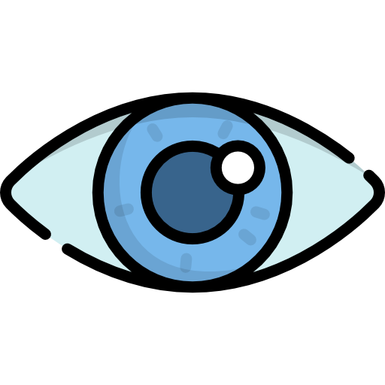
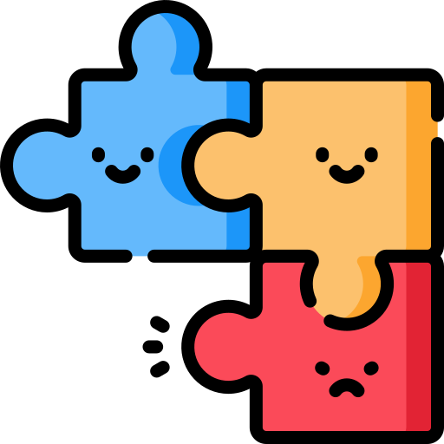

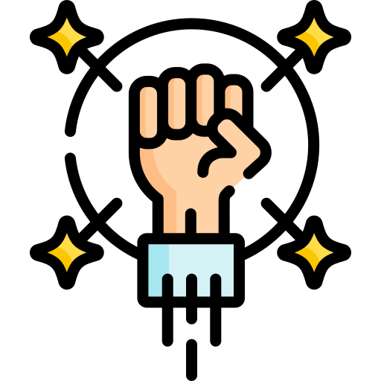
Event Combinations In Action
There are many useful applications of the thirteen event listeners we just looked at.
However, we must mention that the prior examples haven’t established a key idea:
Event listeners are seldom used in isolation; realistically, a single element often has many.
The true power of event handling is best demonstrated when an element has multiple listeners working together on a common task.
The GIF on the right depicts an example of five event listeners being used on a single object. The color picker wouldn’t work without the data from all five events, obtained through accessing their attributes. How cool!
Notes:
Eye icon: https://www.flaticon.com/free-icon/eye_822102?term=eyes&page=1&position=23&origin=search&related_id=822102
Puzzle icon: https://www.flaticon.com/free-icon/puzzle_11628381?term=missing&page=1&position=61&origin=search&related_id=11628381
Meeting icon: https://www.flaticon.com/free-icon/meeting_7185645?term=many&page=1&position=28&origin=search&related_id=7185645
Strength icon: https://www.flaticon.com/free-icon/fight-spirit_2163338?term=strength&page=1&position=7&origin=search&related_id=2163338

Slide 31
Building Interactive Elements
1
2
3
4
5
6
7
8
9
10
11
12
13
14
15
16
17
18
19
20
21
22
23
24
25
26
27
28
29
30
31
32
33
34
35
// the listeners configured on the canvas last slide
function setupEventListeners() {
canvas = document.getElementById('colorCanvas'); // Get the canvas element
canvas.addEventListener('mousedown', function(e) {
isMouseDown = true; // assume this global variable has already been created
updateSelectedColor(e);
});
canvas.addEventListener('mousemove', function(e) {
if (isMouseDown) {
updateSelectedColor(e);
}
});
canvas.addEventListener('mouseup', function() {
isMouseDown = false;
});
canvas.addEventListener('mouseleave', function() {
isMouseDown = false;
});
canvas.addEventListener('wheel', function(e) {
e.preventDefault(); // when inside canvas, prevent actual scrolling
const delta = e.deltaY > 0 ? -0.05 : 0.05;
selectedColor.a = Math.max(0, Math.min(1, selectedColor.a + delta));
renderColorSpace();
updatePageColors();
});
}
JavaScript
This might seem complicated at first. Don’t worry, we’ll break this function down and explain the key details.
This is the first event listener, which handles mousedown events on the canvas element.
Note: This function assumes a few things already exist, like variables and other functions.
This is something we’ll learn more about in the coming lectures.
Why: Needed for IMMEDIATE updates to the color selection, as soon as the button is pressed.
This is the second event listener, which handles mousemove events on the canvas element.
For now: Just focus on understanding the concept. `.addEventListener(…)` can’t be used without an HTML element to target, which must be fetched.
Why: Works in conjunction with the last listener. This is what allows continuous updates in response to any movement of the mouse cursor.
This is the third event listener, which handles mouseup events on the canvas element.
Why: This listener allows the picker to stop updating the selection when the mouse button is released.
This is the fourth event listener, which handles mouseleave events on the canvas element.
This is the fifth event listener, which handles wheel events on the canvas element.
Why: Ceases updates when the cursor leaves the canvas, ensuring consistent behavior.
Why: By tracking wheel movement, we can give users control of the transparency as well! True RGBa.

Slide 32
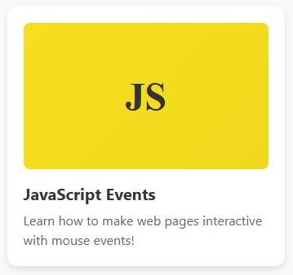
Cards: Interactive Logic Activity
Goal: Add 3 listeners to the card ('mouseenter', 'mouseleave', 'click'). Each should log when their event happens. Assume that you can refer to the <div> using a JavaScript variable called `card`.
1
2
3
4
5
6
7
8
9
10
11
12
13
<!--
Assume that styles.css exists and styles the
elements found below with id and class selectors
-->
<div class="card">
<div id="js-logo">
JS
</div>
<h3 class="card-title">JavaScript Events</h3>
<p class="card-description">
Learn how to make web pages interactive with mouse events!
</p>
</div>
HTML
// Card Event Logic - Solution
card.addEventListener('mouseenter', function() {
console.log("Card highlighted, user is interested!");
});
card.addEventListener('mouseleave', function() {
console.log("Card normal, user moved away");
});
card.addEventListener('click', function() {
console.log("Card clicked, show more info!");
});
1
2
3
4
5
6
7
8
9
10
11
12
13
JavaScript
Here’s an example of how the card might look, with styling applied:
Discussion Questions
What order do you think these events fire in?
What if someone clicks without hovering first?
Could we add more interactive visuals?
If so, which events would we want to listen for?

Slide 33
Problem-Solving with Events
Present common UI challenges (dropdown menus that close when you click outside, tooltips that appear on hover) and work through the event logic needed to solve them. Recommendation is tooltips, simple yet effective.

Slide 34
Event Best Practices
Cover performance considerations (like debouncing mousemove), accessibility concerns (necessity of independently learning to use keyboard event alternatives), and clean code practices (organizing event handlers).

Slide 35
Exercise - Interactive Navigation
Students build a navigation menu that responds to mouse events, reinforcing the idea that good web development involves creating dynamic, visually engaging elements

Slide 36
Preparing for the Final Project
Introduce the concept of reusable components. Explain how the button they're about to build can be saved and used in any future project, emphasizing the power of writing code once and using it everywhere.

Slide 37
Project Introduction: The Ultimate Button
Present the vision: a button component with hover effects, press animations, loading states, and customizable appearances. Show examples of how this one component could be styled for different purposes.

Slide 38
Planning the Button States
Break down the different visual states (default, hover, pressed, disabled, loading) and map them to specific mouse events. This teaches planning before coding.

Slide 39
Building the Foundation
Create the HTML structure and basic CSS. Students learn that good interactive elements start with solid, semantic markup.

Slide 40
Adding the Event Magic
Implement the mouse event handlers that bring the button to life. Focus on the smooth coordination between mouseenter, mouseleave, mousedown, and mouseup.

Slide 41
Polish and Customization
Add advanced features like ripple effects on click, customizable colors, and smooth transitions. This shows how professional touches make components feel premium.

Slide 42
Making It Reusable
Package the button into a reusable format they can easily copy into future projects. Discuss how to make components flexible and maintainable.

Slide 43
Showcase and Next Steps
Students show off their buttons and discuss how they might extend them. Preview what they could learn next (keyboard events, form events, frameworks) and encourage them to see this button as the beginning of building their own component library.

