Slide 1
The Anatomy of a PowerPoint File
1
2
3
4
5
6
7
8
9
10
11
12
13
14
15
16
17
18
19
<?xml version="1.0" encoding="UTF-8"?>
<p:sld xmlns:p="http://schemas.openxmlformats.org/...">
<p:cSld>
<p:spTree>
<p:sp>
<p:nvSpPr>
<p:cNvPr id="2" name="Title"/>
</p:nvSpPr>
<p:txBody>
<a:p>
<a:r>
<a:t>Hello, OOXML</a:t>
</a:r>
</a:p>
</p:txBody>
</p:sp>
</p:spTree>
</p:cSld>
</p:sld>
Office Open Extensible Markup Language
Dylan Connolly (connolly@cs.fsu.edu)

Slide 2
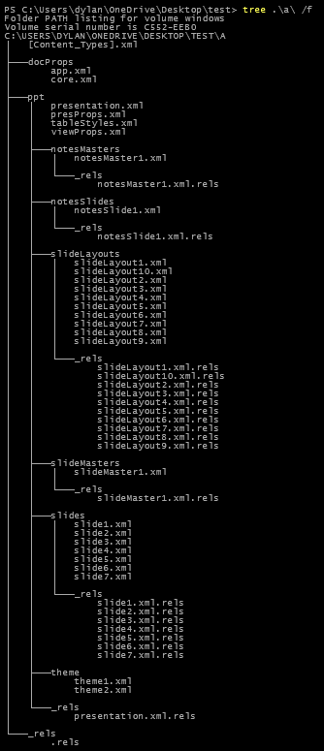
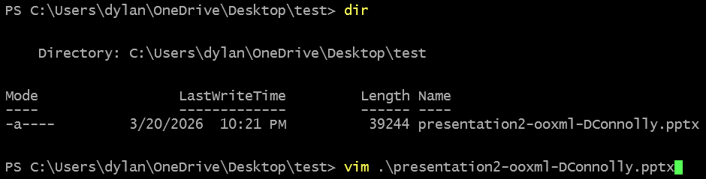
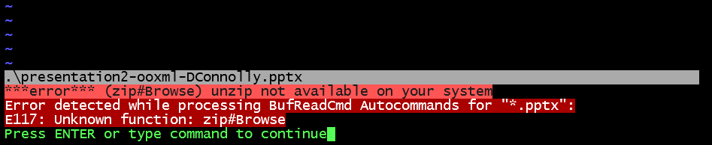
What's Inside?
Ever wondered what a `.pptx` file actually is?
Well, that didn't help very much.
It's secretly a zip file, which we can decompress
Files everywhere. Why?

Slide 3
Textual Data and XML
1
2
3
4
5
6
7
<?xml version="1.0" encoding="UTF-8" ?>
<root>
<cat coat="tuxedo">
<name>Felix</name>
<age>1</age>
</cat>
</root>
12
3
I have a tuxedo cat.
His name is Felix.
Felix is 1 year old.
.txt (Text File, 1961)
Simple, but unstructured
Great for humans, not great for software
.xml (eXtensible Markup Language, 1998)
Not simple, but highly structured
Great for software, not great for humans

Slide 4




Standardization of OOXML
.pptx, .docx, and .xlsx are all compressed folders containing XML and media files, governed by ISO/IEC 29500 and the Open Packaging Convention
Following publication of the standard in 2007, Microsoft deprecated their proprietary .ppt, .doc, and .xls binary formats
This opened the door for third-party developers to implement full Office document support without legal risk

Slide 5
The Folder Tree
[Content_Types].xml is the package manifest — it tells an application what type of file each part is, so it knows how to open and read them
The slideMasters/ directory contains XML files that define deck-wide defaults — background fills, color mappings, placeholder styles, and any shapes shared across all layouts that reference it
The slides/ directory contains a dedicated XML file for each slide in the deck
The slideLayouts/ directory is where all the theme’s layout XML files are stored, each describes document properties like placeholder geometry, and layout-specific fonts, spacing, and alignment
The _rels/ directory holds relationship files that map how parts reference each other — every slide, layout, and master has a .rels file declaring its links to images, charts, layouts, or masters
📁 presentation.pptx (root)
[Content_Types].xml
📁 ppt/
📁 _rels/
📁 slides/
📁 slideMasters/
📁 slideLayouts/
.rels
slide1.xml
slide2.xml ...
slideMaster1.xml
slideLayout1.xml
slideLayout2.xml
...

Slide 6
Relationships and Inheritance
slideLayout2.xml Inherits master defaults Overrides: as needed
slideMaster1.xml
Defines: fonts, colors,
base placeholder geometry
inherits
slide1.xml
Inherits layout defaults
Only stores geometry
or style if it differs
slideLayout1.xml Inherits master defaults Overrides: layout-specific placeholder positions
inherits
inherits

Slide 7

Why It Matters
Because it's just XML in a ZIP, the format is fully programmable!
Tools read, write, edit, and delete presentation elements in memory at the structural level
When saving, an application must build the folders, write the XML files, and perform ZIP compression on the root directory
Thanks to this clever engineering, OOXML document file formats take up their full space only when actively viewed

