Slide 1
HTML: Introduction to Lists, Links, Structure, Display

Slide 2
Lists in HTML
Lists
Ordered
Unordered
Description
<ol></ol>
<ul></ul>
<dl></dl>

Slide 3



<ul></ul>
Order of the items does not matter.
Example: shopping list
Code
1 <html>
2 <head>
3 </head>
4 <body>
5 <ul>milk
6 bananas
7 mangoes
8 cereals
9 </ul>
10 </body>
11 </html>
Output
Notes:
Shopping list<a href="https://www.flaticon.com/free-icons/shopping-list" title="shopping list icons">Shopping list icons created by surang - Flaticon</a>

Slide 4
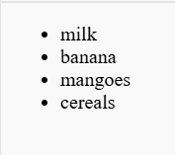
<li></li>
<li> refers to a list of items
Code
1 <!DOCTYPE html>
2 <head>
3 </head>
4 <body>
5 <ul>
6 <li>milk</li>
7 <li>banana</li>
8 <li>mangoes</li>
9 <li>cereals</li>
10 </ul>
11 </body>
12 </html>
Output
Notes:
Piyush: spell check mangoes. “cereals” – “bananas”?

Slide 5
<ol></ol>
Order of the items matters.
Example: directions or recipe
1 <!DOCTYPE html>
2 <html>
3 <body>
4 <ol>
5 <li>Download the application</li>
6 <li>Install it on your device</li>
7 <li>Follow the setup</li>
8 <li>Start your application</li>
9 </ol>
10
11 </body>
12 </html>
Output
Download the application
Install it on your device
Follow the setup
Start your application

Slide 6
<dl></dl>
<dl>
Items with description
Example: glossary, products with description
Syntax
<dl>
<dt> Description term </dt>
<dd>Description definition</dd>
</dl>

Slide 7
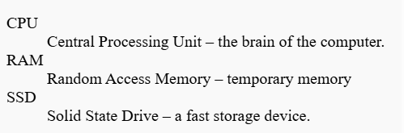
Execution
Code
Output
<dl>
<dt>CPU</dt>
<dd>Central Processing Unit – the brain of the computer.</dd>
<dt>RAM</dt>
<dd>Random Access Memory – temporary memory</dd>
<dt>SSD</dt>
<dd>Solid State Drive – a fast storage device.</dd>
</dl>

Slide 8
Attributes- type
Syntax : <ol type=value>
You can change the ordering symbols!
Possible Counting Symbols | <ol type=value>
Numbers | <ol type=“1”>
Lowercase letters | <ol type=“a”>
Uppercase letters | <ol type=“A”>
Lowercase Roman numerals | <ol type=“i”>
Uppercase Roman numerals | <ol type=“I”>
Notes:
<a href="https://www.flaticon.com/free-icons/novelty" title="novelty icons">Novelty icons created by bsd - Flaticon</a>
Piyush: Needs a table for formatting and beautification
Slide 9: same feedback as slide 7
Slide 10: same feedback as slide 7
Slide 12: same feedback as slide 7
Slide 13: same feedback as slide 7
Slide 14: slide 14 is a duplicate of slide 11
Slide 20: Doesnt have a title

Slide 9
Activity
Let’s try different types of ordered list numbering.
We’ll supply a different value attribute and observe the changes!
Possible Counting Symbols | <ol type=value>
Numbers | <ol type=“1”>
Lowercase letters | <ol type=“a”>
Uppercase letters | <ol type=“A”>
Lowercase Roman numerals | <ol type=“i”>
Uppercase Roman numerals | <ol type=“I”>
Notes:
<a href="https://www.flaticon.com/free-icons/novelty" title="novelty icons">Novelty icons created by bsd - Flaticon</a>

Slide 10

<img></img>
Displays images on the web page.
Syntax
<img src=“URL_of_the_image” alt=“descriptor”></img>
Attribute
src – source (address) of the webpage the image comes from
alt - alternate text for the image
Example Code
<img src=“https://cutecats.com/felix” alt=“Adorable cat”></img>
Notes:
Image icon is built into PowerPoint as a free stock resource

Slide 11




Hyperlink
Links one resource(document/media/text) to another resource.
Works like a doorbell.
The visible text of the link is like the button
The actual link itself, the URL, is like wiring for the doorbell button
Notes:
<a href="https://www.flaticon.com/free-icons/novelty" title="novelty icons">Novelty icons created by bsd - Flaticon</a>
Link Icon from free Microsoft stock icons built into powerpoint
Doorbell icon: https://www.flaticon.com/free-icon/doorbell_9216132?term=doorbell&page=1&position=4&origin=search&related_id=9216132
button icon: https://www.flaticon.com/free-icon/light-switch_890979?term=light+switch&page=1&position=10&origin=search&related_id=890979
Wire icon: https://www.flaticon.com/free-icon/wire_3355265?term=electrical+wires&page=1&position=51&origin=search&related_id=3355265

Slide 12



How to link?
Two different tags are used for this
Anchor tag: <a></a>
Link tag: <link></link>
Link and anchor are not the same! They cannot be used interchangeably.
Notes:
<a href="https://www.flaticon.com/free-icons/novelty" title="novelty icons">Novelty icons created by bsd - Flaticon</a>
Two icon: https://www.flaticon.com/free-icon/2_3570100?term=two&page=1&position=9&origin=search&related_id=3570100
Anchor icon: https://www.flaticon.com/free-icon/anchor_4287284?term=anchor&page=1&position=6&origin=search&related_id=4287284
Warning icon: https://www.flaticon.com/free-icon/warning_3756712?term=warning&page=1&position=8&origin=search&related_id=3756712

Slide 13
Anchor tag :<a></a>
Syntax
<a href=“ web address”>Visible text </a>
Attribute
href – hypertext reference
Meaning
Represents a clickable hyperlink between documents
Example
1 <html>
2 <head>
3 </head>
4 <body>
5 <ul>
6 <li>Free lawnmower <a href=“https://freemower.com”>here</a></li>
7 </ul>
8 </body>
9 </html>
Free lawnmower here
Notes:
<a href="https://www.flaticon.com/free-icons/novelty" title="novelty icons">Novelty icons created by bsd - Flaticon</a>

Slide 14

Link tag:<link />
Syntax
<link rel=“type of linked resource” href=“address”>Visible text />
Attribute
rel – The type of resource that is being linked
href – The hypertext that connects to the resource
An “empty” element reserved for the <head> section, that creates a relationship with a resource. Can do many things; an example is setting the webpage’s icon.
Meaning
Example
1 <html>
2 <head>
3 <title>Programming - CoderOgres</title>
4 <link rel=“icon” href=“images/circle.jpg” />
5 </head>
6 <body>
7 </body>
8 </html>
Notes:
<a href="https://www.flaticon.com/free-icons/novelty" title="novelty icons">Novelty icons created by bsd - Flaticon</a>

Slide 15
Content Display Types
Display Types
Block
Inline
Block-inline
Commonly used to group content together, like paragraphs, images, or other elements.
Often used for styling text, such as changing the color or font of a specific word.
Useful for creating layouts where you want elements to sit next to each other but still have control over their dimensions.
Notes:
<a href="https://www.flaticon.com/free-icons/novelty" title="novelty icons">Novelty icons created by bsd - Flaticon</a>

Slide 16
<div></div>
Generic Content Division HTML element
Block Type Container
Can contain-text, images, HTML elements
text
images
HTML elements
Notes:
<a href="https://www.flaticon.com/free-icons/novelty" title="novelty icons">Novelty icons created by bsd - Flaticon</a>
<a href="https://www.flaticon.com/free-icons/box" title="box icons">Box icons created by Freepik - Flaticon</a>

Slide 17
Activity
Let’s try to visit CoderOgres website using its QR code.
image link: https://i.postimg.cc/7YfPXF38/frame.jpg
Notes:
<!DOCTYPE html>
<html>
<head>
<title>Image Button Example</title>
</head>
<body>
<div>
<a href="https://www.coderogres.com">
<img src="https://i.postimg.cc/7YfPXF38/frame.jpg" alt="QR Code">
</a>
</div>
</body>
</html>

Slide 18
<span></span>
Display properties: Inline Type
Used for styling text
Notes:
<a href="https://www.flaticon.com/free-icons/novelty" title="novelty icons">Novelty icons created by bsd - Flaticon</a>
<a href="https://www.flaticon.com/free-icons/box" title="box icons">Box icons created by Freepik - Flaticon</a>

Slide 19
Activity
Text:
Alice went to the park with her friend Bob. They saw a squirrel near the Maple Tree and laughed together. Later, Alice and Bob bought ice cream from a vendor named Mr. Smith.
Task: Let's span all the names in the above text.
Notes:
Code:
<!DOCTYPE html>
<html>
<head>
<title>Span Tag Story</title>
</head>
<body>
<p>
<span>Alice</span> went to the park with her friend <span>Bob</span>.
They saw a squirrel near the <span>Maple Tree</span> and laughed together.
</p>
<p>
Later, <span>Alice</span> and <span>Bob</span> bought ice cream from a vendor named <span>Mr. Smith</span>.
</p>
<p>
<strong>Task:</strong> Try adding more `<span>` tags around other names, places, or objects in your own sentences.
</p>
</body>
</html>

Slide 20


Looks like navigation menu
Navigation menu
Notes:
<a href="https://www.flaticon.com/free-icons/novelty" title="novelty icons">Novelty icons created by bsd - Flaticon</a>

Slide 21
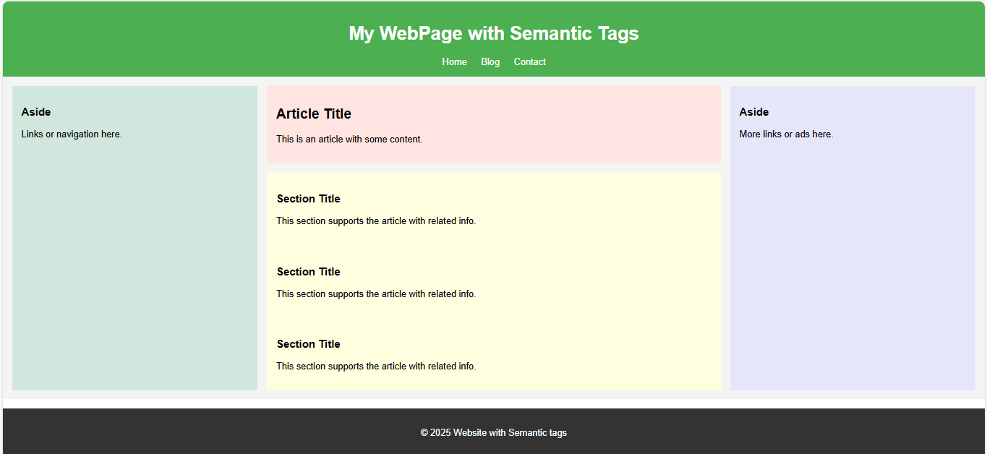
Structural HTML document
Notes:
<a href="https://www.flaticon.com/free-icons/novelty" title="novelty icons">Novelty icons created by bsd - Flaticon</a>

Slide 22
Structured HTML document
<header></header> - Used for introductory content(text/video)
Navigation Bar <nav></nav> Home About Us Product Contact
<main> represents main body of the web page
<aside>
Standalone Information
</aside>
<article>represents information about the web page</article>
<section>represents information supporting article content</section
<section>represents information supporting article content</section
</main>
Footer<footer></footer>
Notes:
<a href="https://www.flaticon.com/free-icons/novelty" title="novelty icons">Novelty icons created by bsd - Flaticon</a>

Slide 23
Why semantic tags?
Organized structure of the content
Accessibility
Browser friendly
Notes:
Organised structure of the content- Content structure is clearly understood as each semantic tag is self descriptive. Maintenance is less. SEO friendly . Lesser creation of classes and id’s
Accessibilty- Screen readers can communicate the data effectively to people with disabilities.
Browser friendly- As structure of the page is designed using standard HTML tags , web pages will be uniform in every browser.

Slide 24
Activity - My favorite pet/hobby
Catchy heading
Home Breeds My Pet
<main> represents main body of the web page
Fun Facts
Introduction
Supporting text
Supporting text
</main>
Footer<footer></footer>
Notes:
<a href="https://www.flaticon.com/free-icons/novelty" title="novelty icons">Novelty icons created by bsd - Flaticon</a>

