Slide 1
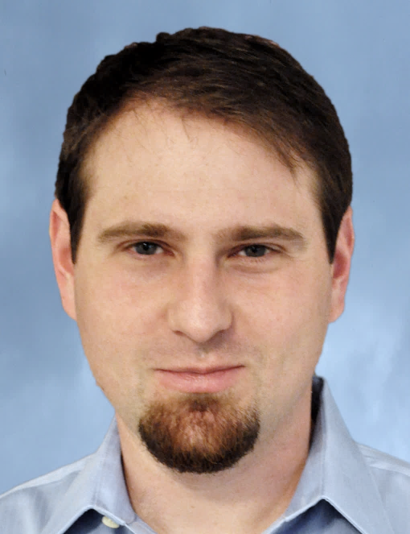
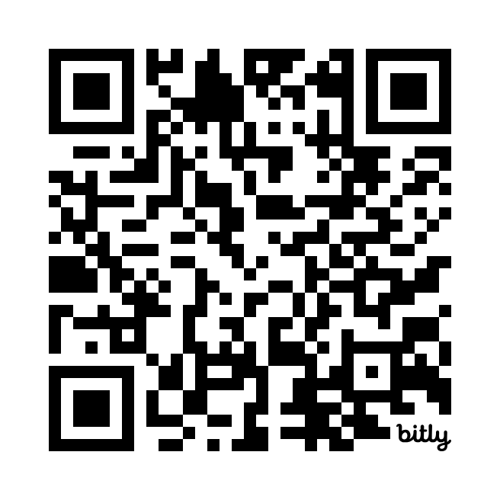
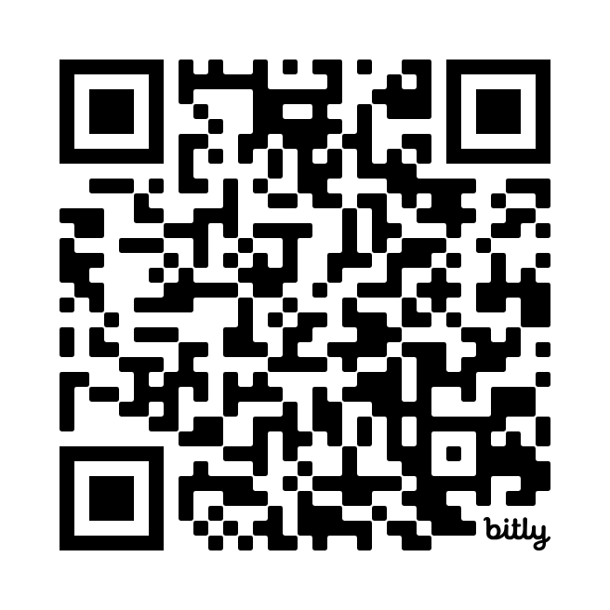
Research Interests
AI: Healthcare, Translation, Knowledge Platforms
Guns and Gun Violence: Sales, Diffusion, Media Coverage
Social Media: social Influence, information skew, misinfo
Networks and Diffusion: Contagion and how things spread
Randomized Experiments on Social Networks
Dylan Walker
Associate Professor of Management Science
dylan@chapman.edu
Office 307E
Google Scholar
dylantwalker.com

