Slide 1
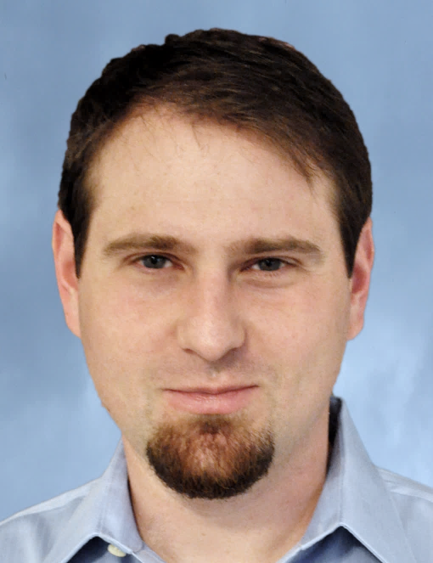
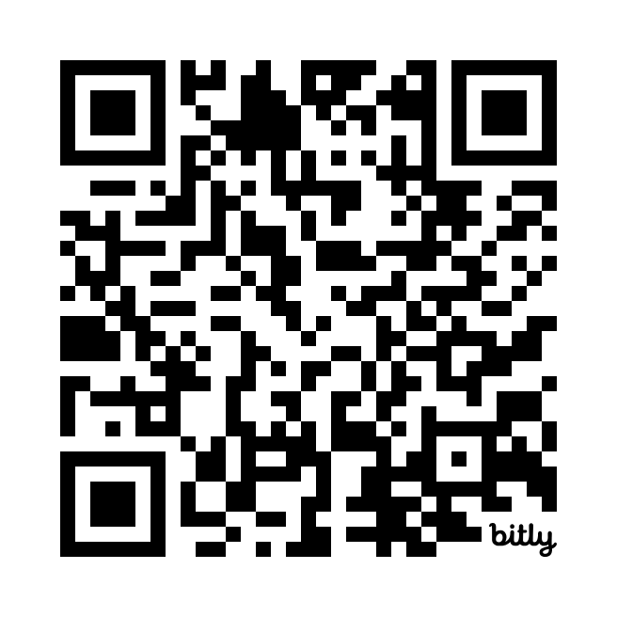
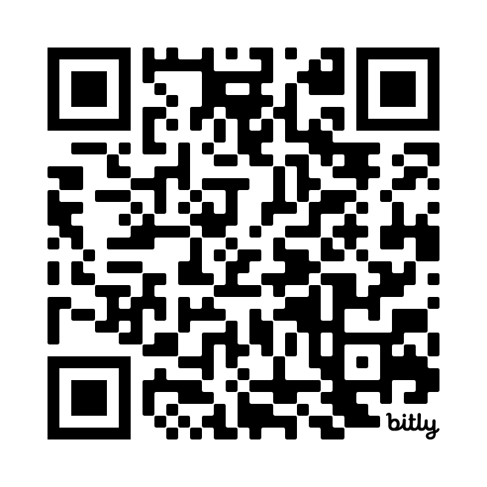
Research Interests
AI: Healthcare, Translation, Knowledge Platforms
Guns and Gun Violence: Sales, Diffusion, Media Coverage
Social Media: social Influence, information skew, misinfo
Networks and Diffusion: Contagion and how things spread
Randomized Experiments on Social Networks
Dylan Walker
Associate Professor of Management Science
dylan@chapman.edu
Office 307E
Google Scholar
dylantwalker.com

Slide 2
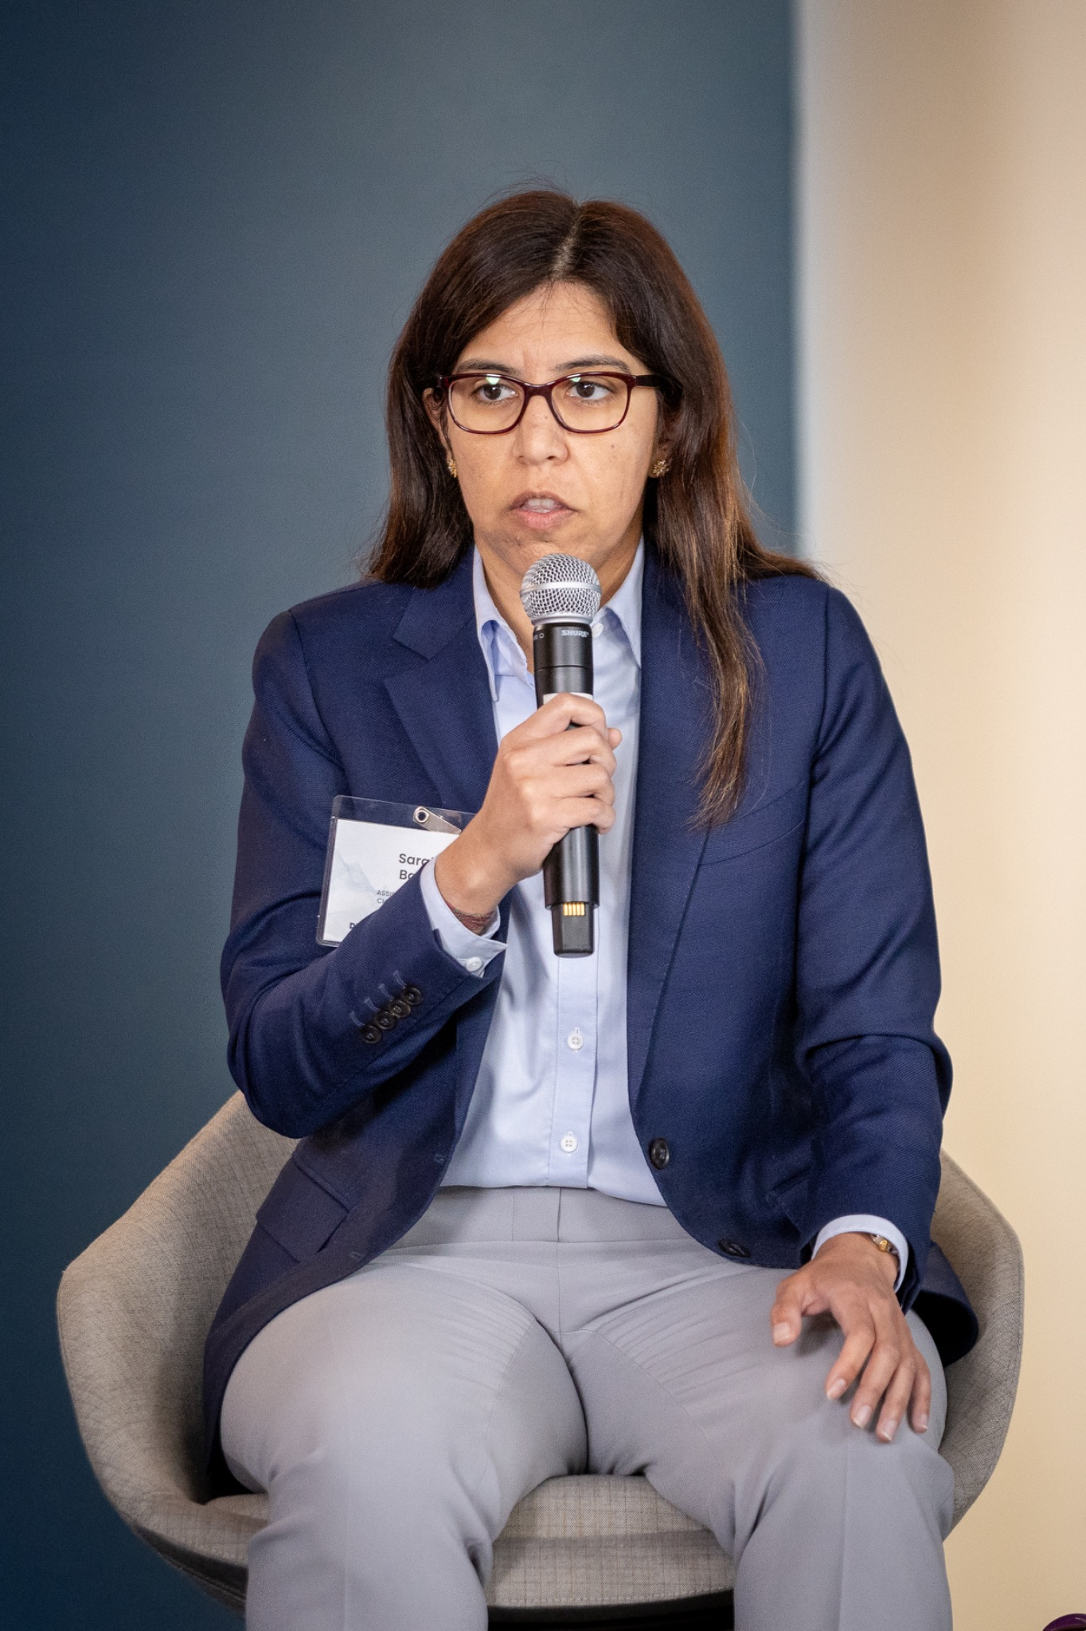
AI and Future of Work Researcher
Current research interests: algorithmic hiring, the effects of AI on the labor market
Publications in MIS Quarterly, Journal of Econometrics, Journal of Policy Analysis and Management, Sloan Management Review, NeurIPS
Presenting AI-Enabled Job Markets & Market Participation: Jobseekers' "Rational Expectations" About Competition vs "AI Aversion" at AI and the Future of Work at Wharton, SCECR, and NBER Digital Economics and Artificial Intelligence
Teaching MGSC 220: Foundations of Business Analytics
Ask me about how I am changing my Excel-based class to incorporate large language models (LLMs)
Sarah H. Bana
Assistant Professor of Management Science
bana@chapman.edu
Office: 307D

