Slide 1
SYNTHETIC BANKING DATA
SDV vs Differential Privacy
Which synthesizer for customer + transaction data — and why
Pipeline · 5 methods · fidelity / diagnostic / privacy · bootstrapped comparison

Slide 2
HOW IT WORKS
The pipeline
1 · Seed data
2,000 customers ~24k transactions rule-driven
2 · Synthesize
5 models SDV (4) + DP (1) + constraints
3 · Evaluate
fidelity · diagnostic privacy (bootstrapped)
4 · Use
LLM product recommender
• One rule-driven ground truth (income↔occupation, credit eligibility, age→channel) feeds every method.
• Constraints (SDV CAG) attach before fitting → valid output at generation, not patched afterward.
• Same seed + metadata for all 5 → only the synthesizer changes, so the comparison is clean.

Slide 3
WHAT WE COMPARE
Five synthesis methods
 | Synthesizer | Paradigm | What it does
M1 | HMA + Gaussian Copula | SDV | Models customer→txn FK jointly (multi-table)
M2 | CTGAN (per table) | SDV | GAN — sharp marginals & transaction timing
M3 | CTGAN + PAR | SDV | Adds a sequence model for transactions
M4 | TVAE (per table) | SDV | Variational autoencoder — smooth, correlated
M5 | SmartNoise MST | OpenDP (DP) | Noisy marginals → (ε≈6, δ) differential privacy
• M1–M4 (SDV) optimise statistical fidelity; M5 (SmartNoise) trades fidelity for a formal privacy guarantee.
• M1 is the only one that models the customer→transaction relationship directly (native referential integrity).

Slide 4
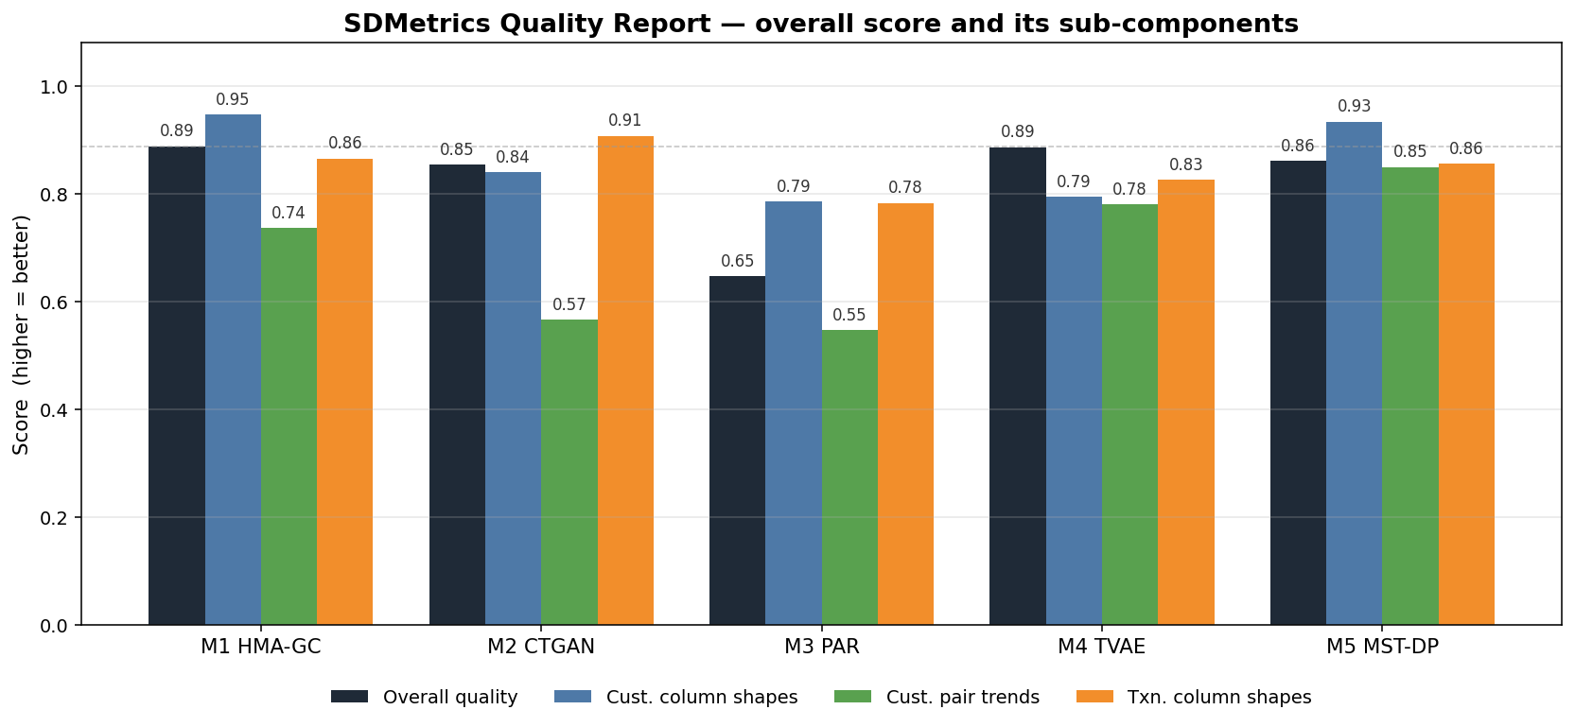
METRIC 1
Fidelity metrics — does it look like the real data?
Two components
• Column Shapes — each column's distribution (marginals). Scored by KSComplement (numeric) / TVComplement (categorical): 1.0 = identical.
• Column Pair Trends — relationships between columns (correlation / contingency similarity).
• Overall Quality = average of the two — the headline fidelity score.
SDMetrics QualityReport — overall fidelity decomposed into Column Shapes and Column Pair Trends, per method.

Slide 5
METRIC 2
Diagnostic metric — is it structurally valid?
• Diagnostic ≠ fidelity. It does not ask 'is it realistic?' — it asks 'is it well-formed?'
• Data validity — values stay within valid ranges and known categories (credit∈[300,850], real product ids).
• Data structure — primary keys unique, no missing required fields.
• Referential integrity — every transaction references a real customer AND a real product (no orphan foreign keys).
Diagnostic / referential integrity | M1 | M2 | M3 | M4 | M5
Score (1.0 = perfect) | 1.00 | 1.00 | 0.74 | 1.00 | 1.00
Only M3 (PAR) breaks integrity — it merges product_id/category and rejects the FixedCombinations constraint.

Slide 6
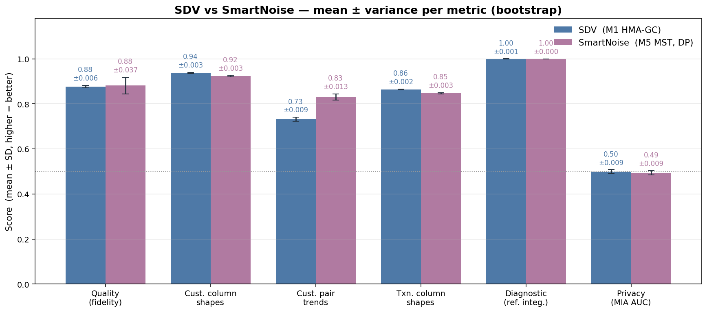
THE KEY RESULT
SDV vs SmartNoise — the comparison
Mean ± SD (bootstrap)
• Fidelity: means are close — SDV wins shapes, SmartNoise wins pair trends.
• Variance is the story: SmartNoise's DP noise gives ~6× the quality SD (±0.037 vs ±0.006).
• Diagnostic / referential integrity: both perfect (1.00).
• Privacy (MIA AUC): both ≈ 0.50 — no measurable membership leakage either way.
• Only real difference: M5 adds a formal (ε≈6, δ)-DP guarantee.
SDV = M1 (HMA-GC, recommended); SmartNoise = M5 (MST, DP). Error bars = ±1 SD over bootstrap resamples.

Slide 7
THE NUMBERS
Per-metric: mean ± variance
Metric (category) | SDV (M1) | SmartNoise (M5) | Read
Quality — fidelity | 0.88 ± 0.006 | 0.88 ± 0.037 | tie mean · SDV 6× stabler
Cust. column shapes — fidelity | 0.94 ± 0.003 | 0.92 ± 0.003 | SDV
Cust. pair trends — fidelity | 0.73 ± 0.009 | 0.83 ± 0.014 | SmartNoise
Txn. column shapes — fidelity | 0.86 ± 0.002 | 0.85 ± 0.003 | SDV
Diagnostic — ref. integrity | 1.00 ± 0.001 | 1.00 ± 0.000 | tie (perfect)
Privacy — MIA AUC (↓) | 0.50 ± 0.009 | 0.49 ± 0.009 | tie (no leakage)
Formal DP guarantee | ✗ | ✓ ε ≈ 6 | SmartNoise
Mean ± SD over the bootstrap (fidelity/diagnostic B=200; privacy B=300). Lower MIA AUC = more private; 0.5 = none.

Slide 8
CONCLUSION
Verdict: use SDV for this data
• Equal-or-better mean fidelity — SDV (M1) wins column shapes & txn shapes, ties on quality, loses only pair trends.
• Far more stable — DP noise gives SmartNoise ~6× the quality variance; SDV is reproducible run-to-run.
• Native referential integrity — HMA models the customer→transaction FK, so every row is structurally valid (1.00).
• Keeps structure DP drops — cross-table (income→product) and transaction timing survive; M5's sequence signal collapses.
• Privacy is empirically equal here — at n=2,000 no method leaks membership (MIA AUC ≈ 0.50, ε = 0).
• So the DP guarantee buys nothing measurable for this data type/scale — and costs fidelity + stability.
Choose SmartNoise (DP) only when: data is small / high-dimensional, records are outlier-heavy, or a worst-case ε guarantee is a hard requirement.

