Slide 1




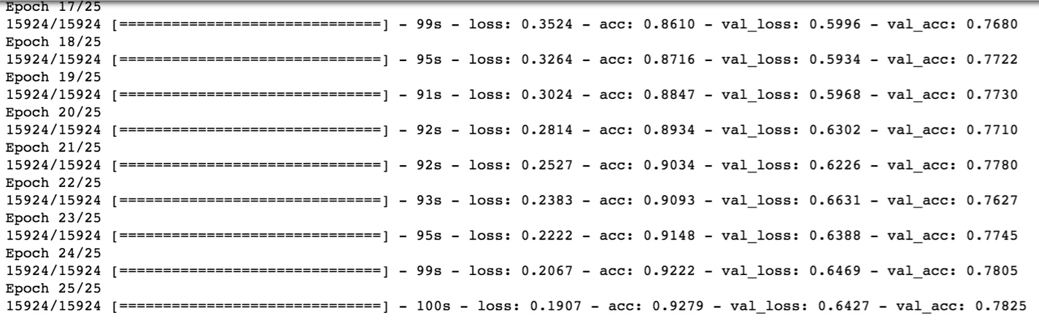

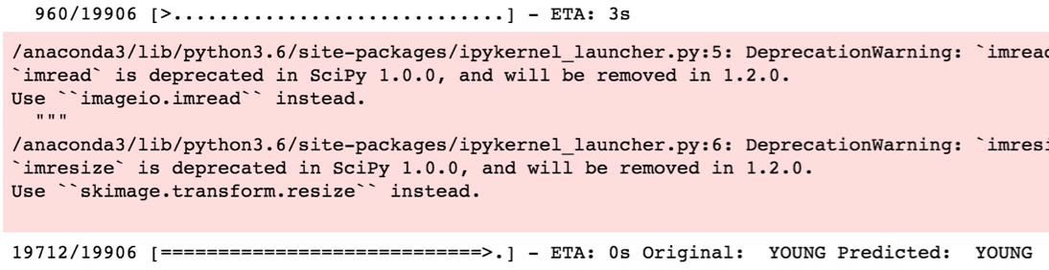
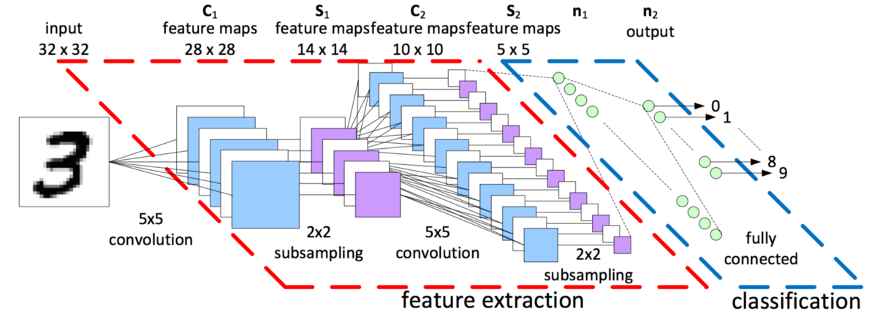
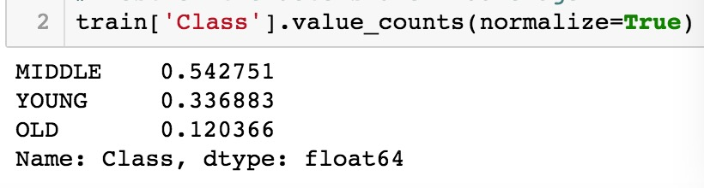

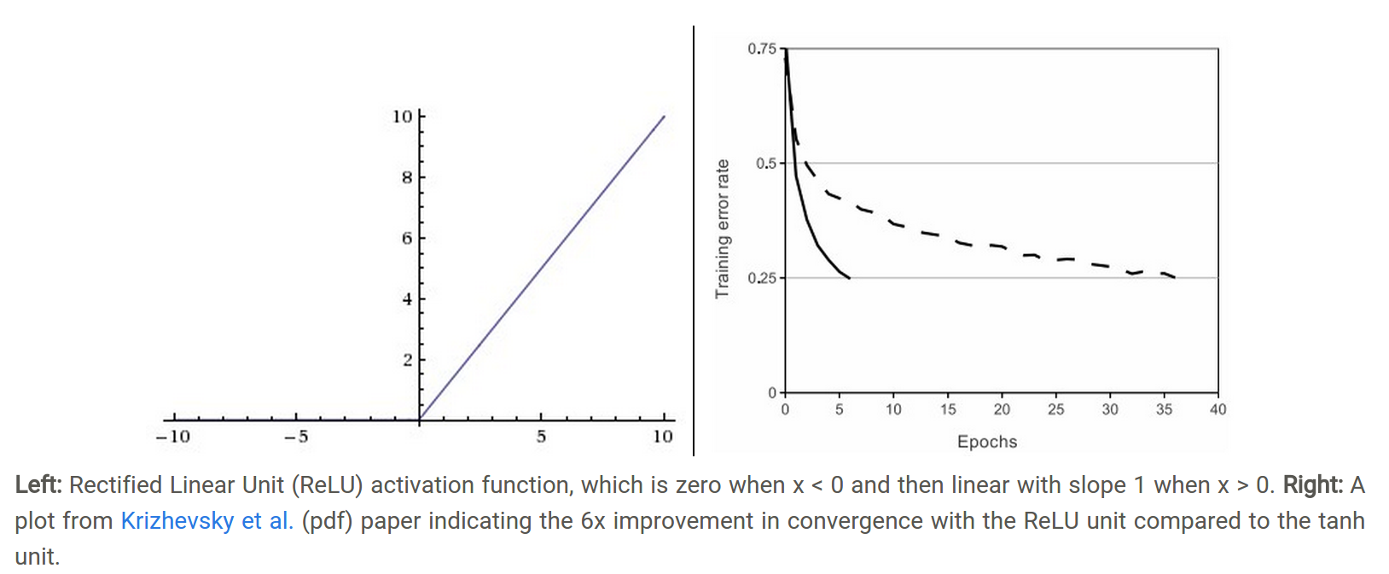
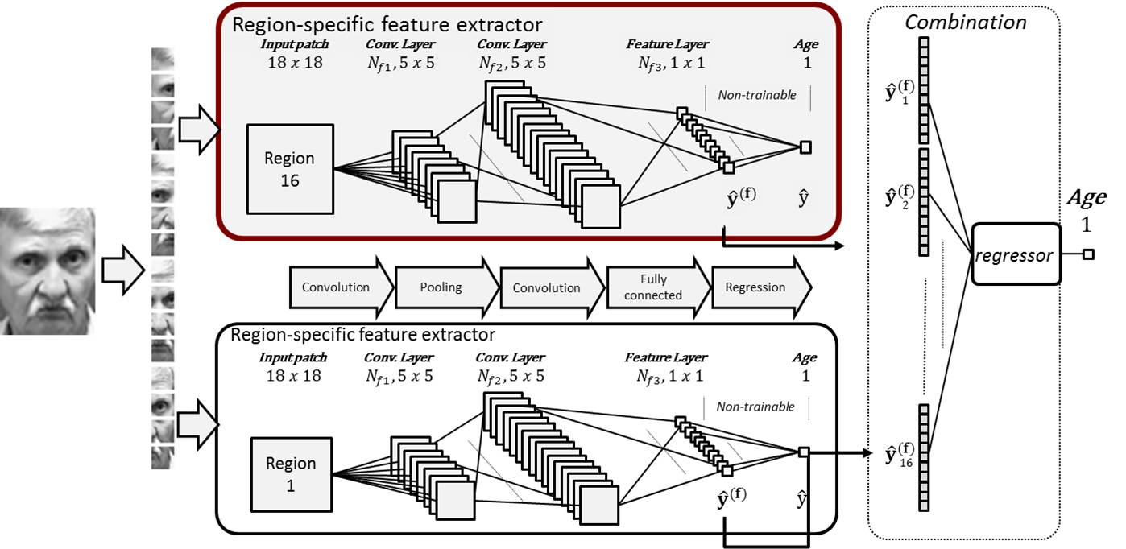
Age Detection in Facial Recognition Junxin Xia, Hantao Ren, Hao Cheng
Business Intelligence & Analytics
Introduction: Problem
Nowadays, information security is becoming more and more important than ever. Identity recognition has already permeated into every aspect of daily life. Among many kinds of biometric methods, facial recognition system is a technology capable of identifying or verifying a person from a digital image or a video frame from a video source.
The most important advantage of face is that it can be captured at a distance and in a covert manner.
Deep learning with convolutional neural network relies on the image pixels as the features, rather than extracting them manually. The main advantage of CNN compared to its predecessors is that it automatically detects the important features without any human supervision.
Results & Evaluation：
Model | Accuracy
Classical Neural Network | 62%
CNN | 78.25%
Data Understanding
Data source: we have downloaded the facial expression dataset from Kaggle. The dataset contains about 50,000 facial mages.
Data description: the facial images were classified into three categories---the young, middle-age and elderly people. Through the facial recognition, it can tell which category the image belongs to.
Predicted：Young
CNN Results：
Classical Neural Network Result：
Modeling：
CNN-Convolutional Neural Network：
Relu as activation function:
Facial Recognition Modeling (Age Detection):
Dataset and Data Preprocessing：
Conclusion
We have used 8 hidden layers in CNN to achieve 78% accuracy in 3 labels prediction: young, middle and old.
The model apply to real world in age detection or related facial recognition.
Deployment
We could achieve more accurate in our models.

