Slide 1
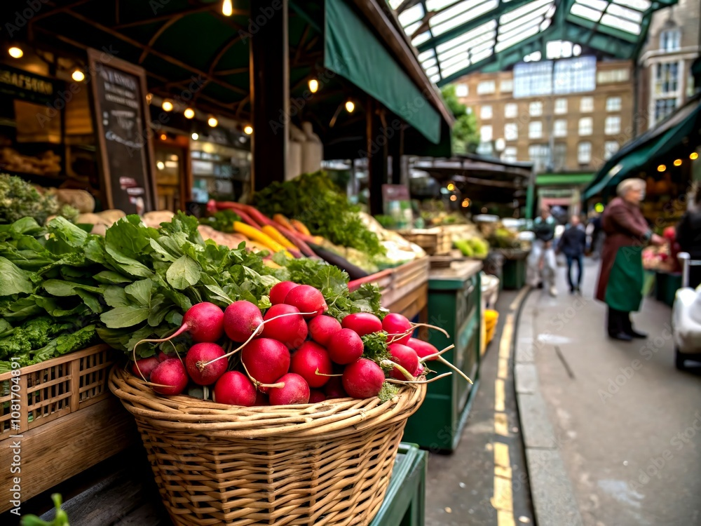




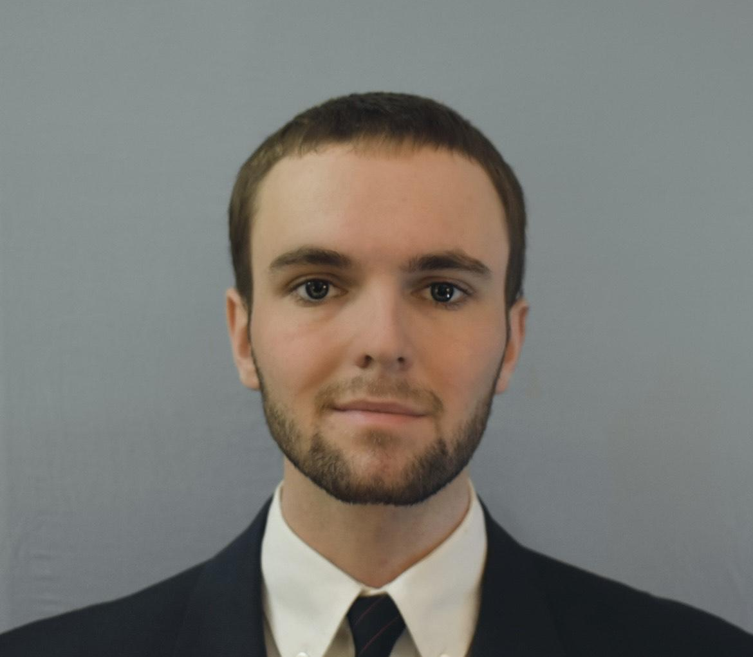
Fruitful Network Development
Decentralized AgTech: Your Data, Your Network, Your Community
· Computer Engineering & Mathematics
· Motivated by Community
Founder & Creator
Dylan Montgomery

Slide 2


The System Isn’t Built for Small Agriculture
Industrial Farming
Barriers For People To Help
Lack Of Options
Fruitful Network Development
THE PROBLEM

Slide 3
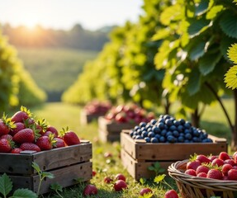

The People Behind the Problem
Fruitful Network Development
CUSTOMER SEGMENT
Local HUBs: Disconnected & Under-Resourced
Juggling many suppliers & tools manually
Customer segments
Community Service Agriculture (CSA)
Delivers SSL to subscribers.
Farmers’ Markets
Payed vendor fees to sell at
SSL Grocery Stores
Only source from SSL producer
Buyers demand is real—but the systems fail them

Slide 4
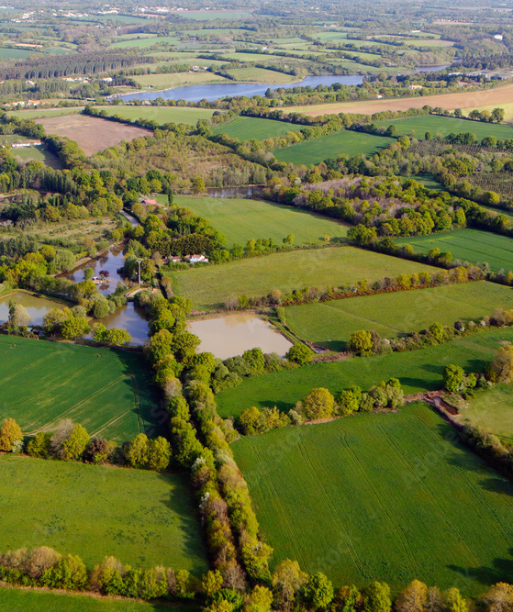
A Future Where Local Agriculture Competes at Scale
Local businesses with big-league logistics
Modular, open tools—zero subscriptions
A future where digital ecosystems belong to everyone
Fruitful Network Development
VISION

Slide 5
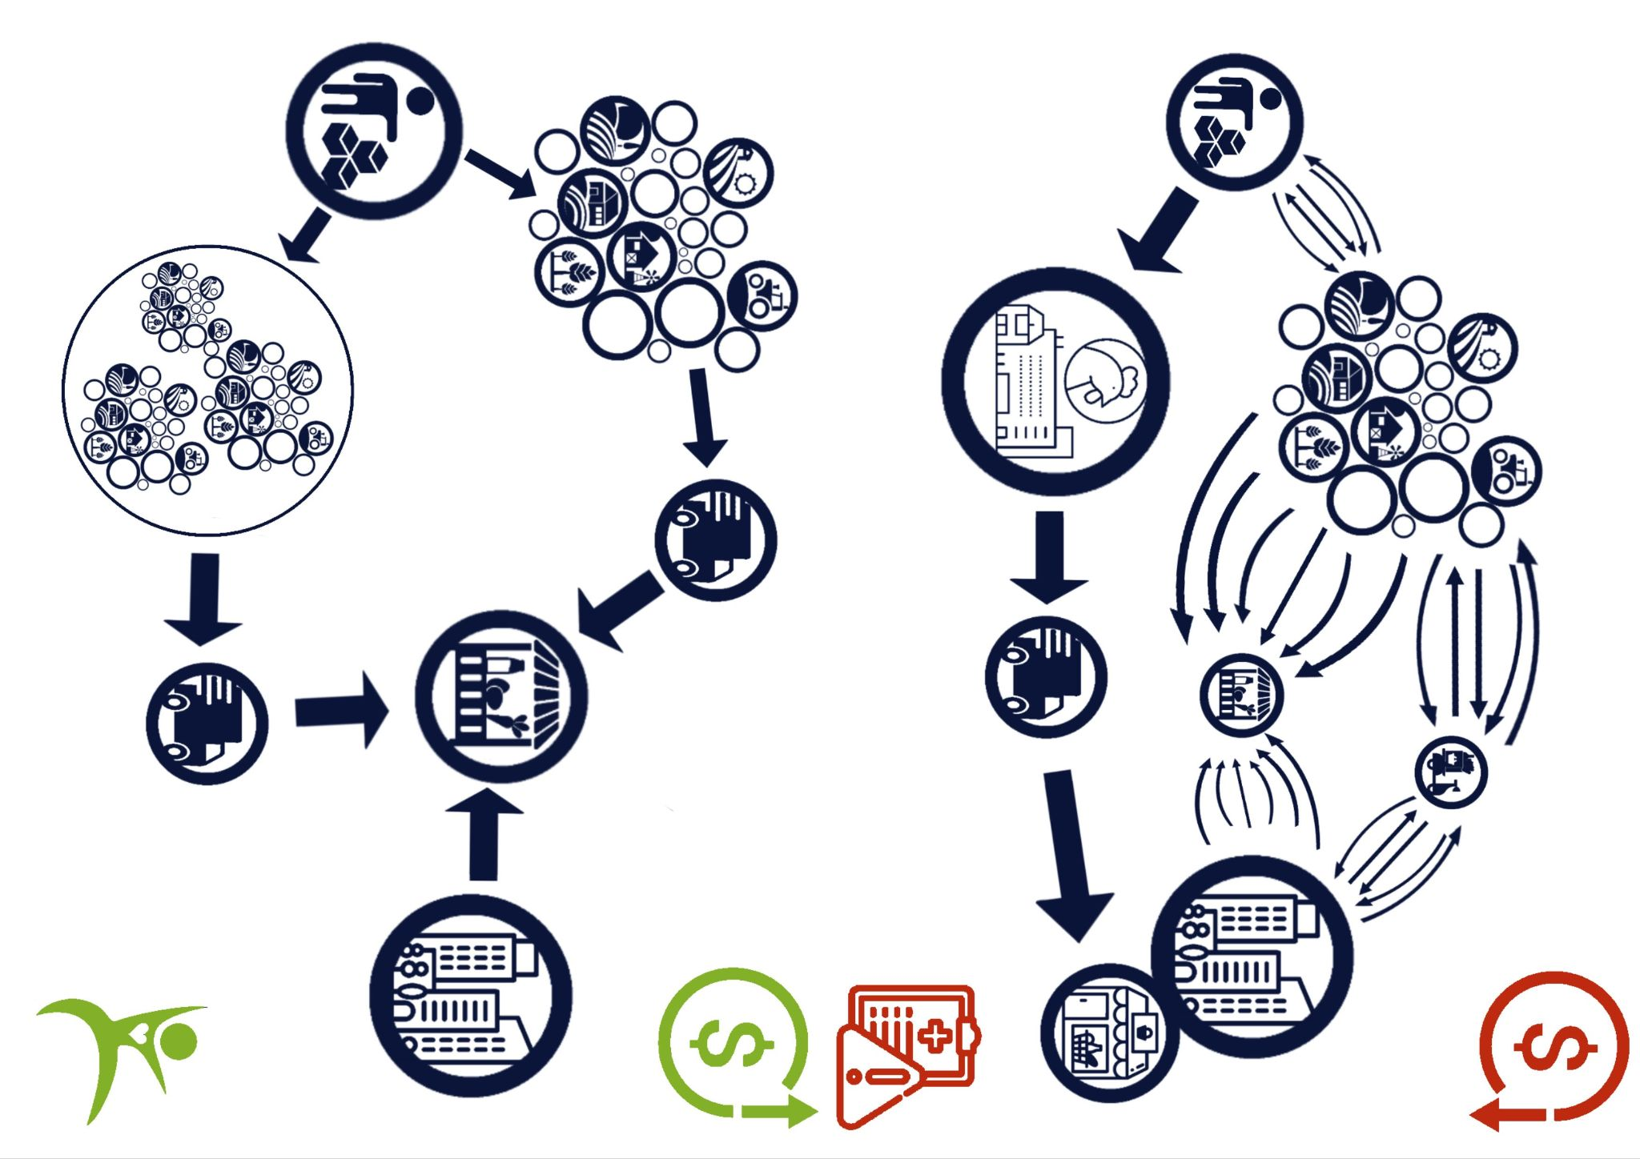
FDN’s Framework: Built for Hubs, Powered by Connection
Organize Internally
Websites, Shipping, POS, or Inventory;
Then connect externally
Open-source:
You own it
We tailor it
No lock-in
Fruitful Network Development
SOLUTION
Before
After

Slide 6
Decentralized Tools That Drive Local Efficiency
Fruitful Network Development
VALUE PROPOSITION
01
02
03
04
TOOLS
INSIGHTS
NETWORK
Adapt
Use Simple Tools To Automate & Integrate
Inventory
Supply
Orders
Delivery
Schedules
Reports
Or Design for a team
Get Predictive Insights on
Waste
Margins
Trends
Or Plan with past data.
Connect
Bureaus
Unions
Foundations
Suppliers
Business
Consumers
React to sudden changes in the business landscape with chain protocol.
Enables growth later. Add functionality like bar codes.

Slide 7
2.8 M
A $70 Billion Gap in Local Agricultural Efficiency
& A Disruptive Model
7.4 B
80 M
Fruitful Network Development
SOM: Given a developmental period, FDN could serve a market of NE Ohio Counties
MARKET
TAM: Total US market annually has ~70 Billion in losses.
10% share of recoup
SAM: 2-5 years to serve Ohio’s market
800 Million lossed)

Slide 8
The Only Open, Subscription Free, Scalable, Tailored Option
Fruitful Network Development
MARKET COMPETITION
Subscription free
Tailored
3rrd party Integratable
Inventory POS management
Delivery management
Team Sweet
Website integration
FDN’s Mycite
_✔_
_✔_
_✔_
_✔_
_✔_
_✔_
_✔_
Delivery Biz Pro
_🗴_
_✔_
_🗴_
_✔_
_✔_
_🗴_
_🗴_
Shopify
_🗴_
_🗴_
_🗴_
_✔_
_🗴_
_🗴_
_✔_
Laprendo
_✔_
_🗴_
_🗴_
_🗴_
_🗴_
_🗴_
_✔_

Slide 9
Ready to Launch With the Right Backing
Fruitful Network Development
ROADMAP
Legal Setup + Operating Agreement
First Client Pilots + USDA Grant Validation
2 Year goals:
Pilot Client Deployment
USDA Pilot Study
Farmers Bureau & local Gov. Partnership
Team Onboarding + Developer Contracts
In-House Hosting + EBT Integrations
County Farm Bureau Storage/ Distribution
Centers

Slide 10
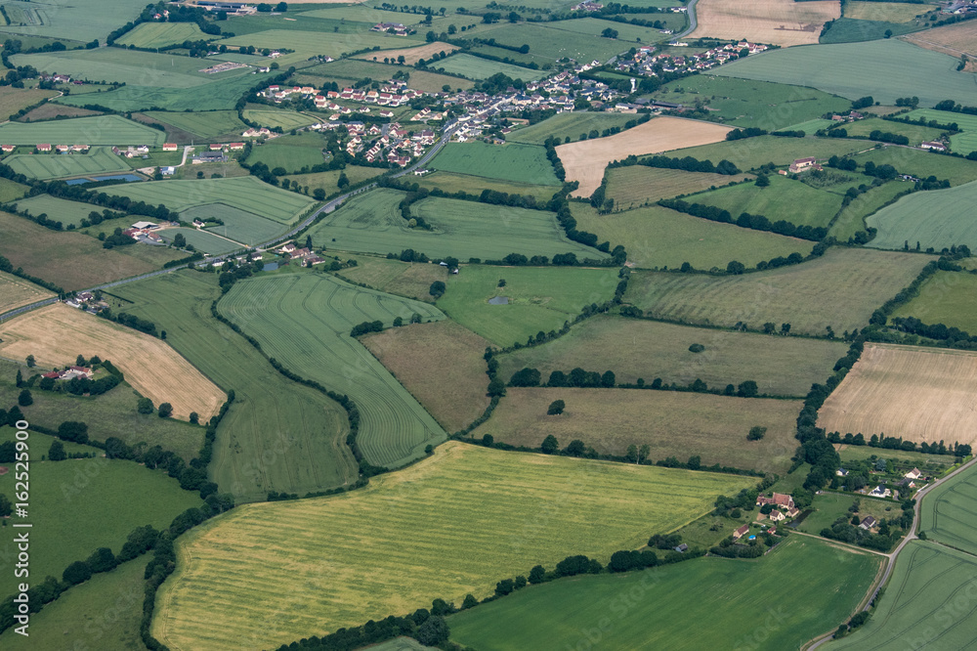
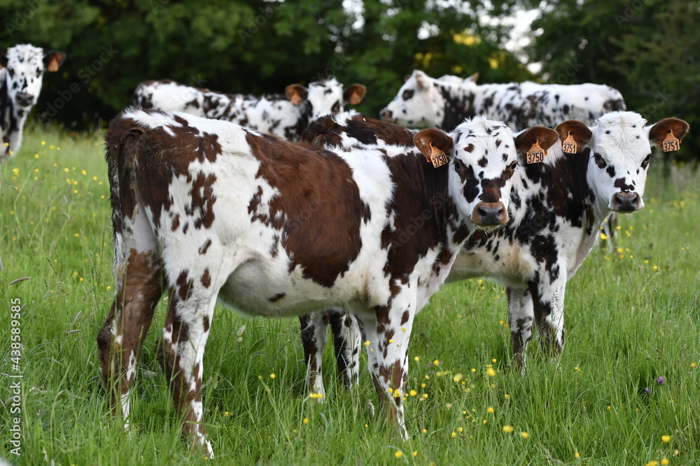
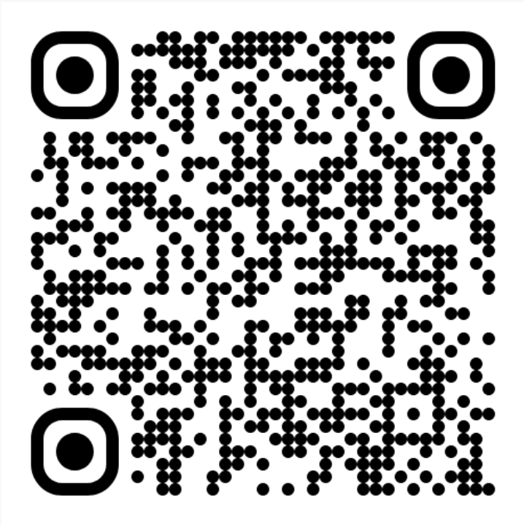
Let’s get MOO-ving to build something local, scalable, and ours.
Collaboration over Centralization
Fruitful Network Development
NEXT STEPS
Contact: Dylan Montgomery to learn more at
dylancarsonmontgomery@gmail.com
Or learn more here:

