Slide 1


Xcode Career Service
关注 Xcode 即可获得热腾腾的高频题解析视频、面试技巧及准备tips、北美IT就业咨询等干货
一对一实习或工作信息咨询服务
一对一面试能力评定 + 修改简历
一对一Mock interview强化训练服务

Slide 2
想进 xcode 的刷题群，请加老师微信 singerdmx， 他会拉你进群

Slide 3
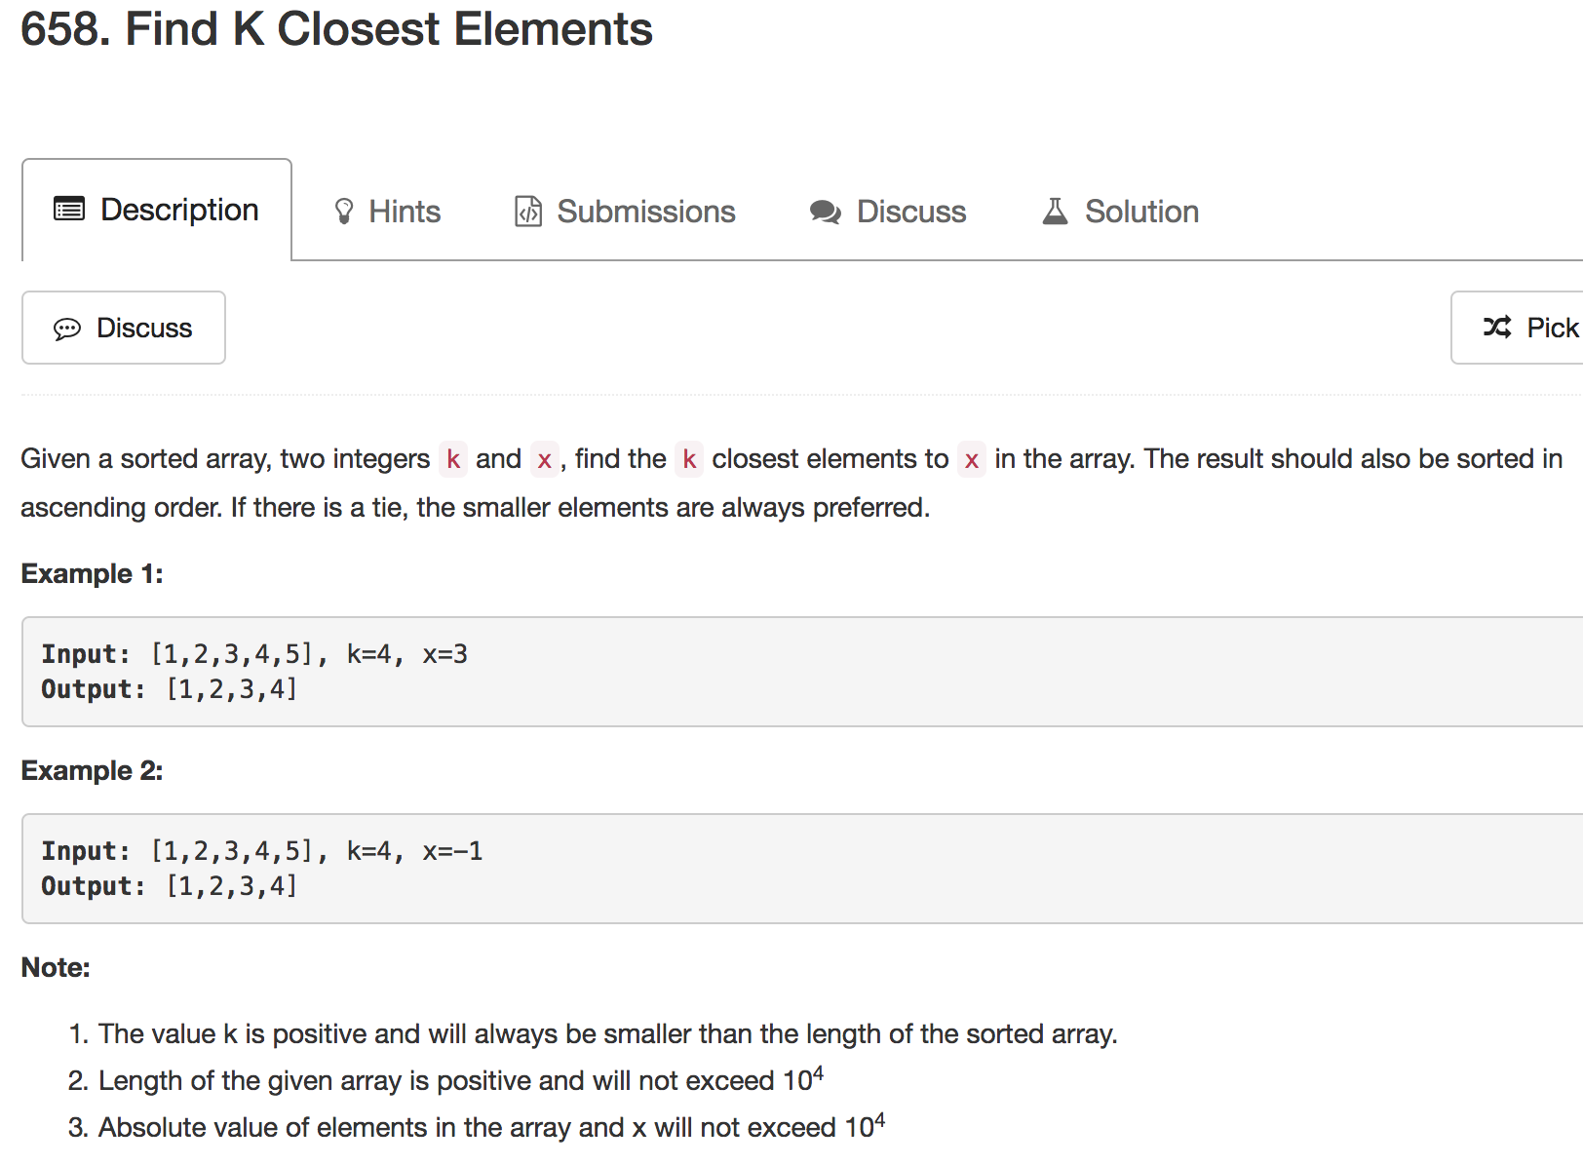
Mock

Slide 4
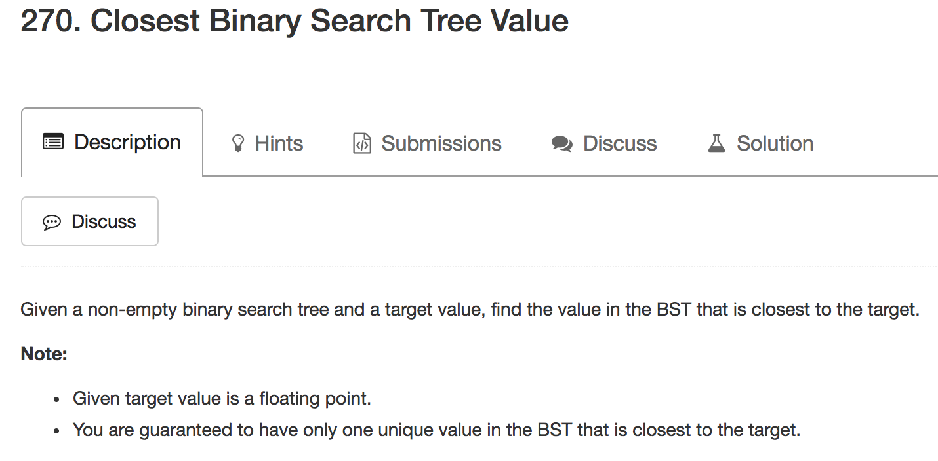

Slide 5
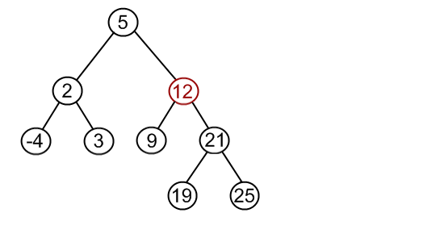
Target: 8
Diff: 8 - 5 = 3
Min diff: 3

Slide 6
Target: 8
Diff: 12 - 8 = 4
Min diff: 3

Slide 7
Target: 8
Diff: 9 – 8 = 1
Min diff: 1

Slide 8
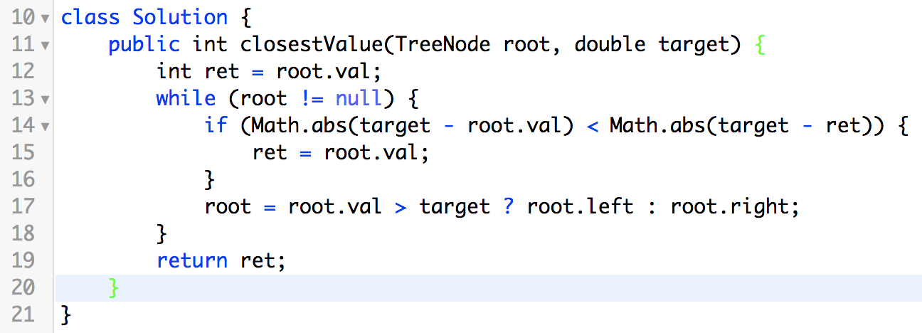

Slide 9
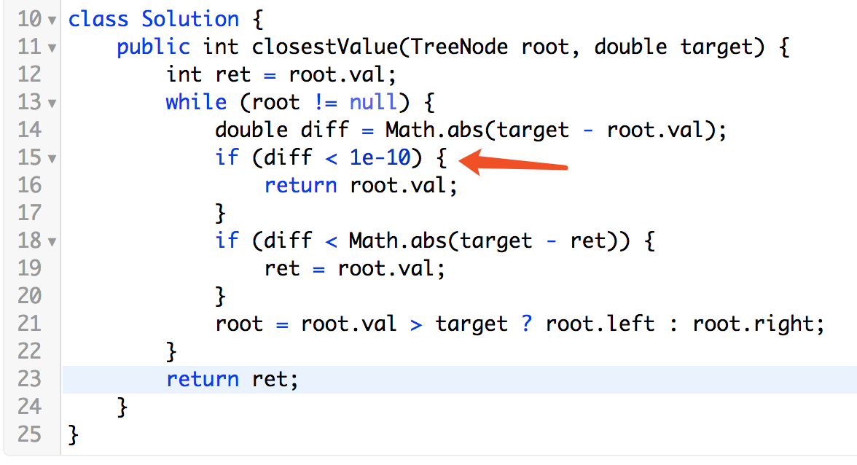

Slide 10
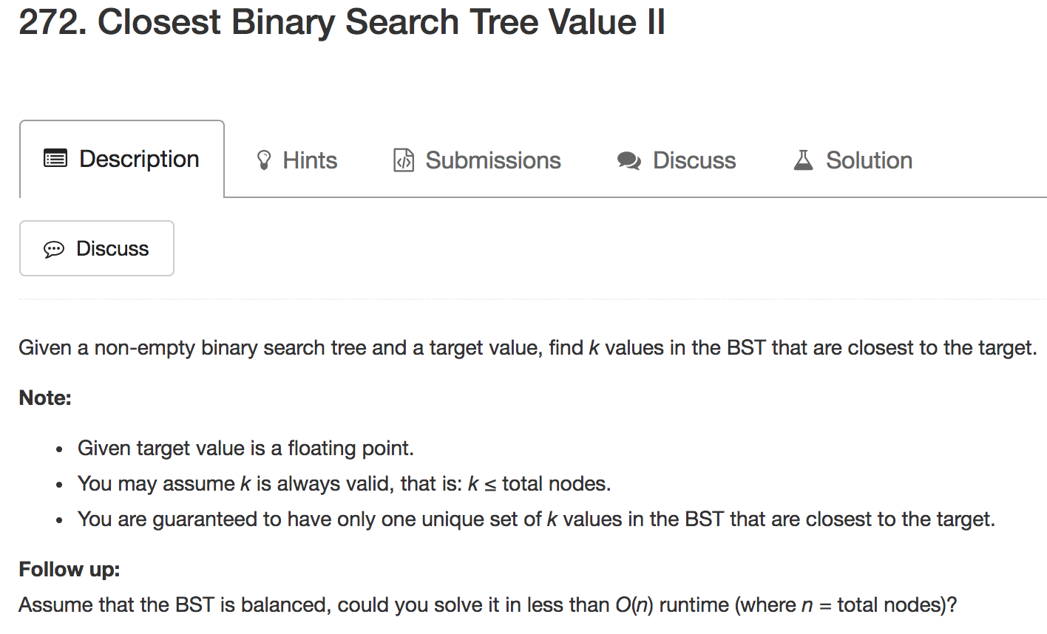

Slide 11
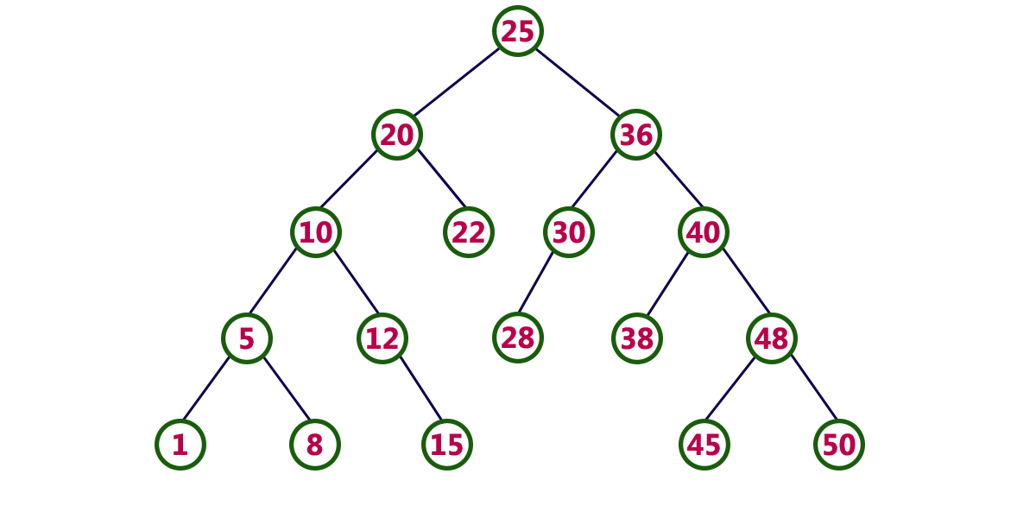
Target: 27
K: 7

Slide 12
1, 5, 8, 10, 12, 15, 20, 22, 25, 28, 30, 36, 38, 40, 45, 48, 50
Target: 27
K: 7

Slide 13
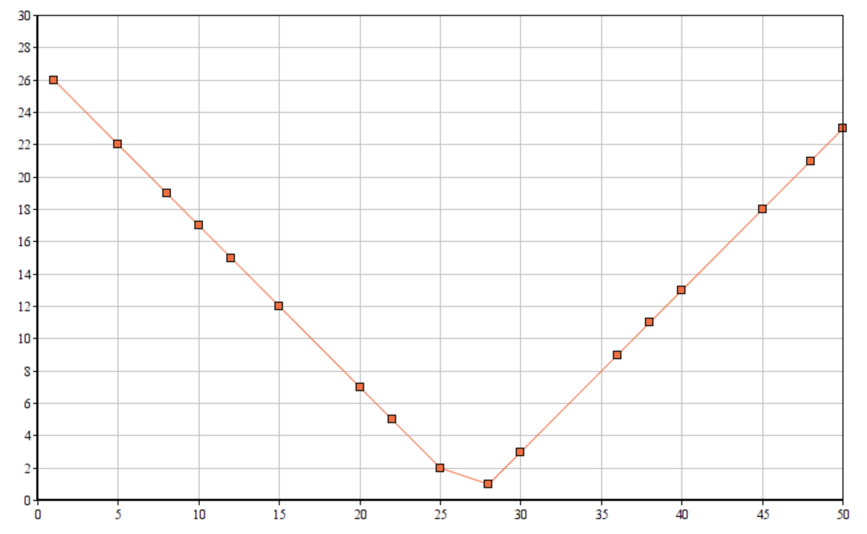
Value
Distance
1 | 26
5 | 22
8 | 19
10 | 17
12 | 15
15 | 12
20 | 7
22 | 5
25 | 2
28 | 1
30 | 3
36 | 9
38 | 11
40 | 13
45 | 18
48 | 21
50 | 23

Slide 14
Target: 27
Inorder Traversal
K: 7
1, 5, 8, 10, 12, 15, 20, 22, 25, 28, 30, 36, 38, 40, 45, 48, 50
Current TreeNode
LinkedList: [1, 5, 8, 10, 12, 15, 20]

Slide 15
Target: 27
Inorder Traversal
K: 7
1, 5, 8, 10, 12, 15, 20, 22, 25, 28, 30, 36, 38, 40, 45, 48, 50
Current TreeNode
LinkedList: [5, 8, 10, 12, 15, 20, 22]

Slide 16
Target: 27
Inorder Traversal
K: 7
1, 5, 8, 10, 12, 15, 20, 22, 25, 28, 30, 36, 38, 40, 45, 48, 50
Current TreeNode
LinkedList: [8, 10, 12, 15, 20, 22, 25]

Slide 17
Target: 27
Inorder Traversal
K: 7
1, 5, 8, 10, 12, 15, 20, 22, 25, 28, 30, 36, 38, 40, 45, 48, 50
Current TreeNode
LinkedList: [10, 12, 15, 20, 22, 25, 28]

Slide 18
Target: 27
Inorder Traversal
K: 7
1, 5, 8, 10, 12, 15, 20, 22, 25, 28, 30, 36, 38, 40, 45, 48, 50
Current TreeNode
LinkedList: [12, 15, 20, 22, 25, 28, 30]

Slide 19
Target: 27
Inorder Traversal
K: 7
1, 5, 8, 10, 12, 15, 20, 22, 25, 28, 30, 36, 38, 40, 45, 48, 50
Current TreeNode
LinkedList: [15, 20, 22, 25, 28, 30, 36]

Slide 20
Target: 27
Inorder Traversal
K: 7
1, 5, 8, 10, 12, 15, 20, 22, 25, 28, 30, 36, 38, 40, 45, 48, 50
Current TreeNode
LinkedList: [20, 22, 25, 28, 30, 36, 38]

Slide 21
Value
Distance
1 | 26
5 | 22
8 | 19
10 | 17
12 | 15
15 | 12
20 | 7
22 | 5
25 | 2
28 | 1
30 | 3
36 | 9
38 | 11
40 | 13
45 | 18
48 | 21
50 | 23

Slide 22
Target: 27
Inorder Traversal
K: 7
1, 5, 8, 10, 12, 15, 20, 22, 25, 28, 30, 36, 38, 40, 45, 48, 50
Current TreeNode
LinkedList: [20, 22, 25, 28, 30, 36, 38]

Slide 23
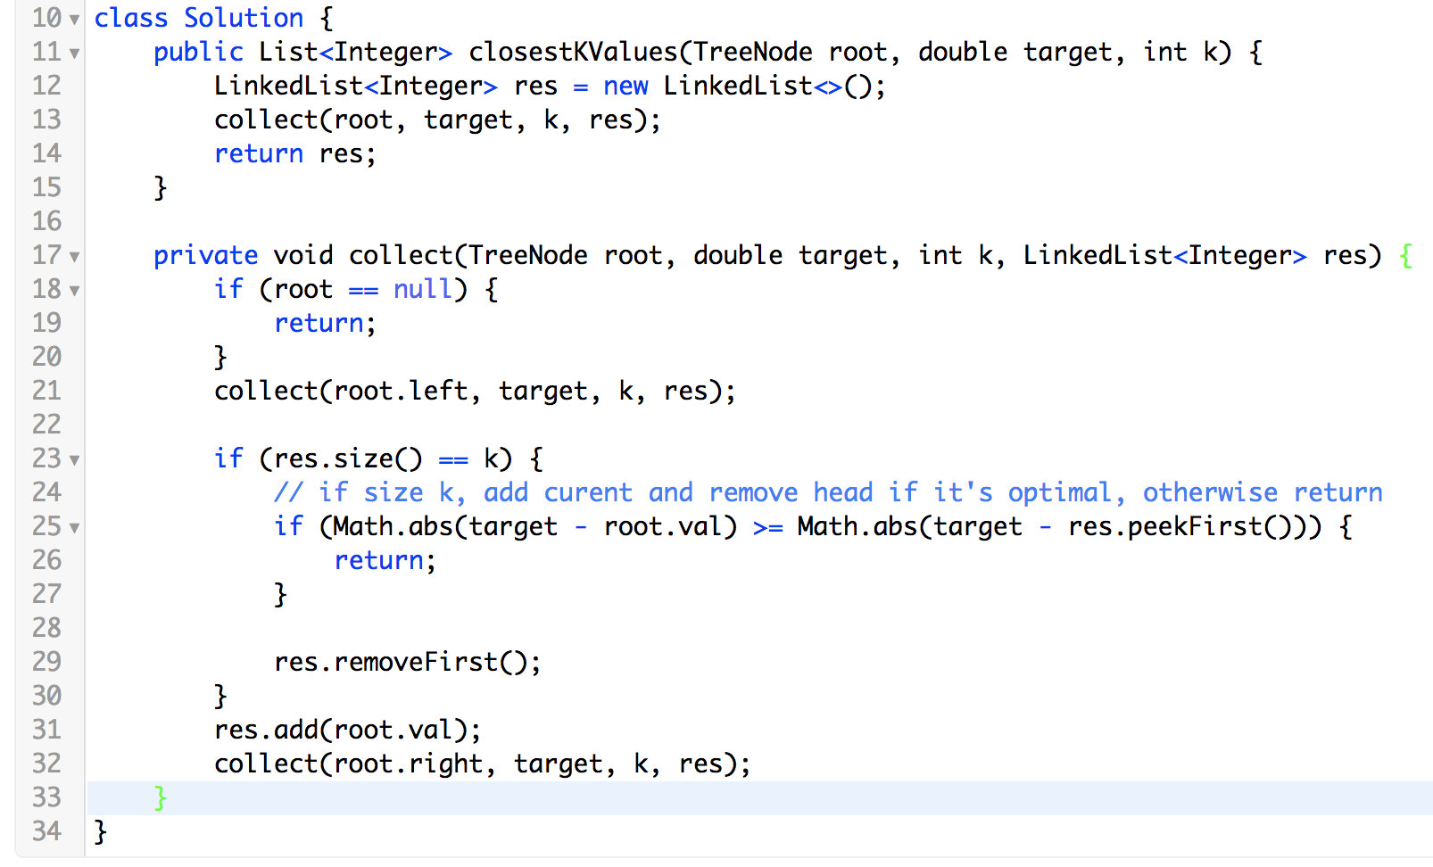

Slide 24
Test Cases
1, 5, 8, 10, 12, 15, 20, 22, 25, 28, 30, 36, 38, 40, 45, 48, 50
Target: -3

Slide 25
Test Cases
1, 5, 8, 10, 12, 15, 20, 22, 25, 28, 30, 36, 38, 40, 45, 48, 50
Target: 53

Slide 26
Test Cases
1, 5, 8
K: 7
?

Slide 27
Iterative?

Slide 28
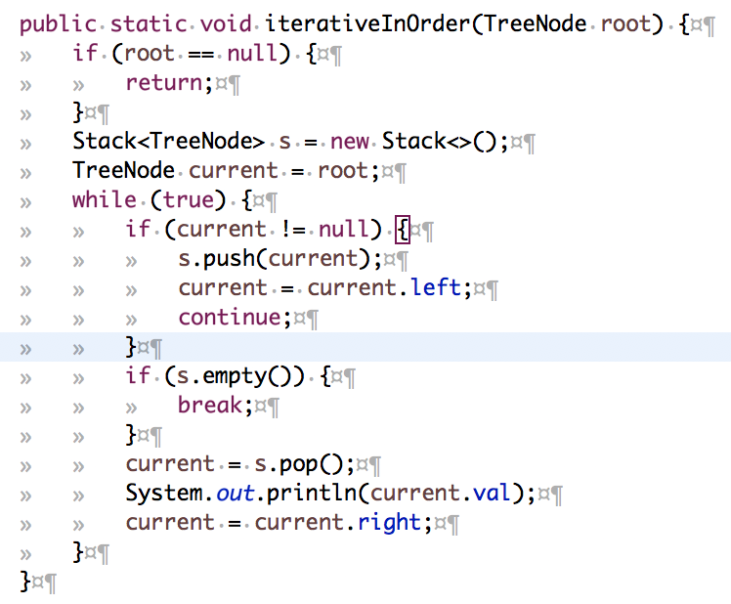

Slide 29
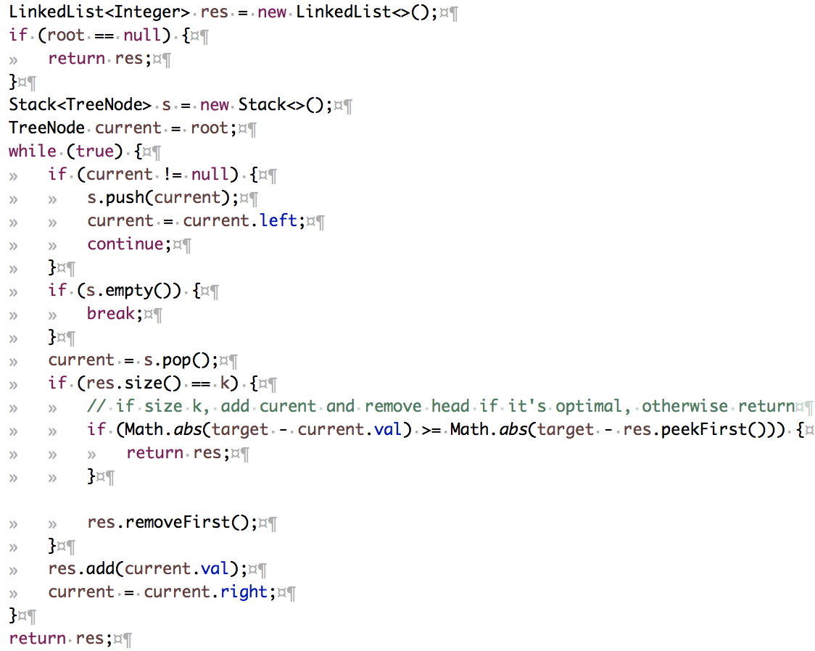

Slide 30
Xcode Career Service
想要购买录下的视频，可以联 xc0d3@outlook.com
一节课的视频是10美元，或者拉一个新的小伙伴来上课亦可

