Slide 1


Xcode Career Service
关注 Xcode 即可获得热腾腾的高频题解析视频、面试技巧及准备tips、北美IT就业咨询等干货
一对一实习或工作信息咨询服务
一对一面试能力评定 + 修改简历
一对一Mock interview强化训练服务

Slide 2
想进 xcode 的刷题群，请加老师微信 singerdmx， 他会拉你进群

Slide 3
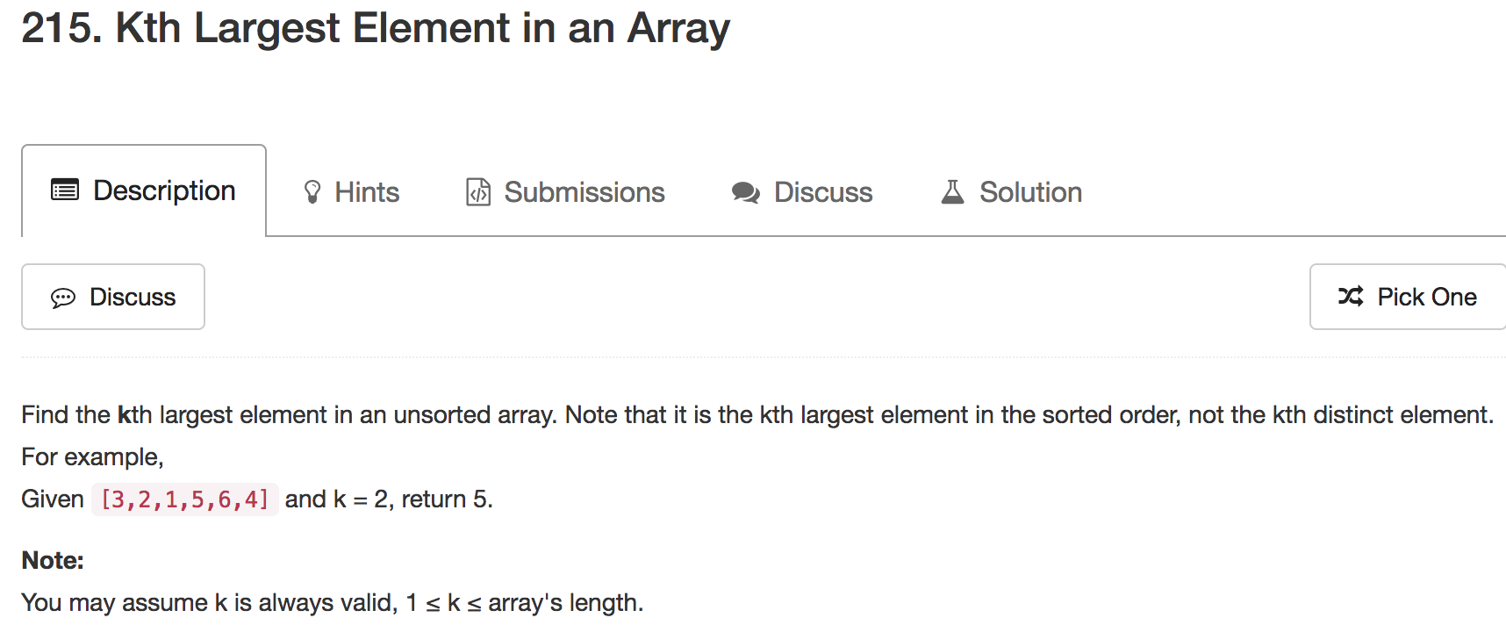
Mock

Slide 4
Wiggle Sort 专题

Slide 5
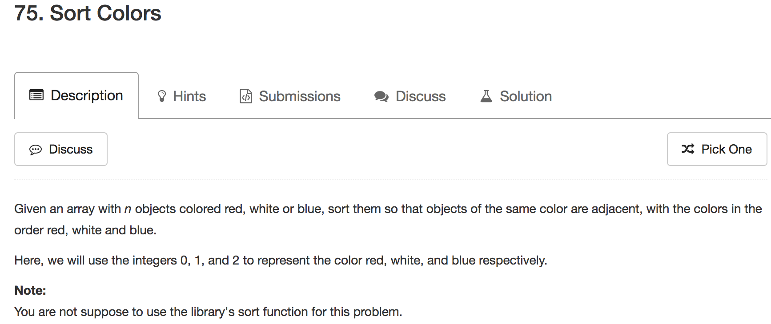

Slide 6
Three Pointers
m
0 | 1 | 0 | 2 | 1 | 0 | 0 | 2 | 1
l
r

Slide 7
m
0 | 1 | 0 | 2 | 1 | 0 | 0 | 2 | 1
l
r

Slide 8
m
0 | 1 | 0 | 2 | 1 | 0 | 0 | 2 | 1
l
r

Slide 9
swap
m
0 | 0 | 1 | 2 | 1 | 0 | 0 | 2 | 1
l
r

Slide 10
m
0 | 0 | 1 | 2 | 1 | 0 | 0 | 2 | 1
l
r

Slide 11
swap
m
0 | 0 | 1 | 1 | 1 | 0 | 0 | 2 | 2
l
r

Slide 12
m
0 | 0 | 1 | 1 | 1 | 0 | 0 | 2 | 2
l
r

Slide 13
m
0 | 0 | 1 | 1 | 1 | 0 | 0 | 2 | 2
l
r

Slide 14
m
0 | 0 | 0 | 1 | 1 | 1 | 0 | 2 | 2
l
r

Slide 15
m
0 | 0 | 0 | 0 | 1 | 1 | 1 | 2 | 2
l
r

Slide 16
m
0 | 0 | 0 | 0 | 1 | 1 | 1 | 2 | 2
l
r

Slide 17
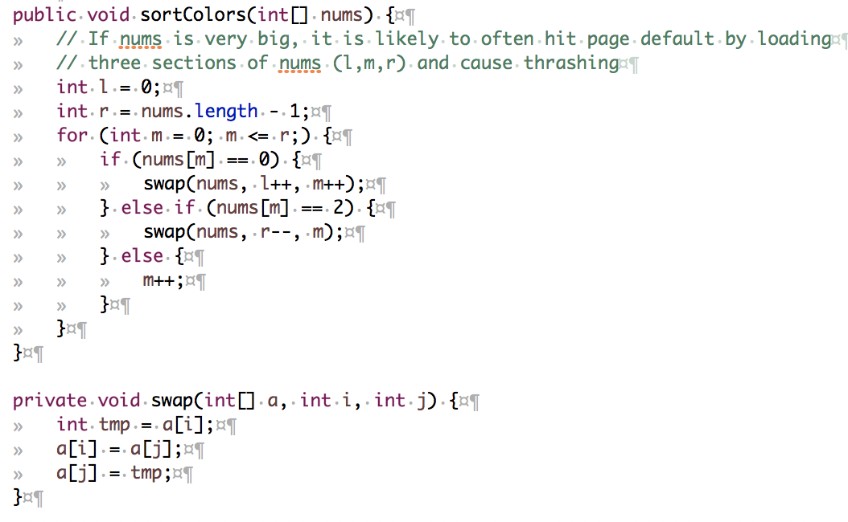

Slide 18
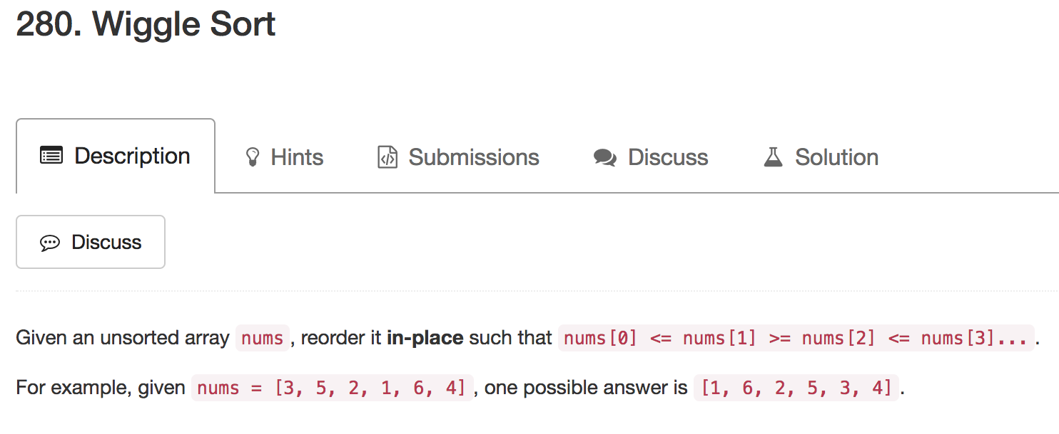

Slide 19
target
1 | 0 | 2 | 1 | 0 | 0 | 2 | 1
0 | 1 | 2 | 3 | 4 | 5 | 6 | 7
index

Slide 20
target
swap
0 | 1 | 2 | 1 | 0 | 0 | 2 | 1
0 | 1 | 2 | 3 | 4 | 5 | 6 | 7
index

Slide 21
target
0 | 1 | 2 | 1 | 0 | 0 | 2 | 1
0 | 1 | 2 | 3 | 4 | 5 | 6 | 7
index

Slide 22
target
swap
0 | 2 | 1 | 1 | 0 | 0 | 2 | 1
0 | 1 | 2 | 3 | 4 | 5 | 6 | 7
index

Slide 23
target
0 | 2 | 1 | 1 | 0 | 0 | 2 | 1
0 | 1 | 2 | 3 | 4 | 5 | 6 | 7
index

Slide 24
target
0 | 2 | 1 | 1 | 0 | 0 | 2 | 1
0 | 1 | 2 | 3 | 4 | 5 | 6 | 7
index

Slide 25
target
swap
0 | 2 | 1 | 1 | 0 | 2 | 1 | 1
0 | 1 | 2 | 3 | 4 | 5 | 6 | 7
index

Slide 26
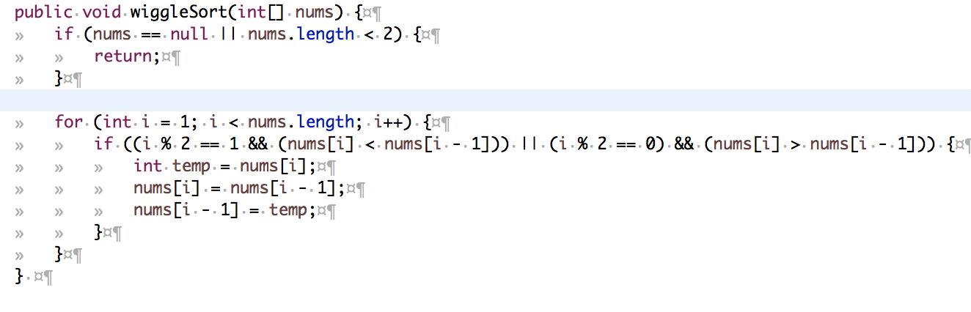
Greedy

Slide 27
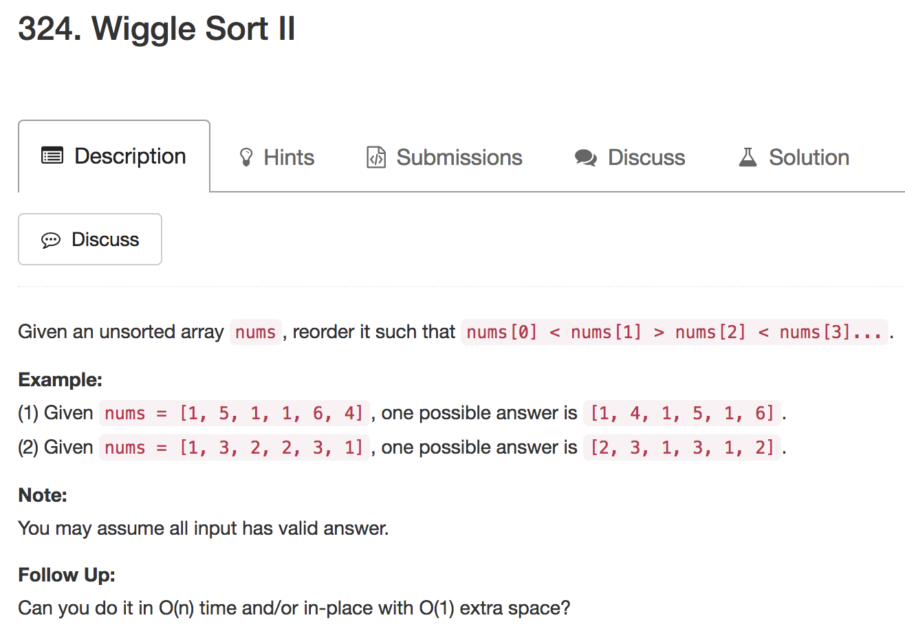

Slide 28
1 | 5 | 1 | 1 | 6 | 4
Sort
1 | 1 | 1 | 4 | 5 | 6

Slide 29
1 | 5 | 1 | 1 | 6 | 4
Find Median
int median = findKthLargest(nums, (nums.length + 1) >>> 1)
= 1
nums.length = 6, 3rd number
nums.length = 5, 3rd number

Slide 30
1 | 5 | 1 | 1 | 6 | 4
Find Median and Patition
1 | 1 | 1 | 5 | 6 | 4

Slide 31
1 | 1 | 1 | 5 | 6 | 4
Even number indexes
1 |  | 1 |  | 1

Slide 32
1 | 1 | 1 | 5 | 6 | 4
Odd number indexes
1 | 5 | 1 | 6 | 1 | 4

Slide 33
1 | 5 | 1 | 1 | 6 | 4
Sort Color
1 | 1 | 1 | 5 | 6 | 4

Slide 34
Three Pointers
m
1 | 5 | 1 | 1 | 6 | 4
mid = 1
left > 1
right < 1
l
r

Slide 35
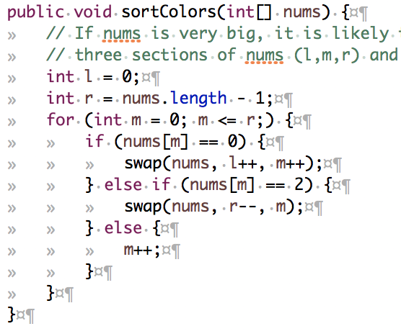
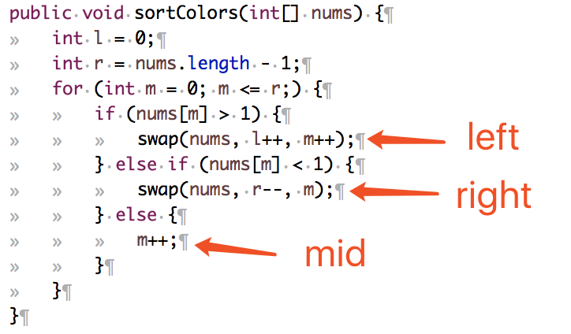

Slide 36
m
1 | 5 | 1 | 1 | 6 | 4
mid = 1
left > 1
right < 1
l
r

Slide 37
m
swap
1 | 4 | 1 | 1 | 6 | 5
mid = 1
left > 1
right < 1
l
r

Slide 38
m
swap
1 | 6 | 1 | 1 | 4 | 5
mid = 1
left > 1
right < 1
l
r

Slide 39
m
swap
1 | 1 | 1 | 6 | 4 | 5
mid = 1
left > 1
right < 1
l
r

Slide 40
m
1 | 1 | 1 | 6 | 4 | 5
mid = 1
left > 1
right < 1
l
r

Slide 41
0 | 1 | 2 | 3 | 4 | 5
n = 6 => (n | 1) = 7
The index mapping, (1 + 2 * index) % (n | 1)
1 | 3 | 5 | 0 | 2 | 4

Slide 42
0 | 1 | 2 | 3 | 4 | 5
n = 6 => (n | 1) = 7
The index mapping, (1 + 2 * index) % (n | 1)
1 | 3 | 5 | 0 | 2 | 4

Slide 43
0 | 1 | 2 | 3 | 4 | 5
n = 6 => (n | 1) = 7
The index mapping, (1 + 2 * index) % (n | 1)
1 | 3 | 5 | 0 | 2 | 4

Slide 44
0 | 1 | 2 | 3 | 4 | 5
n = 6 => (n | 1) = 7
The index mapping, (1 + 2 * index) % (n | 1)
1 | 3 | 5 | 0 | 2 | 4

Slide 45
0 | 1 | 2 | 3 | 4 | 5 | 6
n = 7 => (n | 1) = 7
The index mapping, (1 + 2 * index) % (n | 1)
1 | 3 | 5 | 0 | 2 | 4 | 6

Slide 46
m
1 | 3 | 5 | 0 | 2 | 4
index
1 | 5 | 1 | 1 | 6 | 4
mid = 1
left > 1
right < 1
l
r

Slide 47
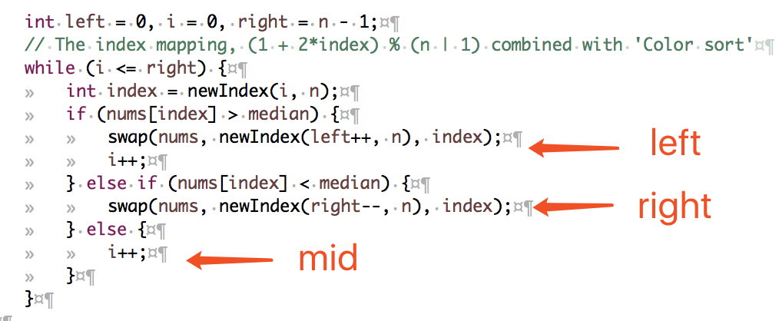

Slide 48
Xcode Career Service
想要购买录下的视频，可以联 xc0d3@outlook.com
一节课的视频是10美元，或者拉一个新的小伙伴来上课亦可

