Slide 1


Xcode Career Service
关注 Xcode 即可获得热腾腾的高频题解析视频、面试技巧及准备tips、北美IT就业咨询等干货
一对一实习或工作信息咨询服务
一对一面试能力评定 + 修改简历
一对一Mock interview强化训练服务

Slide 2
想进 xcode 的刷题群，请加老师微信 singerdmx， 他会拉你进群

Slide 3
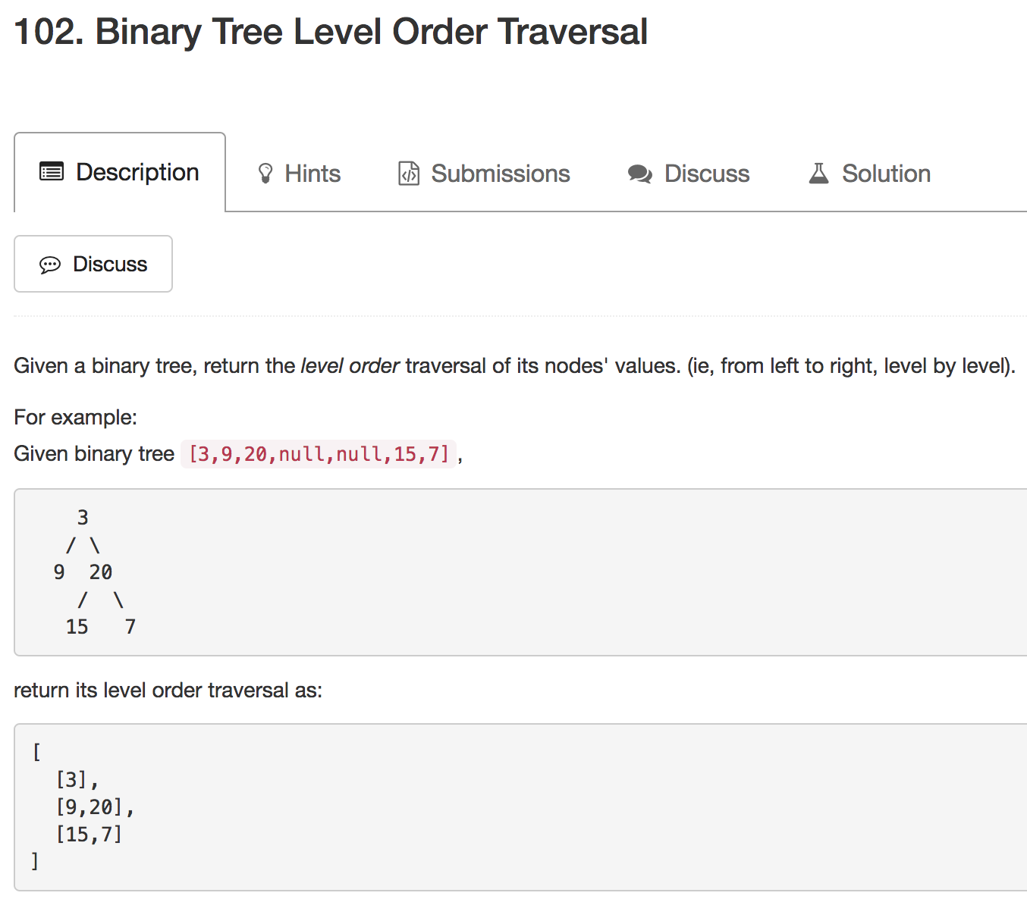
Mock

Slide 4
Binary Search 专题

Slide 5
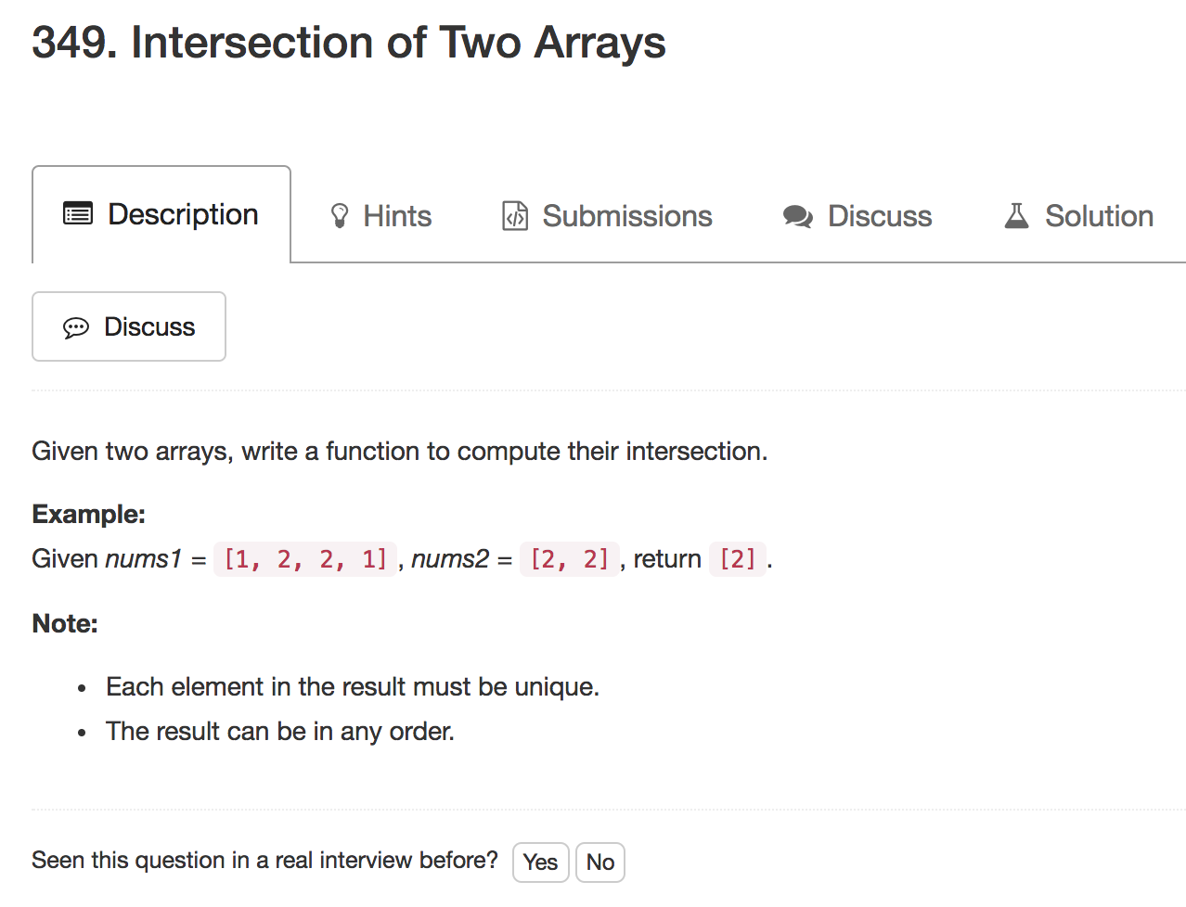

Slide 6
1. Hashmap
2. two pointers
3. 如果没有额外空间，如果一个很大，一个很小，适合scan小的，并且在大的里面做binary search

Slide 7
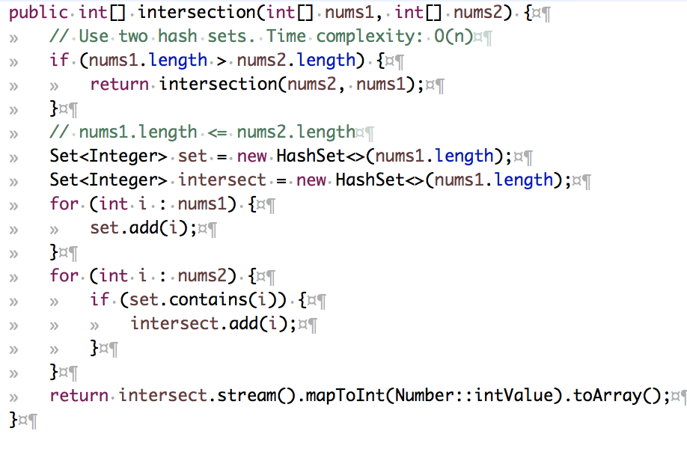
Hashmap
Extra Space
num1.length is m,
num2.length is n,
runtime O(m + n)

Slide 8
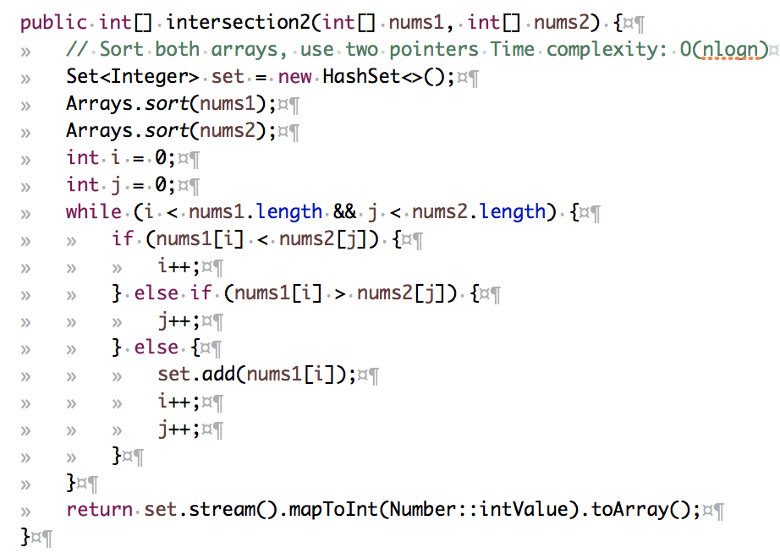
Two Pointers
If already sorted,
num1.length is m,
num2.length is n,
runtime O(m + n),
no need to use
hashmap

Slide 9
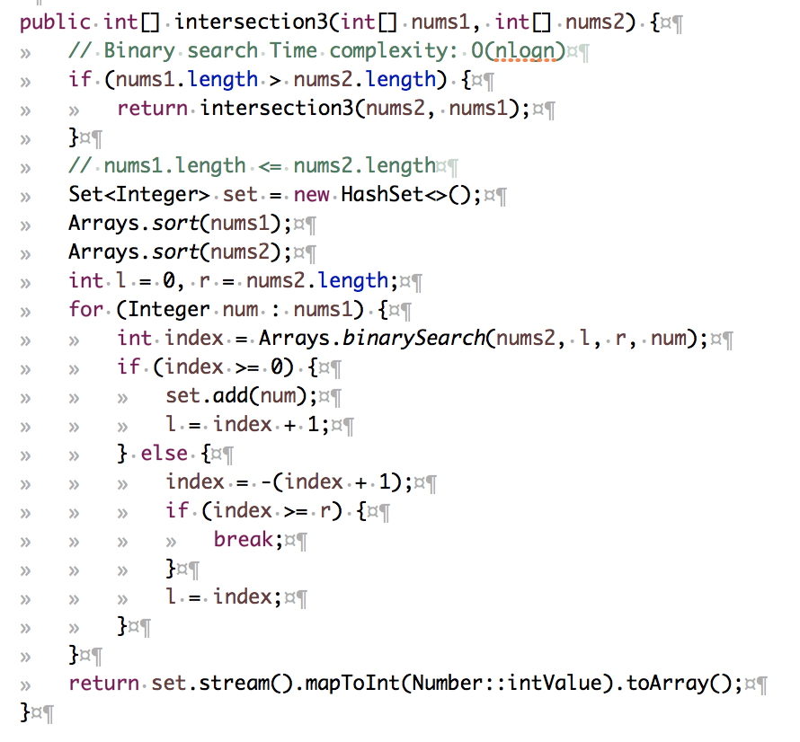
Binary Search
If already sorted,
num1.length is m,
num2.length is n,
runtime m * log(n)

Slide 10
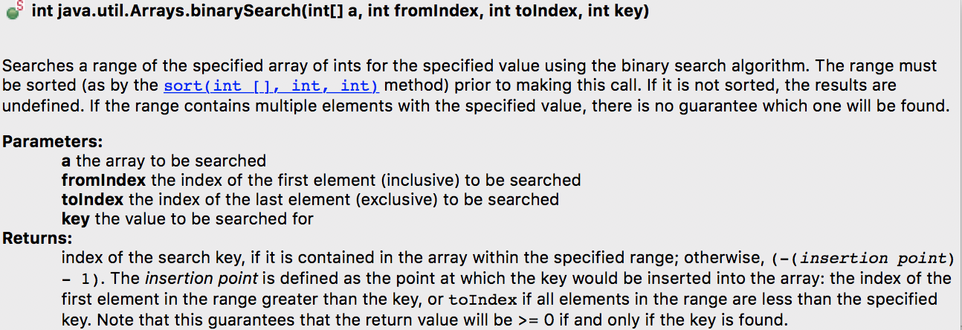

Slide 11
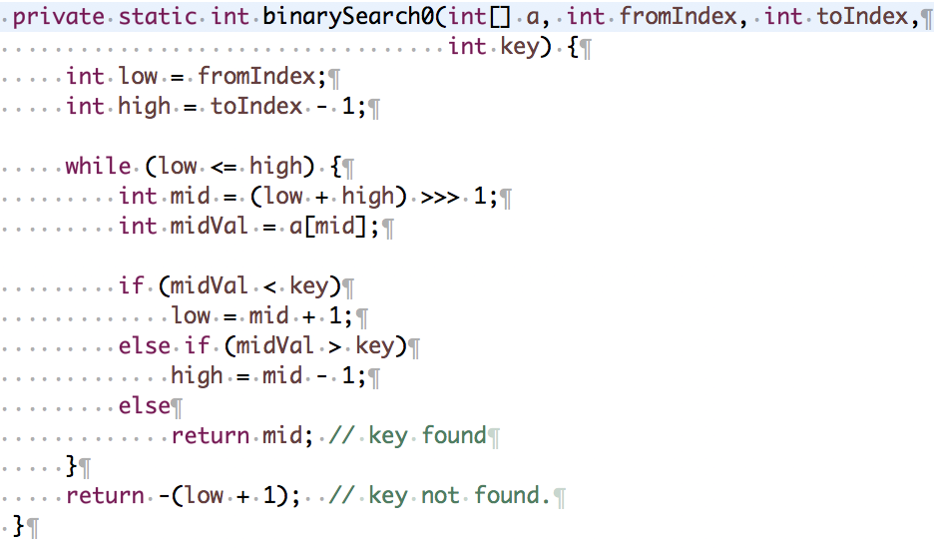

Slide 12
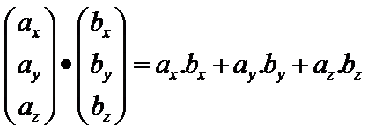
Fb高频题: Dot Product
Conduct Dot Product of two large sparse Vectors

Slide 13
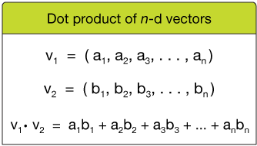
Sparse: lots of zeroes
v1: [3, 5, 0, 0, 1, 0, 0, 0, 8, 0, 0, 9, 0, 0, 0, 0, 2]
v2: [4, 0, 0, 2, 0, 0, 0, 1, 0, 6, 7, 0, 1, 0, 5, 2, 0]
index: [0, 1, 2, 3, 4, 5, 6, 7, 8, 9, 10,11,12,13,14,15,16]

Slide 14
v1: [3, 5, 0, 0, 1, 0, 0, 0, 8, 0, 0, 9, 0, 0, 4, 0, 2]
v2: [4, 0, 0, 2, 0, 0, 0, 1, 0, 6, 7, 0, 1, 0, 5, 2, 5]
index: [0, 1, 2, 3, 4, 5, 6, 7, 8, 9, 10,11,12,13,14,15,16]
non-zero indexes
v1: [0, 1, 4, 8, 11, 14, 16]
v2: [0, 3, 7, 9, 10, 12, 14, 15, 16]
intersection
intersection index: [0, 14, 16]

Slide 15
v1: [3, 5, 0, 0, 1, 0, 0, 0, 8, 0, 0, 9, 0, 0, 4, 0, 2]
v2: [4, 0, 0, 2, 0, 0, 0, 1, 0, 6, 7, 0, 1, 0, 5, 2, 5]
index: [0, 1, 2, 3, 4, 5, 6, 7, 8, 9, 10,11,12,13,14,15,16]
intersection index: [0, 14, 16]
Dot Product = v1[0] * v2[0] + v1[1] * v2[1] + v1[2] * v2[2]
= 3 * 4 + 4 * 5 + 2 * 5

Slide 16
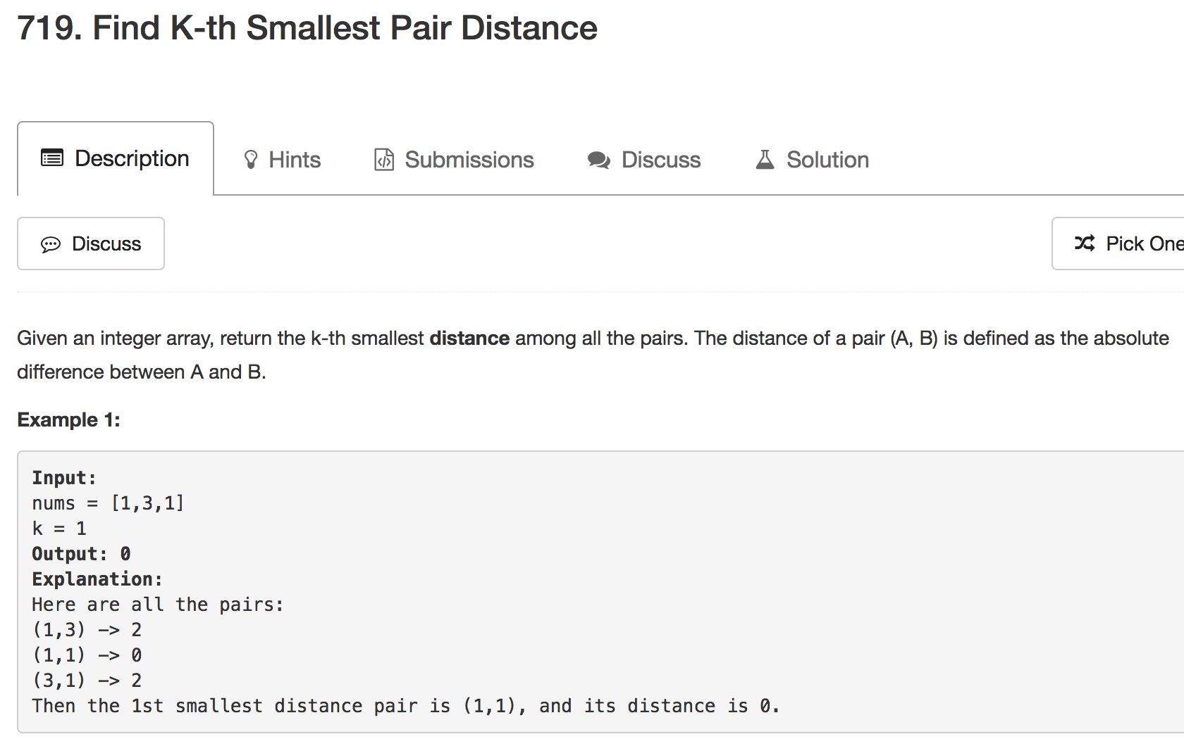

Slide 17
Note:
2 <= len(nums) <= 10000.
0 <= nums[i] < 1000000.
1 <= k <= len(nums) * (len(nums) - 1) / 2.

Slide 18
int smallestDistancePair(int[] nums, int k)
(1) Sort
1 | 1 | 3
(2) Guess
(3) Count

Slide 19
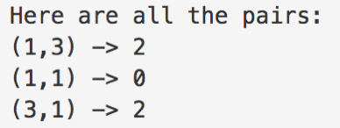
Guess: Binary Search
Range?
int lo = 0;
int hi = nums[nums.length - 1] - nums[0];
distance: [0, 2, 2]

Slide 20
Guess: Binary Search
1 | 1 | 3
lo = 0
hi = 2
distance: [0, 2, 2]

Slide 21
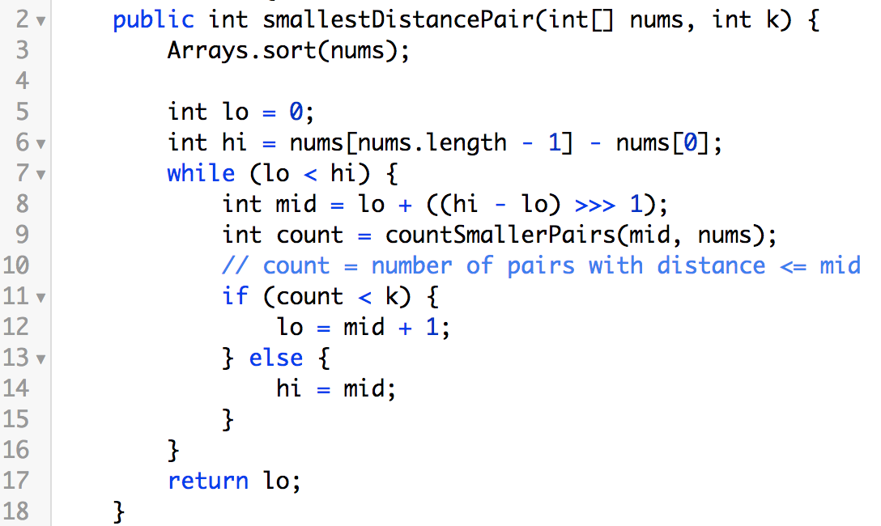
boilerplate

Slide 22
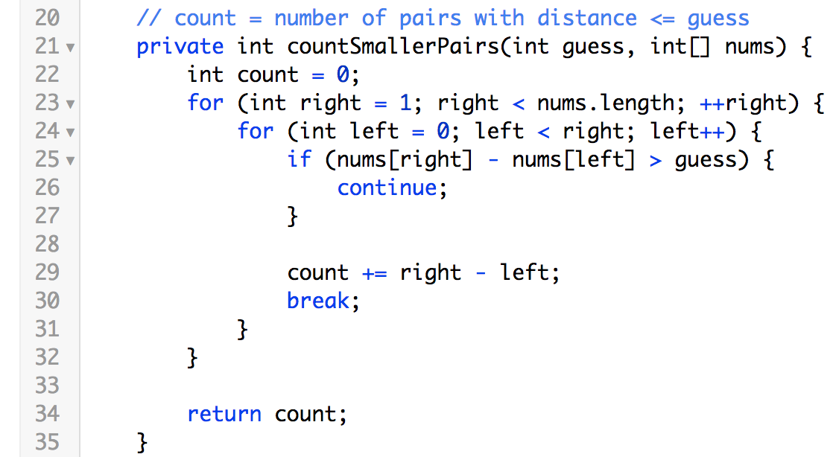
nums[right] – nums[left] <= guess
Two pointers linear scan
left
right

Slide 23
How many pairs?
left
right
1 pair

Slide 24
How many pairs?
left
right
2 pairs

Slide 25
How many pairs?
left
right
3 pairs
count = right - left

Slide 26
nums = [1, 1, 3], k = 1
lo = 0
hi = 2
mid = 1
count = 1
distance: [0, 2, 2]
hi = 1

Slide 27
nums = [1, 1, 3], k = 1
lo = 0
hi = 1
mid = 0
count = 1
distance: [0, 2, 2]
hi = 0

Slide 28
nums = [1, 1, 3], k = 2
lo = 0
hi = 2
mid = 1
count = 1
distance: [0, 2, 2]
lo = 2

Slide 29
nums = [1, 1, 3], k = 3
lo = 0
hi = 2
mid = 1
count = 1
distance: [0, 2, 2]
lo = 2

Slide 30
Further Optimization

Slide 31
Find right such that nums[right] <= nums[left] + guess

Slide 32
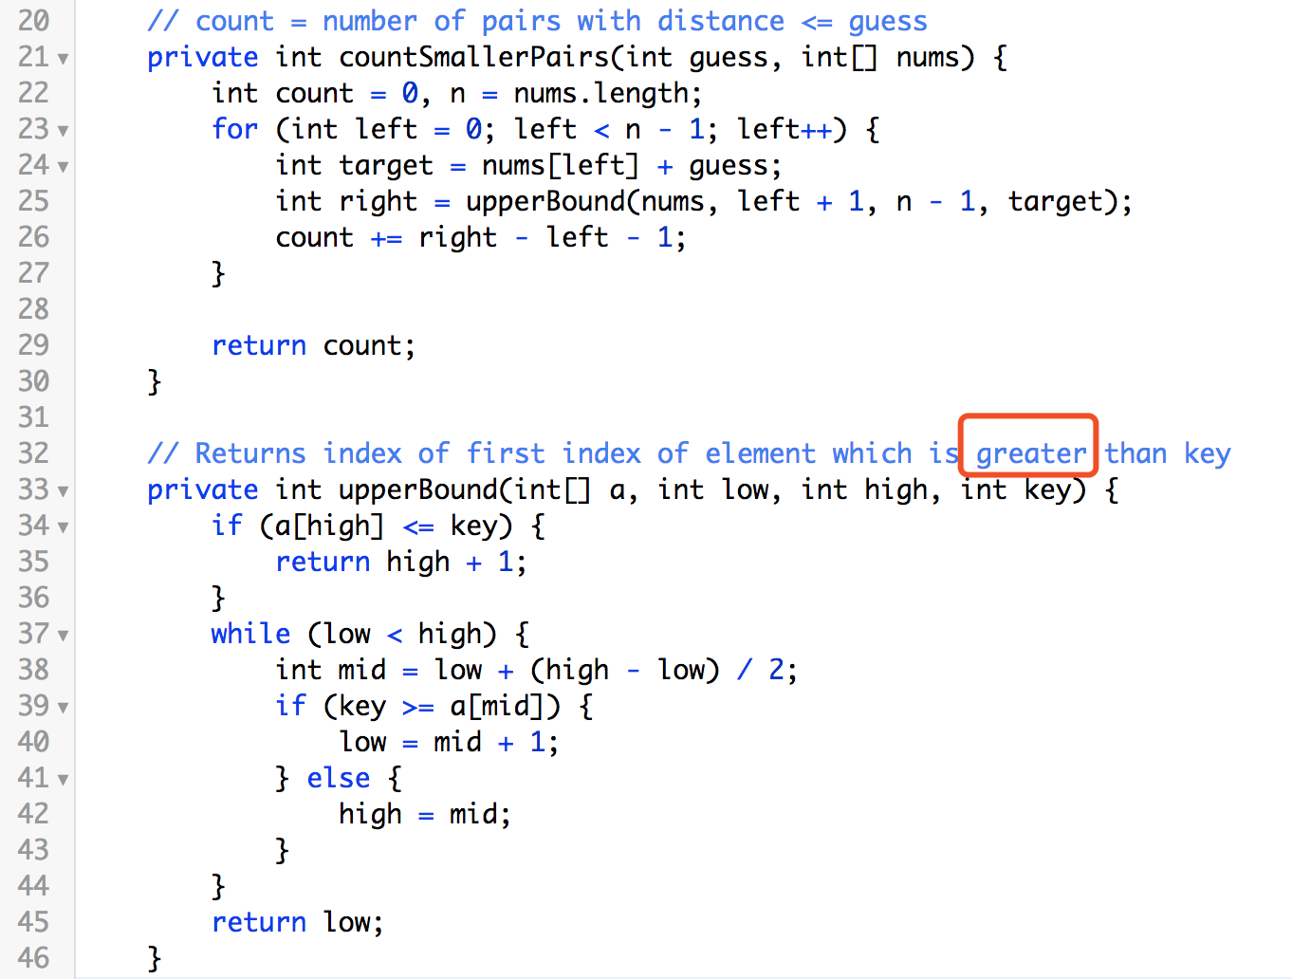
duplicates
=>
greater

Slide 33
Further Optimization
Use Map<Integer, Integer> to memorize
guess and its count

Slide 34
Runtime
N is the length of nums, and W is equal to nums[nums.length - 1] - nums[0]
Arrays.sort(nums) => N * logN

Slide 35
Binary Search => logN * logW

Slide 36
Xcode Career Service
想要购买录下的视频，可以联 xc0d3@outlook.com
一节课的视频是10美元，或者拉一个新的小伙伴来上课亦可

