Slide 1


Xcode Career Service
关注 Xcode 即可获得热腾腾的高频题解析视频、面试技巧及准备tips、北美IT就业咨询等干货
一对一实习或工作信息咨询服务
一对一面试能力评定 + 修改简历
一对一Mock interview强化训练服务

Slide 2
想进 xcode 的刷题群，请加老师微信 singerdmx， 他会拉你进群

Slide 3
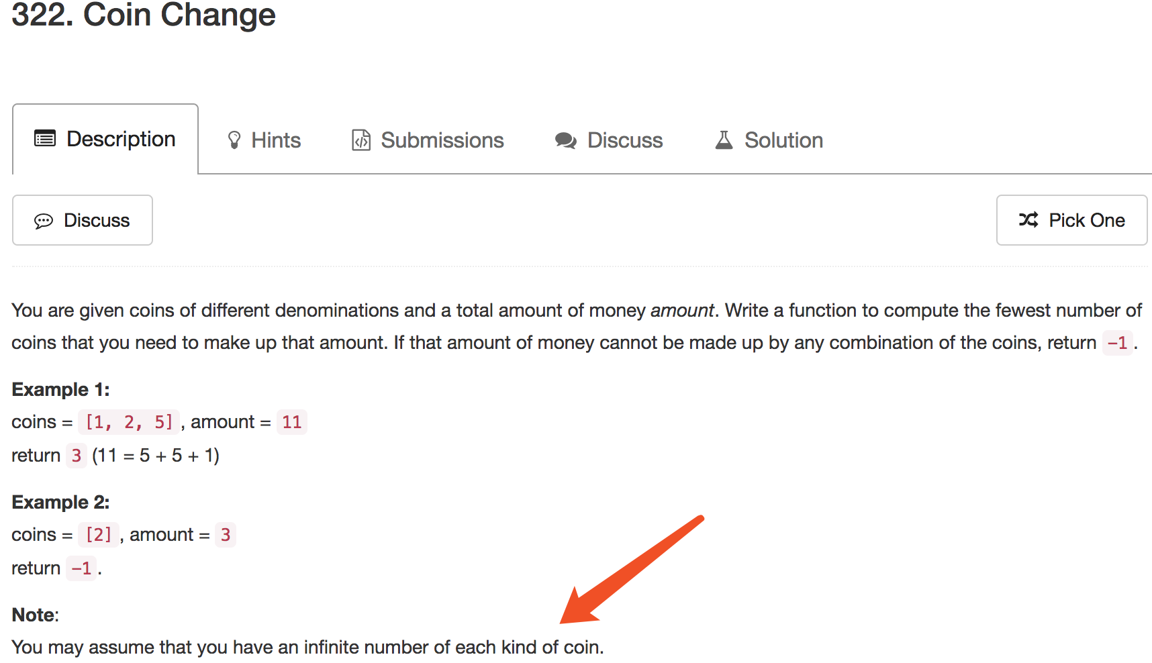
Mock

Slide 4
DP 专题

Slide 5
DP 核心思想
（1） Deduction Formula
（2） Initialization
（3） Space Improvement (Bonus)

Slide 6
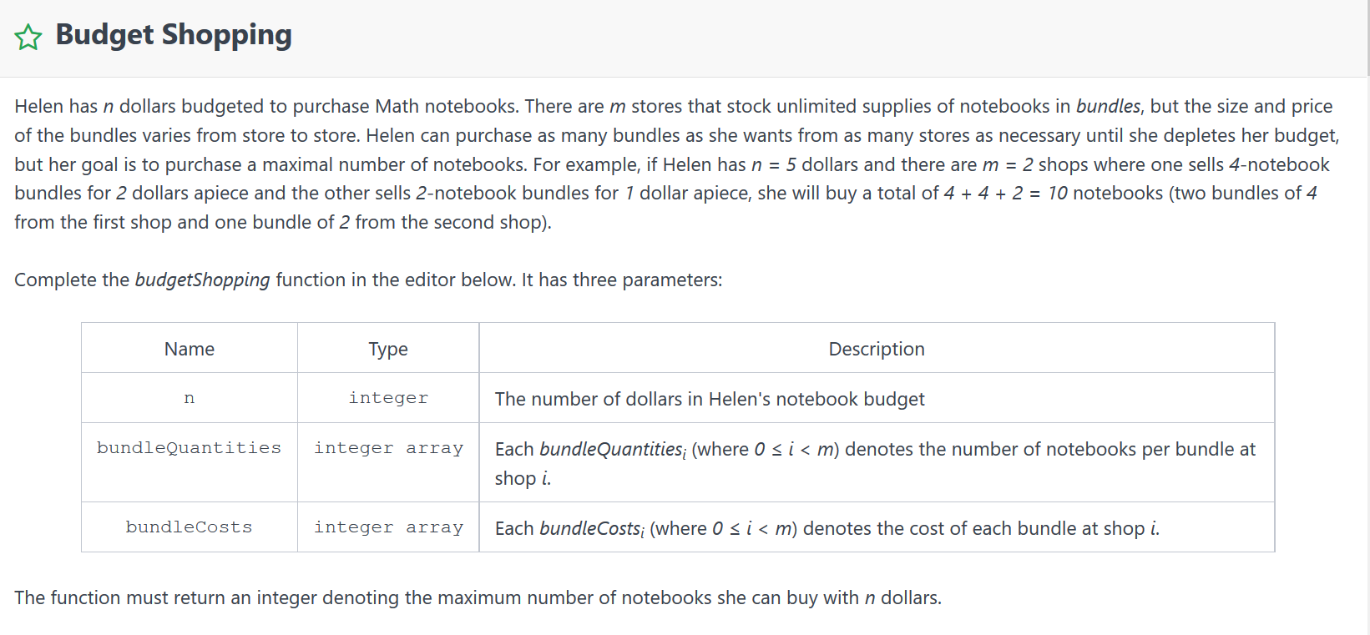

Slide 7
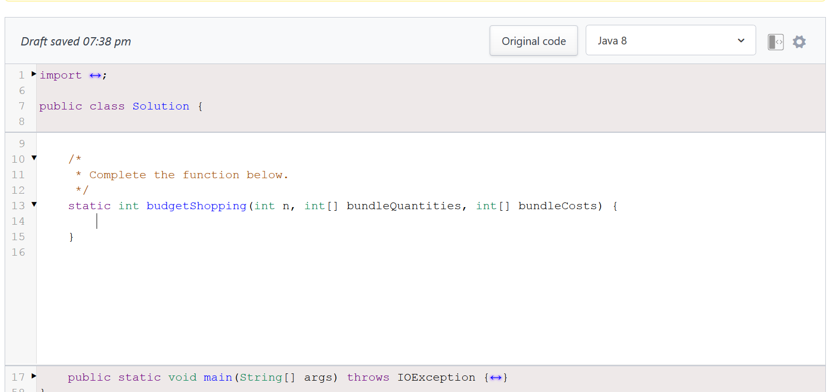

Slide 8
Helen has n = 50 dollars to purchase notebooks from 2 stores described by bundleQunantities = [20, 19] and bundleCost = [24, 20]. She makes the following purchases:
One bundle of 20 notebooks from shop 0 at a cost 24 dollars and has 50 – 24 = 26 dollars left.
Another bundle of 20 notebooks from shop 0 at a cost 24 dollars and has 26 – 24 = 2 dollars left.
Helen can’t afford any more notebooks, so we return the total number of notebooks she was able to purchase: 20 + 20 = 40.

Slide 9
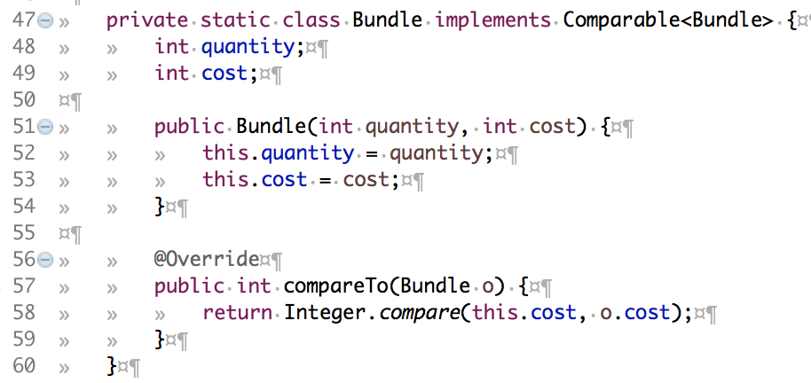

Slide 10
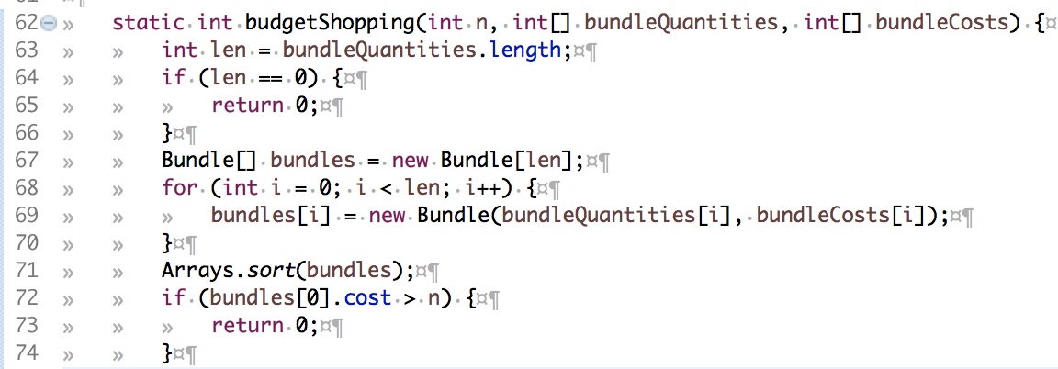

Slide 11
（1） Deduction Formula
f(i) is the maximum number of notebooks given i dollars
f(n) is our target goal
Adding a bundle “b”
We need to spend “i + b.cost” dollars, i.e. f(i + b.cost)
We get “f(i) + b.quantity” notebooks

Slide 12
（1） Deduction Formula
f(i) = f(i – b.cost) + b.quantity
Trying different bundles
=> f(i) = max(f(i – b.cost) + b.quantity) given different b

Slide 13
（2） Initialization
int[] f = new int[n + 1]
int max = 0
Why max?

Slide 14
（2） Initialization
int[] f = new int[n + 1]
for (Bundle b : bundles) {
f[b.cost] = b.quantity;
}
f[i] == 0 means i dollars cannot be used
to buy notebooks

Slide 15
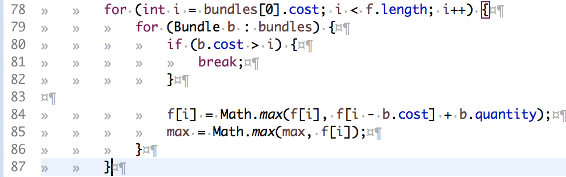

Slide 16
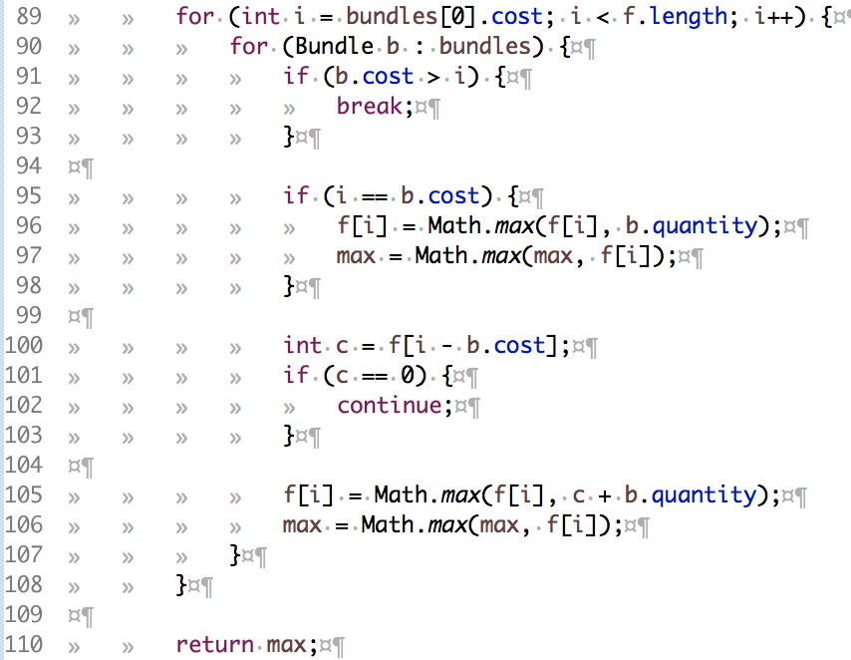

Slide 17
Helen has n = 50 dollars to purchase notebooks from 2 stores described by bundleQunantities = [20, 19] and bundleCost = [24, 20]. She makes the following purchases:
One bundle of 20 notebooks from shop 0 at a cost 24 dollars and has 50 – 24 = 26 dollars left.
Another bundle of 20 notebooks from shop 0 at a cost 24 dollars and has 26 – 24 = 2 dollars left.
Helen can’t afford any more notebooks, so we return the total number of notebooks she was able to purchase: 20 + 20 = 40.

Slide 18
cost | 20 | 24
quantity | 19 | 20
n = 50
Bundles
f: [0, 0, 0, 0, 0, 0, 0, 0, 0, 0, 0, 0, 0, 0, 0, 0, 0, 0, 0, 0, 19, 0, 0, 0, 20, 0, 0, 0, 0, 0, 0, 0, 0, 0, 0, 0, 0, 0, 0, 0, 38, 0, 0, 0, 39, 0, 0, 0, 40, 0, 0]
f[20] = 19
f[24] = 20
f[40] = 38 = f[20] + f[20]
f[44] = 39 = f[20] + f[24]
f[48] = 40 = f[24] + f[24]

Slide 19
Variation
What if coins are limited?
What if bundles are limited?
背包问题
Knapsack problem

Slide 20
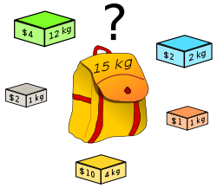
Given a set of items, each with a weight and a value, determine the number of each item to include in a collection so that the total weight is less than or equal to a given limit and the total value is as large as possible. It derives its name from the problem faced by someone who is constrained by a fixed-size knapsack and must fill it with the most valuable items.

Slide 21
Backpack
Given n items with size Ai, an integer m denotes the size of a backpack. How full you can fill this backpack?
Example
If we have 4 items with size [2, 3, 5, 7], the backpack size is 11, we can select [2, 3, 5], so that the max size we can fill this backpack is 10. If the backpack size is 12. we can select [2, 3, 7] so that we can fulfill the backpack.
You function should return the max size we can fill in the given backpack.
Note
You can not divide any item into small pieces.

Slide 22
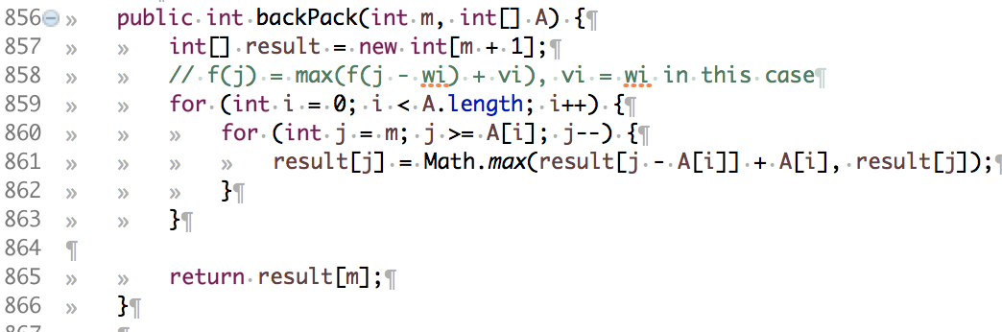

Slide 23
Backpack II
Given n items with size Ai and value Vi, and a backpack with size m. What's the maximum value can you put into the backpack?
Example
Given 4 items with size [2, 3, 5, 7] and value [1, 5, 2, 4], and a backpack with size 10. The maximum value is 9.
Note
You cannot divide item into small pieces and the total size of items you choose should smaller or equal to m.

Slide 24
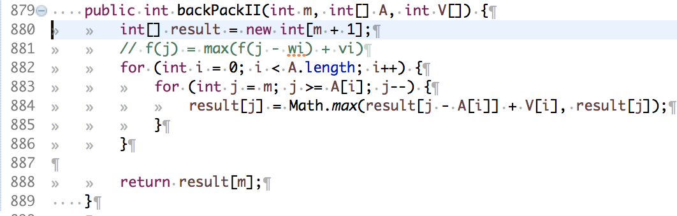
for (Bundle b : bundles) {
for (int j = n; j >= b.cost; j--) {
f[j] = Math.max(f[j - b.cost] + b.quantity, f[j]);
}
}

Slide 25
Xcode Career Service
想要购买录下的视频，可以联系 xc0d3@outlook.com
一节课的视频是10美元，或者拉一个新的小伙伴来上课亦可

