Slide 1
Sensitivity Analysis

Slide 2
Analyses Performed: Briefer
Outlier Remover
An automatic function that removes outliers
Leave-One-Out Analysis
Remove one study and see its effect on heterogeneity
Influence Diagnostics
Several metrics

Slide 3
Pooled OR

Slide 4
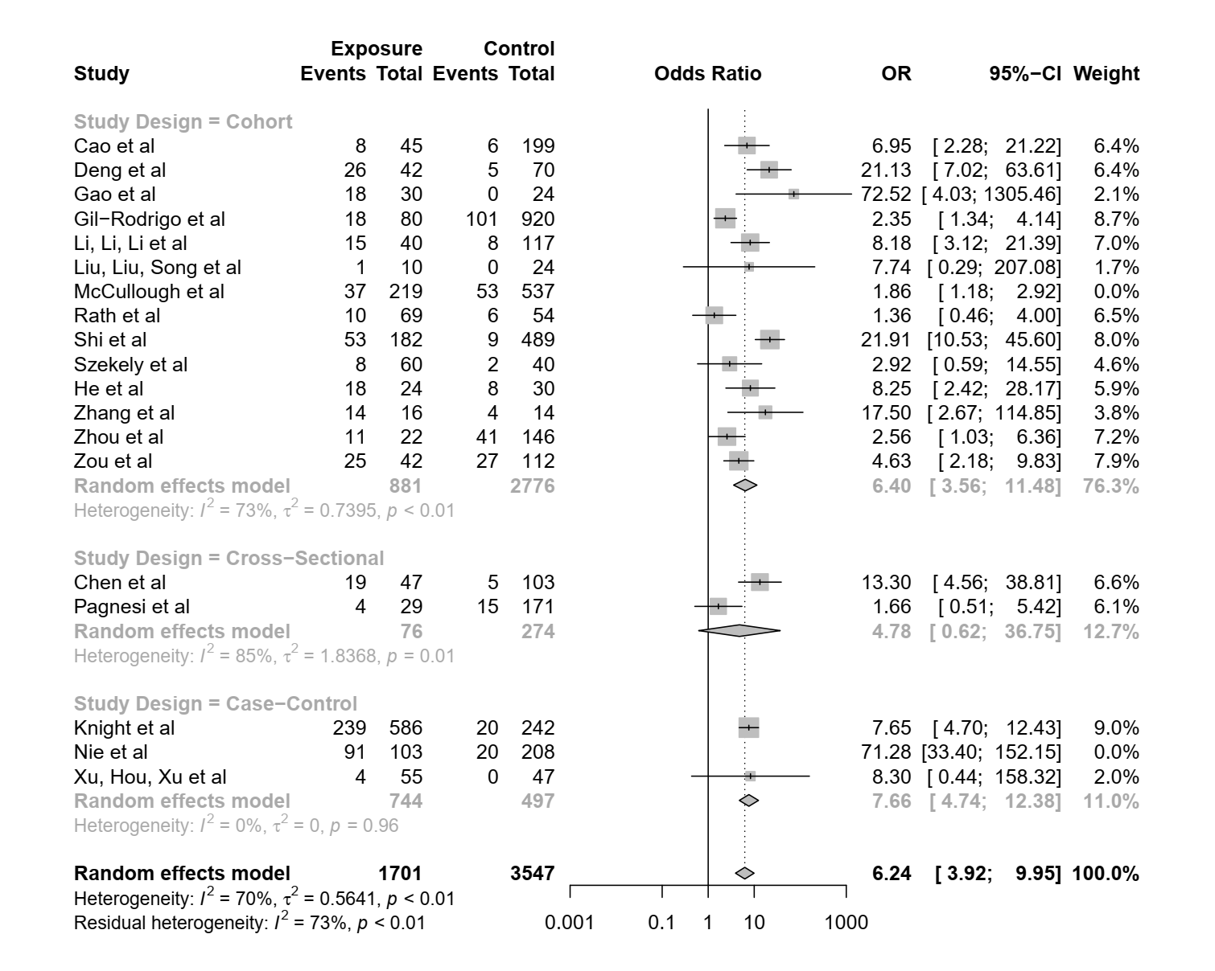
Pooled OR of All Studies

Slide 5
Identified outliers (random-effects model)
------------------------------------------
"McCullough et al", "Nie et al"
Results with outliers removed
-----------------------------
OR 95%-CI %W(random) Study Design exclude
Cao et al 6.9550 [ 2.2797; 21.2184] 6.4 Cohort
Deng et al 21.1250 [ 7.0152; 63.6139] 6.4 Cohort
Gao et al 72.5200 [ 4.0286; 1305.4562] 2.1 Cohort
Gil-Rodrigo et al 2.3542 [ 1.3394; 4.1380] 8.7 Cohort
Li, Li, Li et al 8.1750 [ 3.1243; 21.3904] 7.0 Cohort
Liu, Liu, Song et al 7.7368 [ 0.2891; 207.0783] 1.7 Cohort
McCullough et al 1.8565 [ 1.1800; 2.9208] 0.0 Cohort *
Rath et al 1.3559 [ 0.4598; 3.9986] 6.5 Cohort
Shi et al 21.9121 [10.5295; 45.5999] 8.0 Cohort
Szekely et al 2.9231 [ 0.5872; 14.5500] 4.6 Cohort
He et al 8.2500 [ 2.4158; 28.1741] 5.9 Cohort
Zhang et al 17.5000 [ 2.6666; 114.8459] 3.8 Cohort
Zhou et al 2.5610 [ 1.0305; 6.3645] 7.2 Cohort
Zou et al 4.6296 [ 2.1802; 9.8309] 7.9 Cohort
Chen et al 13.3000 [ 4.5578; 38.8102] 6.6 Cross-Sectional
Pagnesi et al 1.6640 [ 0.5108; 5.4207] 6.1 Cross-Sectional
Knight et al 7.6452 [ 4.7009; 12.4338] 9.0 Case-Control
Nie et al 71.2833 [33.3974; 152.1468] 0.0 Case-Control *
Xu, Hou, Xu et al 8.3010 [ 0.4352; 158.3169] 2.0 Case-Control
Number of studies combined: k = 17

Slide 6
OR 95%-CI z p-value
Random effects model 6.2434 [3.9177; 9.9498] 7.70 < 0.0001
Quantifying heterogeneity:
tau^2 = 0.5641; tau = 0.7511; I^2 = 69.5% [49.9%; 81.5%]; H = 1.81 [1.41; 2.32]
Quantifying residual heterogeneity:
I^2 = 72.5% [54.0%; 83.6%]; H = 1.91 [1.47; 2.47]
Test of heterogeneity:
Q d.f. p-value
52.54 16 < 0.0001
Results for subgroups (random effects model):
k OR 95%-CI tau^2 tau Q I^2
Study Design = Cohort 13 6.3957 [3.5619; 11.4841] 0.7395 0.8599 44.43 73.0%
Study Design = Cross-Sectional 2 4.7777 [0.6211; 36.7506] 1.8368 1.3553 6.55 84.7%
Study Design = Case-Control 2 7.6619 [4.7418; 12.3804] 0 0 0.00 0.0%
Test for subgroup differences (random effects model):
Q d.f. p-value
Between groups 0.36 2 0.8346
Details on meta-analytical method:
- Mantel-Haenszel method
- DerSimonian-Laird estimator for tau^2
- Mantel-Haenszel estimator used in calculation of Q and tau^2 (like RevMan 5)
- Continuity correction of 0.5 in studies with zero cell frequencies

Slide 7
Influence Analysis of Pooled OR

Slide 8
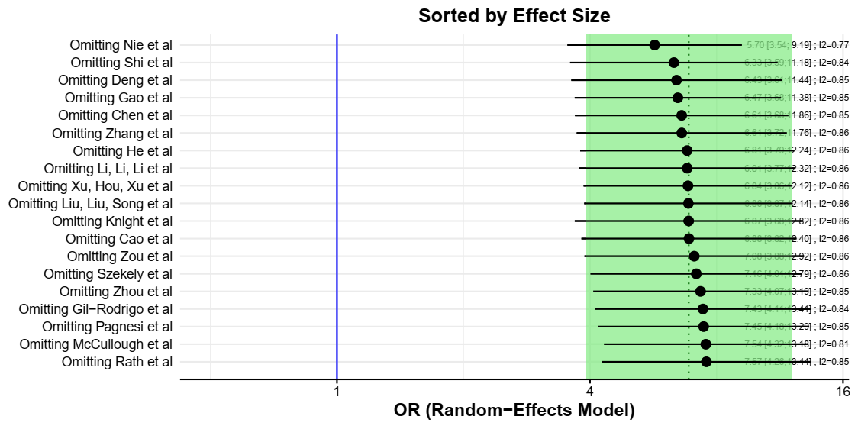

Slide 9
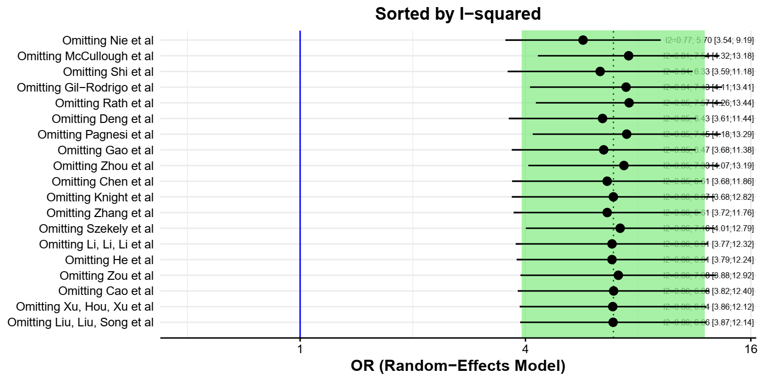

Slide 10
Leave-One-Out Analysis (Sorted by I2)
-----------------------------------
Effect LLCI ULCI I2
Omitting Nie et al 5.700 3.535 9.191 0.766
Omitting McCullough et al 7.545 4.319 13.180 0.813
Omitting Shi et al 6.333 3.587 11.181 0.838
Omitting Gil-Rodrigo et al 7.427 4.114 13.408 0.843
Omitting Rath et al 7.567 4.262 13.436 0.849
Omitting Deng et al 6.426 3.611 11.435 0.851
Omitting Pagnesi et al 7.455 4.183 13.288 0.852
Omitting Gao et al 6.471 3.679 11.385 0.854
Omitting Zhou et al 7.329 4.072 13.194 0.854
Omitting Chen et al 6.610 3.684 11.861 0.855
Omitting Knight et al 6.869 3.679 12.824 0.855
Omitting Zhang et al 6.613 3.719 11.757 0.856
Omitting Li, Li, Li et al 6.812 3.768 12.316 0.857
Omitting Szekely et al 7.162 4.010 12.793 0.857
Omitting He et al 6.811 3.790 12.241 0.857
Omitting Zou et al 7.081 3.880 12.922 0.857
Omitting Cao et al 6.879 3.817 12.399 0.858
Omitting Liu, Liu, Song et al 6.857 3.875 12.137 0.858
Omitting Xu, Hou, Xu et al 6.843 3.862 12.124 0.858

Slide 11
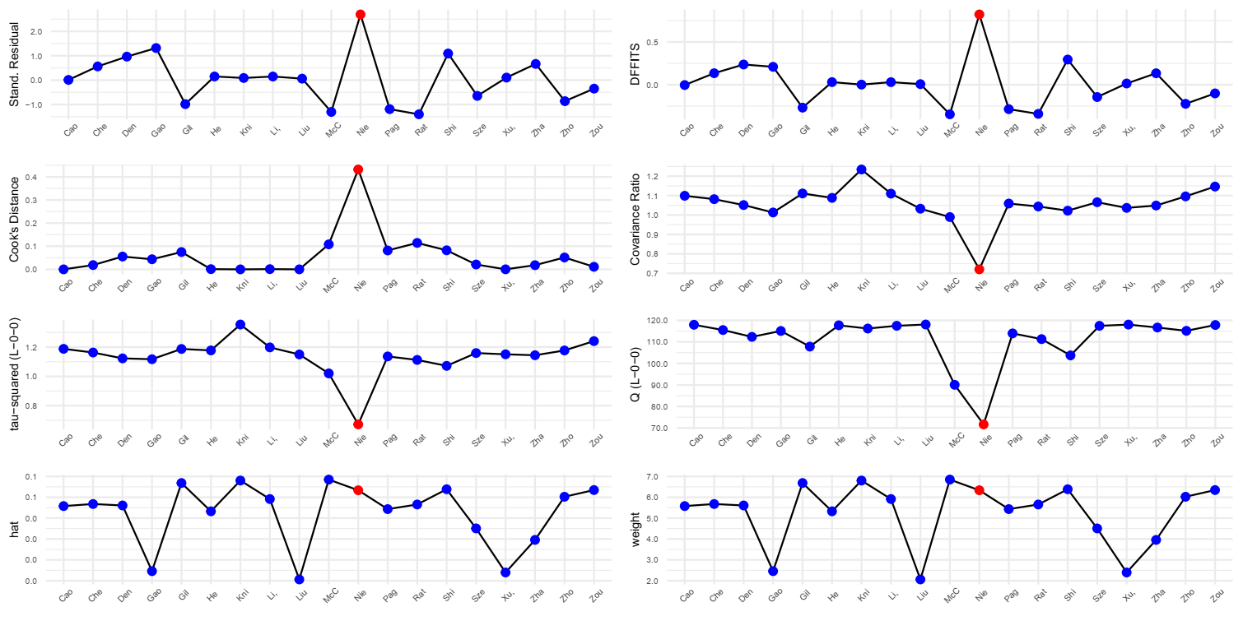
Note how Nie et al (red dot) is an outlier. (Influence Plot)

Slide 12
Influence Diagnostics
-------------------
rstudent dffits cook.d cov.r QE.del hat weight infl
Omitting Cao et al 0.009 -0.004 0.000 1.099 117.958 0.056 5.579
Omitting Deng et al 0.964 0.236 0.055 1.051 112.339 0.056 5.608
Omitting Gao et al 1.316 0.209 0.044 1.013 115.076 0.025 2.458
Omitting Gil-Rodrigo et al -0.985 -0.268 0.075 1.111 107.814 0.067 6.684
Omitting Li, Li, Li et al 0.148 0.030 0.001 1.110 117.485 0.059 5.916
Omitting Liu, Liu, Song et al 0.060 0.007 0.000 1.033 118.073 0.021 2.061
Omitting McCullough et al -1.305 -0.346 0.108 0.990 90.044 0.068 6.849
Omitting Rath et al -1.403 -0.341 0.114 1.044 111.292 0.057 5.654
Omitting Shi et al 1.091 0.294 0.082 1.022 103.720 0.064 6.385
Omitting Szekely et al -0.647 -0.144 0.021 1.066 117.474 0.045 4.507
Omitting He et al 0.149 0.031 0.001 1.088 117.715 0.053 5.327
Omitting Zhang et al 0.664 0.134 0.018 1.049 116.682 0.040 3.957
Omitting Zhou et al -0.863 -0.223 0.051 1.096 115.146 0.060 6.026
Omitting Zou et al -0.349 -0.101 0.011 1.147 117.852 0.063 6.346
Omitting Chen et al 0.562 0.135 0.018 1.082 115.506 0.057 5.677
Omitting Pagnesi et al -1.191 -0.286 0.082 1.059 113.949 0.054 5.433
Omitting Knight et al 0.087 0.001 0.000 1.235 116.205 0.068 6.803
Omitting Nie et al 2.694 0.822 0.432 0.720 71.653 0.063 6.336 *
Omitting Xu, Hou, Xu et al 0.104 0.014 0.000 1.037 118.041 0.024 2.394

Slide 13
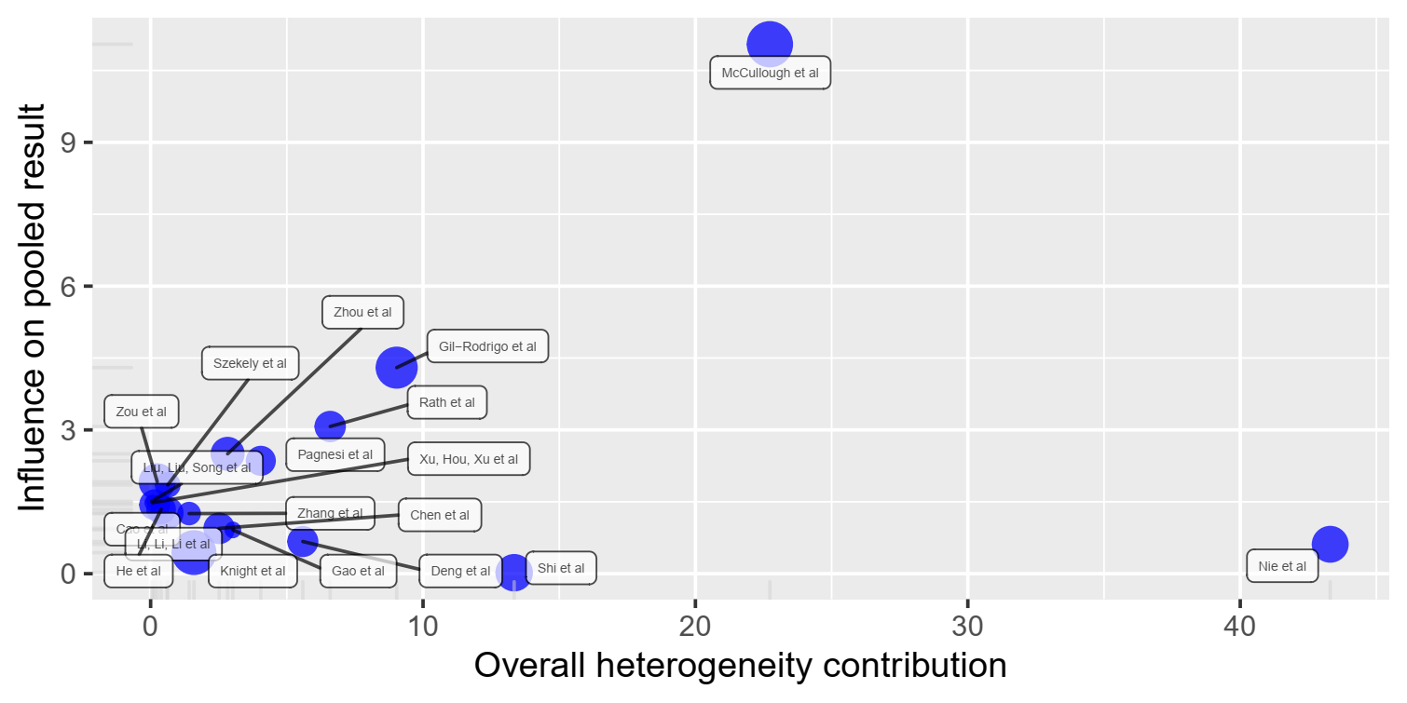
Note how Nie et al and McCullough et al are outliers. (Baujat Plot)

Slide 14
Baujat Diagnostics (sorted by Heterogeneity Contribution)
-------------------------------------------------------
HetContrib InfluenceEffectSize
Omitting Nie et al 43.304 0.613
Omitting McCullough et al 22.733 11.047
Omitting Shi et al 13.345 0.020
Omitting Gil-Rodrigo et al 9.033 4.300
Omitting Rath et al 6.591 3.071
Omitting Deng et al 5.587 0.671
Omitting Pagnesi et al 4.045 2.355
Omitting Gao et al 3.020 0.913
Omitting Zhou et al 2.825 2.501
Omitting Chen et al 2.516 0.946
Omitting Knight et al 1.591 0.440
Omitting Zhang et al 1.413 1.254
Omitting Szekely et al 0.627 1.852
Omitting Li, Li, Li et al 0.600 1.266
Omitting He et al 0.386 1.341
Omitting Zou et al 0.241 1.918
Omitting Cao et al 0.147 1.437
Omitting Xu, Hou, Xu et al 0.069 1.481
Omitting Liu, Liu, Song et al 0.038 1.509

Slide 15
Cohort OR

Slide 16
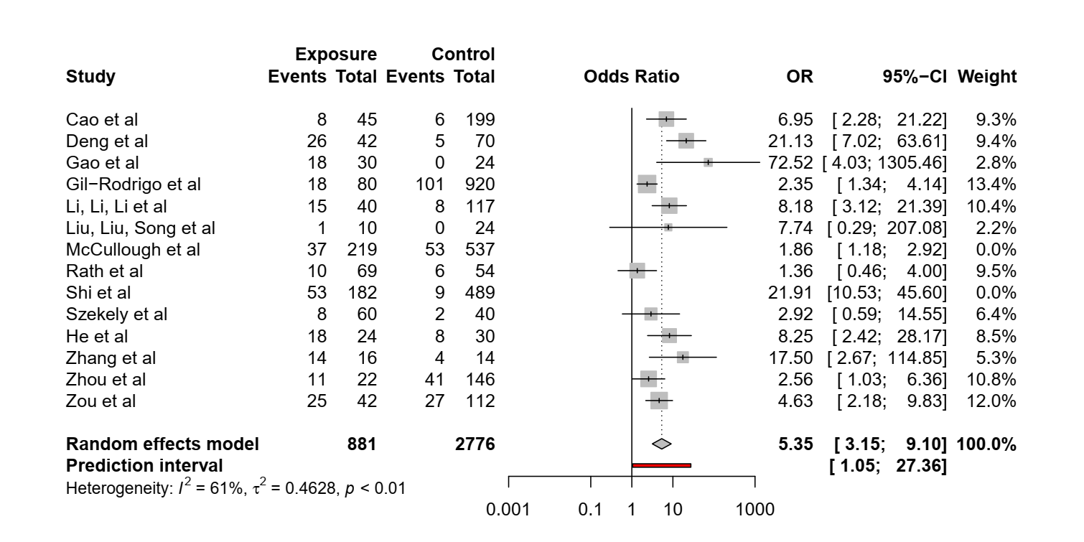
Pooled OR of Cohort Studies

Slide 17
Identified outliers (random-effects model)
------------------------------------------
"McCullough et al", "Shi et al"
Results with outliers removed
-----------------------------
OR 95%-CI %W(random) exclude
Cao et al 6.9550 [ 2.2797; 21.2184] 9.3
Deng et al 21.1250 [ 7.0152; 63.6139] 9.4
Gao et al 72.5200 [ 4.0286; 1305.4562] 2.8
Gil-Rodrigo et al 2.3542 [ 1.3394; 4.1380] 13.4
Li, Li, Li et al 8.1750 [ 3.1243; 21.3904] 10.4
Liu, Liu, Song et al 7.7368 [ 0.2891; 207.0783] 2.2
McCullough et al 1.8565 [ 1.1800; 2.9208] 0.0 *
Rath et al 1.3559 [ 0.4598; 3.9986] 9.5
Shi et al 21.9121 [10.5295; 45.5999] 0.0 *
Szekely et al 2.9231 [ 0.5872; 14.5500] 6.4
He et al 8.2500 [ 2.4158; 28.1741] 8.5
Zhang et al 17.5000 [ 2.6666; 114.8459] 5.3
Zhou et al 2.5610 [ 1.0305; 6.3645] 10.8
Zou et al 4.6296 [ 2.1802; 9.8309] 12.0
Number of studies combined: k = 12

Slide 18
OR 95%-CI z p-value
Random effects model 5.3549 [3.1523; 9.0965] 6.21 < 0.0001
Prediction interval [1.0480; 27.3614]
Quantifying heterogeneity:
tau^2 = 0.4628; tau = 0.6803; I^2 = 60.8% [26.3%; 79.1%]; H = 1.60 [1.16; 2.19]
Test of heterogeneity:
Q d.f. p-value
28.04 11 0.0032
Details on meta-analytical method:
- Mantel-Haenszel method
- DerSimonian-Laird estimator for tau^2
- Mantel-Haenszel estimator used in calculation of Q and tau^2 (like RevMan 5)
- Continuity correction of 0.5 in studies with zero cell frequencies

Slide 19
Influence Analysis of Cohort RR

Slide 20
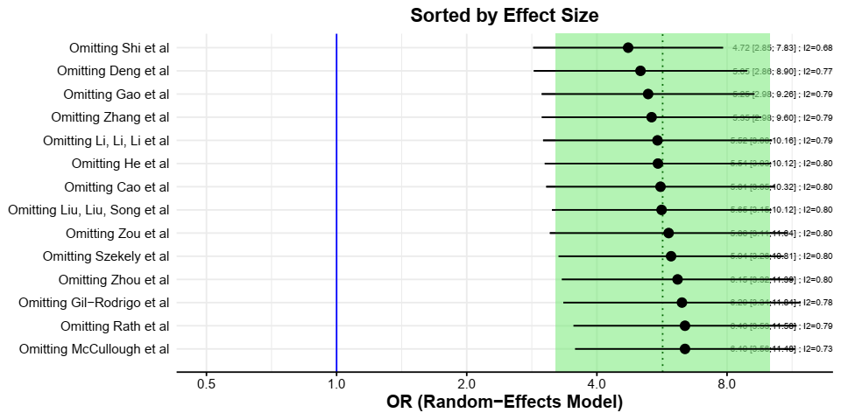

Slide 21
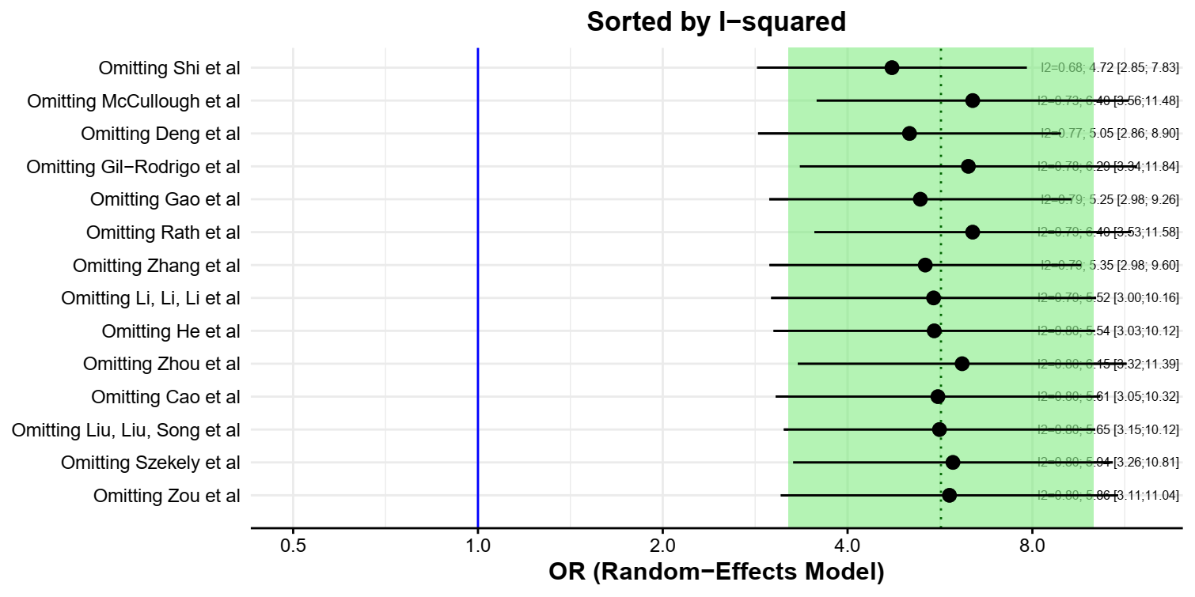

Slide 22
Leave-One-Out Analysis (Sorted by I2)
-----------------------------------
Effect LLCI ULCI I2
Omitting Shi et al 4.725 2.850 7.834 0.679
Omitting McCullough et al 6.396 3.562 11.484 0.730
Omitting Deng et al 5.046 2.859 8.905 0.767
Omitting Gil-Rodrigo et al 6.292 3.345 11.838 0.785
Omitting Gao et al 5.255 2.982 9.261 0.787
Omitting Rath et al 6.395 3.532 11.581 0.787
Omitting Zhang et al 5.353 2.984 9.604 0.793
Omitting Li, Li, Li et al 5.524 3.003 10.160 0.795
Omitting He et al 5.537 3.030 10.116 0.797
Omitting Zhou et al 6.147 3.318 11.388 0.798
Omitting Cao et al 5.613 3.054 10.318 0.799
Omitting Liu, Liu, Song et al 5.646 3.149 10.123 0.801
Omitting Szekely et al 5.939 3.261 10.814 0.801
Omitting Zou et al 5.862 3.114 11.038 0.801

Slide 23
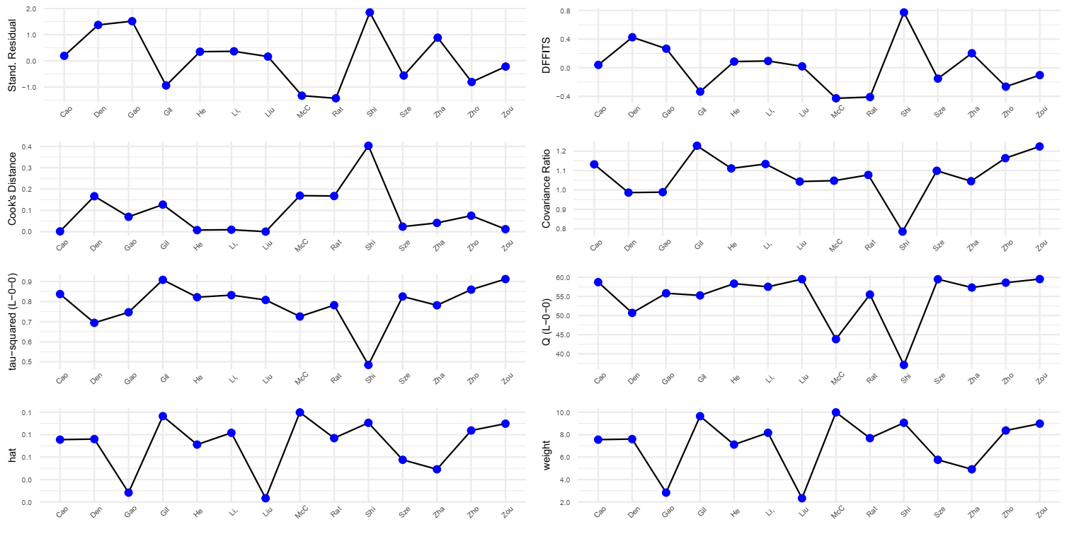
Influence plot of all cohort studies

Slide 24
Influence Diagnostics
-------------------
rstudent dffits cook.d cov.r QE.del hat weight infl
Omitting Cao et al 0.193 0.040 0.002 1.132 58.748 0.076 7.555
Omitting Deng et al 1.371 0.426 0.166 0.986 50.697 0.076 7.606
Omitting Gao et al 1.514 0.266 0.070 0.988 55.835 0.028 2.835
Omitting Gil-Rodrigo et al -0.939 -0.334 0.127 1.228 55.272 0.096 9.646
Omitting Li, Li, Li et al 0.364 0.095 0.009 1.134 57.529 0.082 8.165
Omitting Liu, Liu, Song et al 0.164 0.019 0.000 1.043 59.526 0.023 2.333
Omitting McCullough et al -1.327 -0.427 0.169 1.048 43.823 0.100 9.983
Omitting Rath et al -1.428 -0.410 0.167 1.077 55.500 0.077 7.689
Omitting Shi et al 1.848 0.774 0.403 0.785 37.082 0.091 9.053
Omitting Szekely et al -0.561 -0.152 0.024 1.099 59.505 0.058 5.759
Omitting He et al 0.350 0.086 0.008 1.111 58.356 0.071 7.115
Omitting Zhang et al 0.886 0.203 0.041 1.045 57.330 0.049 4.914
Omitting Zhou et al -0.807 -0.265 0.075 1.164 58.602 0.084 8.369
Omitting Zou et al -0.218 -0.103 0.012 1.224 59.550 0.090 8.978

Slide 25
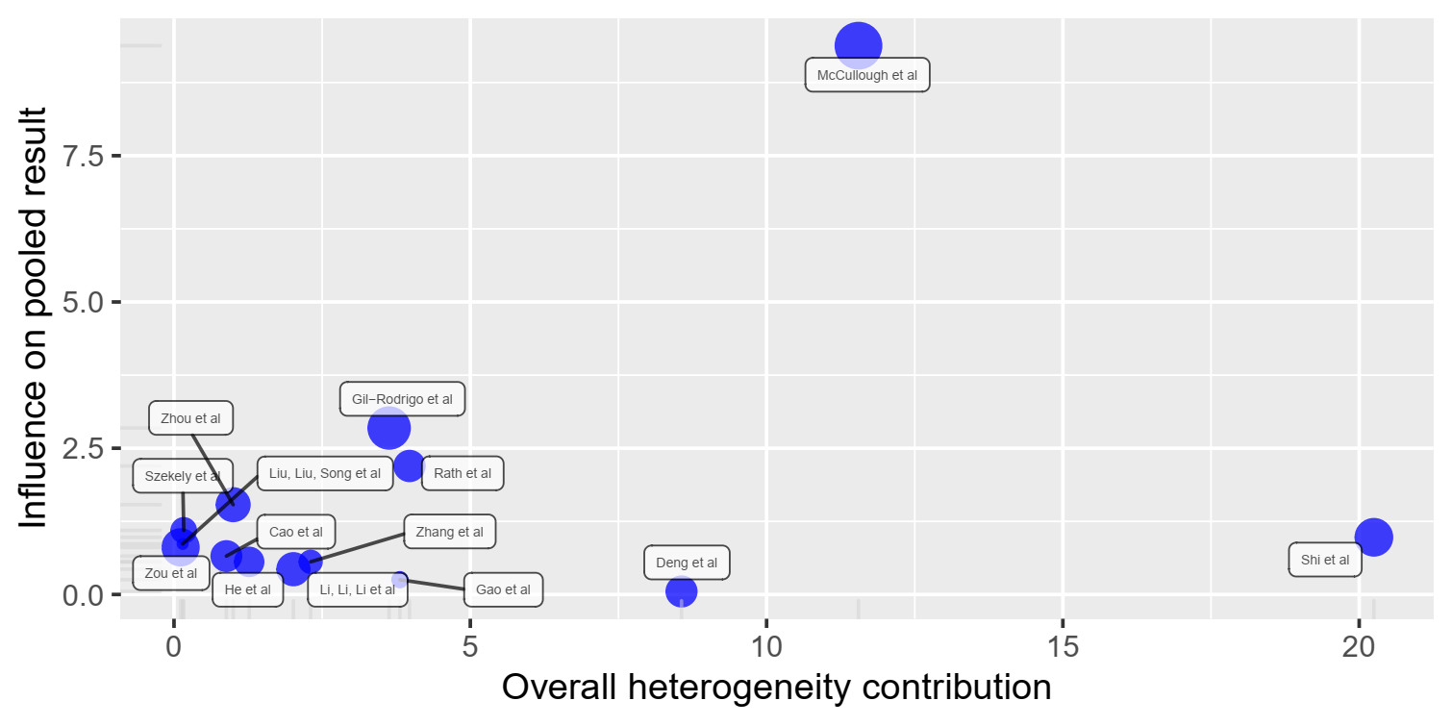
Note how Shi et al and McCullough et al are outliers. (Baujat Plot)

Slide 26
Baujat Diagnostics (sorted by Heterogeneity Contribution)
-------------------------------------------------------
HetContrib InfluenceEffectSize
Omitting Shi et al 20.248 0.978
Omitting McCullough et al 11.551 9.380
Omitting Deng et al 8.564 0.052
Omitting Rath et al 3.974 2.197
Omitting Gao et al 3.812 0.253
Omitting Gil-Rodrigo et al 3.630 2.845
Omitting Zhang et al 2.306 0.559
Omitting Li, Li, Li et al 2.015 0.432
Omitting He et al 1.268 0.557
Omitting Zhou et al 0.998 1.535
Omitting Cao et al 0.884 0.656
Omitting Szekely et al 0.164 1.096
Omitting Liu, Liu, Song et al 0.146 0.864
Omitting Zou et al 0.111 0.805

