Slide 1
Fair Market Rent Difference: A Spatial Analysis of Unfair Housing Prices
Dylan Micheals & Shouro Shuvit

Slide 2
Introduction
Problem: Housing prices are often unfair and unaffordable
Current Policy: Fair Market Rent (FMR) is used to determine housing prices
Problem is that it only looks at a narrow portion of what influences housing prices
Goal: Analyze the difference between FMR and actual housing prices to identify areas of unfair housing prices

Slide 3
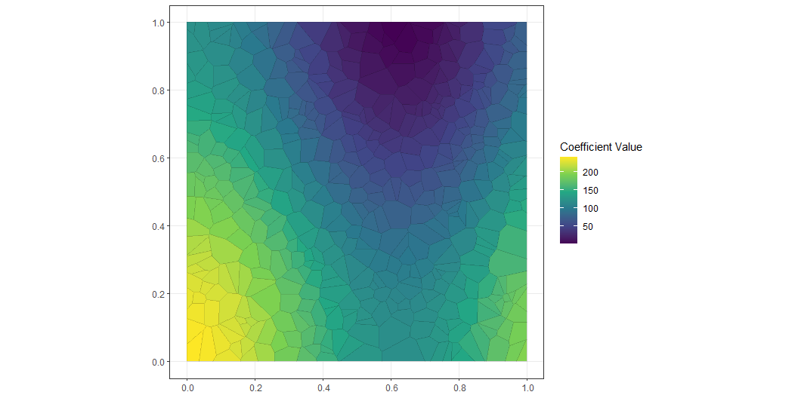
Simulation

Slide 4
Methods
Data: 100k apartments for Rent Classified Dataset
Data: FMR Dataset
Analysis:
Exploratory Data Analysis: Analyze correlations between variables and create a basic linear model
Random Forest: Predict housing prices based on bedrooms, bathrooms, square footage, and population
Geographically Weighted Regression: Predict housing prices based on bedrooms, bathrooms, square footage, and population

Slide 5
Methods
Model Choice: GWR was chosen because it accounts for spatial autocorrelation which was crucial in our understanding of how the covariates vary over space

Slide 6
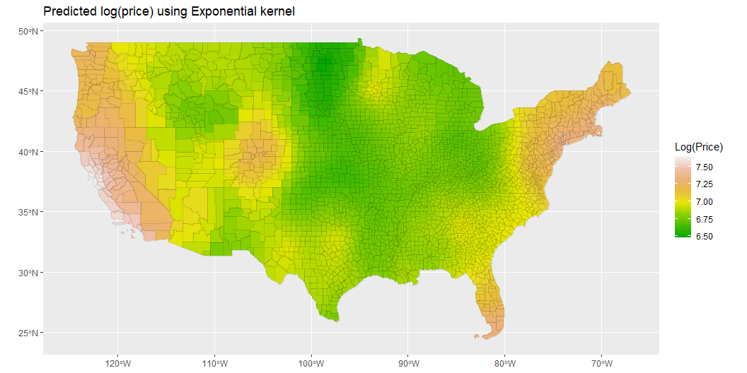
Results

Slide 7
Discussion
What do our results mean?
Why are some areas more unfair than others?
New York City, Western Coast, Colorado, Miami
How can we use this information to make housing more affordable?
Information can be used to pinpoint

Slide 8
Conclusion
We see in the aforementioned areas that there are other factors that the FMR cannot capture
Moving forward, what can we do to improve upon our research

