Slide 1

Portfolio
Top Class Mechanical Engineer
Kim,Dongho

Slide 2
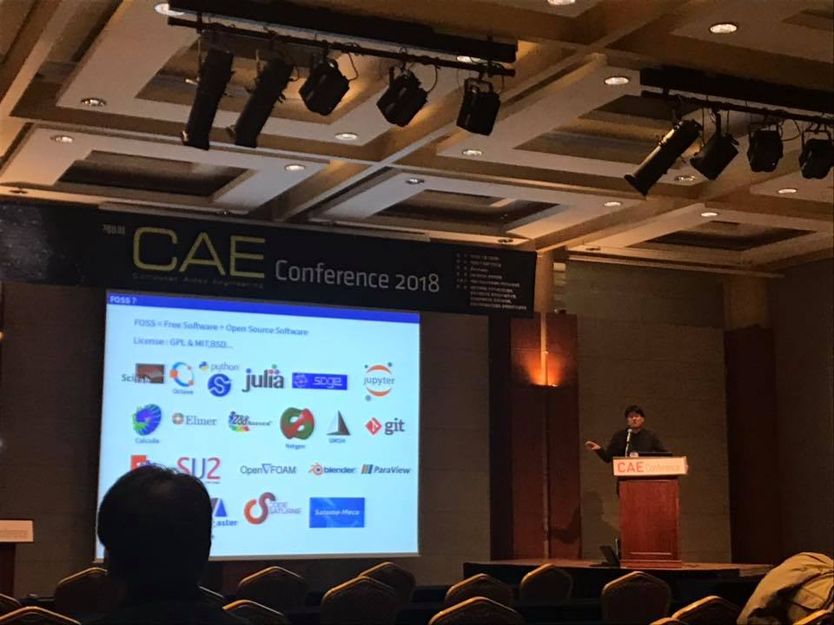
Entrepreneurship is dead?
In traditional manufacturing, it’s true.
But
In the high-touch industry, it is alive.
I thought Gentle Monster has it.

Slide 3
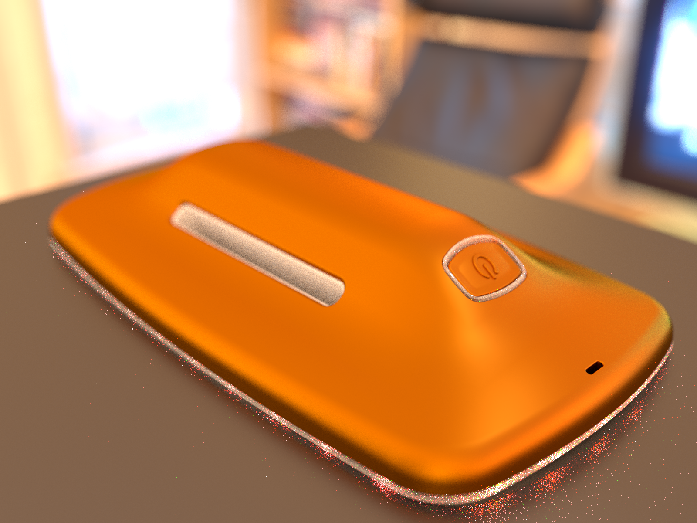
Wearable Wellness device
Aalok Fat Melt with IR LED
Keyword – Simplify, Easy
Technical Issue – Bioheat and Battery, Low Power Problems

Slide 4
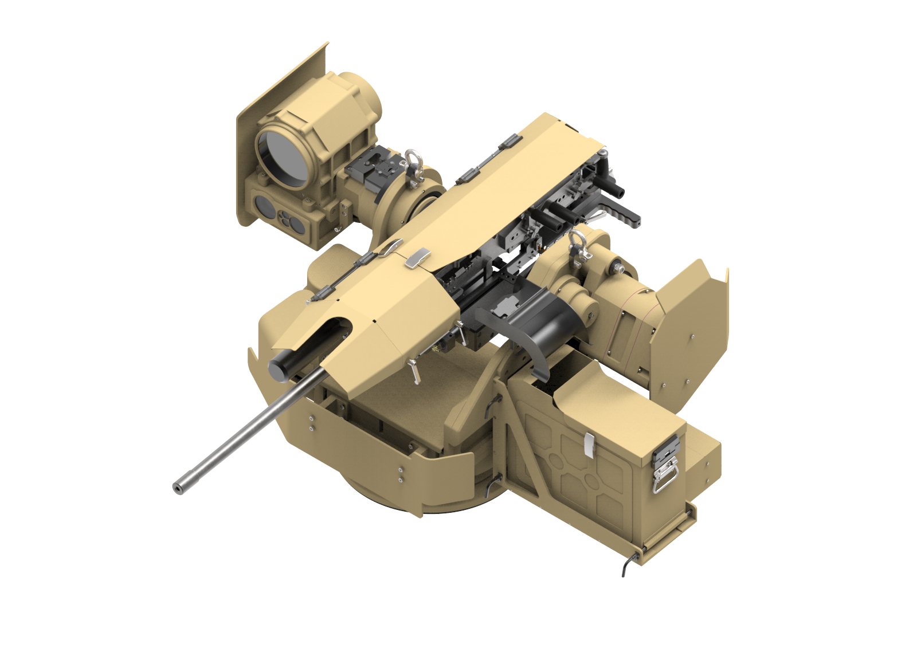
Military Robot
Keyword – Fast Development, High Reliablility
Technical Issue – Amunition Feed, Triggering Mechanism

Slide 5
Modular Robotics

