Slide 1

FBA
|
QUANTITATIVE FINANCE
RESEARCH GROUP
Optimal Execution with Continuous Trading I
Nov 3rd, 2023
발표자: 박지혁

Slide 2
Outline
Ⅰ. | Introduction, model description
Ⅱ. | liquidation without Penalties only Temporary Impact
Ⅲ. | Optimal Acquisition with Terminal Penalty and Temporary Impact
Ⅳ.
FBA
|
QUANTITATIVE FINANCE
RESEARCH GROUP

Slide 3
Introduction, model description
챕터 소개와 배경
1. 알고리즘 트레이딩 전략의 개발
Classical optimal execution strategies: agent는 정해진 기간에서, 시장 주문(Market order)만을 이용하여 연속적으로 자산을 획득하거나(acquire) 청산함(liquidate).
이때 대량의 자산을 사고파는 가장 효율적인 (efficient or cost-effective) 방법을 찾는 것이 목표.
Agent의 행동은 자산의 가격에 영향을 미칠 수 있으며, agent는 자신의 거래가 자산 가격에 미치는 영향을 고려해 거래의 속도나 규모 (level of urgency)를 조절할 수 있음.
2. 키워드 정리
Institutional Traders – agency broker에게 대규모의 투자를 맡김 – Limit Order Book 상의 평균 거래 규모보다 커, 시장에 충격을 줄 수 있음. 따라서 Parent order를 Child order로 분할해 실행하는 경우가 많음.
Execution cost - benchmark price(주문이 주어졌을 때의 판매자, 구매자 간 중간 가격) 와 실제 execution price와의 차이 - Positive execution cost는 해당 operation에서의 value의 손실을 나타냄.
FBA
|
QUANTITATIVE FINANCE
RESEARCH GROUP

Slide 4
Introduction, model description
모델링
고려해야 할 사항: agent가 보유하는 자산의 수(inventory), 중간 가격의 변화(dynamics of midprice), agent의 시장 주문이 midprice에 미치는 영향
is trading rate, the speed at which the agent is liqui­dating or acquiring shares (optimization variable)
is agent's inventory, which is clearly affected by how fast she trades
is midprice process, and is also affected in principle by the speed of her trading
is execution price
is agent's cash process resulting from the agent's execution strategy
FBA
|
QUANTITATIVE FINANCE
RESEARCH GROUP

Slide 5
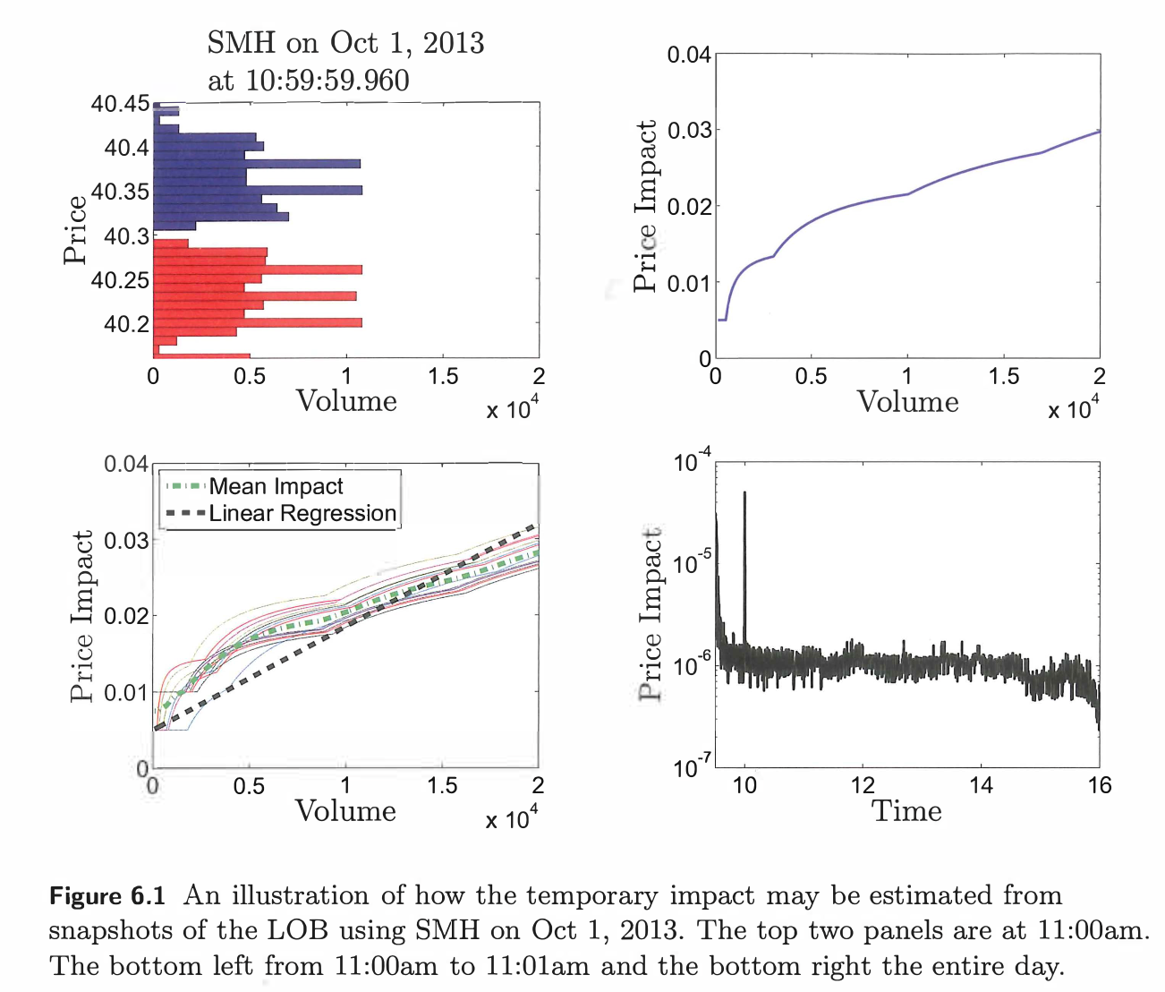
Introduction, model description
모델링
Set of SDEs (plus sign means acquiring, minus sign means liquidating)
$∗W$ is standard Brownian motion, $g:R_{+}→R_{+}$ is permanent price impact on the midprice
$∗f:R_{+}→R_{+}$ is temporary price impact, $Δ$ is bid-ask spread(positive constant)
FBA
|
QUANTITATIVE FINANCE
RESEARCH GROUP

Slide 6
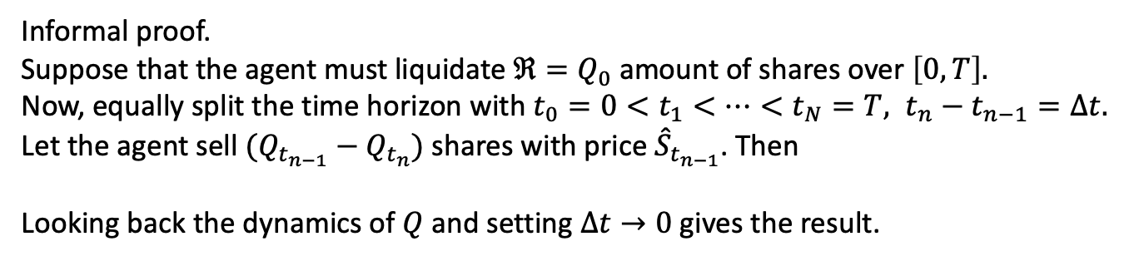
Introduction, model description
모델링
Set of SDEs
Informal proof.
Suppose that the agent must liquidate $ℜ=Q_{0}$ amount of shares over $\left[0,T\right].$
Now, equally split the time horizon with $t_{0}=0<t_{1}<⋯<t_{N}=T, t_{n}−t_{n−1}=Δt.$
Let the agent sell $(Q_{t_{n−1}}−Q_{t_{n}})$ shares with price ${\hat{S}}_{t_{n−1}}$. Then
Looking back the dynamics of $Q$ and setting $Δt→0$ gives the result.
FBA
|
QUANTITATIVE FINANCE
RESEARCH GROUP

Slide 7

liquidation without Penalties only Temporary Impact
Optimal liquidation problem
: How to liquidate $ℜ$ shares over [0, T]?
Let’s assume $g\left(ν_{t}\right)=0.$i.e. agent's own trades do not affect the midprice of the asset
Let $f\left(ν_{t}\right)=kν_{t}.$ i.e. Temporary effect is linear in the speed in the trading
And let $Δ=0.$ i.e. $S_{t}$represents the best bid price
Objective to be minimized: execution cost w.r.t. $υ$
Value function:
FBA
|
QUANTITATIVE FINANCE
RESEARCH GROUP

Slide 8
liquidation without Penalties only Temporary Impact
Solving the model
From Dynamic Programming Principle(DPP), we gain this Dynamic Programming Equation(DPE)
(6.4)
Terminal inventory is zero:
First-order condition:
(6.5), (6.6)
Value function ansatz:
(6.7)
Factor out q from h:
(6.8)
FBA
|
QUANTITATIVE FINANCE
RESEARCH GROUP

Slide 9
liquidation without Penalties only Temporary Impact
Solving the model, cont’d
From (6.7), reduce (6.5) to:
(6.9)
Integrate:
Terminal inventory condition:
(6.10)
So the optimal inventory, optimal trading speed is:
(6.11), (6.12)
same as that of the time weighted average price (TWAP)
FBA
|
QUANTITATIVE FINANCE
RESEARCH GROUP

Slide 10

Optimal Acquisition with Terminal Penalty and Temporary Impact
Optimal acquisition problem
: How to acquire at most $ℜ$ shares over [0, T]?
It is allowed that $Q_{T}^{υ}< ℜ$, and in this case she must execute a buy MO for the remaining amount and pick up an additional penalty. This penalty is parameterized by $α.$
Objective to be minimized:
Value function:
FBA
|
QUANTITATIVE FINANCE
RESEARCH GROUP

Slide 11

Optimal Acquisition with Terminal Penalty and Temporary Impact
Solving the model
DPE with terminal condition $H\left(T,S,y\right)=yS+ αy^{2}$
(6.14)
First-order condition:
(6.15)
Value function anstaz:
(6.16)
Reduce (6.15) to:
(6.17)
FBA
|
QUANTITATIVE FINANCE
RESEARCH GROUP

Slide 12
Optimal Acquisition with Terminal Penalty and Temporary Impact
Solving the model, cont’d
Integrate over [0,t]:
So the optimal inventory path is:
(6.18)
The optimal trading speed is:
(6.19)
FBA
|
QUANTITATIVE FINANCE
RESEARCH GROUP

Slide 13


6.5 Liquidation with Permanent Prick Impact
When we switch from acquisition back to liquidation, discussing the liquiation of a total of $ℜ$ shares through market orders(Mos)
Trades impact prices both temporarily and permanently.
The midprice dynamics, affected by a negative sign due to the agent's sell trades exerting a permanent downward pressure, are denoted by
The model assumes that sell trades negatively impact prices temporarily.
Additionally, the agent is required to execute an MO to achieve a total revenue of considering as the terminal liquidation penalty parameter.
FBA
|
QUANTITATIVE FINANCE
RESEARCH GROUP

Slide 14



6.5 Liquidation with Permanent Prick Impact
The agent's goal is to minimize the execution cost, expressed as:
the investor's wealth process is as outlined in section 6.2.
The section evolves from detailing the cash process in terms of integrated execution costs to incorporating the cash process as a direct state variable.
The model now includes a new element, a running inventory penalty
A parameter indicating the urgency and cost of delayed share liquidation.
The higher is, the more penalized the agent is for postponing trades, encouraging strategies that prioritize the early liquidation of inventory.
FBA
|
QUANTITATIVE FINANCE
RESEARCH GROUP

Slide 15
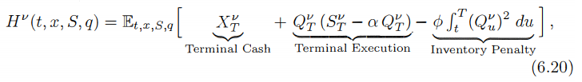





6.5 Liquidation with Permanent Prick Impact
The agent’s performance criterion is
Definition of the value function
HJB equation
the optimal speed of trading and present the first-order condition:
Upon substituting the optimal feed back control into the DPE, it reduces to
FBA
|
QUANTITATIVE FINANCE
RESEARCH GROUP

Slide 16


6.5 Liquidation with Permanent Prick Impact
By inspecting the terminal condition it suggests the ansatz
The variable ℎ, with an undetermined terminal condition h(T,S,q)=−αq2, represents additional value.
The first term of the ansatz signifies the accumulated cash of the strategy, while the second term denotes the mark-to-market book value of the remaining inventory at midprice.
The function ℎ signifies the extra value obtained from optimally liquidating the remaining shares.
Present the simplified nonlinear PDE for ℎ:
FBA
|
QUANTITATIVE FINANCE
RESEARCH GROUP

Slide 17









6.5 Liquidation with Permanent Prick Impact
The optimal control in feedback form from (6.22) takes on the much more compact form
The solution appears to employ a separation of variables where
satisfies the non-linear ODE.
subject to the terminal condition can be exactly integrated.
First, let then re-arranging the ODE we obtain
Subject to Next integrating both sides [t,T]
So that where ( below)
FBA
|
QUANTITATIVE FINANCE
RESEARCH GROUP

Slide 18




6.5 Liquidation with Permanent Prick Impact
The optimal speed of trading is given by the formula:
γ is a parameter that encapsulates the risk aversion and market impact coefficients, and is the optimal inventory level at time t.
the agent's inventory dynamics can be described by the differential equation
Function of the optimal trading speed
FBA
|
QUANTITATIVE FINANCE
RESEARCH GROUP

Slide 19
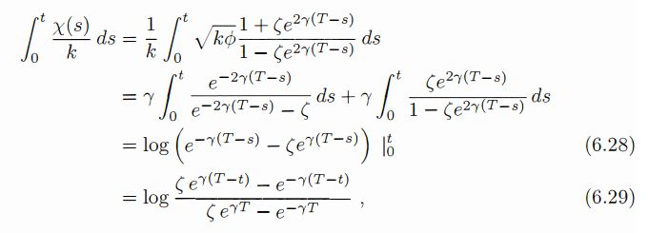



6.5 Liquidation with Permanent Prick Impact
To obtain the inventory along the optimal strategy we first solve the integral
Hence
Substituting this expression into (6.27) allows us to write the optimal speed to
trade as a simple deterministic function of time
FBA
|
QUANTITATIVE FINANCE
RESEARCH GROUP

Slide 20
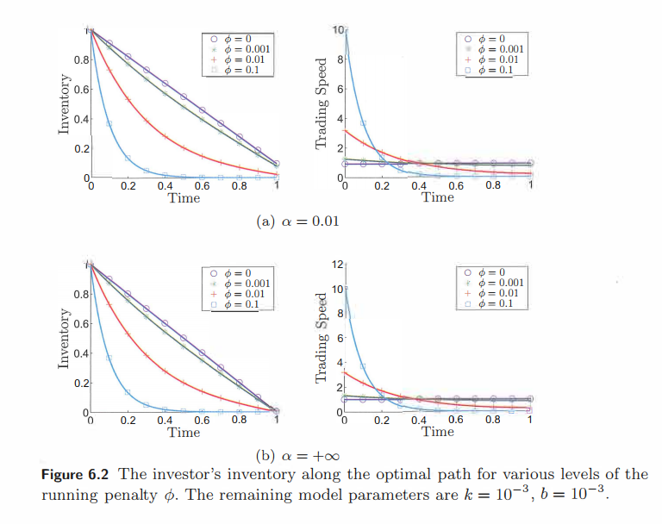
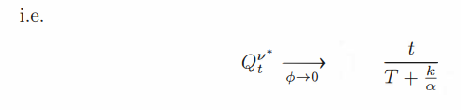
6.5 Liquidation with Permanent Prick Impact
Figure 6.2 illustrates the inventory levels under the optimal strategy for two different levels of liquidation penalty α and various levels of the running penalty ϕ. Without a running penalty (ϕ=0), the strategies are linear and, as α approaches infinity, they align with a TWAP strategy.
When the running penalty ϕ increases, the trading curves become more convex, indicating a strategy that prioritizes selling assets earlier. This makes sense as ϕ reflects the urgency for liquidation. With an increase in the liquidation penalty, the strategies aim to reduce the terminal inventory to zero.
FBA
|
QUANTITATIVE FINANCE
RESEARCH GROUP

Slide 21




6.5 Liquidation with Permanent Prick Impact
Equivalence Between Permanent Price Impact and Terminal Liquidation Penalty
Figure 6.2 illustrates the inventory levels under the optimal strategy for two different levels of liquidation
From the optimal speed of trading formula, the permanent impact and the liquidation penalty always appear in the form α−1/2​b as seen in equation (6.26).
the liquidation of terminal inventory being quadratic allows us to define a single parameter
How the optimal speed of trading is influenced by permanent price impact and liquidation penalties.
o examine the effect on proceeds from selling shares, the agent's terminal cash is calculated under an arbitrary strategy
The agent's cash position is governed by the following Stochastic Differential Equation (SDE):
where
FBA
|
QUANTITATIVE FINANCE
RESEARCH GROUP

Slide 22

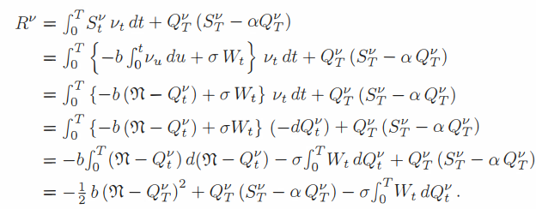
6.5 Liquidation with Permanent Prick Impact
Equivalence Between Permanent Price Impact and Terminal Liquidation Penalty
Simplicity, assume that
the revenue from liquidating her shares, including the liquidation of the terminal inventory is
FBA
|
QUANTITATIVE FINANCE
RESEARCH GROUP

Slide 23



6.5 Execution with Exponential Utility Maximiser
Let us consider the agent who sets preferences based on expected utility of ter­minal wealth with exponential utility:
Value function is
The agent's terminal wealth consists of cash from accumulated trades, represented by Xy, and the value gained from liquidating any remaining assets at the end of the trading period, represented by
This liquidation reflects the impact of executing a large, one-time trade, as outlined in equations (6.1) and (6.2), where Sv, Q v, and X" meet the usual conditions.
Applying the DDP we expect that H satisfies the DPE
With terminal condition
FBA
|
QUANTITATIVE FINANCE
RESEARCH GROUP

Slide 24

6.5 Execution with Exponential Utility Maximiser
The exponential terminal condition suggests that we use the ansatz
And upon substitution into (6.31), we find that h satisfies the non-linear PDE
subject to the terminal condition
Since we expect that h is negative, due to the terminal condition. When we factor out the common terms
And obtain the simpler non-linear PDE
It is straightforward to obtain the optimal control v* in feedback form as
FBA
|
QUANTITATIVE FINANCE
RESEARCH GROUP

Slide 25






6.6 Execution with Exponential Utility Maximiser
And upon substitution ins (6.33), we further find that h solves
Assuming 'h' to be quadratic in 'q' implies that 'h(t, q)' is expressed as , leading to a nonlinear ODE for 'h2(t)' with the condition
Inserting this second ansatz, and factoring out we find that satisfies the non-linear ODE
Comparing (6.35) to (6.25), we see that the two ODEs coincide whenever
and since the terminal conditions are identical, the solutions to the two PDEs are identical.
Using the same steps 6.25
where the constants
FBA
|
QUANTITATIVE FINANCE
RESEARCH GROUP

Slide 26



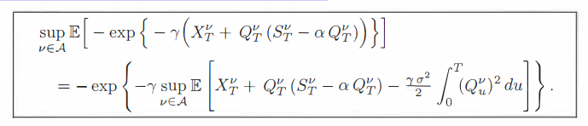
6.6 Execution with Exponential Utility Maximiser
And upon substitution ins (6.33), we further find that h solves
This strategy is identical in form to the one for the risk-neutral agent who is inventory averse appearing in (6.27). Furthermore, the value functions for the two problems (the exponential utility maximiser and the risk-neutral with inventory aversion) can be mapped to one another. From (6.32), we have
where the superscript exp-util emphasises that this is for the exponential utility maximiser. Similarly, from (6.23), we have that
where the superscript inv- aver emphasises that this is for the inventory averse agent. Since the h2 functions coincide when we can write the value functions in terms of one another as follows:
FBA
|
QUANTITATIVE FINANCE
RESEARCH GROUP

Slide 27
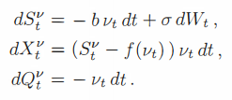

6.7 Non-Linear Temporary Price Impact
To focus on the effects of non-linear impact, we revert back to a risk-neutral agent with inventory aversion through a running penalty as in all sections, other than Section 6.6, and so the agent's performance criteria is as in (6.20) repeated here for convenience:
and the dynamics of Sv , Xv and Qv are also repeated here with the explicit non-linear impact model written in place:
As usual, the DPP suggests that the value function
FBA
|
QUANTITATIVE FINANCE
RESEARCH GROUP

Slide 28
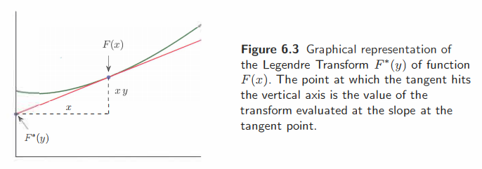



6.7 Non-Linear Temporary Price Impact
Should satisfy the DPE
with terminal condition
Applying the usual ansatz,
When we shares non-linear PDE for h:
with terminal condition
FBA
|
QUANTITATIVE FINANCE
RESEARCH GROUP

Slide 29



6.7 Non-Linear Temporary Price Impact
Denote and assume that . The implication is that the net cost (and not the price impact alone) of trading at a rate of v is convex. This certainly holds true for the linear price impact model, for which and so
Popular power law price impact models Under this convexity assumption, the supremum term becomes
where F* is the Legendre transform of the function F defined as
The Legendre transform is a mapping from the graph of a function to the set of its tangents, and can be best understood from Figure 6.3. the Legendre transform F*(y) of the function F equals the value at which the tangent at a point intersects the vertical axis, and the argument y is the slope of the function at that tangent point.
For example, in a power law impact model we write and so
FBA
|
QUANTITATIVE FINANCE
RESEARCH GROUP

Slide 30

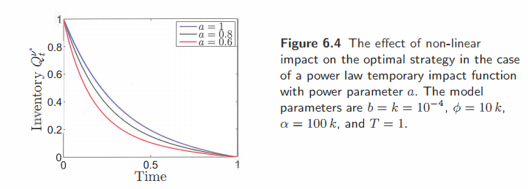

6.7 Non-Linear Temporary Price Impact
For example, in a power law impact model we write and so
Then
We can find the optimal point x* from the first order condition
FBA
|
QUANTITATIVE FINANCE
RESEARCH GROUP

Slide 31


6.7 Non-Linear Temporary Price Impact
and so
and the optimal trading speed in feedback form is
We can then write the non-linear PDE for has
In general, this equation cannot be solved analytically, and one must resort to numerical PDE techniques.
In Figure 6.4, we show the effect of the strength of the power in the power law parameter a on the inventory path from following the optimal strategy
These curves are obtained by numerically solving (6.38) with a finite difference scheme, substituting the solution into (6.37), and then numerically integrating
FBA
|
QUANTITATIVE FINANCE
RESEARCH GROUP

Slide 32
6.7 Non-Linear Temporary Price Impact
The striking result is that as the power law parameter decreases,
so that orders of the same size have less and less of an impact, the agent liquidates faster.
The intuition here is that since trading does not impact prices as much,
the agent prefers to liquidate shares early and reduce her inventory risk,
and doing so does not cause her to lose too much from temporary market impact.
In some sense, the agent behaves as if she has a larger urgency parameter,
but still uses a linear impact model.
FBA
|
QUANTITATIVE FINANCE
RESEARCH GROUP

Slide 33
FBA
|
QUANTITATIVE FINANCE
RESEARCH GROUP
Contact fbaquant@gmail.com Website fbaquant.com

