Slide 1
Music Streaming on Spotify during CoVID-19 Era
Strategizing music releases for the lesser-known artists
Yi Cao

Slide 2
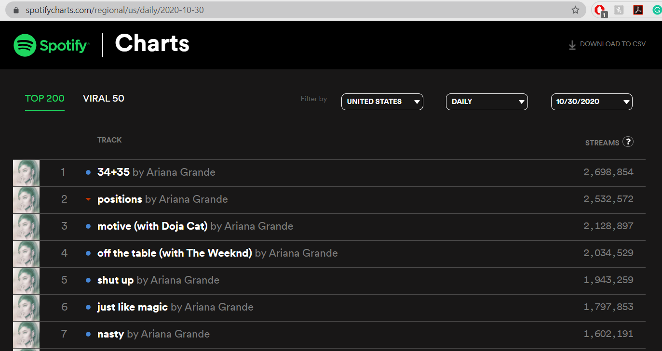
SpotifyCharts.com

Slide 3
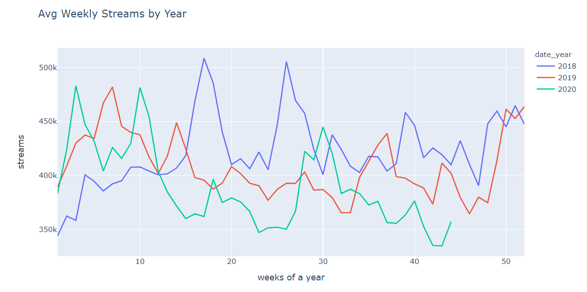
Avg weekly music streams on Top 200 went down after the CoVID-19 outbreak started in 2020

Slide 4
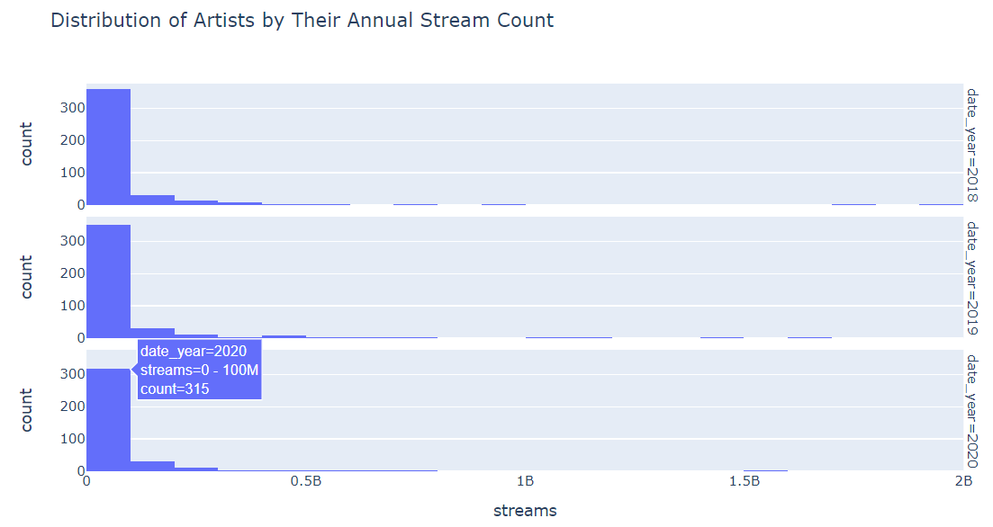
Majority of the artists had an annual stream count in 0-100M range

Slide 5
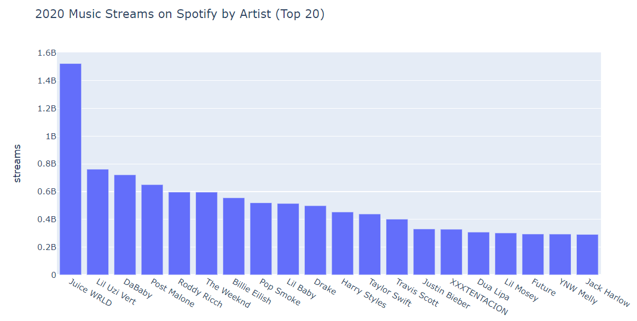
Streaming giants

Slide 6
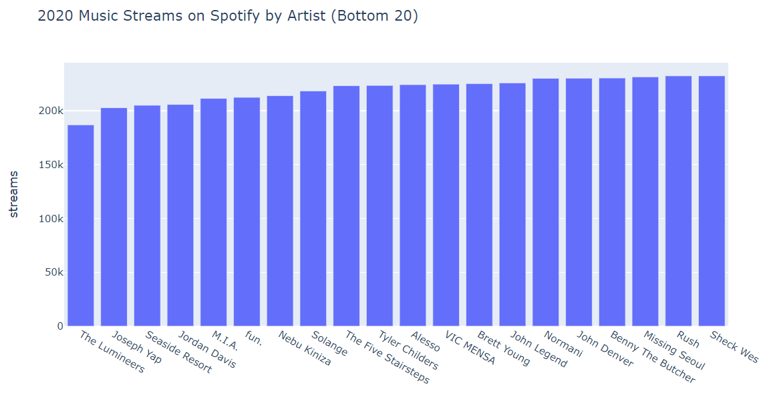
There were ‘big’ artists in the bottom 20 as well

Slide 7
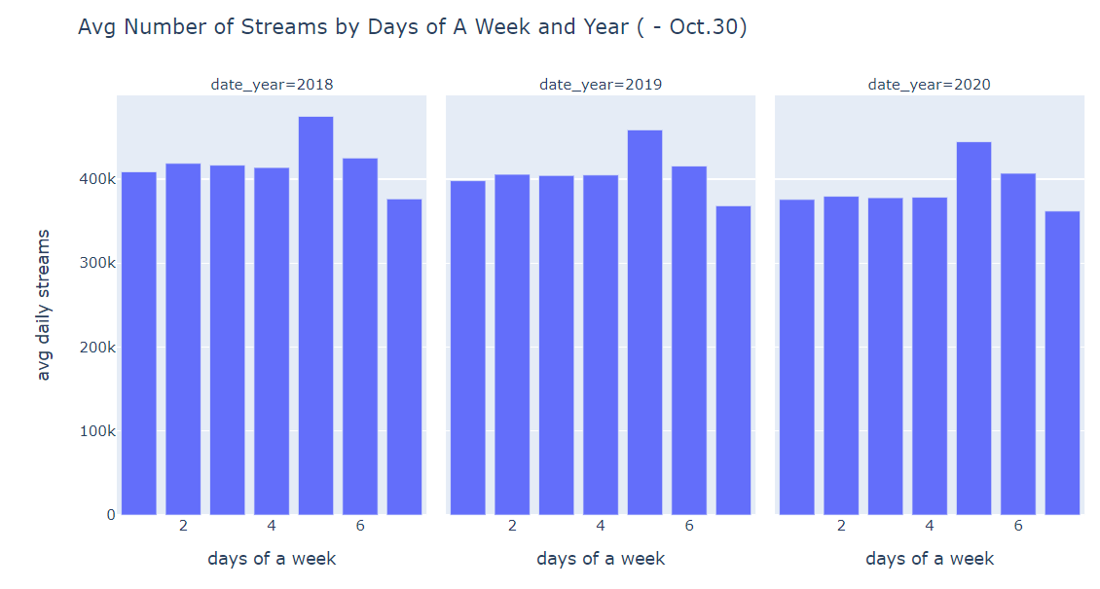
Fridays and Saturdays have the highest average streams

Slide 8
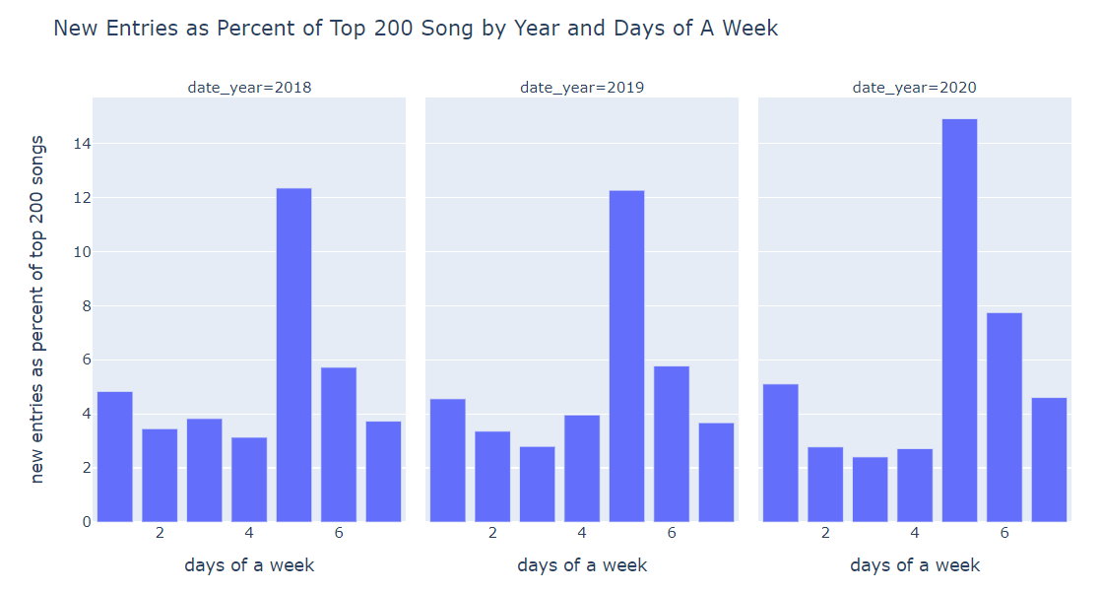
Fridays, Saturdays, and Mondays were the days with highest percent of new entries into the top 200 chart

Slide 9
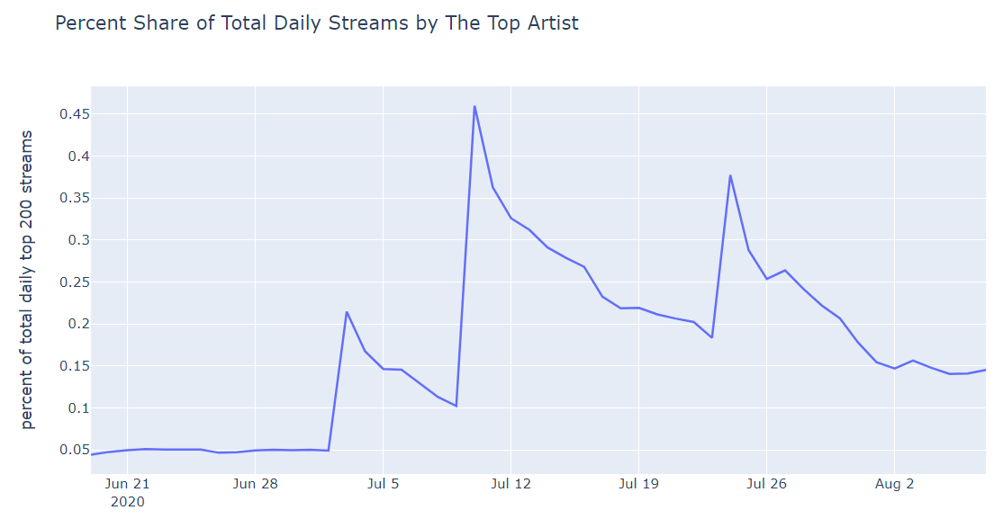
Pop Smoke album: 7/3/20; Juice Wrld album: 7/10/20; Taylor Swift album: 7/24/20

Slide 10
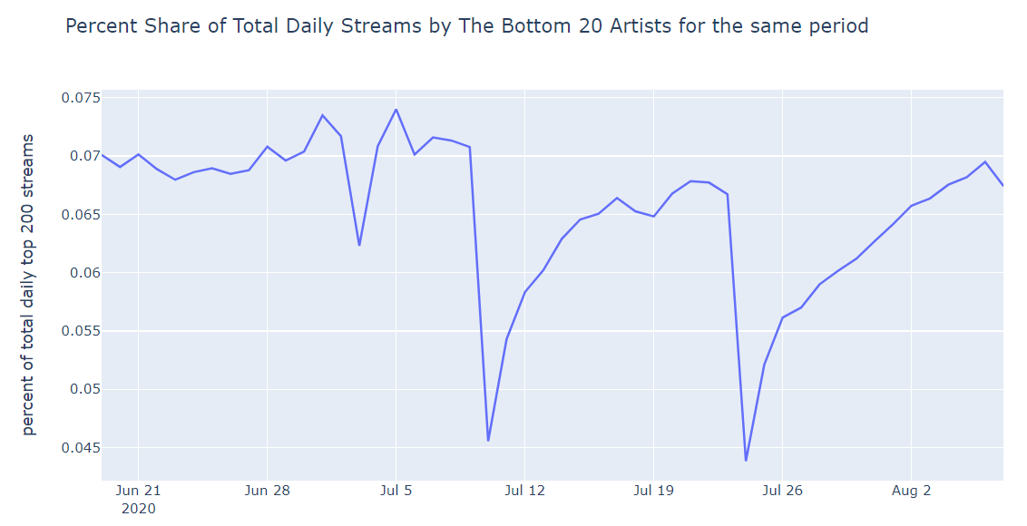
Pop Smoke album: 7/3/20; Juice Wrld album: 7/10/20; Taylor Swift album: 7/24/20

Slide 11
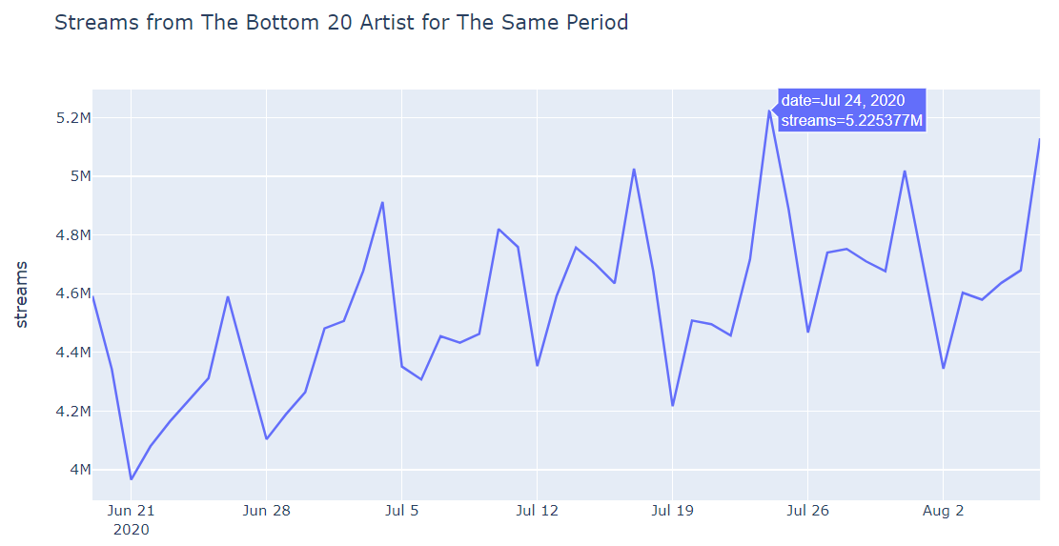
Streaming giants raise the threshold of chart entry

Slide 12
Recommendations for the smaller artists on Spotify
Audio consumption tends to be larger on Fridays and Saturdays, as well as during year-end holiday season; consider spending more resources on promoting your music then …
… unless there are album releases from the historical chart-toppers on the same day, then must avoid by planning around those artists’ release dates

Slide 13
Further Research
Which days/months have small artists historically performed well on in terms of streams and % share of total stream?
Which days/months have had the most album/single releases (requires additional data)

