Slide 1
Music Streaming on Spotify during CoVID-19 Era
Strategizing music releases for the lesser-known artists

Slide 2
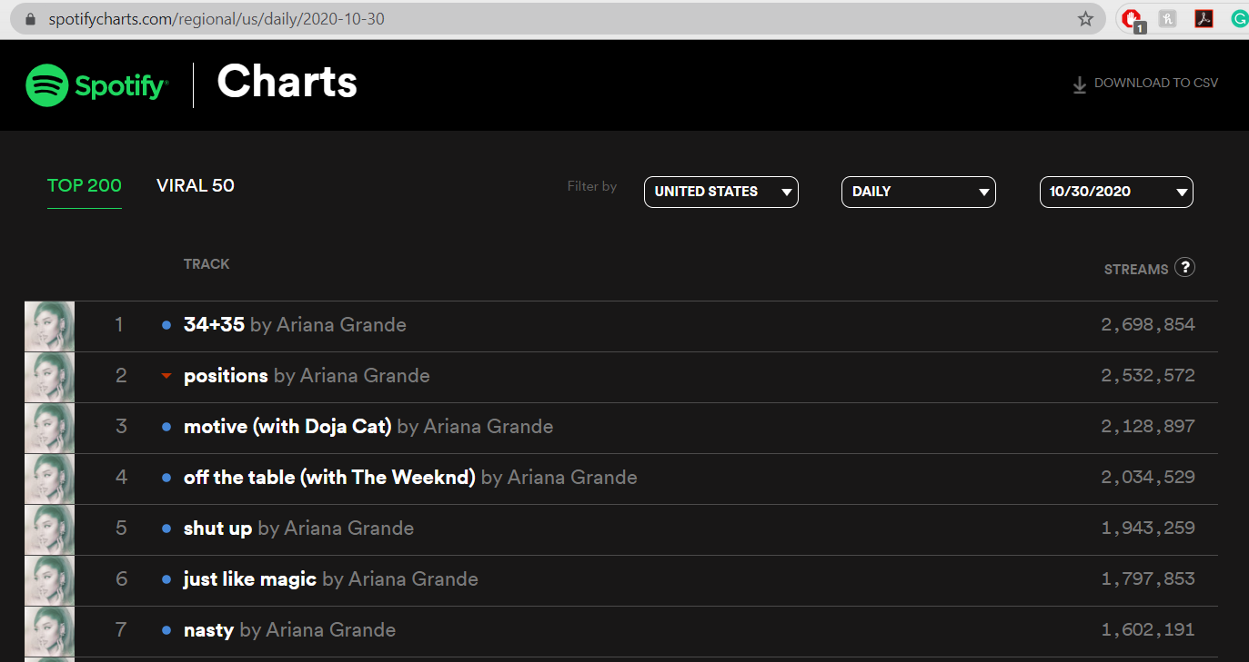
SpotifyCharts.com

Slide 3
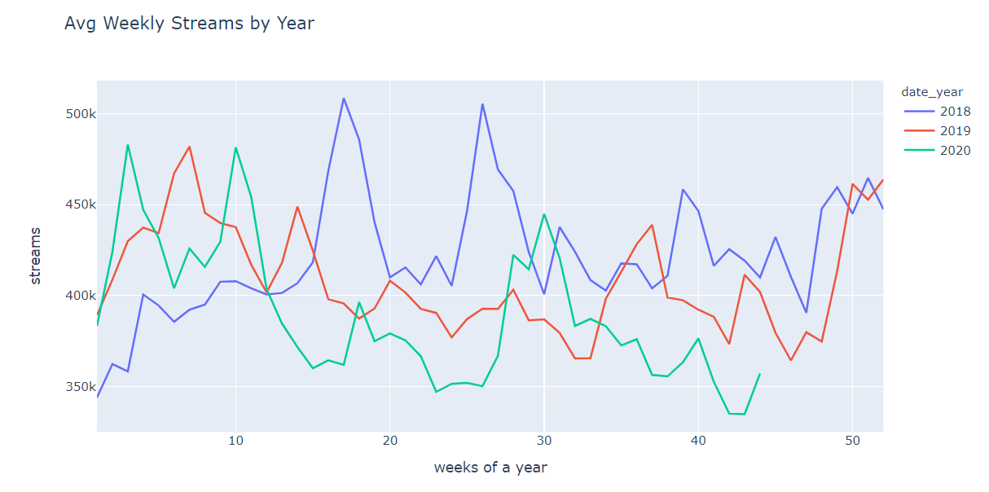
Avg weekly music streams went down after the CoVID-19 outbreak started in 2020

Slide 4
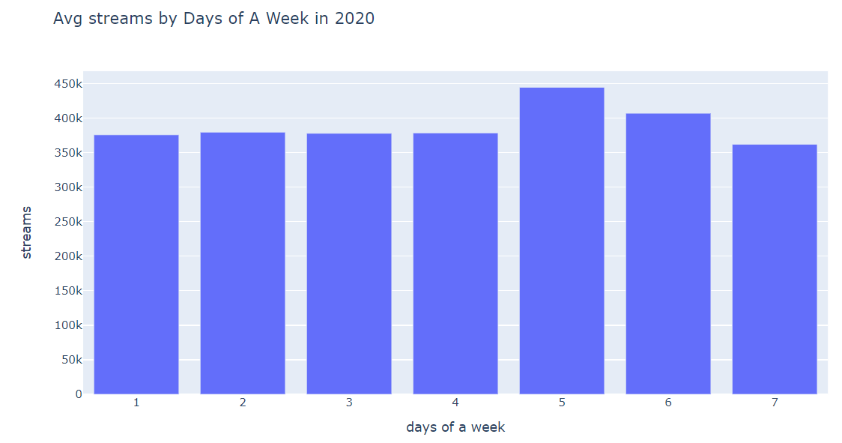
Fridays and Saturdays have the highest average streams

Slide 5
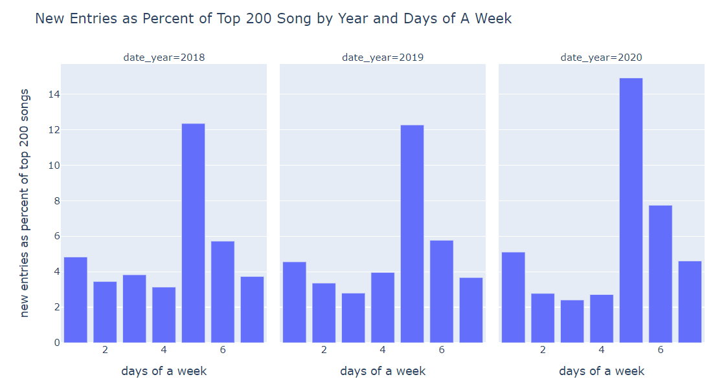
Fridays, Saturdays, and Mondays were the days with most new entries into the top 200 chart

