Slide 1
Music Streaming on Spotify during CoVID-19 Era
Exploring streaming patterns and the impact of big streamers
Yi Cao

Slide 2
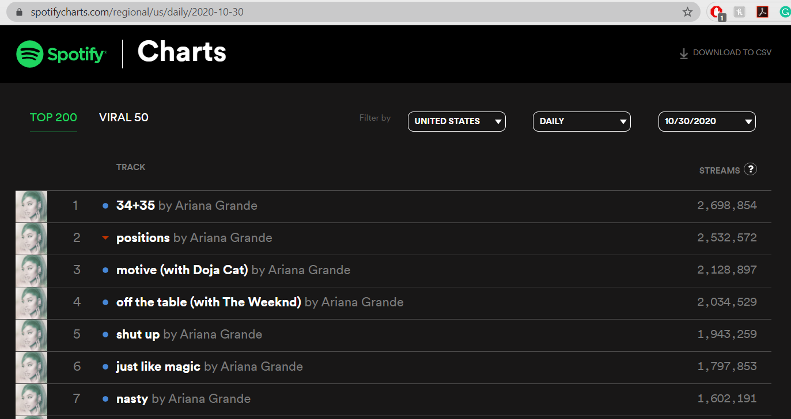
SpotifyCharts.com

Slide 3
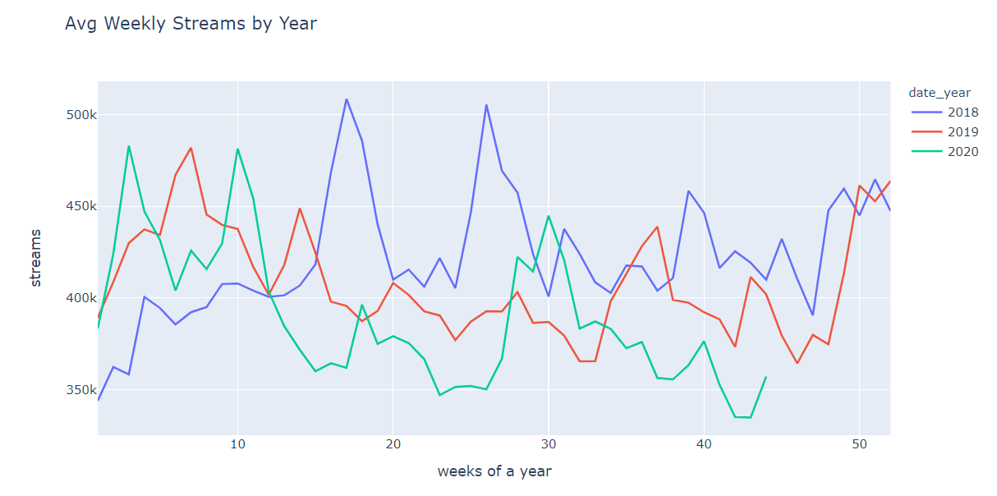
Avg weekly music streams on Top 200 went down after the CoVID-19 outbreak started in 2020

Slide 4
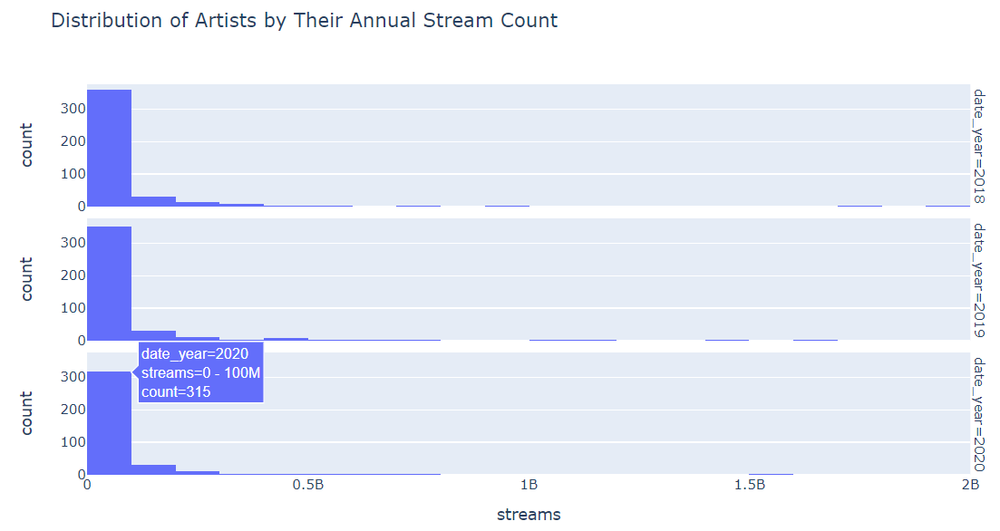
Majority of the artists had an annual stream count in 0-100M range

Slide 5
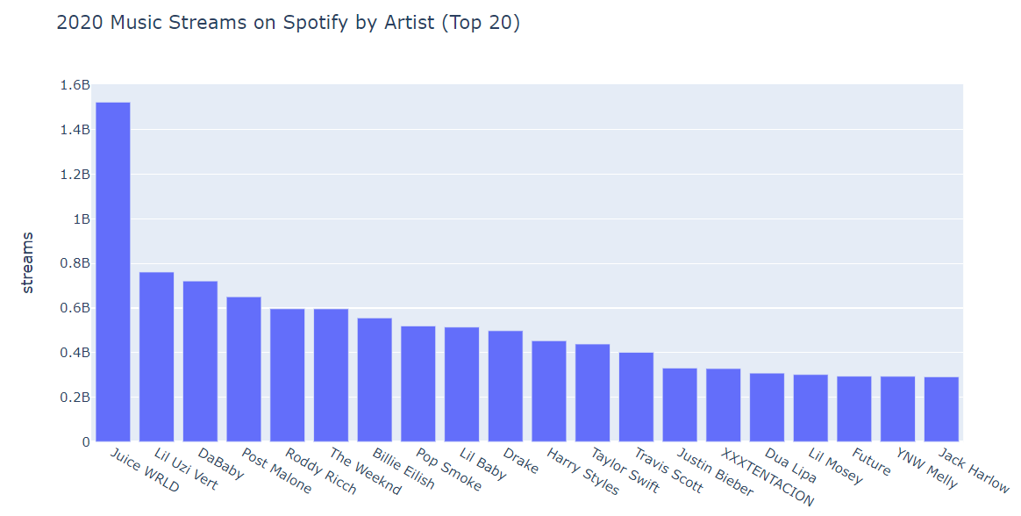
Streaming giants

Slide 6
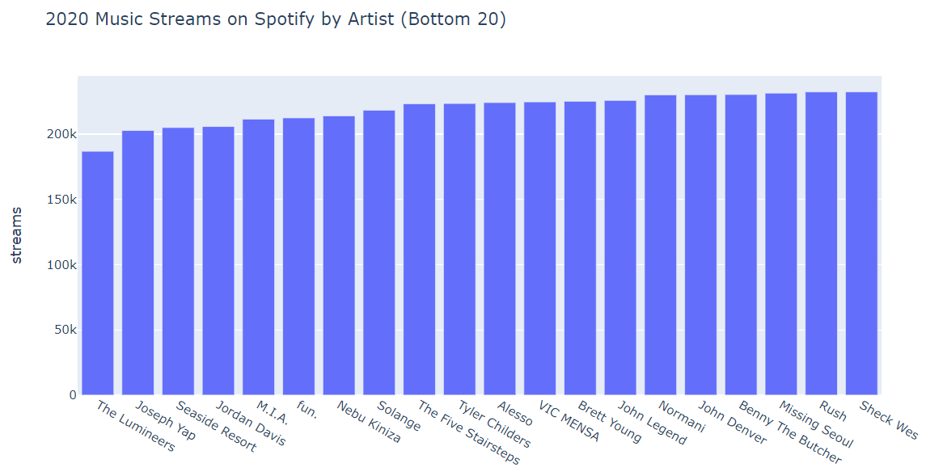
There were ‘big’ artists in the bottom 20 as well

Slide 7
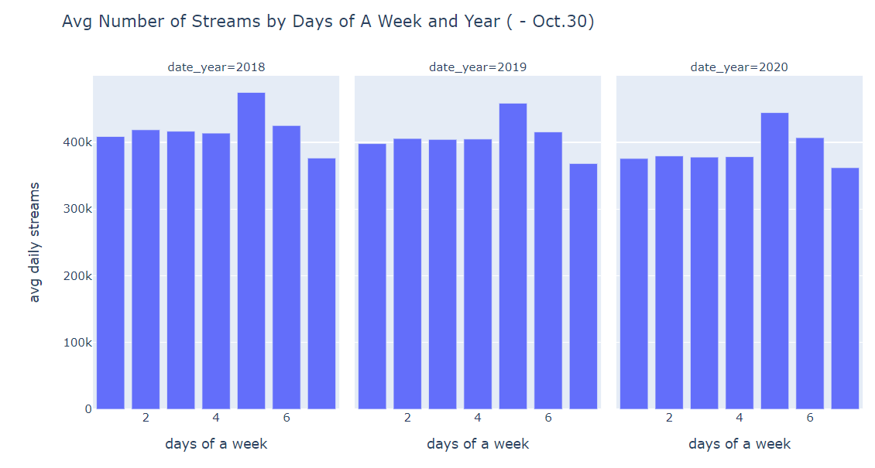
Fridays and Saturdays have the highest average streams

Slide 8
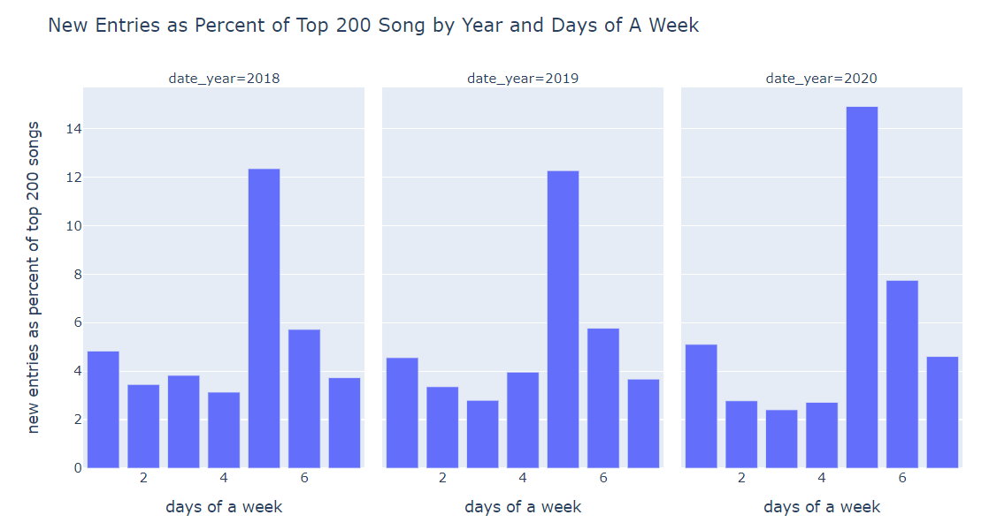
Fridays, Saturdays, and Mondays were the days with highest percent of new entries into the top 200 chart

Slide 9
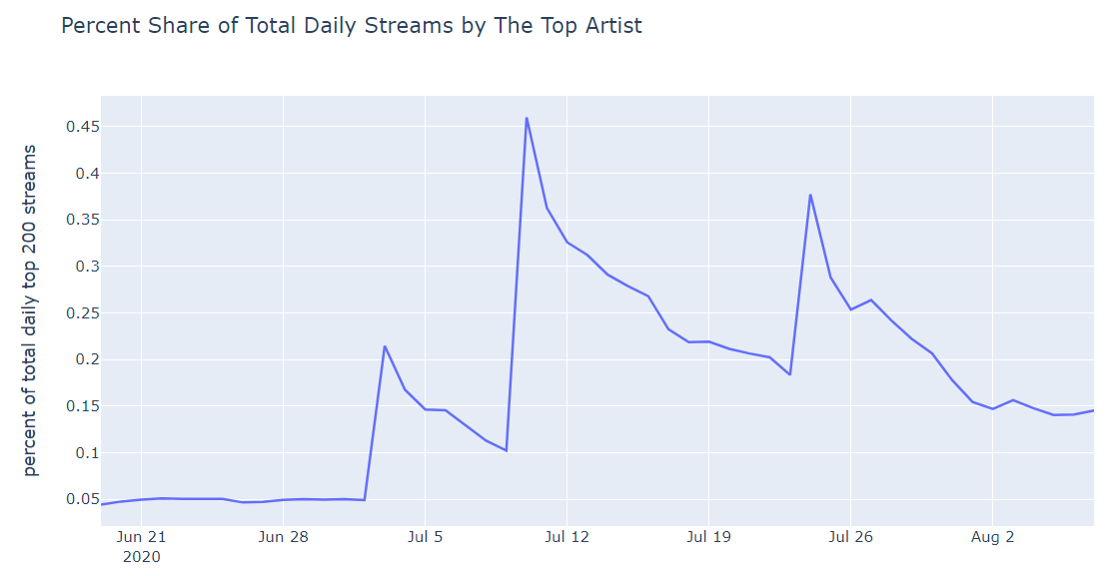
Pop Smoke album: 7/3/20; Juice Wrld album: 7/10/20; Taylor Swift album: 7/24/20

Slide 10
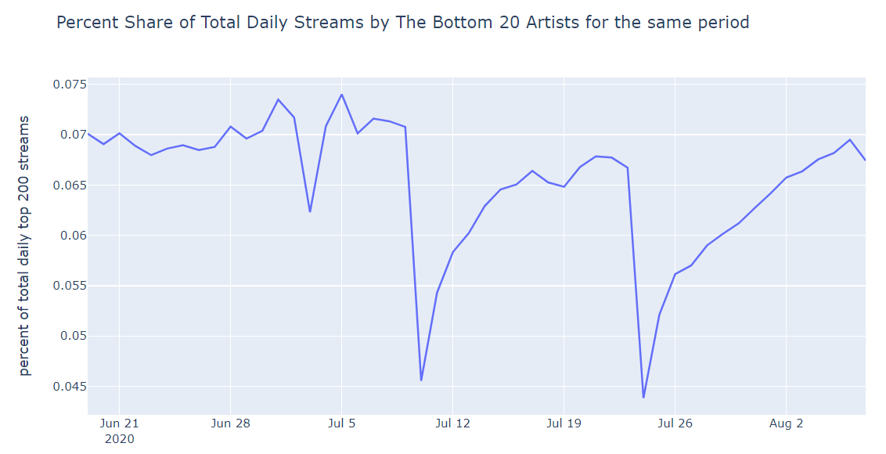
Pop Smoke album: 7/3/20; Juice Wrld album: 7/10/20; Taylor Swift album: 7/24/20

Slide 11
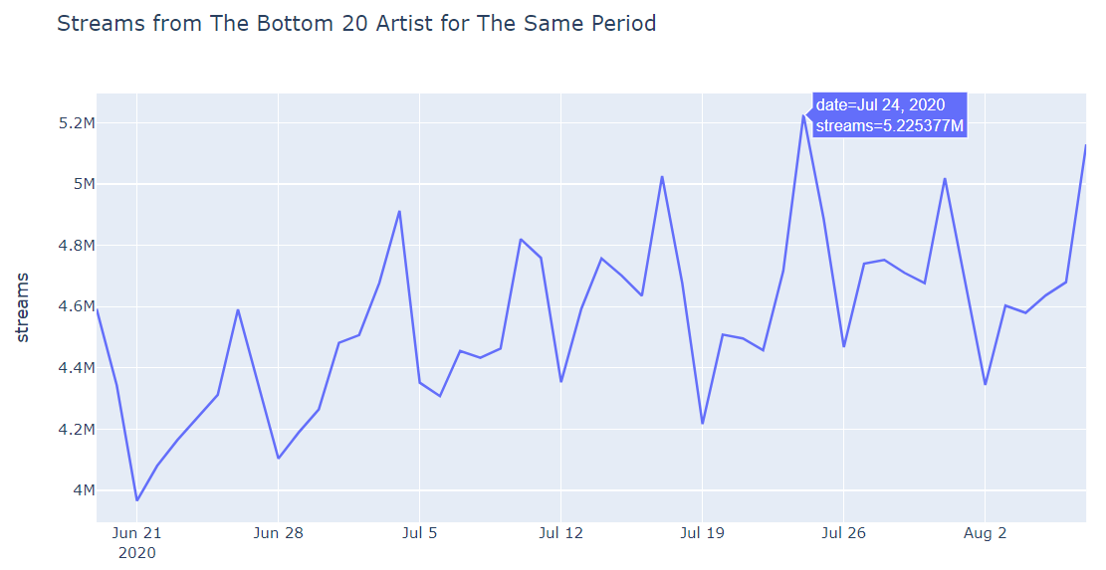
Streaming giants raise the threshold of chart entry

Slide 12
Conclusions
Audio consumption on Spotify was almost always larger on Fridays and Saturdays, as well as during year-end holiday season
New music was released more frequently on Fridays than on any other days of the week
New music releases from big streamers raise the threshold of entering the Top 200 Charts
If you are a lesser-known artist, try to plan your album releases around the big streamers’ release dates

