Slide 1


OGUNTUBERU NATHAN O.
Full-Stack Web Developer. Creative Content Developer. JavaScript Junkie
noguntuberu

Slide 2
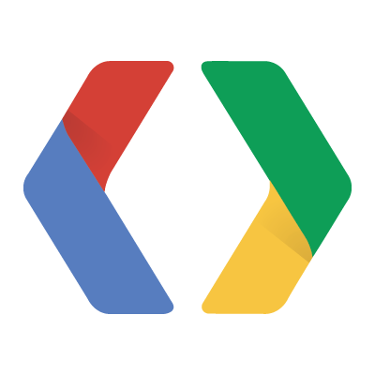
Building Real-Time Applications With WebSocket
https://gdg-ogb.herokuapp.com
https://github.com/dynameek/gdg-ogb.git

Slide 3
SERVERS AND CLIENTS
Virtually all user-based applications require data exchanges.
Server usually stores and serves these data.
Client requests, sends and uses these data
SERVER
RESPONSE
CLIENT
REQUEST

Slide 4
REALTIME APPLICATIONS
Real-Time applications require instantaneous transfer of data.
HTTP Request – Response Cycles are slow and uncertain.
SERVER
RESPONSE
CLIENT
REQUEST

Slide 5
WEBSOCKET: WHAT?
WebSocket is a mechanism that allows steady bi-directional flow of data between clients and servers.
A communication channel is maintained after first request is made. (Server and Clients listen for changes)
Events and data are broadcasted or emitted by clients and servers.

Slide 6
WEBSOCKET: WHAT?
SERVER
CLIENT A
DATA
DATA
CLIENT B

Slide 7
WEBSOCKET: HOW?
Set up socket on the Server
Set up socket on the client
Listen for and handle events

Slide 8
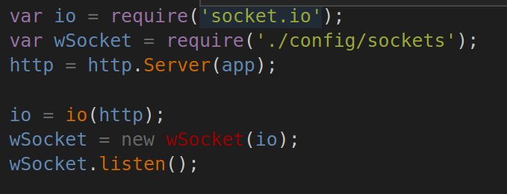
SERVER SET UP
Socket.io | Node.js |Express
app.js

Slide 9
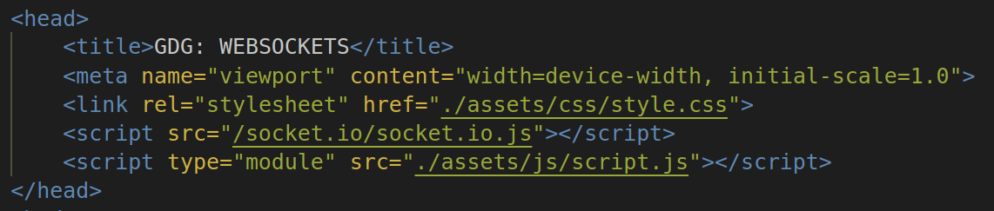
CLIENT SET UP
Socket.io | JavaScript

Slide 10
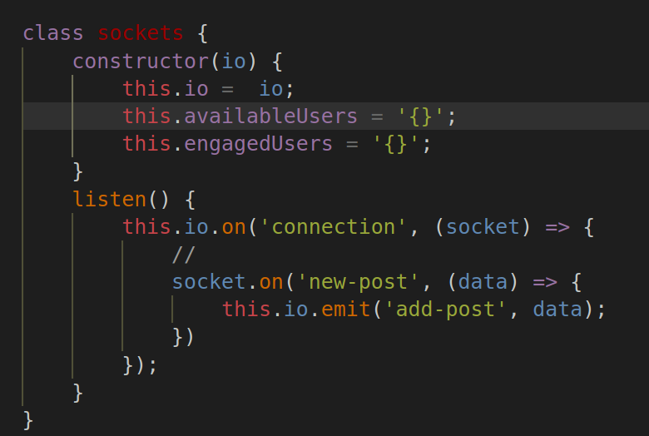
EVENT EMISSION AND HANDLING
SERVER

Slide 11
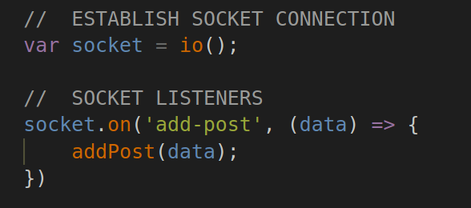
EVENT EMISSION AND HANDLING
CLIENT

Slide 12
THANK YOU
noguntuberu

