Slide 1
WATER
Diffusion
Ebullition
Dissolved CH4
rDis2Gas
Gaseous CH4
AOM
rGas2Dis
Methanogenesis
rDis2Hyd
rHyd2Gas
rGas2Hyd
rHyd2Dis
Hydrate
SEDIMENT

Slide 2

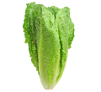
Crop
Weed
Paddition
CropGrowth
P1
WeedGrowth_on_P1
P in upper layer
Crop
Weed
P in lower layer
Percolation
P2
WeedGrowth_on_P2
PercolationLoss

Slide 3
Mortality
Mortality
Infected
Infected
Infection
Recovery
Infection
Recovery
ImmunityLoss
Susceptible
Recovered
Susceptible
Recovered
Vaccination

Slide 4
Mortality
Infected
Infection
Recovery
ImmunityLoss
Susceptible
Recovered
Vaccination
InfectionbyB
RecoveryFromB
Infected By British variant
Mortality

Slide 5
WATER
phytoplankton
Death_p
Detritus
Min_p
Depth
Nup_p
Sinking_p
Sinking_det
NH4⁺
SEDIMENT
Diffusion
Phytobenthos
Nup_b
Sediment NH4⁺
Min_b
Sediment Detritus
Death_b

Slide 6
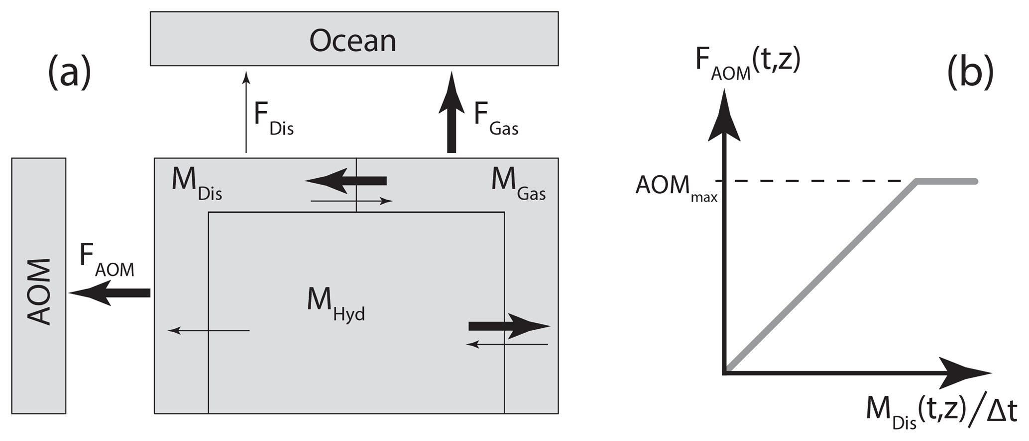
Based on Stranne et al.

