Slide 1
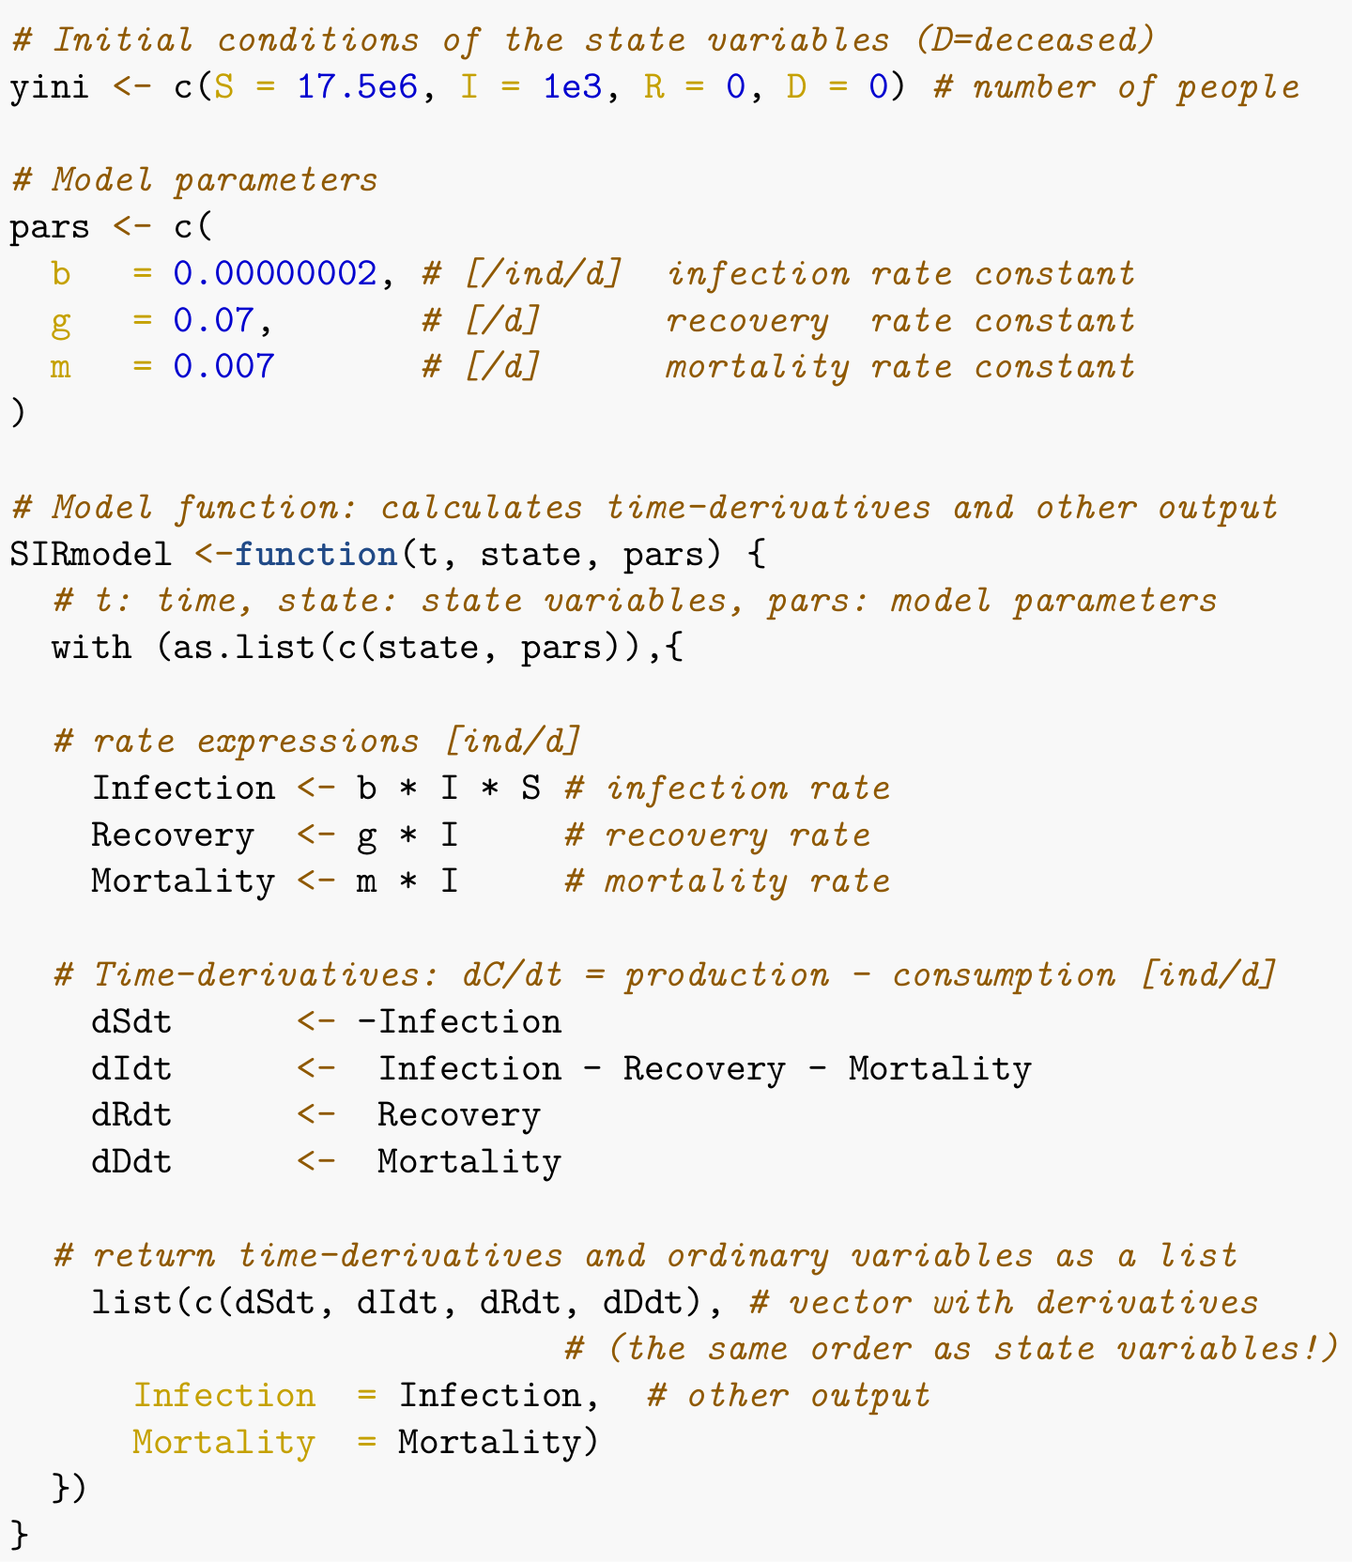

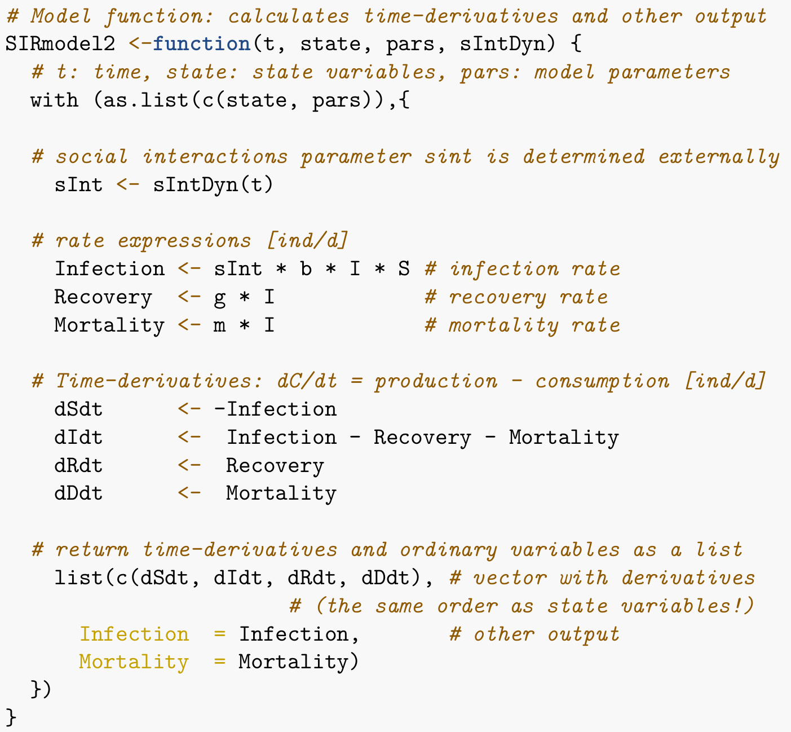


Simplest COVID model
Enhanced COVID model
(a)
(b)
(c)

