Slide 1
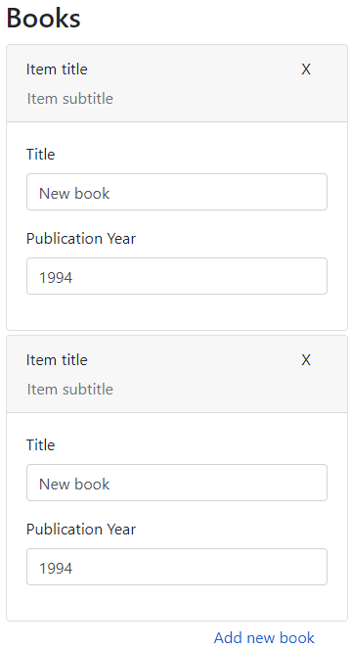
DynamicListContainer
DynamicList
DynamicListItemContainer
Item (your view)

