Slide 1
State management and React Hooks
Daniel Webala, Senior Engineer, Mentorlst
Notes:
What are react hooks and what does state have to do with them?

Slide 2
React hooks and state
What are react hooks and what does it have to do with state?
To understand this, we have to dive deeper into some components
Function composability
Component composability
Stateless vs Stateful logic

Slide 3
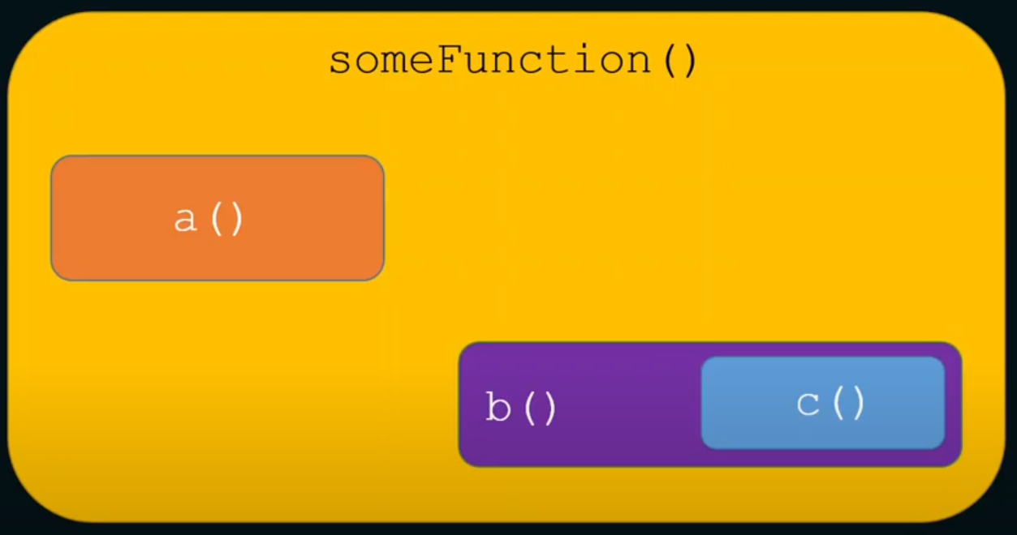
Function composability
In the JavaScript programming language, functions are reusable code logic to perform repeated tasks. Functions are composable. This means you can invoke a function in another function and use its output.

Slide 4
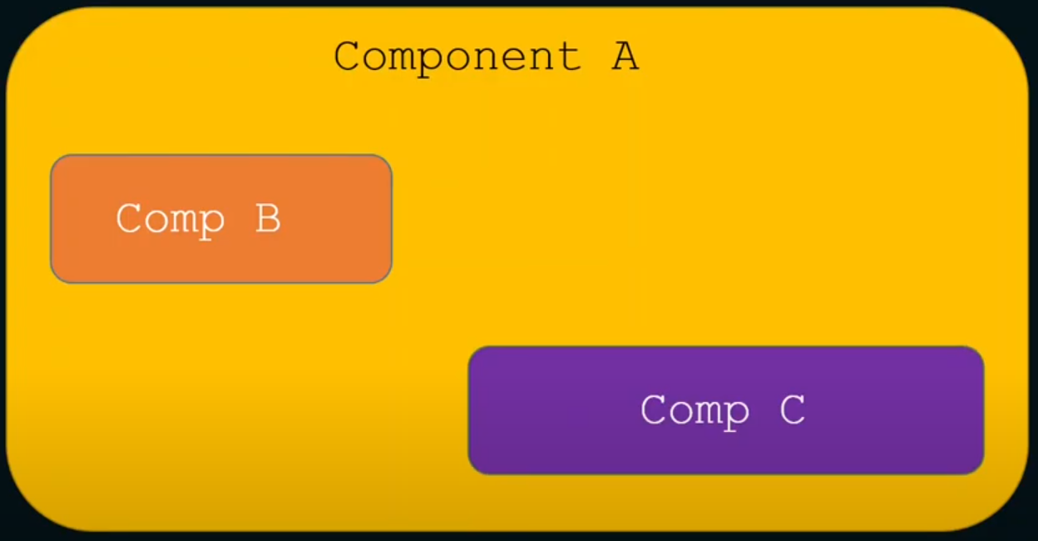
Component composability
Functional components in React are just plain old JavaScript functions! So if functions have composability, React components can also have composability. This means we can use (compose) one or more components into another component.

Slide 5
Stateless vs Stateful logic
Quick recap:
What is state in React?

Slide 6
Stateless vs stateful components
State allows us to manage changing data in an application. It's defined as an object where we define key-value pairs specifying various data we want to track in the application.
State lets a component “remember” information like user input. For example, a form component can use state to store the input value, while an image gallery component can use state to store the selected image index.
Components in React can be stateful or stateless.
A stateful component declares and manages local state in it.
A stateless component is a pure function that doesn't have a local state and side-effects to manage.
Note: A pure function is a function without any side-effects. This means that a function always returns the same output for the same input.

Slide 7
So what are React hooks?
React Hooks are simple JavaScript functions that we can use to isolate the reusable part from a functional component
Hooks let you use different React features from your components. You can either use the built-in Hooks or combine them to build your own.
React comes with a number on in-build hooks but for today, we will only look at 3. The last one will surprise you
useState
useEffect
useSuperSecretSurprise

Slide 8
Hold up, there are rules …
Where can I use react hooks?
Top level of function components
Top level in the body of a custom hook
How do I name them? (Naming convention)
All react hooks have to be prefixed with the ‘use’ keyword.
Where can’t I use them?
Do not call Hooks inside conditions or loops.
Do not call Hooks after a conditional return statement.
Do not call Hooks in event handlers.
Do not call Hooks in class components.
Do not call Hooks inside functions passed to useMemo, useReducer, or useEffect.
Do not call Hooks inside try/catch/finally blocks.

Slide 9
useState hook
useState is a React Hook that lets you add a state variable to your component.
Let’s get practical,

Slide 10
useEffect hook
Effects let a component connect to and synchronize with external systems. This includes dealing with network, browser DOM, animations, widgets written using a different UI library, and other non-React code.
useEffect is a react hook that lets you do this

Slide 11

useRickAndMortyApi

Slide 12

Are you hooked?

