Slide 1
A Fast-and-Dirty Intro to NetworkX (and D3)
*
Lynn Cherny
*And, hopefully, practical

Slide 2
Plan
The Problem: Hairballs.
NetworkX – one tool
Stats on networks (and getting them from NetworkX)
Visualizing networks – some options
D3 demos of several
Lots of Links for Learning More

Slide 3
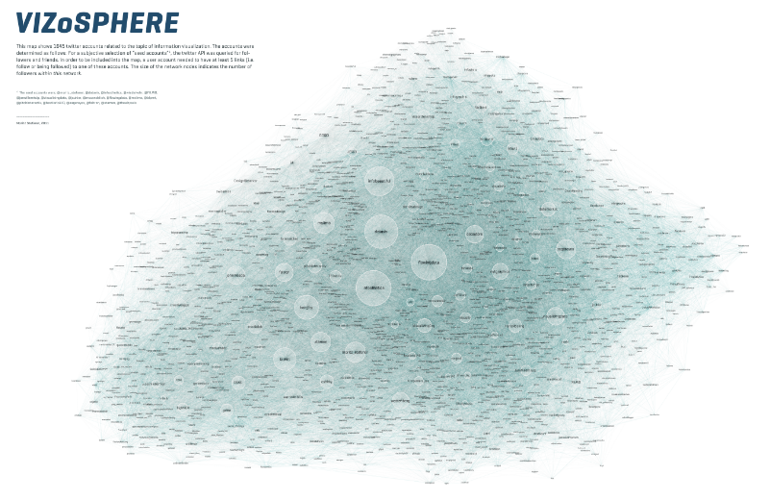
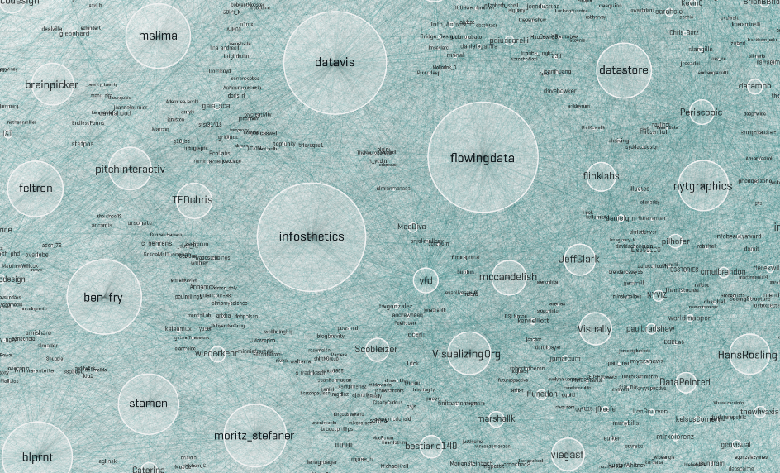
The Problem: Moritz Stefaner’s Dataset on Twitter “Infovis” Folks
See http://well-formed-data.net/archives/642/the-vizosphere

Slide 4
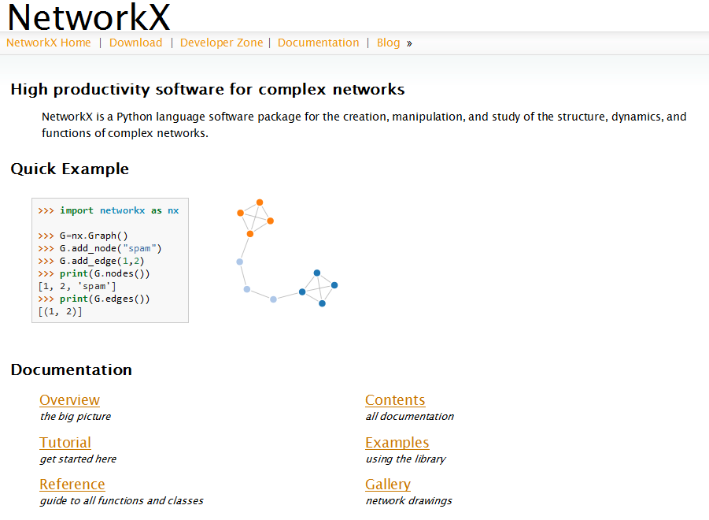
Intro to NetworkX
A Python Library for Network / Graph analysis and teaching, housed and documented well at:
http://networkx.lanl.gov/index.html

Slide 5
Aside on My Overall Code Strategy
Read in edgelist to NetworkX / (or read in JSON)
Convert to NetworkX graph object
Calculate stats & save values as node attributes in the graph
(Verify it’s done with various inspections of the objects)
Write out JSON of nodes, edges and their attributes to use elsewhere
Move to D3 to visualize.
Go back to 1 and restart to revise stats.
Reduce the problem: send
fewer nodes to JSON; or filter visible nodes in UI/vis

Slide 6
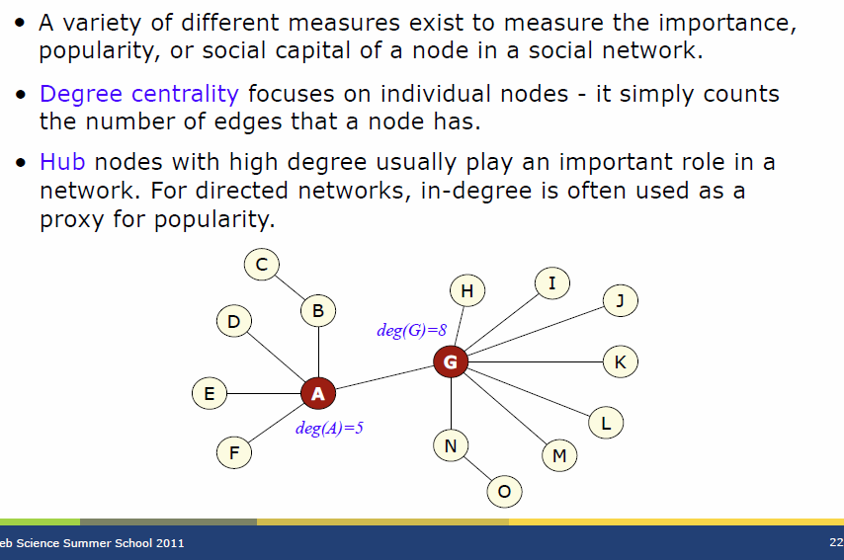
Degree (Centrality)
http://mlg.ucd.ie/files/summer/tutorial.pdf

Slide 7
Example Code from NetworkX
def calculate_degree_centrality(graph):
g = graph
dc = nx.degree_centrality(g)
nx.set_node_attributes(g,'degree_cent',dc)
degcent_sorted = sorted(dc.items(), key=itemgetter(1), reverse=True)
for key,value in degcent_sorted[0:10]:
print "Highest degree Centrality:", key, value
return graph, dc
Highest degree Centrality: flowingdata 0.848447961047 Highest degree Centrality: datavis 0.837492391966 Highest degree Centrality: infosthetics 0.828971393792 Highest degree Centrality: infobeautiful 0.653682288497 Highest degree Centrality: blprnt 0.567255021302 Highest degree Centrality: ben_fry 0.536822884967 Highest degree Centrality: moritz_stefaner 0.529519172246 Highest degree Centrality: eagereyes 0.524041387705 Highest degree Centrality: mslima 0.503956177724 Highest degree Centrality: VizWorld 0.503956177724
There are similar functions for other stats in my code outline.

Slide 8
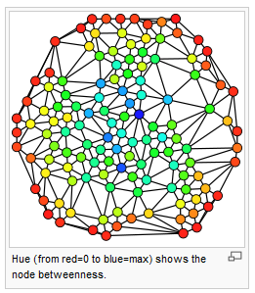
Betweenness
A measure of connectedness between (sub)components of the graph
http://en.wikipedia.org/wiki/Centrality#Betweenness_centrality

Slide 9
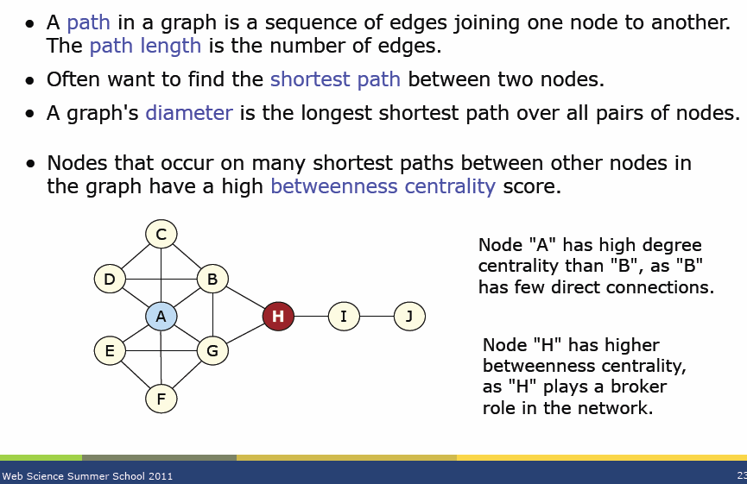
Betweenness (Centrality)
http://mlg.ucd.ie/files/summer/tutorial.pdf

Slide 10
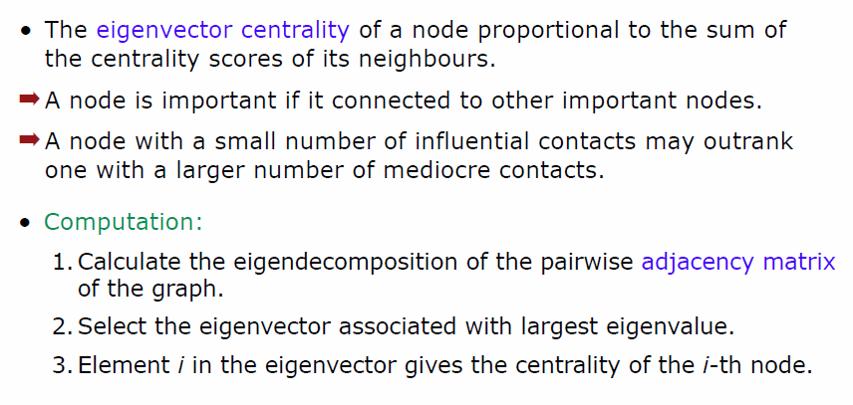
Eigenvector Centrality
http://mlg.ucd.ie/files/summer/tutorial.pdf

Slide 11
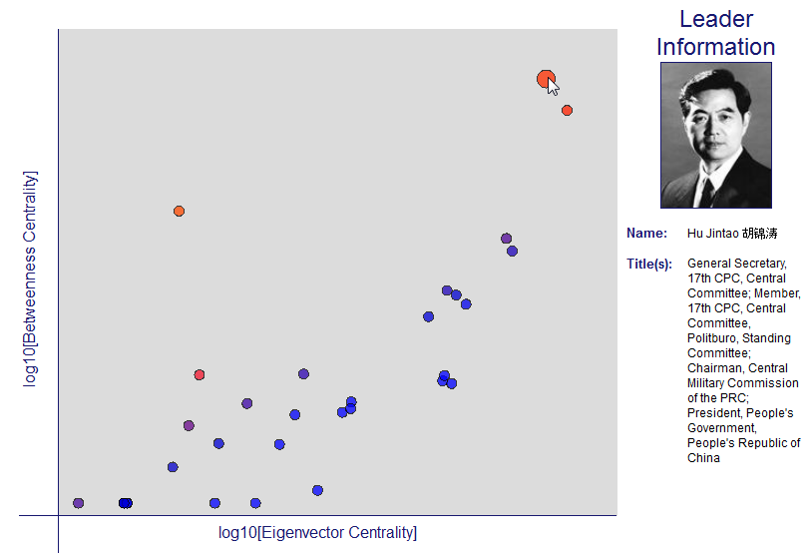
Use Multiple Stats…
Drew Conway’s recent post on central leaders in China:
See also the excellent article by Valid Krebs in First Monday on terrorist networks, using other network metrics in conjunction.

Slide 12
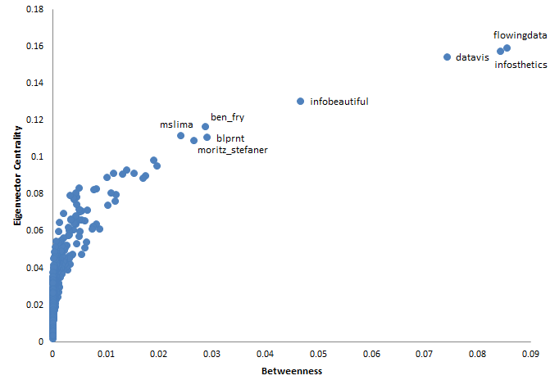
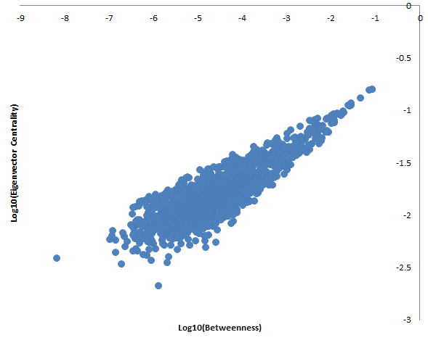
Graph: Infovis tweeters from Moritz…

Slide 13
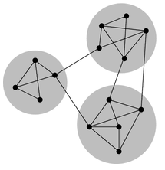
Community Detection Algorithms
E.g., the Louvain method, implemented in a lib that works with NetworkX
def find_partition(graph):
# from http://perso.crans.org/aynaud/communities/
g = graph
partition = community.best_partition( g )
print "Partitions found: ", len(set(partition.values()))
print "Partition for node Arnicas: ", partition["arnicas"]
nx.set_node_attributes(g,'partition',partition)
return g, partition
http://en.wikipedia.org/wiki/File:Network_Community_Structure.png

Slide 14
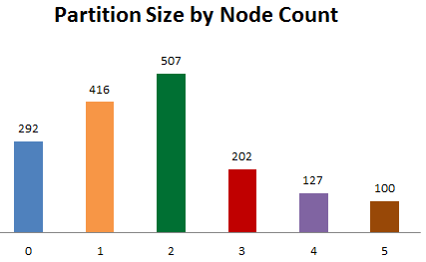
Dump Partition Number by Node
def write_node_attributes(graph, attributes):
# utility function to let you print the node + various attributes in a csv format
if type(attributes) is not list:
attributes = [attributes]
for node in graph.nodes():
vals = [str(dict[node]) for dict in [nx.get_node_attributes(graph,x) for x in attributes]]
print node, ",", ",".join(vals)

Slide 15
Get Yer Stats, Visualize.
Repeat.

Slide 16
Aside: NetworkX I/O utility functions
Input -- List of edge pairs in txt file (e.g., “a b”)
Networkx.read_edgelist converts a file of node pairs to a graph:
Input or Output -- JSON
NetworkX.readwrite.json_graph.node_link_data
NetworkX.readwrite.json_graph.load
def read_in_edges(filename):
g_orig = nx.read_edgelist(filename, create_using=nx.DiGraph())
print "Read in edgelist file ", filename
print nx.info(g_orig)
return g_orig
def save_to_jsonfile(filename, graph):
g = graph
g_json = json_graph.node_link_data(g)
json.dump(g_json, open(filename,'w'))
def read_json_file(filename):
graph = json_graph.load(open(filename))
print "Read in file ", filename
print nx.info(data)
return graph

Slide 17
Saving a Subset…
For most of my visualization demos, I used a subset of the full dataset. I sorted the 1644 nodes by eigenvector centrality score and then saved only the top 100.
Code from my networkx_functs.py file:
eigen_sorted = sorted(eigen.items(), key=itemgetter(1), reverse=True)
for key, val in eigen_sorted[0:5]:
print “Highest eigenvector centrality nodes:", key, val
# for trimming the dataset, you want it reverse sorted, with low values on top.
eigen_sorted = sorted(eigen.items(), key=itemgetter(1), reverse=False)
small_graph = trim_nodes_by_attribute_for_remaining_number(undir_g, eigen_sorted, 100)
print nx.info(small_graph)
#save as json for use in javascript - small graph, and full graph if you want
save_to_jsonfile(path+outputjsonfile, small_graph)

Slide 18
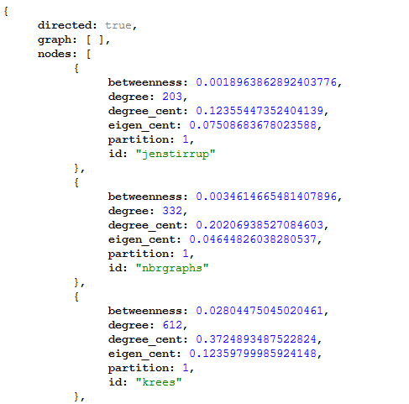
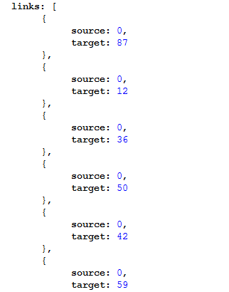
Dump JSON of a graph (after my NetworkX calcs)
Works with all D3 examples I’ll show…

Slide 19
Gotchas to be aware of here
If you don’t use the “DiGraph” (directed graph) class in NetworkX, you will lose some links. This changes some visuals.
Your json links are based on index of the node. If/when you do filtering in JSON based on, say, UI controls, you need to redo your indexing on your links!
[e.g., See my code in demo full_fonts.html]

Slide 20
Visualizing Networks
NetworkX isn’t really for vis – can use graphViz and other layouts for static pics.
Use Gephi to explore and calculate stats, too.
See my blog post and slideshare with UI screencaps of Gephi, using this same data set!
Apart from the hairball, there are other methods to visualize graphs:
See Robert Kosara’s post: http://eagereyes.org/techniques/graphs-hairball
Lane Harrison’s post: http://blog.visual.ly/network-visualizations/
MS Lima’s book Visual Complexity
Like many big data problems, use multiple stats and multiple methods to explore!

Slide 21
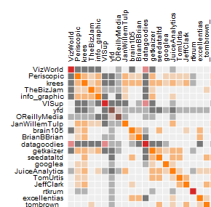
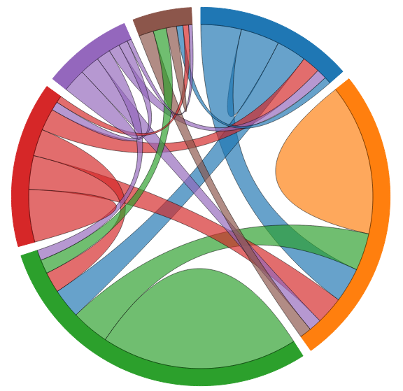
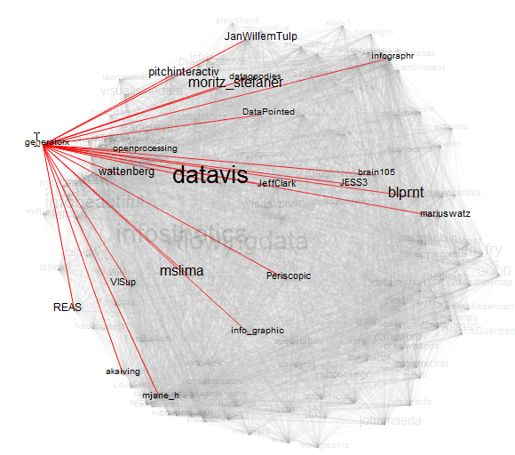
D3.js by Mike Bostock
D3 allows creation of interactive visualizations…
Adjacency Matrix Chord Diagram Networks

Slide 22
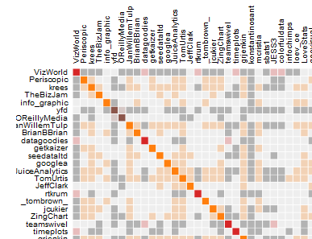
Aside on Data Set Size
Adjacency matrix only holds a small number of nodes at a time – I used 88 of the top 100 selected by eigenvector centrality for this demo.
Chord diagrams are simplified reps of a dataset – comparing the relations between the top 100 by eigenvector centrality vs. the whole 1644 nodes set reveals a most interesting insight!
Interactive network vis is limited by browser performance – and complexity of hairballs. If you want it to be interactive (live) and not a static image, you probably need to reduce your data before or after loading.

Slide 23
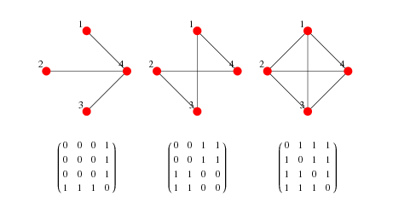
Adjacency Matrix
Square matrix of nodes; cells constitute edge count.
http://mathworld.wolfram.com/AdjacencyMatrix.html
Demo adjacency.html

Slide 24

What did this show?
Be sure to change the sort order on the right side:
The largest partition represented is the orange partition, when you sort by partition (= subcommunity)
Some partitions (colors) have very few representatives in the matrix of the top 88. We can suppose these partitions are not composed of people with the highest eigenvector centrality scores.
Node VizWorld is near or at the top in all the sort-by-attribute methods offered, and is in the red partition, not orange.

Slide 25
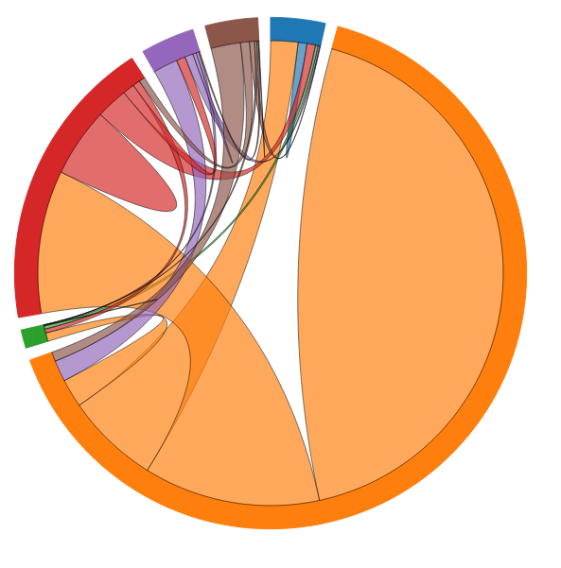
Chord Diagram: Summarize Relations
Top 100 nodes by eigenvector centrality, chords
by target:
Not representative of full network…
Interesting!
Demo

Slide 26
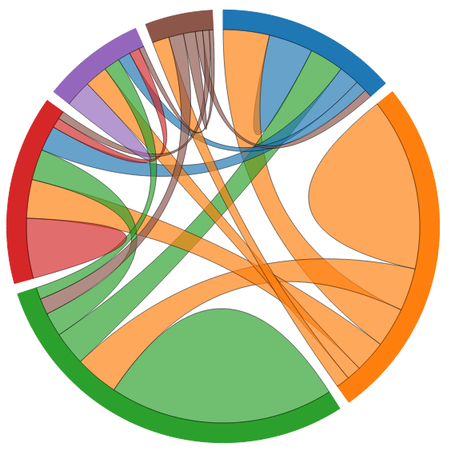
Redo Chord Diagram With All Data…
The demo allows you to swap json files to see the change.

Slide 27
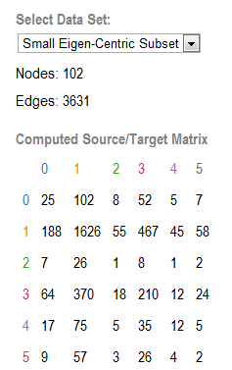
Insights from Comparing Them
The top 100 nodes by eigenvector centrality are mostly the orange partition. The green partition, however, is the largest group in the unfiltered set (the whole 1644 nodes).
Notice how few green and purple partition members “make” the top eigencentric list:
You can see supporting evidence of the orange eigenvector centrality by looking at how many people link to them from other partitions. Change the target/source radio button on the demo to see this in action.

Slide 28
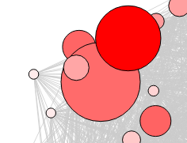
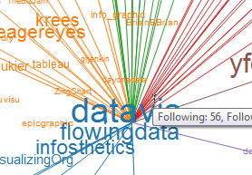
Handling with Graph Rendering…
Typical Nodes/Edges, with sizing/coloring – slow, still a hairball, not much visible useful info.
Avoid this simplistic vis method if you can…
Note this takes a little while to calm down!
Demo redballs
Alternate, slightly better: Names, color by Partition, UI options and edges on click.
Demo force_fonts

Slide 29
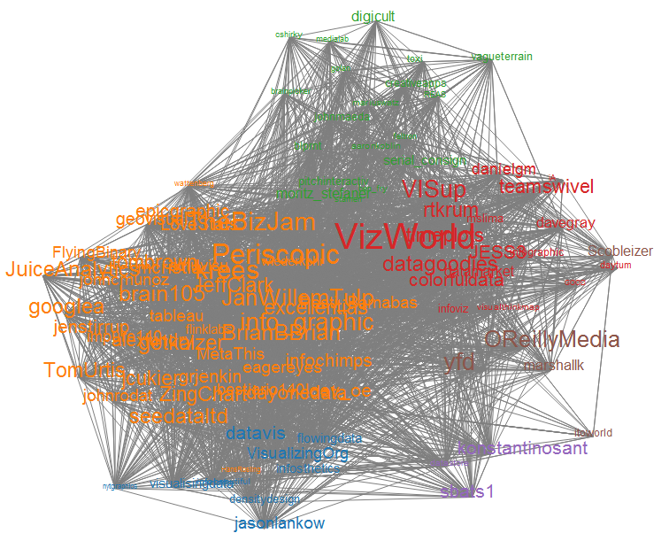
Viewing the top scoring subset only….
Even with a small subset and partition clustering, showing all the links is a visual mess…
So only show them on demand.

Slide 30

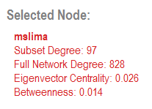
Design Tweaks Made To Make It (More) Useful
Add a click-action to
Fade out nodes unrelated to clicked node
Show lines indicating who they follow
Show the names (unlinked) of who follows them
Add a tooltip showing on-screen degree (i.e., following and followed-by numbers for the subset)
Heavily adjusted layout to separate clusters visually (lots of trial and error, see following slides)
Add stats on the sidebar showing some numbers, to allow you to compare, for instance, onscreen degree vs. degree in the whole set of 1644 nodes:

Slide 31
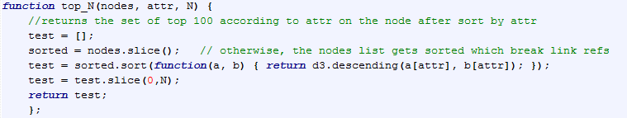

Creating the subset in JS instead of NetworkX
To create the union of the top N by each attribute, I shortcutted and used underscore.js’s union function:
Then you need to update your links by filtering for the links referring to the subset of nodes, and fix the indices!

Slide 32
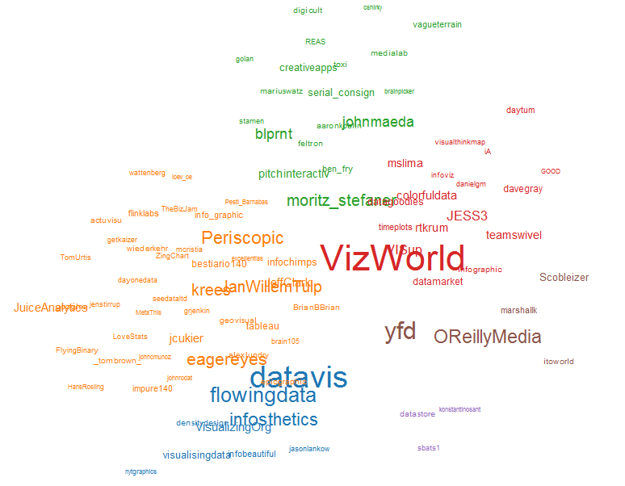
Insights from Subset
The most “readable” view is with fonts sized by “Betweenness” because of the large discrepancies:
Note that these look familiar from the Adjacency Matrix view!

Slide 33
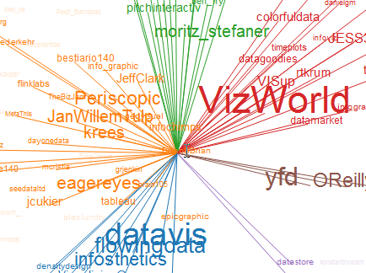
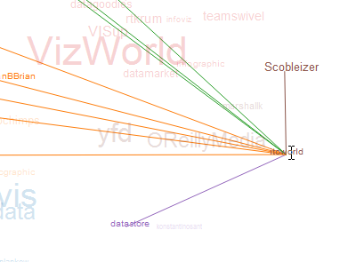

How to “read” the layout
Nodes that drift towards the middle are linked to more partition colors and nodes in the visible subset. Tooltips show the following/follower relations for the subset only.
Nodes towards the fringes are less linked in general inside this subset.
Itoworld, on the edge:

Slide 34
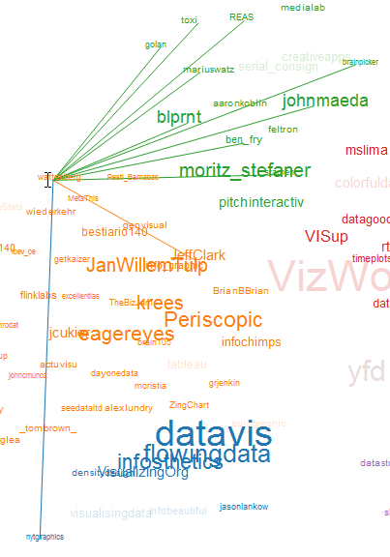


Interesting Oddities
wattenberg is in the orange partition, but within the top N nodes, follows* mostly green:
In general, the top N of the green partition follow each other. They’re the artists!
HansRosling follows no one but is followed by quite a few of the visible subset:
Ditto nytgraphics:
* This data set is from mid-2011!

Slide 35
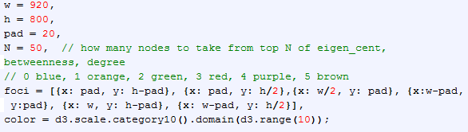
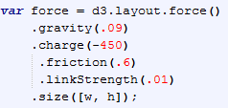
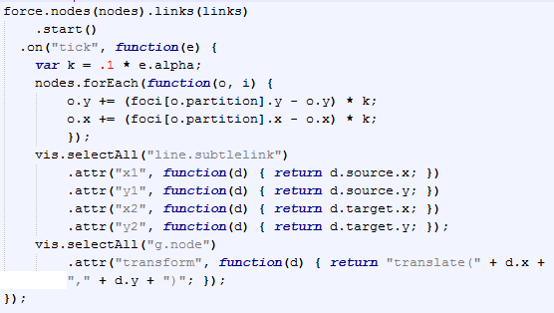
Accomplishing the layout in D3
Lots of screwing with the foci locations to move the nodes to and force settings:
Moving them:

Slide 36
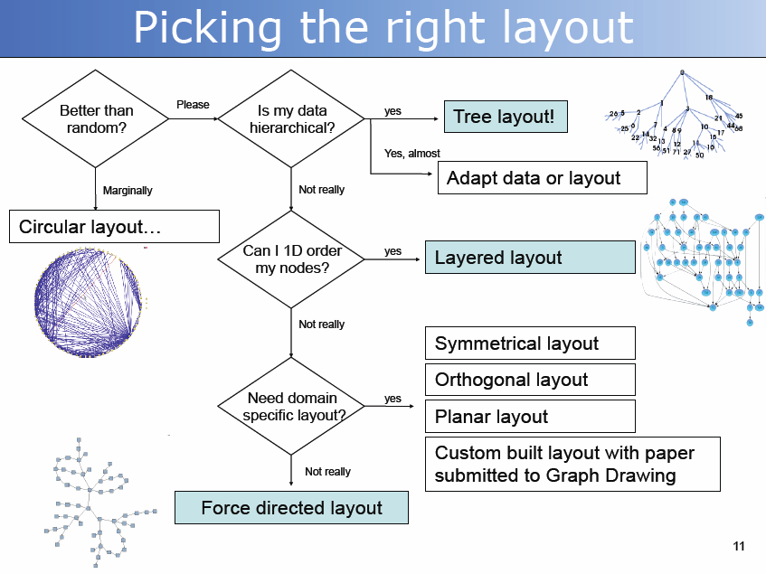
Wrap up with an aside from a Frank van Ham Talk
http://bit.ly/s6udpy

Slide 37
Reminder(s)
The map is not the territory.
Just cuz social media software tools allow links between people doesn’t mean they reflect the true – or complete – social network of relationships.
(Also, this data set is no doubt out of date with respect to current follower relations!)

Slide 38
A Bunch of Links
(In the non-network sense)

Slide 39
General Network Primer Material
MIT OpenCourseware on Networks, Complexity, Applications (many references!)
Frank van Ham’s slides from a recent datavis meetup
CRAN R code/links for handling graphs/networks
Chapter 10 of Rajaraman & Ullman and book on Data Mining of Massive Datasets
Graph Theory with Applications by Bondy and Murty
Intro to Social Network Methods by Hanneman and Riddle
Networks, Crowds, and Markets by Easley and Kleinberg
My lists of sna / networks papers on delicious

Slide 40
NetworkX Info/Tutorials
NetworkX site docs/tutorial: http://networkx.lanl.gov/tutorial/index.html
UC Dublin web science summer school data sets, slides, references: http://mlg.ucd.ie/summer
Stanford basic intro tutorial: http://www.stanford.edu/class/cs224w/nx_tutorial/nx_tutorial.pdf

Slide 41
D3 Example Links (for networks)
D3.js – Mike Bostock
Super Useful force attributes explanation from Jim Vallandingham
D3 Demo Talk Slides with embedded code by MBostock
Chicago Lobbyists by Manning
Mobile Patent Suits by Mbostock
Rollover selective highlight code by Manning
D3 Adjacency Matrix by Mbostock
Chord diagram: http://bost.ocks.org/mike/uberdata/
My giant, growing list of D3 links on delicious

Slide 42
Community Detection (a couple)
Overlapping Community Detection in Networks: State of the Art and Comparative Study by Jierui Xie, Stephen Kelley, Boleslaw K. Szymanski
Empirical Comparison of Algorithms for Network Community Detection by Leskovec, Lang, Mahoney

Slide 43
Sources of “Canned” Network Data
Koblenz Network Collection
CMU’s CASOS
INSNA.org’s member datasets

Slide 44
Blog Post and Links
Zip file of slides, networkx code, and edgelist:
http://www.ghostweather.com/essays/talks/networkx/source.zip
Blog post with links and more text:
http://blogger.ghostweather.com/2012/03/digging-into-networkx-and-d3.html

Slide 45

Lynn Cherny
lynn@ghostweather.com
@arnicas
http://www.ghostweather.com

