Slide 1
INTRODUCING
The Decision Memory Database
https://banditdb.com, contact: Simeon Lukov, s.lukov@dynamicpricing.ai

Slide 2
Every AI Agent and App make decisions.
Most of them never learn.
ML pipelines
take months
A/B tests are
too slow
Personalization is expensive
Data science team, feature stores, model training and pipelines takes time
Split traffic 50/50 for weeks to reach significance. Revenue lost to the losing variant every day.
Real-time recommendation engines cost hundred thousands to build and operate at scale.

Slide 3
BanditDB learns from experience in real-time
1. Agent asks for a decision
2. Tell it what happened
/predict
/reward
Model-Tool-Skill selection · Routing · Orchestration · Experimentation
Personalization · Recommendation
Education · Advertising · Engagement
Clinical Trials · Fraud & Risk · Dynamic Pricing
Churn Prevention · · ·
No model training. No ML team. No infrastructure. Ship in an afternoon.

Slide 4
Under the hood - 4 Models. 1 Binary
LinUCB
Thompson
Sampling
NeuralLinUCB
NeuralTS
Progressive
Tournament
Linear rewards
Fastest convergence
Production default
Bayesian exploration
Best under
stochastic rewards
Non-linear rewards
MLP embedding
14× less memory
Best long-run
convergence
Unsure which fits?
BanditDB picks
the winner for you
In-memory database · Written in Rust · Sub-millisecond predictions · Full backup and restore
Works natively with Claude and other AI agents via MCP (Model Context Protocol)

Slide 5
AI Observability & Transparency out-of-the-box
Causal inference after every decision
Entropy alerting
Full audit trail
Detects arm collapse before it hurts revenue.
OK / Warning / Critical — live dashboard.
WAL + JSONL audit log. Every predict and
reward recorded for compliance.
Convergence signal
Parquet export
95% CI per arm. Tells you exactly when
the experiment is done.
Every checkpoint exports matched
predict→reward pairs. Analyze anywhere.
Enterprise-ready: Role-Based Access Control · Rate limiting · Multi-tenancy · Audit log · OpenAPI spec

Slide 6
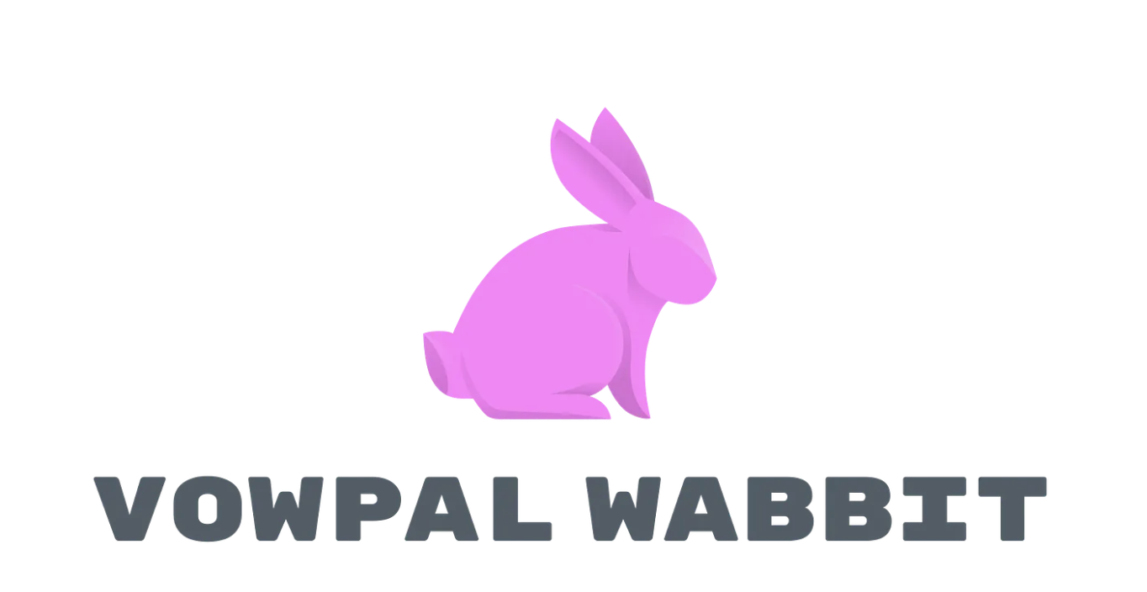


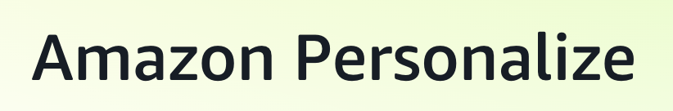
Competition
 | Vector Database | BanditDB
Purpose | Find similar Items | Make optimal decisions
Storage grow | Grow with every document | Fixed size forever – condensed knowledge
Query Type | Nearest neighbor search | Predict best action for context
Learning | Non – static index | Learn on every reword
Answer: | What’s similar | What works
BanditDB sits at the intersection between:
new category database layer and decision intelligence

Slide 7
Why now: AI Agents needs decision memory
AI agents make
millions of decisions
GPT, Claude, and Gemini agents take actions at scale. None of them currently learn which decisions work best. BanditDB closes that loop. No .md files, No contexts or wikis
The data science
bottleneck is real
73% of ML projects never reach production (Gartner). BanditDB ships learning in an afternoon without a data scientist.
Rust + open source
is the right moat
Sub-millisecond latency, 21× memory efficiency, Apache 2.0. The infrastructure layer wins by being fast, cheap, and trusted.

Slide 8
The Market
$47B
$12B
$8B
ML/AI
Infrastructure
Market (2026)
Personalization
Engine
Market (2026)
Decision
Intelligence
Market (2026)
~3% / $1.4B
~20% / $2.4B
~25% / $2B
SAM 2026 ~$5.8B · SAM 2031 ~$14B · SAM 2036 ~$35B
SOM 2036 ~$10B - $15B (data source: Garthner)

Slide 9
The Business Model
Open-source drives adoption → Cloud converts power users → Enterprise converts revenue
OPEN SOURCE
BANDITDB CLOUD
ENTERPRISE
Self-Hosted
Managed Cloud
Private Deployment
Free
Usage-based
Custom
✓ All 5 algorithms
✓ Everything in Open Source
✓ Everything in Cloud
✓ WAL + checkpoint durability
✓ Zero infrastructure
✓ On-premise or VPC deploy
✓ Full HTTP API
✓ Auto-scaling to 100K+ req/sec
✓ SSO / SAML
✓ RBAC + rate limiting
✓ Web dashboard + analytics
✓ SOC 2 · HIPAA · GDPR
✓ Parquet export
✓ Automatic backups
✓ Dedicated SLA (99.99%)
✓ MCP server for AI agents
✓ 99.9% SLA
✓ Custom integrations
✓ Community support
✓ Email + chat support
✓ Dedicated success engineer

Slide 10
The Ask
We are raising $600K pre – seed to finish the BanditDB Cloud and run the Go-to-market motion
Engineering 10%
Go-to-Market 70%
Operations 20%
Managed cloud, enterprise auth, Prometheus metrics, horizontal scaling
Developer relations, enterprise sales, docs, community
Infrastructure, security audit, legal, compliance
Try it now at: sandbox.banditdb.com

Slide 11
Thank You!
https://banditdb.com, contact: Simeon Lukov, s.lukov@dynamicpricing.ai

