Slide 1
Decision Memory Database for Self-Learning AI Agents

Slide 2
Every AI Agent and App make decisions.
Most of them never learn.
ML pipelines
take months
A/B tests are
too slow
Feedback loops are hard to build

Slide 3
BanditDB learns from experience in real time
The Self-Learning Loop
Input
Agent Injects
Context Vector
[0.65, 0.95, 0.21, ]
Action
DB Computes Optimal Decision
predict
Update
Agent Reports Actual Outcome
reward

Slide 4
10x Faster Optimization. Ship in an afternoon
Democratizing Decision Intelligence
Optimization Core:
User experience:
Models, Tools, Skills, Routings,
Orchestrations
Experimentation, Personalization, Recommendation, Education
Business Revenue:
High-Stakes Critical:
Advertising, Dynamic Pricing, Churn Prevention.
Clinical Trials, Fraud & Risk,
Fintech, Edge devices

Slide 5
The Control Plane for AI Decision Learning
Instant Causal Impact
Safe Exploration
Decision Confidence tracking. Turns
stochasticity in deterministic rules
Monitor exploration, convergence,
confidence, and policy health.
Governance
Enterprise ready
Predict-and-reward history for governance
and compliance.
Backup, restore, multi-tenancy, access control, and rate limits.

Slide 6

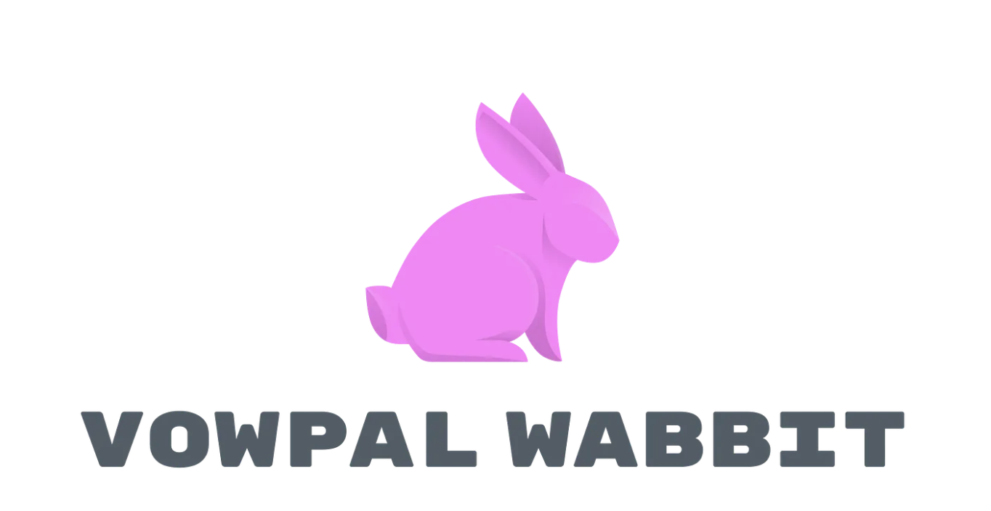



Legacy Alternatives
BanditDB
Make optimal decisions in-memory
Vector Database
Finds similar items
Decision Infrastructure Market
TAM $17B
SAM $5B
SOM $2B

Slide 7
The Business Model
Open-source drives adoption → Cloud converts power users → Enterprise converts revenue
OPEN SOURCE
BANDITDB CLOUD
ENTERPRISE
Self-Hosted
Managed Cloud
Private Deployment
Free
Usage-based
Custom
The Ask
$600K to finish BanditDB Cloud and run the Go-To-Market motion
Engineering 10%
Go-to-Market 70%
Operations 20%

Slide 8
The Traction
Dynamic Pricing AI
Handling $2M/month
Accenture >
AI Agents
Orchestration
Clinical Trials
Right dosage
prescription
Ed Tech
Personalized
education

Slide 9
Thank You!
https://banditdb.com, contact: Simeon Lukov, s.lukov@dynamicpricing.ai

