Slide 1
Skin Disease Detection using Whatsapp-bot
Submitted in the partial fulfillment for the award of the degree of
BACHELOR OF ENGINEERING
IN
Artificial Intelligence and Machine Learning
Submitted by:
Puranjay Kwatra -19BCS6061
Rajeswar Sharma -19BCS6051
Aman Sharma -19BCS6043
Kritesh Sharma -19BCS6057
Vishal Choudhary -19BCS6073
Under the Supervision of:
Dr. Monika Singh
Department of AIT-CSE
DISCOVER . LEARN . EMPOWER

Slide 2
Outline
Introduction to Project
Problem Formulation
Objectives of the work
Methodology used
Results and Outputs
Conclusion
Future Scope
References

Slide 3
Introduction to Project
Skin cancer is a dangerous and widespread disease .Each year there are approximately 5.4 million new cases of skin cancer are recorded in India alone.
When it comes to skin disease detection, you can base your data on multiple sources of information.
As stated above, you can take a deeper look at your own skin disease detection model and analyze the results.

Slide 4
Problem Formulation
Skin cancer is a common form of cancer, and early detection increases the survival rate.
So, if there is way that a person can detect or check his skin condition using a very handy tool so it will be easy to cure at early stage.
The deep learning models built here are tested on standard datasets, and the metric area under the curve of 95% was observed.

Slide 5
Objectives
Data Preparation
Creating a project and loading the dataset
Building a deep learning classifier
Tuning the model
Checking result
Drawing Inferences
Code Access
Deploying the model as a Flask API
Integrating it with Whatsapp-bot

Slide 6
Methodology used
We have used dataset from various sources like kaggle, and then created a deep learning model to analyze all the data with 75 percent accuracy on test dataset.
Created a Whatsapp-bot and then integrated it with the model for user-friendly access.

Slide 7
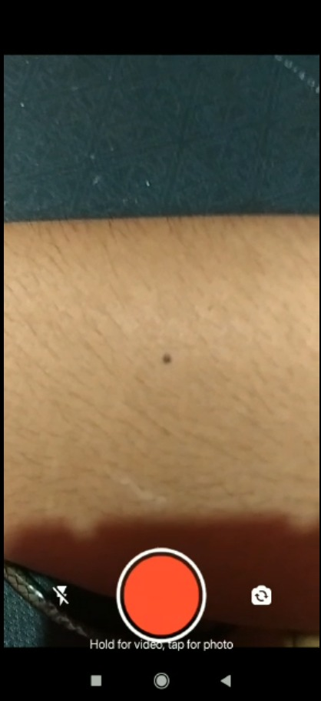
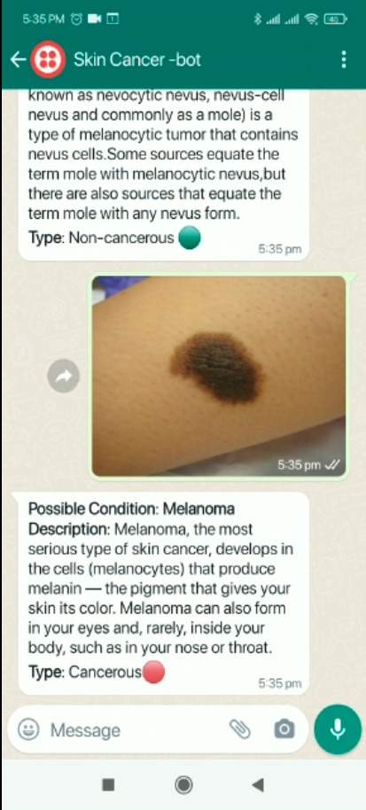
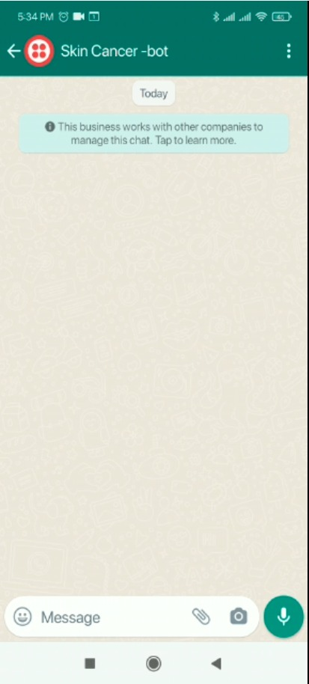
Results and Outputs

Slide 8
Conclusion
There is a need to incorporate clinicians in the design process for these algorithms and a need to build intrinsically explainable deep learning algorithms for cancer detection.
It is important to evaluate proposed methods alongside clinicians to determine the clinical strengths and weaknesses of the methods
As per the Covid rules and guidelines there is need of these new methods to be introduced.

Slide 9
Future Scope
Increasing accuracy of model
Loading more dataset
Recognising more types of diseases
Web deployment

Slide 10
References
[1]A. Masood, A.A. Al-Jumaily
Review article computer aided diagnostic support system for skin cancer: a review of techniques and algorithms
[2] R. Siegel, D. Naishadham, A. Jamal
Cancer statistics, 2012
Cancer J. Clin. (2012), pp. 10-29, 10.3322/caac.20138
[3] R. Siegel, K.D. Miller, A. Jamal
Cancer statistics, 2018
Cancer J. Clin. (2018), pp. 7-30, 10.3322/caac.21442
[4] A. Esteva1, B. Kuprel1, R.A. Novoa, J. Ko, S.M. Swetter, H.M. Blau, S. Thrun
Dermatologist-level classification of skin cancer with deep neural networks
Nature (2017), pp. 115-126, 10.1038/nature21056

