Slide 1


Introduction to Git / Github
Paige Bailey PyLadies-HTX January 7th, 2015

Slide 2

Roadmap Introductions!
Command Line Interface
Installing and Configuring Git
Registering for GitHub
Creating a GitHub Repository
Basic Git Commands

Slide 3
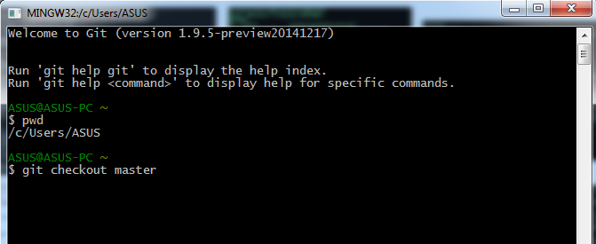
Command Line Interface (CLI)
Windows: Git Bash
Mac / Linux: Terminal
The CLI can help you:
Navigate folders
Create files, folders, and programs
Edit files, folders, and programs
Run computer programs

Slide 4
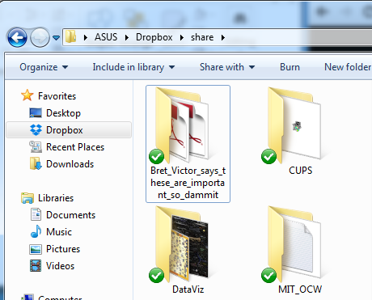
Directories
“Directory” is just another name for a folder (like the folders you see in Windows and on your Mac)
Directories are organized like a tree
Directories can be inside other directories (just like you can have folders in folders)
Directories can be navigated using the CLI
ASUS/Dropbox/share
Bret_Victor…
CUPS
DataViz
MIT_OCW

Slide 5
Directories
The “MIT_OCW” directory is contained inside of the “share” directory, which is within the “Dropbox” directory
One directory “up” from the “MIT_OCW” directory is the “share” directory
ASUS/Dropbox/share
Bret_Victor…
CUPS
DataViz
MIT_OCW

Slide 6
Directory Structures
The directory structure on your computer probably looks something like this:
/
Users
Apps
Paige
~
Games
Utilities
Pictures
Books
Pictures

Slide 7
Special Directories: root
The directory at the top of the tree is called the “root” directory
“root” contains all the other directories; it is represented by a slash “/”
/
Users
Apps
Paige
~
Games
Utilities
Pictures
Books
Pictures

Slide 8
Special Directories: home
The name you use to log in to your computer; represented by a tilde symbol “~”
Contains most of your personal files: pictures and music and such
/
Users
Apps
Paige
~
Games
Utilities
Pictures
Books
Pictures

Slide 9
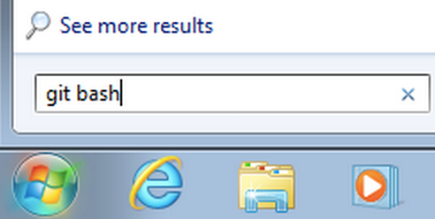
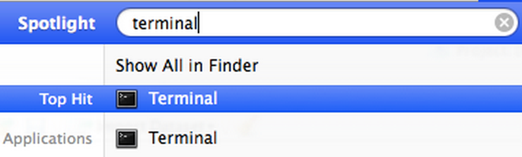
Navigating Directories
For Windows:
Open up the “Start” menu
Search for “git bash”
Open Git Bash
For Mac computers:
Open up Spotlight
Search for “terminal”
Open up the Terminal

Slide 10
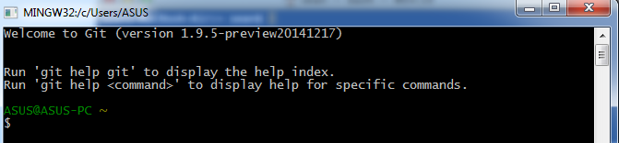
CLI Basics
When you open Git Bash, or a Terminal, you’ll see a prompt which should look something like the picture you see below
Your computer’s name, then your username, then a $
This is your home directory, and currently it is your “working directory”

Slide 11
CLI Basics
You can imagine tracing all of the directories from “root” to “home” (your “path”)
/
Users
Apps
Paige
~
Games
Utilities
Pictures
Books
Pictures

Slide 12
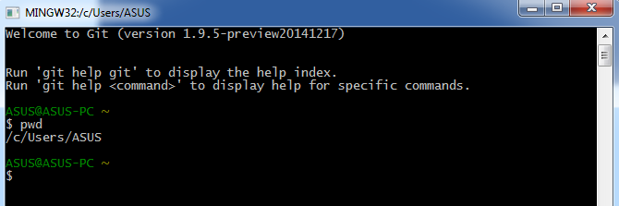
CLI Basics
Type pwd in your CLI prompt and press enter
This displays the path to your “working directory” (the directory that you’re currently in). Stands for “print working directory”.
That’s the same path that we just traced on the file structure tree

Slide 13
CLI Command RECIPE
command flags arguments
command is the CLI command which does a specific task
flags are options we give to the command for behaviors, preceded by a dash “-”
arguments: what the command modifies, or other options for command
There can be zero or more flags or arguments for each command
Example: pwd is a command that had zero flags or arguments

Slide 14
Common Commands
pwd | Displays the path to the current working directory
clear | Clears out the commands that you currently have displayed in the CLI
ls | Lists files and folders in the current directory
ls –a | Lists hidden and unhidden files and folders (“-a” is a flag)
ls –al | Lists details for hidden and unhidden files and folders (“-l” is a flag)
cd | Takes you to your home directory. Takes as an argument the directory you want to visit.
cd .. | Go up one directory
mkdir | Makes a directory; takes as an argument the folder you want to make
touch | Creates an empty file (argument is the file name)
cp | Copy; first argument is a file, second argument is the path where you want the file to be copied. Use the flag “-r” to copy a directory.
rm | Remove; argument is the file you want to remove. The flag “-r” can remove a directory.
date | Prints today’s date.
echo | Prints out to the CLI whatever arguments you provide

Slide 15
Common Commands
Let’s try it!
pwd | Displays the path to the current working directory
clear | Clears out the commands that you currently have displayed in the CLI
ls | Lists files and folders in the current directory
ls –a | Lists hidden and unhidden files and folders (“-a” is a flag)
ls –al | Lists details for hidden and unhidden files and folders (“-l” is a flag)
cd | Takes you to your home directory. Takes as an argument the directory you want to visit.
cd .. | Go up one directory
mkdir | Makes a directory; takes as an argument the folder you want to make
touch | Creates an empty file (argument is the file name)
cp | Copy; first argument is a file, second argument is the path where you want the file to be copied. Use the flag “-r” to copy a directory.
rm | Remove; argument is the file you want to remove. The flag “-r” can remove a directory.
date | Prints today’s date.
echo | Prints out to the CLI whatever arguments you provide

Slide 16
Version Control
Version control is a system that records changes to a file or set of files over time so that you can recall specific versions later.
Many of us constantly create something, save it, change it, then save it again
Version (or revision) control is a means of managing this process in a reliable and efficient way
Especially important when collaborating with others

Slide 17
Git
Git is a free and open-source distributed version control system designed to handle everything from small to very large projects with speed and efficiency.
Created by the same people who developed Linux
The most popular implementation of version control today
Everything is stored in local repositories (“repos”) on your computer
Operated from the command line

Slide 18
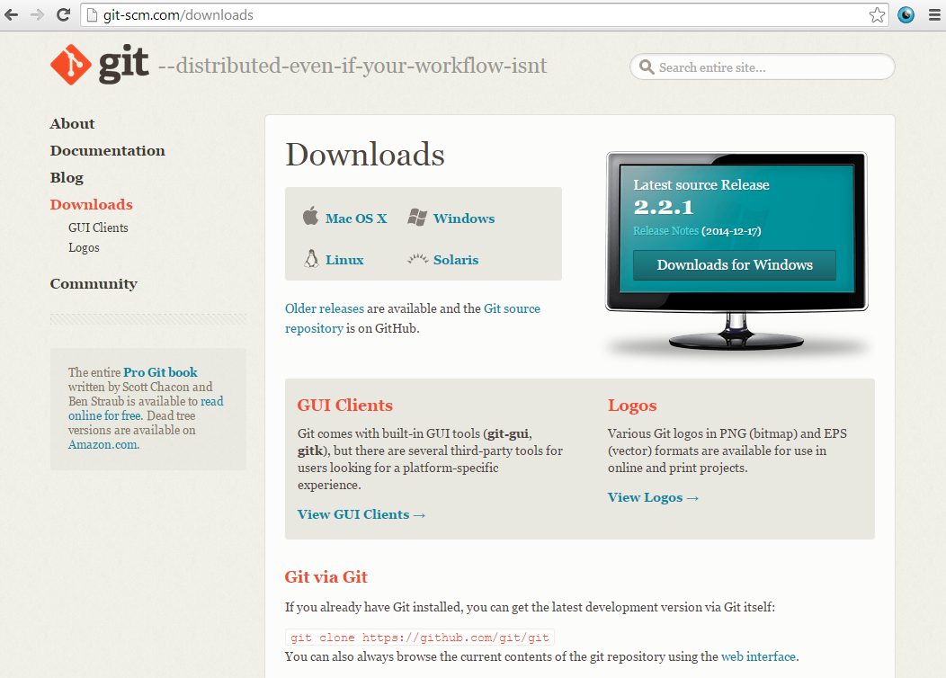
Download and Install Git
http://git-scm.com/downloads
Click on the download link for your computer (Mac, Linux, Windows)

Slide 19
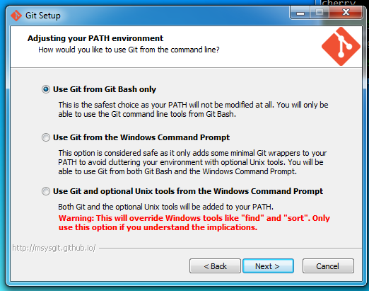
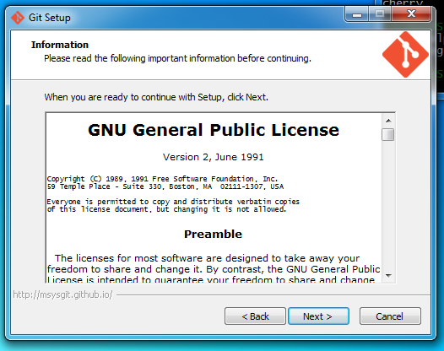
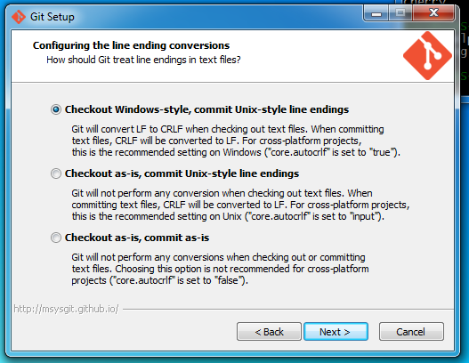
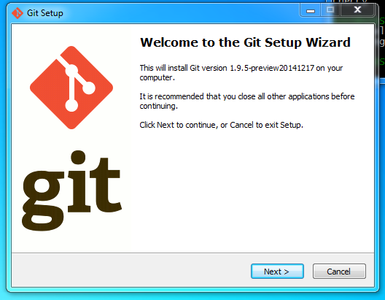
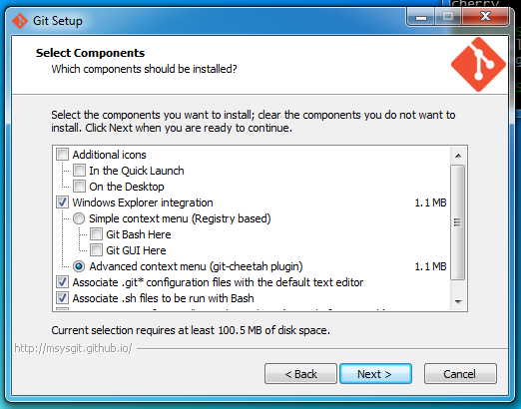
Download and Install Git
Once the file is downloaded, open it up and begin the installation process
Just go with the defaults, and then open up Git Bash

Slide 20

Configure Username and Email
Each commit to a Git repository will be “tagged” with the username of the person who made the commit
Enter the following commands in Git Bash, one at a time, to set your username and email. Make sure you remember which email you used – that’ll be the one we’ll need to use to register for GitHub.
Type git config –list afterward, to make sure your changes were made

Slide 21
GitHub
GitHub is a web-based hosting service for software development projects that use the Git revision control system.
Allows users to “push” and “pull” their local repositories to and from remote repositories on the web
Provides users with a homepage that displays public repos
Repos are backed up on GitHub servers in case something happens to local files
Can follow other folks online and share projects

Slide 22
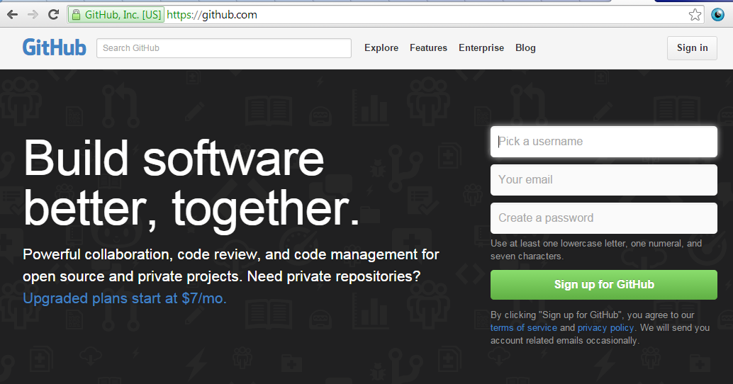
Github
https://github.com
Enter in a username, email, and password, and click “Sign up for Github”.
Use a .edu address if you’ve got access to one!

Slide 23
Git vs. GitHub
Git is local on your computer
GitHub is available via the internet (“remote”)
GitHub allows you to:
Share your repos with others
Access other users’ repositories
Store remote copies of your repositories on GitHub’s server in case something bad happens to the local copies on your computer
You don’t need GitHub to use git

Slide 24
Creating a GitHub RePository
Two methods of creating a GitHub repository:
Start a repository from scratch
“Fork” another user’s repository
https://github.com/YourUserName --> “Create a new repo”
https://github.com/new (if you’re logged into your GitHub account)
Create a name for the repo; select “Public”; make a brief description; initialize with a README; and click “Create repository” button.

Slide 25
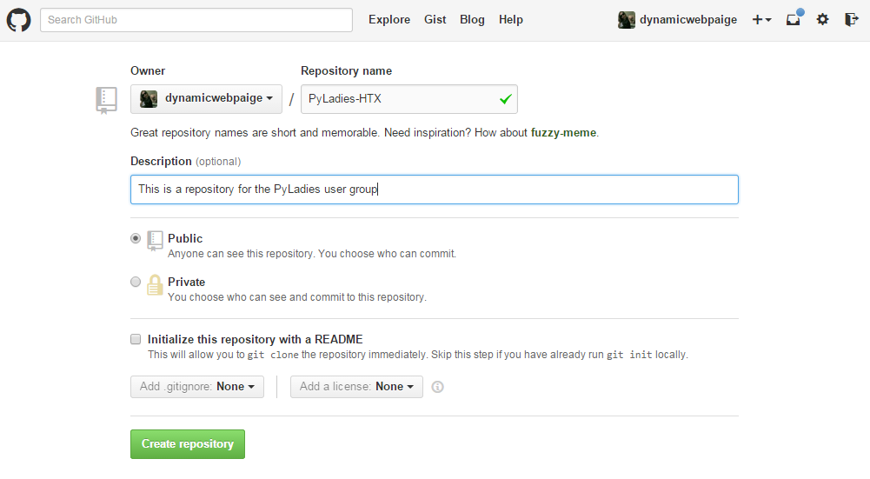
Make a Repo

Slide 26


Creating a Local Copy
Now you need to create a copy of this repository on your computer so that you can make changes to it!
Open Git Bash
Create a directory on your computer to store your copy of the repo
Navigate to this new directory using “cd”

Slide 27

Creating a Local Copy
Initialize a local Git repository in this directory with “git init”
Point your local repository at the remote repository you just created on the GitHub server

Slide 28
Forking another user’s repo
The second method of creating a repository is to make a copy of someone else’s.
This process is called “forking” and is an important aspect of open-source software development.
Let’s fork my “PyLadiesHTX” directory:

Slide 29

Clone the Repo
So there’s a copy of the repository in your GitHub account now…
…but you still need to make a local copy on your computer.
This is called “cloning”. You can do it with the following command:

Slide 30
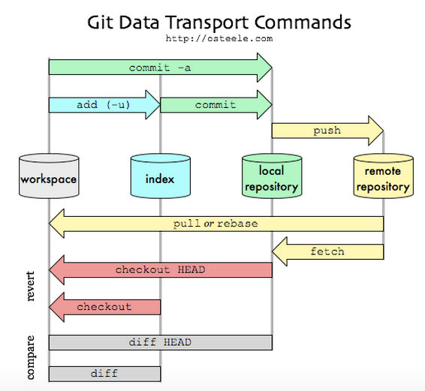
Pushing and Pulling

Slide 31
Adding
If you add new files to a local repository (a directory that’s just housed on your computer, not on the internet) you need to let Git know that they need to be tracked.
This should always be done before committing.
git add . | Adds all new files
git add –u | Updates tracking for files that changed names or were deleted
git add –A | Does both of the previous steps

Slide 32

Committing and Pushing
If you want to commit changes to your local repository, you use the following command:
To push those local changes to GitHub, you’d use the command:

Slide 33



Branches
Sometimes you’re working on a project with a version that’s being used by a lot of different people
You might not want to edit the version that everyone’s editing – so you can branch off a copy of the repo with the command:
To see what branch you’re on, type:
To switch back to the master branch type:

Slide 34
Pull Requests
If you fork someone’s repo or have multiple branches, you will both be working separately
Sometimes you want to merge in your changes with the other branch / repo
To do so, you need to send in a “pull request” (feature of GitHub)
Extra resources:
http://git-scm.com/doc
https://help.github.com
Google it! Or use StackOverflow

Slide 35
Thank you!
PyLadies-HTX 2015

