Slide 1

There’s no place like home.
Analyzing HPD police beat data with Python and ArcGIS

Slide 2



Paige Bailey
@DynamicWebPaige
www.paige-bailey.com
Founder of PyLadies-HTX
GIS / Python at Chevron
Houston, TX
B.S. Geophysics / B.A. Sociology
Rice University '13
M.S. Subsurface Geoscience
Rice University '16
A.B.A Business Administration
Hill College '08

Slide 3
...apartment-hunting is a Thing.

Slide 4
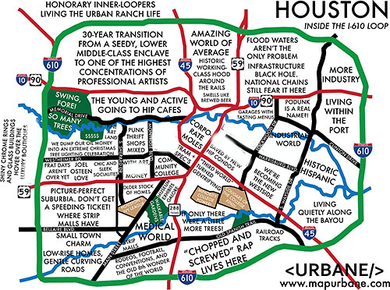

Slide 5
Selection criteria

Slide 6
Selection criteria
Near work

Slide 7
Selection criteria
Near work
Near school

Slide 8
Selection criteria
Near work
Near school
Near METRO

Slide 9
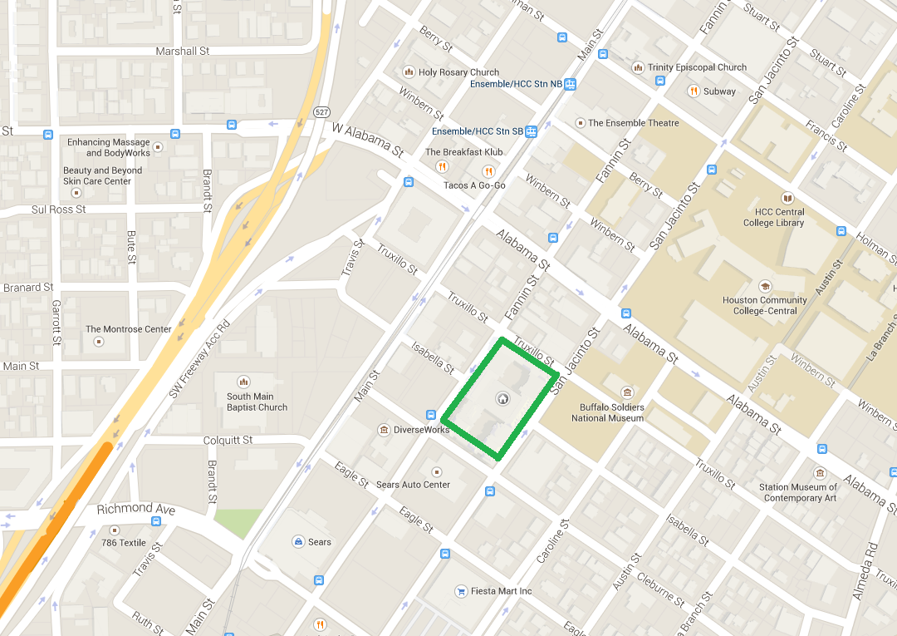

Slide 10
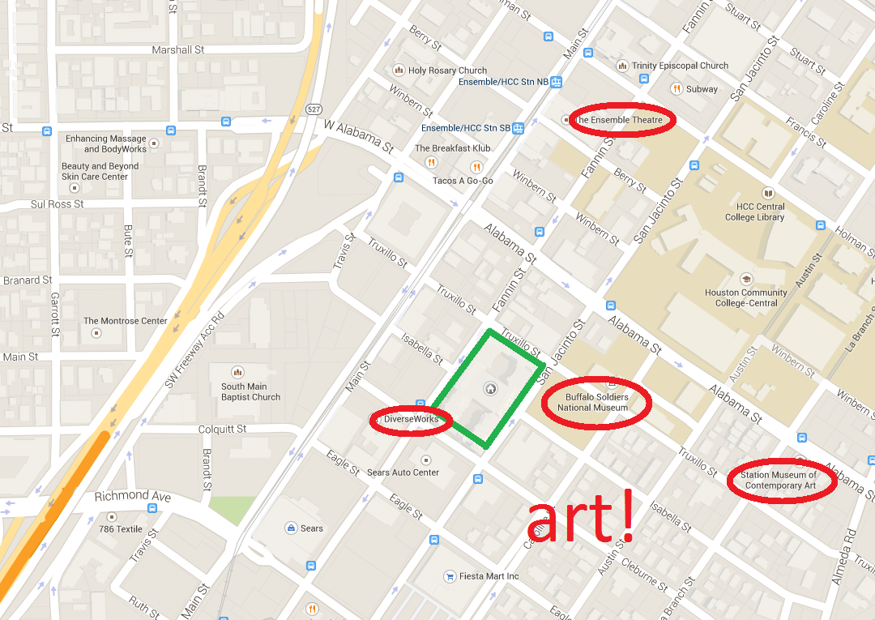

Slide 11
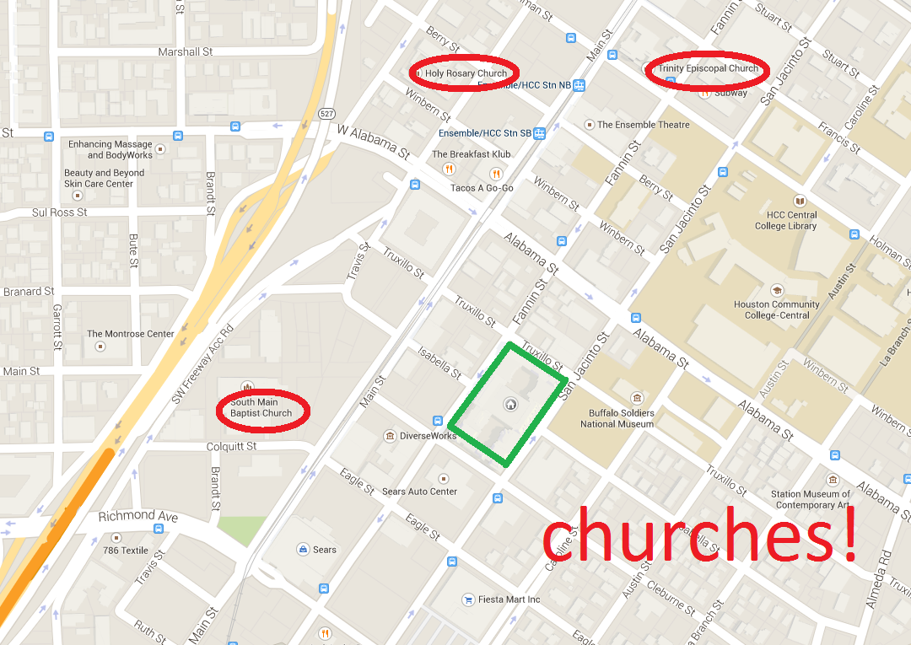

Slide 12
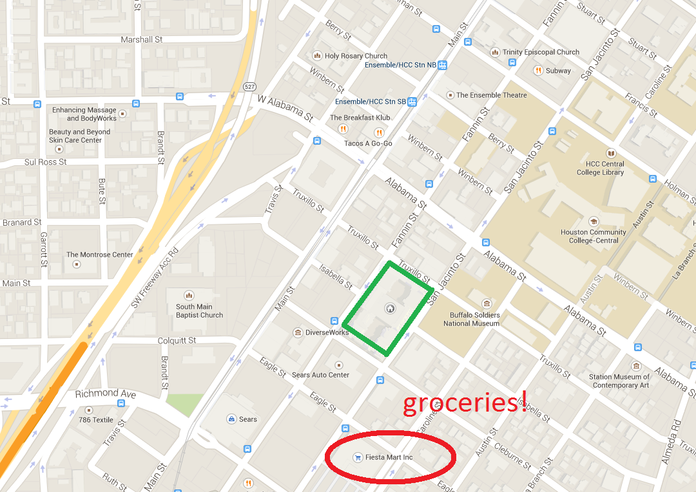

Slide 13
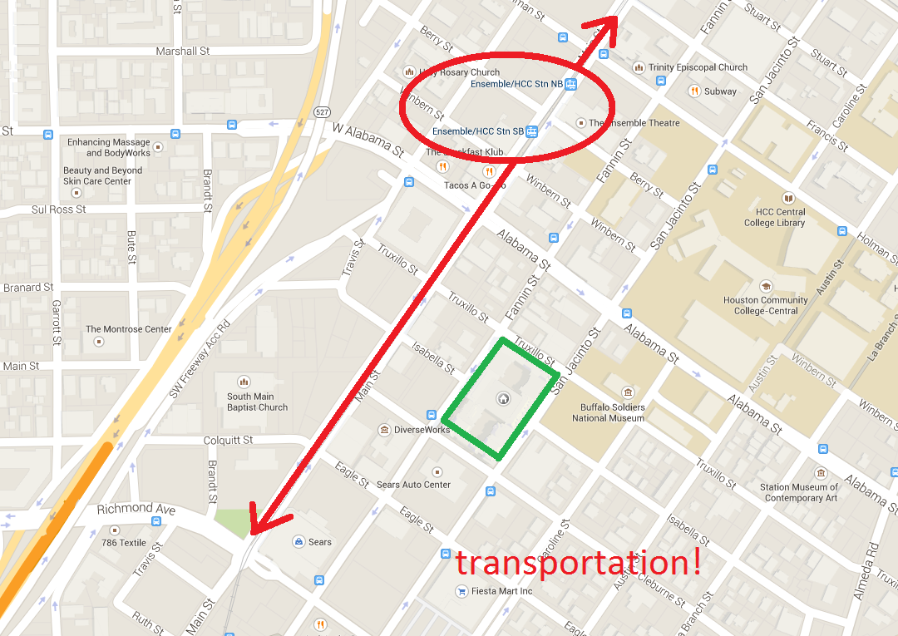

Slide 14
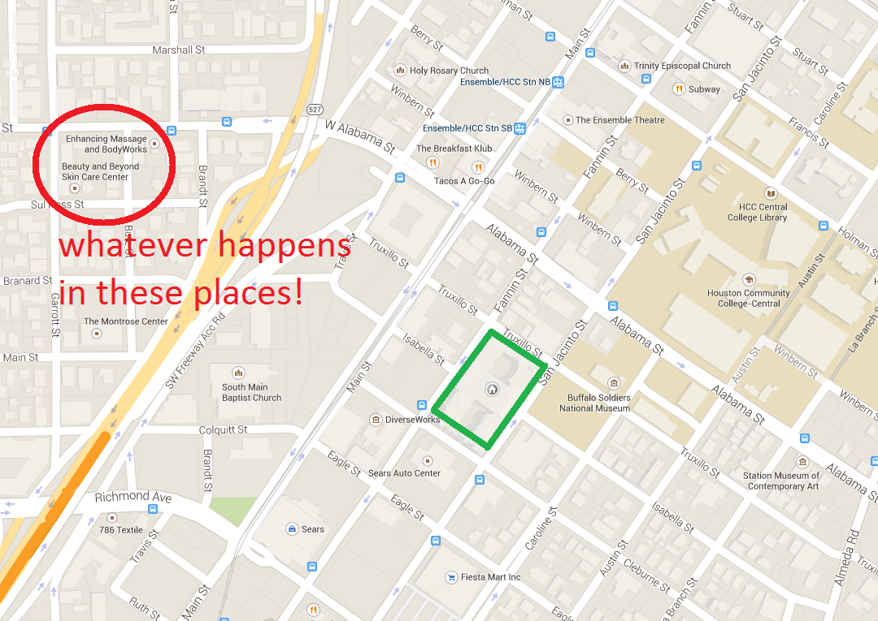

Slide 15
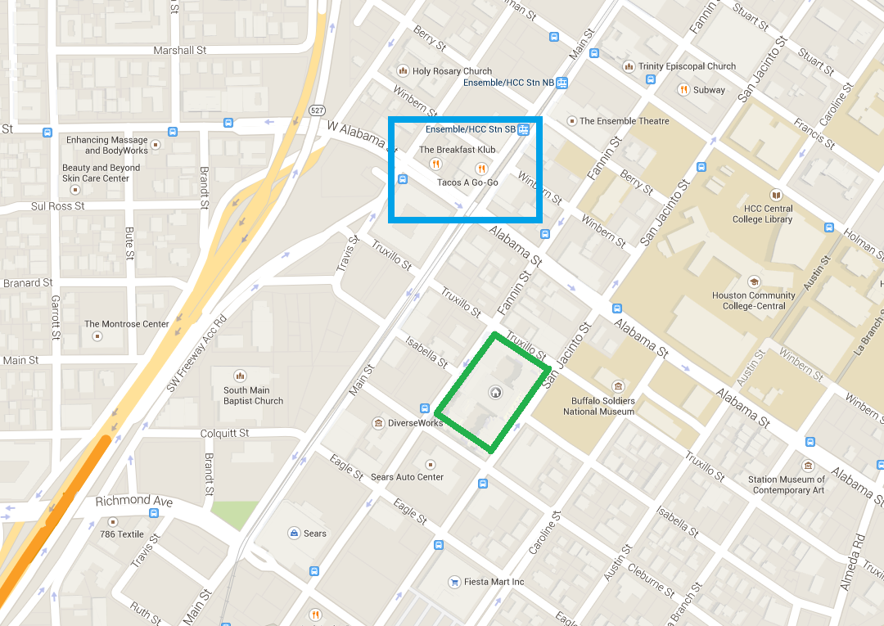

Slide 16
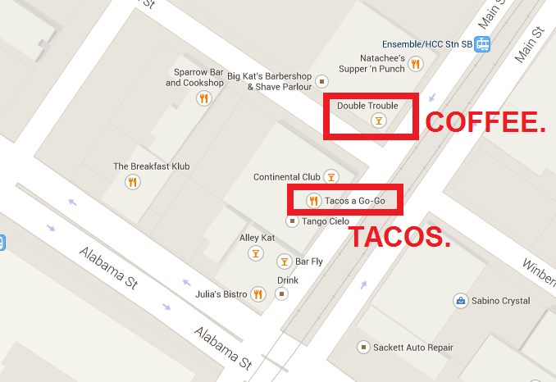

Slide 17
“If you park your car outside, make sure only to park it on Fannin or Truxillo.”
– Security Guard

Slide 18
???
How can one side of a building be more secure than another side?

Slide 19
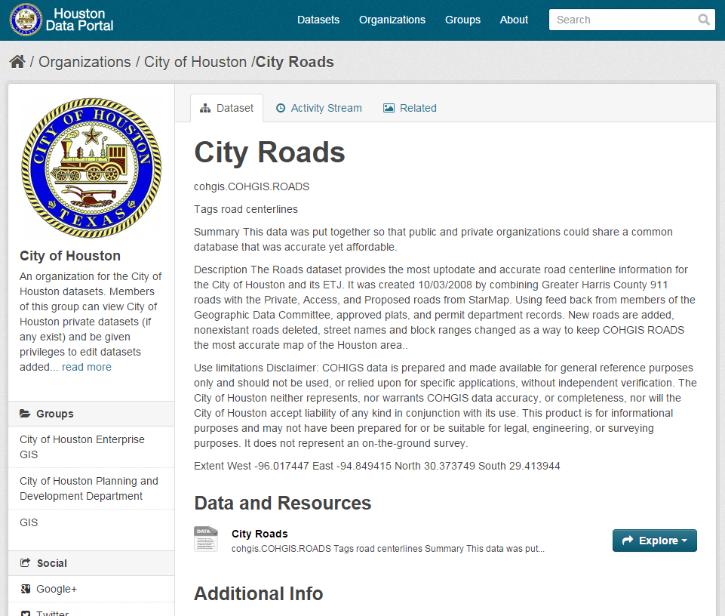
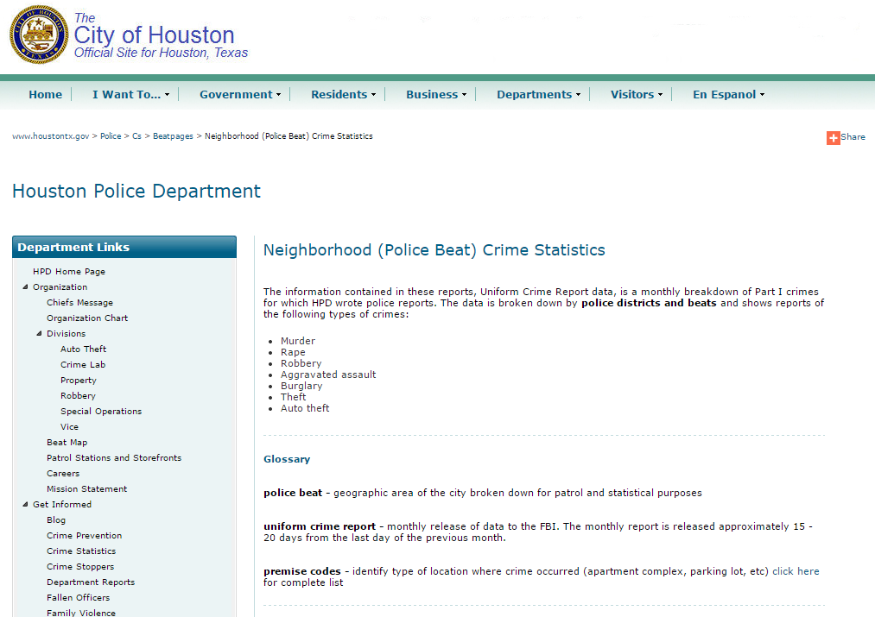
Obtaining the Data
Houston Police Department’s Neighborhood (Police Beat) Crime Statistics
  http://www.houstontx.gov/police/cs/beatpages/beat_stats.htm
Also used the City of Houston’s “ROADS” shapefile, via the Open Data Portal
  http://data.ohouston.org/dataset/city-roads

Slide 20
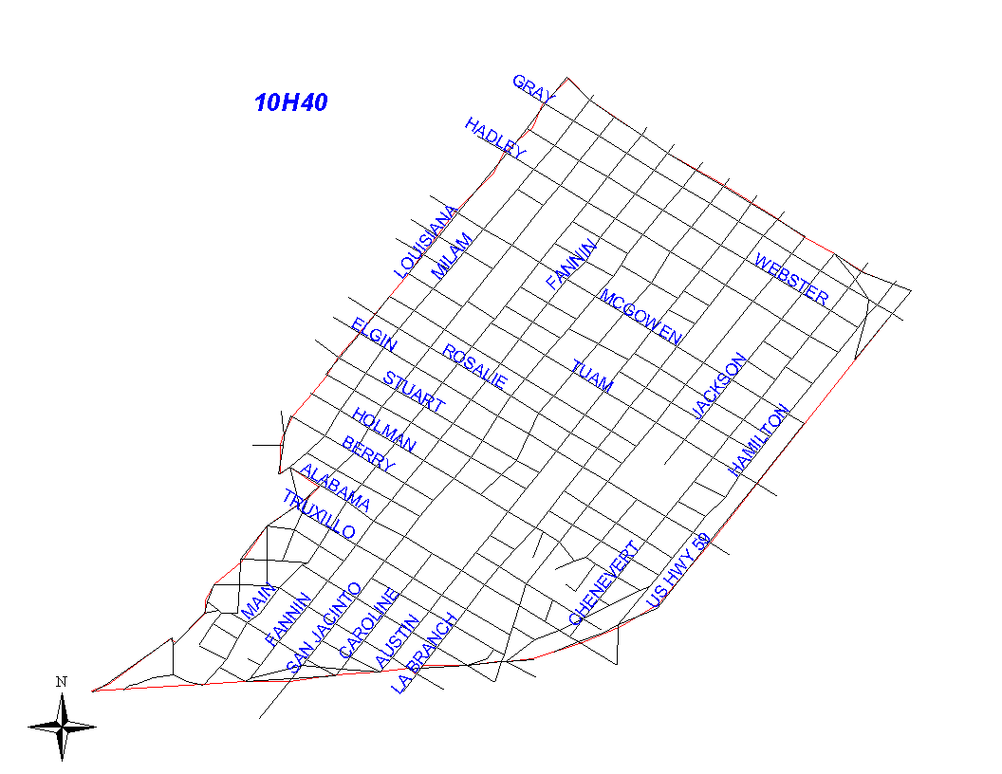
Data for 10H40
7,445 entries since June 2009
Averages out to ~108 crimes per month (3-4 per day)
Zip codes included:
  77002
  77003
  77004
  77006

Slide 21
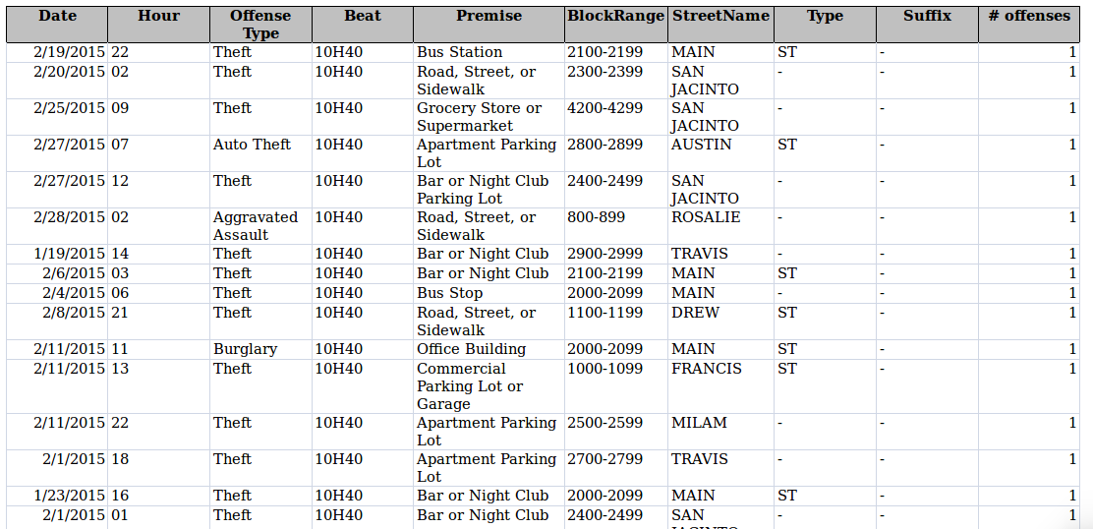
Attribute data per crime
Date
Hour (0 – midnight, 23 – 11:00pm)
Offense Type
  Murder
  Rape
  Robbery
  Aggravated Assault
  Burglary
  Theft
  Auto Theft
Beat
Premise Code
Block Range
Street Name
# of Offenses

Slide 22
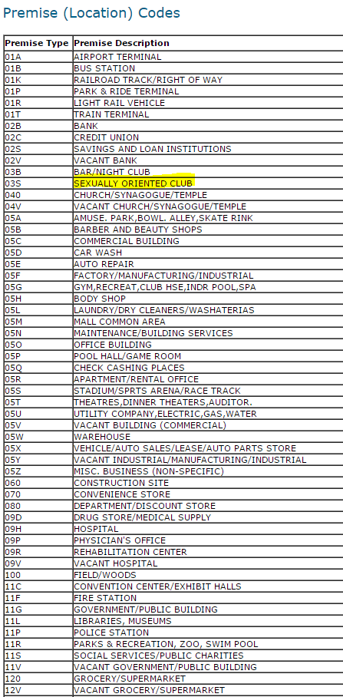
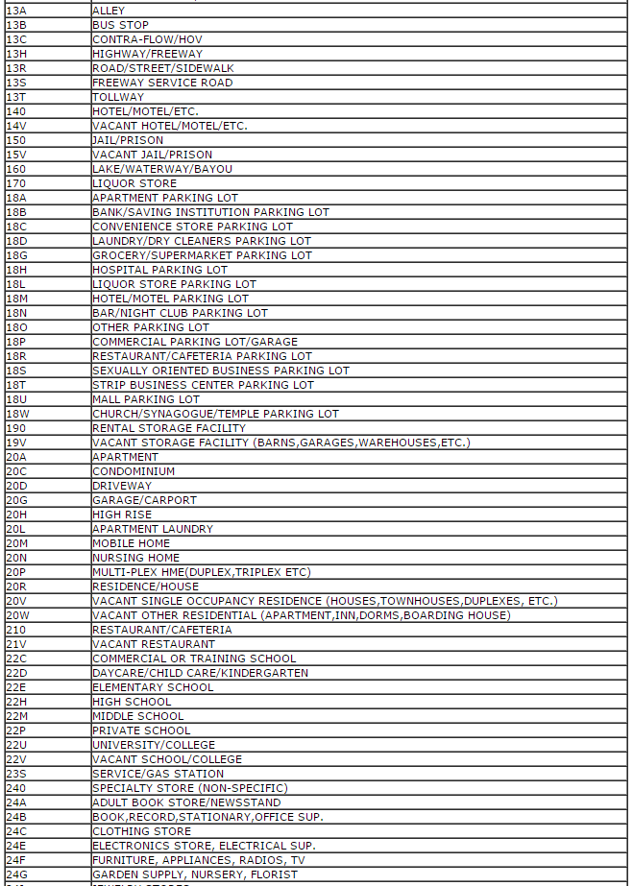
Attribute data per crime
Date
Hour (0 – midnight, 23 – 11:00pm)
Offense Type
  Murder
  Rape
  Robbery
  Aggravated Assault
  Burglary
  Theft
  Auto Theft
Beat
Premise Code
Block Range
Street Name
# of Offenses

Slide 23
Potential problems with the data
Not sure if “date” refers to “date the complaint was filed”, or “date the event occurred”.
Same for “hour” – is this the hour the crime was reported? Or the hour the crime occurred?
Two months were missing from the data set; some previous months’ data is intermixed
“UNK” values for block ranges occurred several times.
Table changed format some time in 2010 (easily dealt with using Beautiful Soup; meant hand-manipulation for initial analysis).

Slide 24
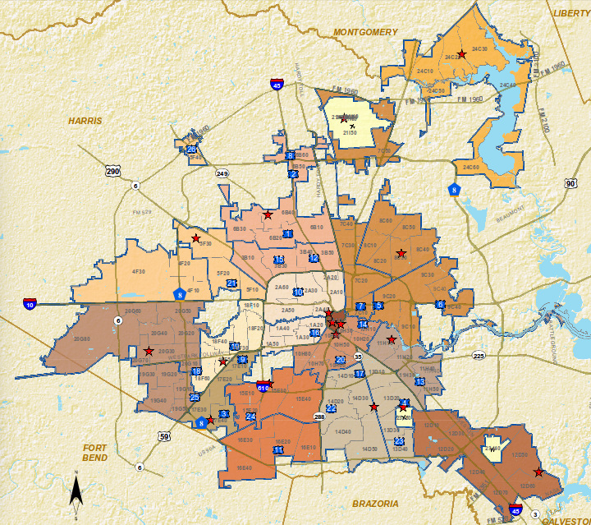
What are the most common crimes committed?
10H40 seems to get everything…
  Aggravated Assault – 511
  Auto Theft – 427
  Burglary – 554
  Murder – 4
  Rape – 45
  Robbery – 632
  Theft – 5,272

Slide 25
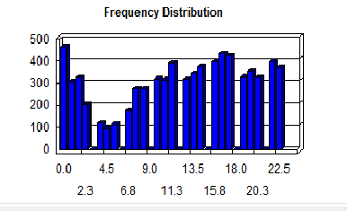
When are those crimes most likely to happen?
Most occur around midnight and between 4:00 – 6:00pm.
The least number of crimes occur between 3:00am and 6:00am.
Not quite sure why there would be such a spike between 4:00 – 6:00pm – maybe because so many people are headed home from work and away from school?

Slide 26
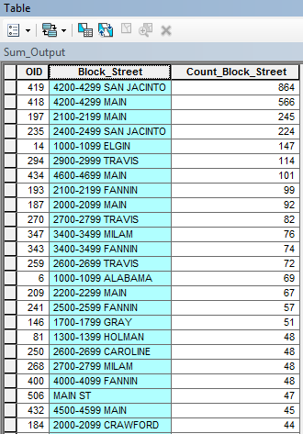
Where are crimes most likely to happen?
Merged the “BLOCK RANGE” and “STREET NAME” attributes in order to make a single attribute called “Block_Street”
Python:
str([block_range]) + “ “ + ([street_name]).upper()
Top instances
(>100 crimes committed):
  4200 – 4299 San Jacinto: 864
  4200 – 4299 Main St: 566
  2100 – 2199 Main St: 245
  2400 – 2499 San Jacinto: 224
  1000 – 1099 Elgin St: 147
  2900 – 2999 Travis St: 114
  4600 – 4699 Main St: 101

Slide 27
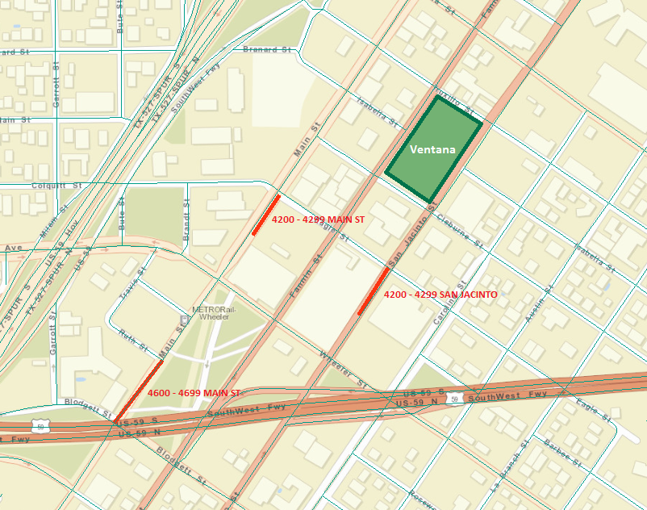
So how close is that to me?
Three of the most high-crime areas are located fairly close to my apartment complex:
  4200 – 4299 San Jacinto St - 864
  4200 – 4299 Main St – 566
  4600 – 4699 Main St – 101
20.6%
of crimes in the 10H40 police beat

Slide 28
Which side of the Ventana is most dangerous?
Least dangerous?
  3900 – 4000 Fannin Street
  3900 – 4000 San Jacinto Street
  1000 – 1200 Truxillo Street
  1000 – 1200 Cleburne Street
Most dangerous:
San Jacinto Street and Cleburne Street
(like the guard said)
Least dangerous:
Fannin Street and Truxillo Street

Slide 29
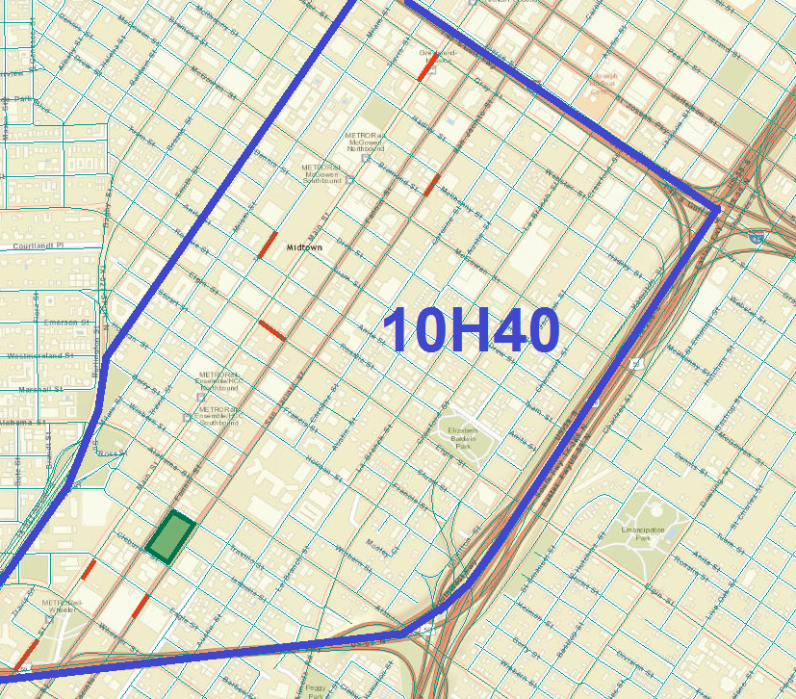
Police Beat 10H40
Most of the crime appears to be occurring along the MetroRail
The Greyhound Station appears to have a very high crime rate, as well.
Of the three MetroRail stops in my vicinity, the HCC/Ensemble Theatre stop has a lower crime rate than the Wheeler Station stop or the McGowen Street station stop.

Slide 30
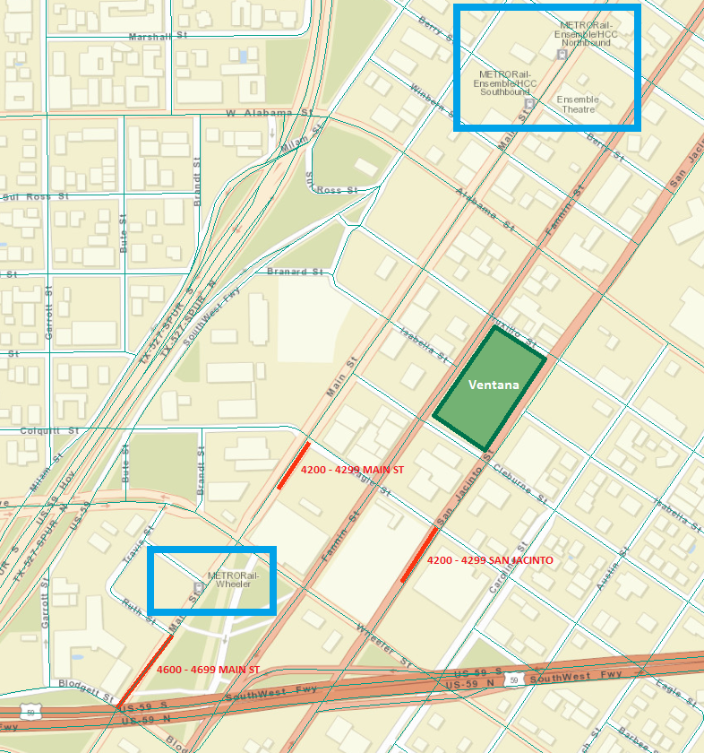
Which MetroRail stop is the safest?
There are two MetroRail options for me when I go to work or to school:
  Wheeler Station
  Ensemble / HCC Station
Both are equidistant from my apartment
It’s obvious to see, when mapped, that the safest MetroRail station for me to go to – no matter what time of day – is the HCC / Ensemble Theatre Station.

Slide 31
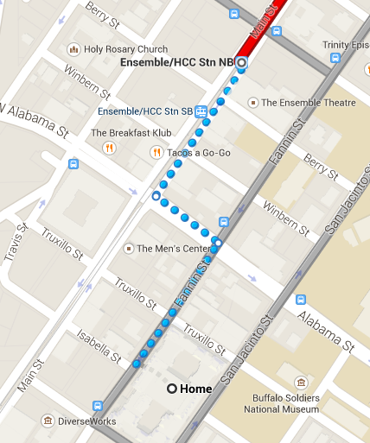
Which route is the safest to walk to work?
When is the safest time?
Route to work (as recommended by Google Maps transportation routing):
  4000 Fannin to 3800 Fannin
  1100 Alabama to 1000 Alabama
  3700 Main St to 3500 Main St
Crimes along this route:
160 total (2.15%)
Weighted route using ArcGIS Network Analyst tool – instead of distance, optimizes for route with least amount of criminal activity for given time of day
Safest Route – 104 crimes total (1.4%)
  4000 Fannin St to 3600 Fannin St
  1100 Berry St to HCC Station

Slide 32
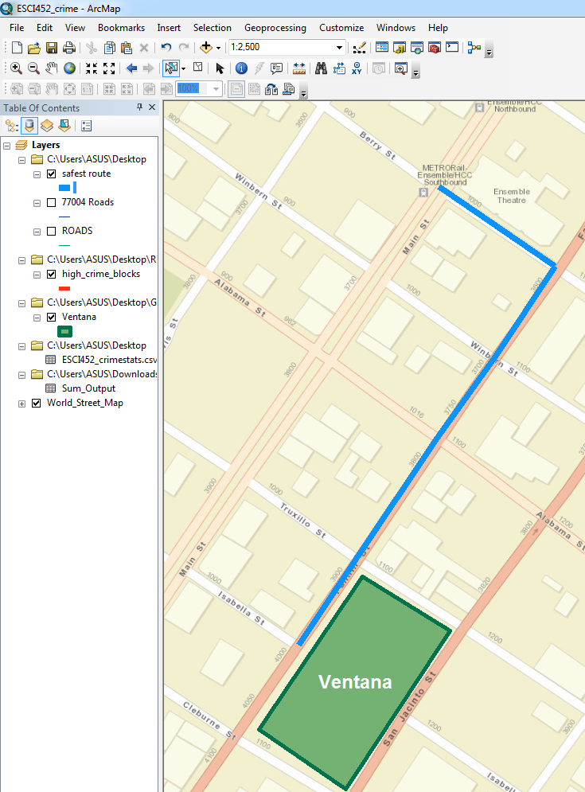
Which route is the safest to walk to work?
When is the safest time?
The most safe time to walk along the safest route is between 3:00am and 5:00am
Zero crimes have been committed along the Fannin Street route since 2009 for that time frame
6 thefts, 2 burglaries, and 1 aggravated assault have occurred between the hours of 7:00am – 9:00am along the Fannin Street route
When I normally walk to work, between 5:00 and 7:00 am, there has been 1 rape, 2 auto thefts, and 1 theft.
4 out of 7,445 instances = not that bad.

Slide 33
How much was risk reduced?
The route I'd currently been walking to the MetroRail was to the Wheeler Station stop
Three of the most dangerous blocks in Houston
Total number of offenses between the hours of 5:00 and 7:00am since June 2009:
72
~1% of the total offenses for 10H40
Thefts, robberies, rapes, aggravated assaults
Risk was reduced to .0537%

Slide 34
“It would be great if you could do this for all of Houston!
I worry so much about biking home from school to my apartment...”

Slide 35
“Could you do this for the Westheimer area?
Never know where to park my car...”

Slide 36
“Could you do this for the bike paths along the Bayou?”

Slide 37
Absolutely!

Slide 38
...but there's no way in heck I'm doing that by hand.
Absolutely!

Slide 39
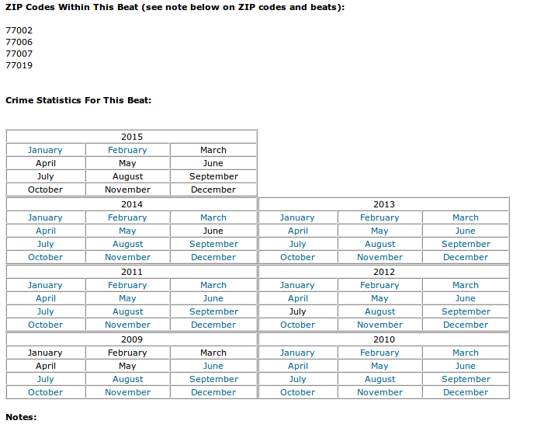
Data format on HPD's web site
92 police beats
69 months of data per police beat
6,348 separate .csv files

Slide 40
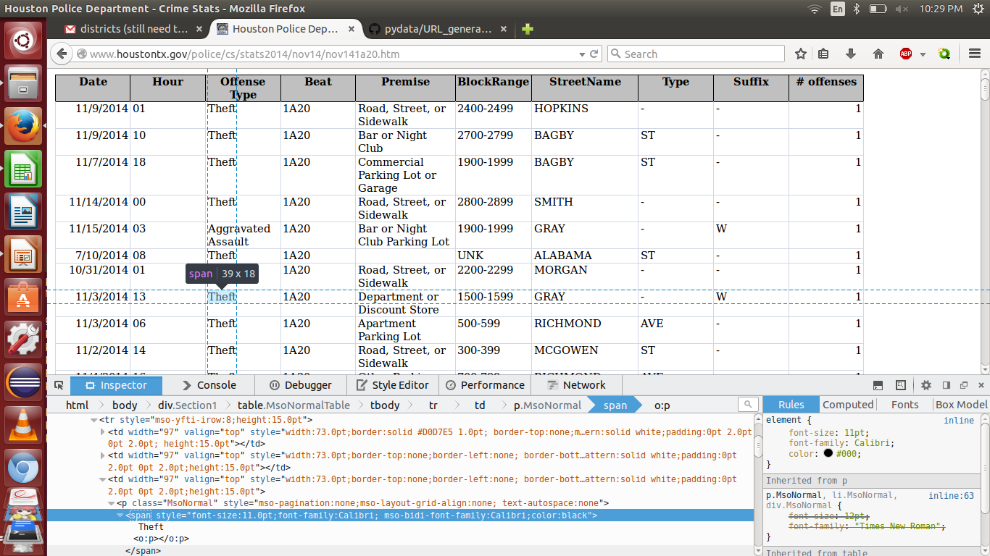
Suitable for automation?
URL's for each police beat are in a consistent format
Tables and associated data are also in a (fairly) consistent format
Same tag <span> used for each cell value

Slide 41
Pain points
Column order changed depending on date, beat
(never the number of columns, though, or their names)
Some months' data was unavailable
(webpage doesn't exist, or its name had been misspelled)
UTF-8 vs. Unicode; strings vs. integers
Dates with dissimilar formats
“UNK” values vs. empty strings
City blocks' names not in same format as CoH's ROADS.shp
( str([block_range]) + “ “ + ([street_name]).upper() )

Slide 42
Pain points – all solvable!
Column order changed depending on date, beat
(never the number of columns, though, or their names)
Some months' data was unavailable
(webpage doesn't exist, or its name had been misspelled)
UTF-8 vs. Unicode; strings vs. integers
Dates with dissimilar formats
“UNK” values vs. empty strings
City blocks' names not in same format as CoH's ROADS.shp
( str([block_range]) + “ “ + ([street_name]).upper() )

Slide 43
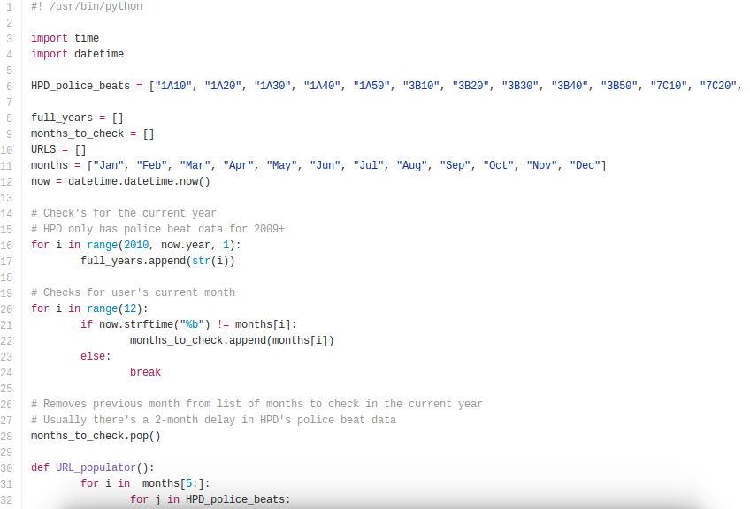
Tools and methodology
Created a script to generate a list of URL's for HPD police beats, using current date (-2 months)
Libraries used:
datetime, time

Slide 44
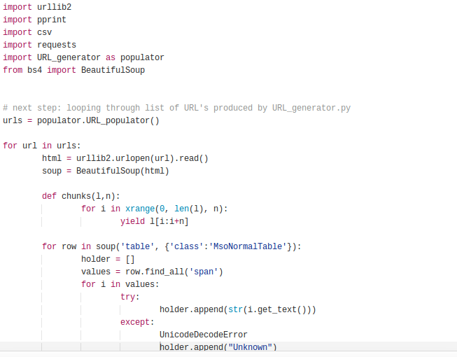
Tools and methodology
Cycled through the list of URL's pulling everything from within the <span> tag
UnicodeDecodeError
r = requests.get()
r.raise_for_status()
open('out.csv','a')
BeautifulSoup(html)
soup('table', {'class': 'MsoNormalTable'}):

Slide 45
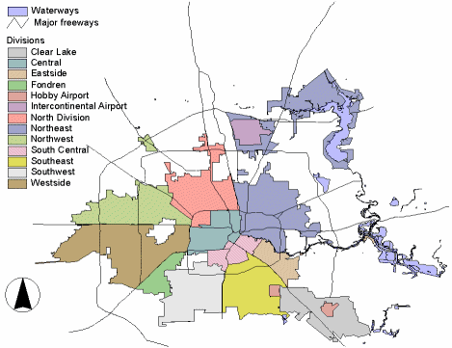
Results
.csv with just under a million criminal offenses in Houston from June 2009 – February 2015
812,154
Crimes divided into city blocks with standard format for columns / block names
(e.g., 4100-4199 FANNIN)
Compatible with the City of Houston's enterprise GIS ROADS.shp
...and if anyone was curious: my district (South Central) was responsible for 5.125% of total crimes, despite only housing 4% of the population and covering 18.4 square miles

Slide 46

Results
.csv with just under a million criminal offenses in Houston from June 2009 – February 2015
812,154
Crimes divided into city blocks with standard format for columns / block names
(e.g., 4100-4199 FANNIN)
Compatible with the City of Houston's enterprise GIS ROADS.shp
...and if anyone was curious: my district (South Central) was responsible for 5.125% of total crimes, despite only housing 4% of the population and covering 18.4 square miles

Slide 47
Next Steps
Incorporating Houston 311 Data
http://hfdapp.houstontx.gov/311/index.php
  Noise complaints
  Garbage in yards
  Water / sewage outages
Putting everything online, sans ArcGIS:
  Query crime rates for given blocks from local police departments
  Assess time of day that the person wants to travel
  Route them around potentially dangerous areas

Slide 48
Thank you!
@nodDFW – coworking space in Dallas, TX
Open Houston: Houston's Open Data Initiative
ESCI 452 classmates

Slide 49
Thank you!
Questions?

