Slide 1
Management: Concepts & Techniques: MS 301
By
Dr. Saurabh Pratap
I I I T, DM Jabalpur

Slide 2
Outline of Class
Logistic & Supply Chain Management
Operations Management
Financial Management
Marketing Management
Managing Organizations
Mid Sem.
End Sem. (30% + 70%)

Slide 3
Logistics Systems
Planning and Control
By
Dr. Saurabh Pratap
I I I T, DM Jabalpur

Slide 4
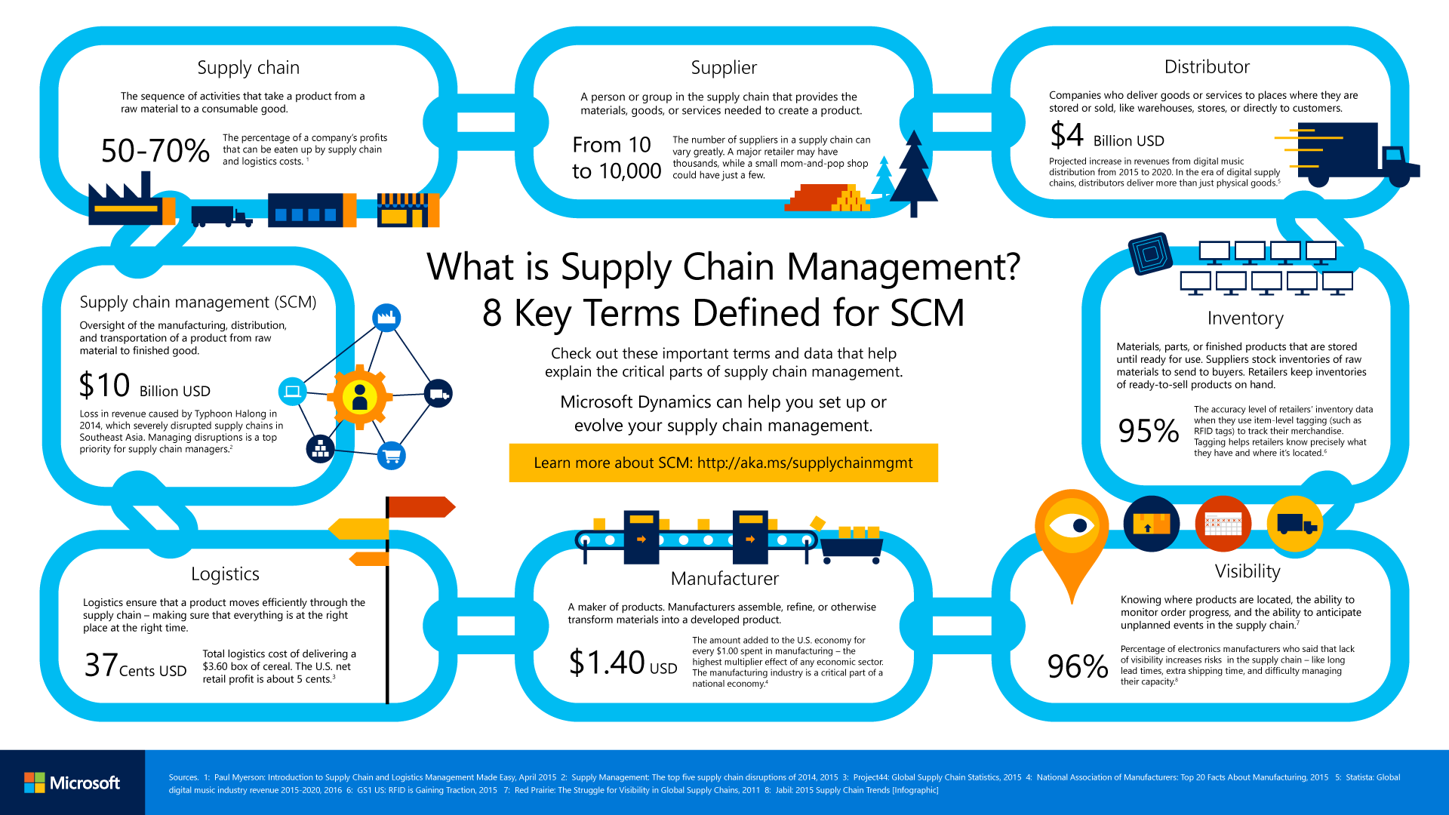

Slide 5
What is logistic
Logistics deals with the planning and control of material ﬂows and related information in organizations, both in the public and private sectors
To get the right materials to the right place at the right time, while optimizing a given performance measure (e.g. minimizing total operating costs) and satisfying a given set of constraints (e.g. a budget constraint)
To decide how and when raw materials, semi-ﬁnished and ﬁnished goods should be acquired, moved and stored.

Slide 6
Signiﬁcance of logistics
Total logistics cost incurred by USA organizations in 1997 was 862 billion dollars, corresponding to approximately 11% of the USA Gross Domestic Product (GDP).
This cost is higher than the combined annual USA government expenditure in social security, health services and defence.

Slide 7
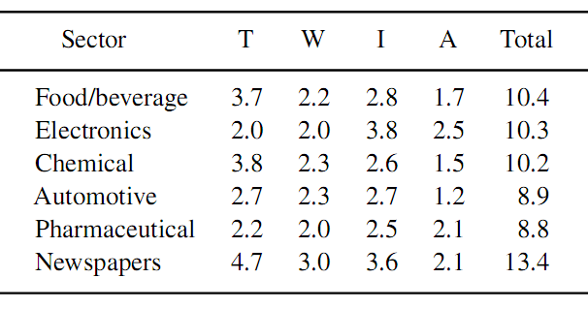
Table 1 Logistics costs (as a percentage of GDP) in EU countries
T, transportation;W, warehousing; I, inventory; A, administration

Slide 8
What is logistic system
A logistics system is made up of a set of facilities linked by transportation services
Facilities are sites where materials are processed, e.g. manu-factured, stored, sorted, sold or consumed.
They include manufacturing and assembly centres, warehouses, distribution centers (DCs), transshipment points, transportation terminals, retail outlets, mail sorting centers, garbage incinerators, dump sites, etc.

Slide 9
What is Supply chain ?
A supply chain is a complex logistics system in which raw materials are converted into finished products and then distributed to the final users (consumers or companies)
It includes suppliers, manufacturing centers, warehouses, DCs and retail outlets.

Slide 10
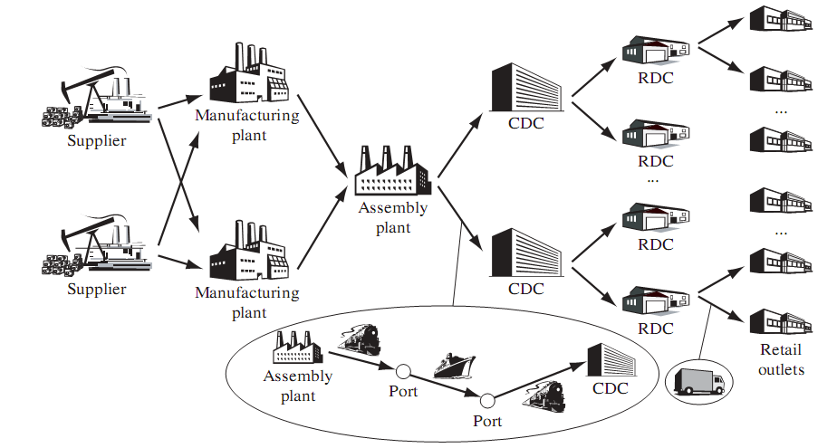
Figure 1: Typical supply chain

Slide 11
Figure 1 shows a typical supply chain in which the production and distribution systems are made up of two stages each.
In the production system, components and semi-finished parts are produced in two manufacturing centers while finished goods are assembled at a different plant.

Slide 12
The distribution system consists of two central distribution centers (CDCs) supplied directly by the assembly centre, which in turn replenish two regional distribution centres (RDCs) each.
Each of the transportation links in Figure 1 could be a simple transportation line (e.g. a truck line) or of a more complex transportation process involving additional facilities (e.g. port terminals) and companies (e.g. truck carriers)

Slide 13
Manufacturing plants contain machines, buffers, belt conveyors or other material handling equipment,
DCs include shelves, forklifts or automatic storage and retrieval systems.

Slide 14
Logistics is not normally associated with the detailed planning of material ﬂows inside manufacturing and assembly plants.
Strictly speaking, topics like aggregate production planning and machine scheduling are beyond the scope of logistics.

Slide 15
Push versus pull supply chains
In a pull (or make-to-order (MTO)) system, finished products are manufactured only when customers require them.
Hence, in principle, no inventories are needed at the manufacturer.
In a push (or make-to-stock (MTS)) system, production and distribution decisions are based on forecasts. As a result, production anticipates effective demand, and inventories are held in warehouses and at the retailers

Slide 16
Whether a push system is more appropriate than a pull system depends on product features, manufacturing process characteristics, as well as demand volume and variability.
MTO systems are more suitable whenever lead times are short, products are costly, and demand is low and highly variable.
In some cases, a mixed approach can be used.

Slide 17
For example, in make-to-assembly (MTA) systems components and semi-finished products are manufactured in a push-based manner while the final assembly stage is pull-based.

Slide 18
Product and information ﬂows in a supply chain
Products ﬂow through the supply chain from raw material sources to customers, except for obsolete, damaged and nonfunctioning products which have to be returned to their sources for repair or disposal.
Information follows a reverse path. It traverses the supply chain backward from customers to raw material suppliers.

Slide 19
Product and information ﬂows cannot move instantaneously through the supply channel.
First, freight transportation between raw material sources, production plants and consumption sites is usually time consuming.
Second, manufacturing can take a long time, not only because of processing itself, but also because of the limited plant capacity (not all products in demand can be manufactured at once).

Slide 20
Information can ﬂow slowly because order collection, transmission and processing take time, or because retailers place their orders periodically (e.g. once a week), and distributors make their replenishment decisions on a periodic basis (e.g. twice a week)

Slide 21
Degree of vertical integration and third-party logistics
A supply chain is said to be vertically integrated if its components (raw material sources, plants, transportation system, etc.) belong to a single ﬁrm
The supply chain is operated by several independent companies
The relationships between the companies of a supply chain may be transaction based and function speciﬁc (as those illustrated in the previous example), or they can be strategic alliances.
Strategic alliances include third-party logistics (3PL) and vendor-managed resupply

Slide 22
3PL
3PL is a long-term commitment to use an outside company to perform all or part of a company’s product distribution
It allows the company to focus on its core business while leaving distribution to a logistics outsourcer
3PL is suitable whenever the company is not willing to invest much in transportation and warehousing infrastructures, or whenever the company is unable to take advantage of economies of scale because of low demand
3PL causes the company to lose control of distribution and may possibly generate higher logistics costs

Slide 23
Retailer-managed versus vendor-managed resupply
In recent years, there has been a growth in vendor-managed systems, in which vendors monitor customer sales (or consumption) and inventories through electronic data interchange (EDI), and decide when and how to replenish their customers.
Vendors are thus able to achieve cost savings through a better coordination of customer deliveries while customers do not need to allocate costly resources to inventory management.
Vendor managed resupply is popular in the gas and soft drink industries

Slide 24
How logistic system works
Logistics systems are made up of three main activities:
Order processing,
Inventory management
Freight transportation.

Slide 25
Order processing
Order processing is strictly related to information ﬂows in the logistics system and includes a number of operations
Customers may have to request the products by filling out an order form.
These orders are transmitted and checked.
The availability of the requested items and customer’s credit status are then verified.
Later on, items are retrieved from the stock (or produced), packed and delivered along with their shipping documentation.
Finally, customers have to be kept informed about the status of their orders.

Slide 26
Traditionally, order processing has been a very time-consuming activity (up to 70% of the total order-cycle time).
However, in recent years it has benefited greatly from advances in electronics and information technology.
Bar code scanning allows retailers to rapidly identify the required products and update inventory level records.

Slide 27
Laptop computers and modems allow salespeople to check in real time whether a product is available in stock and to enter orders instantaneously.
EDI allows companies to enter orders for industrial goods directly in the seller’s computer without any paperwork

Slide 28
Inventory management
Inventory management is a key issue in logistics system planning and operations
Inventories are stockpiles of goods waiting to be manufactured, transported or sold
Typical examples:
components and semi-finished products (work-in-process) waiting to be manufactured or assembled in a plant

Slide 29
Merchandise (raw material, components, finished products) transported through the supply chain (in-transit inventory)
Finished products stocked in a DC prior to being sold;
Finished products stored by end-users (consumers or industrial users) to satisfy future needs

Slide 30
Reasons why a logistician may wish to hold inventories in some facilities of the supply chain
Improving service level
Reducing overall logistics cost
Coping with randomness in customer demand and lead times
Making seasonal items available throughout the year
Speculating on price patterns
Overcoming inefficiencies in managing the logistics system

Slide 31
Holding an inventory can, however, be very expensive for a number of reasons
A company that keeps stocks incurs an opportunity (or capital) cost represented by the return on investment the ﬁrm would have realized if money had been better invested
Warehousing costs must be incurred, whether the warehouse is privately owned, leased or public

Slide 32
The aim of inventory management
To determine stock levels in order to minimize total operating cost while satisfying customer service requirements.
In practice, a good inventory management policy should take into account five issues:
(1) the relative importance of customers;
(2) the economic significance of the different products;
(3) transportation policies;
(4) production process flexibility;
(5) competitors’ policies

Slide 33
Inventory and transportation strategies
Inventory and transportation policies are intertwined.
When distributing a product, three main strategies can be used:
Direct shipment,
Warehousing
Cross docking

Slide 34
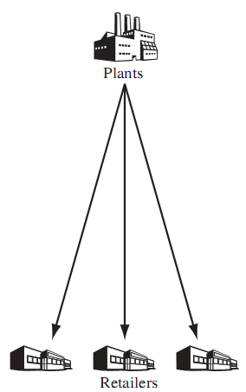
Direct Shipment
Goods are shipped directly
from the manufacturer to
the end-user (the retailers
in the case of retail goods)

Slide 35
Direct shipments eliminate the expenses of operating a DC and reduce lead times
If a typical customer shipment size is small and customers are dispersed over a wide geographic area, a large fleet of small trucks may be required.
Direct shipment is common when fully loaded trucks are required by customers or when perishable goods have to be delivered timely

Slide 36
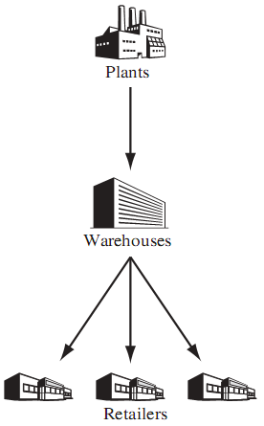
Warehousing
A traditional approach
in which goods are
received by warehouses
and stored in tanks,
pallet racks or on
shelves

Slide 37
When an order arrives, items are retrieved, packed and shipped to the customer.
Warehousing consists of four major functions:
Reception of the incoming goods,
Storage,
Order picking and
Shipping

Slide 38
Cross docking
Cross docking also referred to as just-in-time distribution is a relatively new logistics technique that has been successfully applied by several retail chains

Slide 39
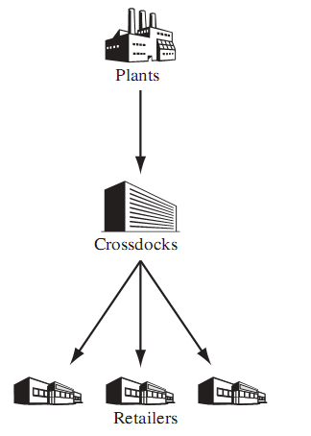
A cross dock is a transshipment
facility in which incoming
Shipments (possibly originating
from several manufacturers)
are sorted, consolidated with
Other products and transferred
directly to outgoing trailers
without intermediate storage
Or order picking.

Slide 40
Centralized versus decentralized warehousing.
In centralized warehousing, a single warehouse serves the whole market, while in decentralized warehousing the market is divided into different zones, each of which is served by a different (smaller) warehouse.
Decentralized warehousing leads to reduced lead times since warehouses are much closer to customers. On the other hand, centralized warehousing is characterized by lower facility costs because of larger economies of scale.

Slide 41
Inbound transportation costs (the costs of shipping the goods from manufacturing plants to warehouses) are lower in a centralized system
while outbound transportation costs (the costs of delivering the goods from the warehouses to the customers) are lower in a decentralized system

Slide 42
Freight transportation
It allows production and consumption to take place at locations that are several hundreds or thousands of kilometers away from each other
Companies in developed countries can take advantage of lower manufacturing wages in developing countries
Perishable goods can be made available in the worldwide market

Slide 43
Freight transportation often accounts for even two-thirds of the total logistics cost
Major impact on the level of customer service
Transportation planning plays a key role in logistics system management
The company can resort to a carrier that uses common resources (vehicles, crews, terminals) to fulfil several client transportation needs (common transportation)

Slide 44
A manufacturer or a distributor can choose among three alternatives to transport its materials
The company may operate a private fleet of owned or rented vehicles (private transportation)
A carrier may be in charge of transporting materials through direct shipments regulated by a contract (contract transportation)

Slide 45
Distribution channels
A few manufacturing firms sell their own products to end users directly, in most cases intermediaries participate in product distribution.
These can be sales agents or brokers, who act for the manufacturer, or wholesalers, who purchase products from manufacturers and resell them to retailers, who in turn sell them to end-users.
A distribution channel is a path followed by a product from the manufacturer to the end-user.
A relevant marketing decision is to select an appropriate combination of distribution channels for each product

Slide 46
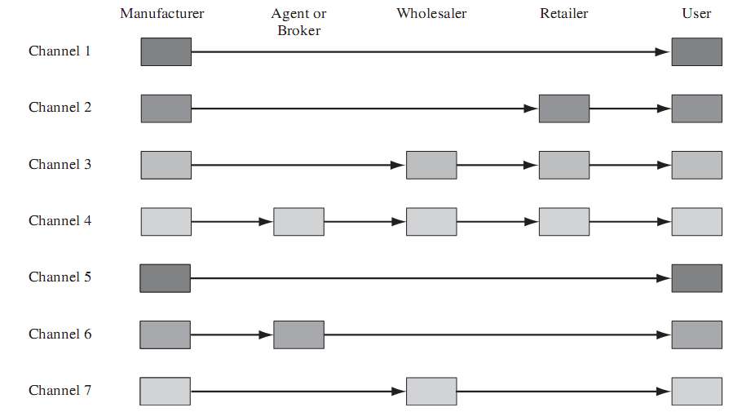
Figure 1.3 illustrates the main distribution channels.

Slide 47
Channels 1–4 correspond to consumer goods
while channels 5–7 correspond to industrial goods

Slide 48
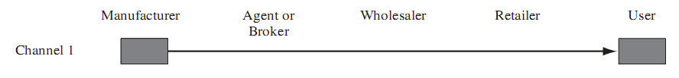
Channel 1
In channel 1, there are no intermediaries.
This approach is suitable for a restricted number of products (cosmetics and encyclopedias sold door-to-door, handicraft sold at local fleamarkets, etc.)

Slide 49
Channel 2
In channel 2, producers distribute their products through retailers (e.g. in the tyre industry)

Slide 50
Channel 3
Channel 3 is popular when ever manufacturers distribute their products only in large quantities and retailers cannot afford to purchase large quantities of goods (e.g. in the food industry)

Slide 51
Channel 4
Channel 4 is similar to channel 3 except that manufacturers are represented by sales agents or brokers (e.g. in the clothing industry)

Slide 52
Channel 5
Channel 5 is used for most industrial goods (raw material, equipment, etc.). Goods are sold in large quantities so that wholesalers are useless.

Slide 53
Channel 6
Channel 6 is the same as channel 5, except that manufacturers are represented by sales agents or brokers.

Slide 54
Channel 7
Channel 7 is used for small accessories (paper clips, etc.).

Slide 55
Freight consolidation
Consolidation can be achieved in three ways
Facility consolidation: Small shipments that have to be transported over long distances may be consolidated so as to transport large shipments over long distances and small shipments over short distances
Multi-stop consolidation: Less-than-truckload pick-up and deliveries associated with different locations may be served by the same vehicle on a multi-stop route
Temporal consolidation: Shipment schedules may be adjusted forward or backward so as to make a single large shipment rather than several small ones

Slide 56
Modes of transportation
There are ﬁve basic modes (ship, rail, truck, air and pipeline), which can be combined in several ways in order to obtain door-to-door services such as those provided
The features of the most common containers for transporting solid goods are given in Table 2

Slide 57
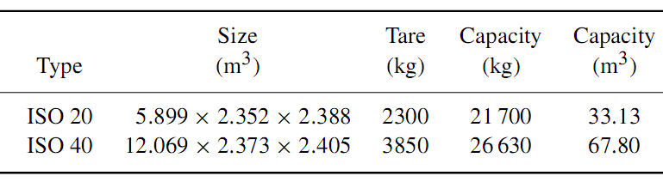
Table 2:Main features of the most common containers used for transporting solid goods
* Tare is the weight of an empty vehicle or container.

Slide 58
When selecting a carrier, a shipper must take two fundamental parameters into account
Price (or cost) and
Transit time

Slide 59
Price (cost)
The cost of a shipper’s operated transportation service is the sum of all costs associated with operating terminals and vehicles
The price of a transportation service is simply the rate charged by the carrier to the shipper
According to recent surveys, transportation by truck is approximately seven times more expensive than by train, which is four times more costly than by ship

Slide 60
Transit time
Transit time is the time a shipment takes to move between its origin to its destination.
It is a random variable inﬂuenced by weather and trafﬁc conditions
A comparison between the average transit times of the ﬁve basic modes is provided in Figure 4

Slide 61
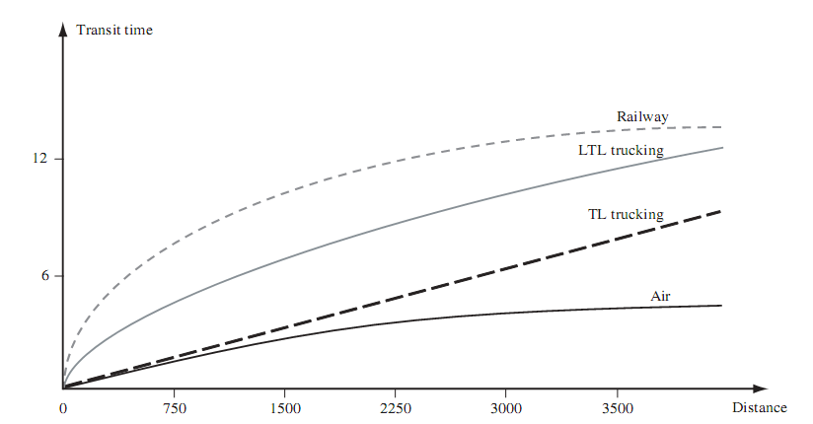
Figure 4:Average transit time (in days) as a function of distance (in kilometres) between origin and destination
TL = truckload
LTL = less-than-truckload

Slide 62
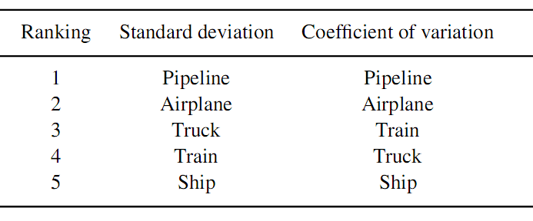
The standard deviation and the coefficient of variation (standard deviation over average transit time) of the transit time are two measures of the reliability of a transportation service (shown in Table 3)
Table 3

Slide 63
Rail
Rail transportation is inexpensive (especially for long-distance movements), relatively slow and quite unreliable
Railroad is a slow mover of raw materials (coal, chemicals, etc.) and of low-value ﬁnished products (paper, tinned, food, etc.)
This is due mainly to three reasons:

Slide 64
Convoys transporting freight have low priority compared to trains transporting passengers
Direct train connections are quite rare
A convoy must include tens of cars in order to be worth operating

Slide 65
Truck
Trucks are used mainly for moving semi-ﬁnished and ﬁnished products.
Road transportation can be truckload (TL) or less-than-truckload (LTL)
A TL service moves a full load directly from its origin to its destination in a single trip.

Slide 66
If shipments add up to much less than the vehicle capacity (LTL loads), it is more convenient to resort to several trucking services in conjunction with consolidation terminals rather than use direct shipments (see Figure 6)

Slide 67
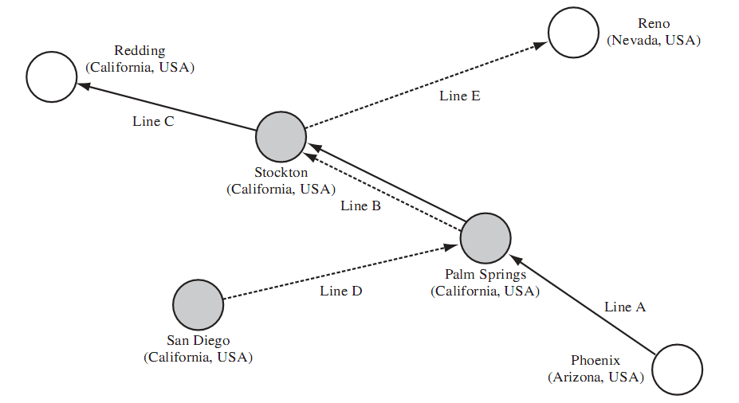
Figure 6: Example of LTL transportation

Slide 68
Air
Air transportation is in principle very fast, it is slowed down in practice by freight handling at airports

Slide 69
Intermodal transportation
Although there are in principle several combinations of the ﬁve basic modes of transportation, in practice only a few of them turn out to be convenient
The most frequent intermodal services are
air–truck (bird back) transportation
train–truck (piggyback) transportation
ship–truck (fishy back) transportation

Slide 70
Containers are the most common load units in intermodal transportation and can be moved in two ways
Containers are loaded on a truck and the truck is then loaded onto a train, a ship or an airplane (trailer on flatcar)
Containers are loaded directly on a train, a ship or an airplane (container on flatcar)

Slide 71
Logistics Managerial Issues
In a logistics strategy, managers aim at achieving a suitable compromise between three main objectives:
Capital reduction
Cost reduction
Service level improvement

Slide 72
Capital reduction
The ﬁrst objective is to reduce as much as possible the level of investment in the logistics system (which depends on owned equipment and inventories)
This can be accomplished in a number of ways, for example
By choosing public warehouses instead of privately owned warehouses, and by using common carriers instead of privately owned vehicles
Capital reduction usually comes at the expense of higher operating costs

Slide 73
Cost reduction
Objective is to minimize the total cost associated with transportation and storage
For example, one can operate privately owned warehouses and vehicles (provided that sales volume is large enough)

Slide 74
Service level improvement
The level of logistics service greatly inﬂuence customer satisfaction which in turn has a major impact on revenues
Improving the logistics service level may increase revenues, especially in markets with homogeneous low-price products where competition is not based on product features
The level of logistics service is often expressed through the order-cycle time

Slide 75
Order-cycle time is the elapsed time between the instant a purchase order (or a service request) is issued and the time goods are received by the customer (or service is provided to the user)
When a retailer outlet issues an order, the following events may occur
(a) if the goods required by the outlet are available at the associated RDC, the merchandise will be delivered shortly
(b) otherwise, the RDC has to resupply its stocks by placing an order to the CDC, in which case the shipment to the retailer will be further delayed
(c) if the goods are not available even at the CDC, the plants will be requested to produce them

Slide 76
Cost versus level of service relationship
Different logistics systems can be classified on the basis of classical multi-objective analysis concepts.
Each logistics system is characterized by a level of investment, a cost and a level of service
Figure 7 talk about cost versus level of service curve

Slide 77
What is level of service ?
The level of service is deﬁned as the percentage of orders having an order-cycle time less than or equal to a given number of working days (let’s say four days)

Slide 78
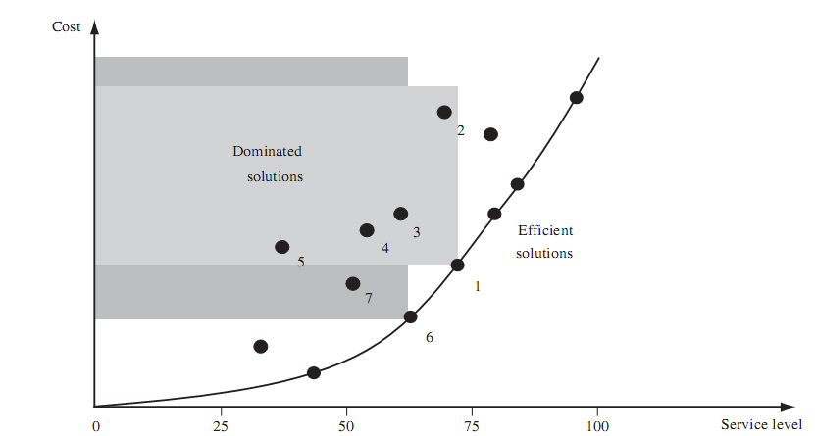
Figure 7: cost versus level of service curve

Slide 79
Sales versus service relationship
The level of logistics service greatly influences sales volume given in the figure 8

Slide 80
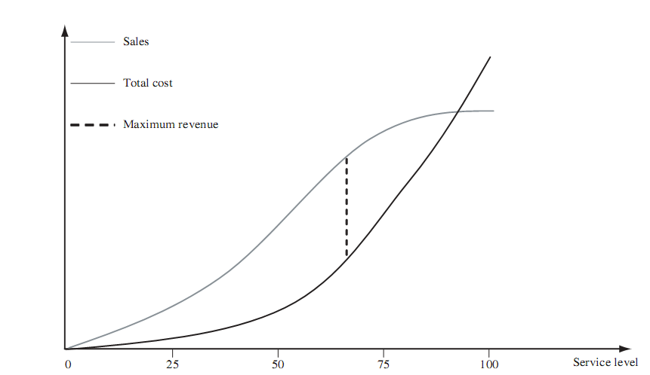
Figure 8: Determination of the optimum service level

Slide 81
If service is poor, few sales are generated.
As service approaches that of the competition, the sales volume grows.
As service is further improved, sales are captured from competing suppliers (provided that other companies do not change their logistics system).
Finally, if service improvements are carried too far, sales continue to increase but at a much slower rate.
The sales versus service relationship can be estimated by means of buyer surveys and computer simulations

Slide 82
Determining the optimal service level
The cost versus level of service and sales versus level of service relationships can be used to determine the level of service that maximizes the proﬁt contribution to the ﬁrm, as shown in Figure 8.
The optimal service level usually lies between the low and high extremes.
In practice, a slightly different approach is often used: ﬁrst, a customer service level is set, then the logistics system is designed in order to meet that service level at minimum cost.

Slide 83
Emerging Trends in Logistics

Slide 84
Globalization
In order to take advantage of lower manufacturing costs or cheap raw materials available in some countries
As a result of globalization, transportation needs have increased
As a result of globalization, more emphasis must be put on the efficient design and management of supply chains

Slide 85
Information technologies
It provide to share data on stock levels, timing of deliveries, positioning of intransit goods in the supply chain, etc
At the operational level geographic information systems (GISs) global positioning systems (GPSs) and on-board computers allow dispatchers to keep track of the current position of vehicles and to communicate with drivers

Slide 86
E-commerce
It is common to distinguish between business-to-business (B2B) and business-to-consumers (B2C) transactions.
B2C e-commerce sales worldwide reached US$1.471 trillion in 2014, a jump of almost 20% over 2013.
The growth of e-commerce parallels that of globalization and information technologies.
As a result of e-commerce the volume of goods between producers and retailers should go down while more direct deliveries should be expected between manufacturers and end-users.

Slide 87
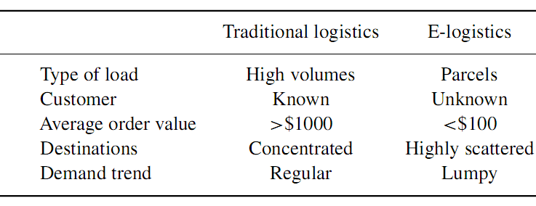
Table 4: Main differences between traditional logistics and e-logistics
E-commerce leads to a more complex organization of the entire logistics system (e-logistics)
Table 4 reports the main differences between traditional logistics and e-logistics

Slide 88
Points Of Presence In The Territory (POPITT)
A POPITT is a company-owned facility where customers may go either for purchasing and fetching the ordered goods, or for returning defective products.
Unlike traditional shops, a POPITT only stores already sold goods waiting to be picked up by customers and defective products waiting to be returned to the manufacturers.
This solution simplifies distribution management but reduces customer service level since it does not allow for home deliveries

Slide 89
Logistics Decisions

Slide 90
When designing and operating a logistics system, one needs to address several fundamental issues
Should new facilities (manufacturing and assembly centers, CDCs, RDCs, etc.) be opened?
What are their best conﬁguration, size and location?
Should any existing facility be divested, displaced or sized down?
Where should materials and components be acquired and stored?
Where should manufacturing and assembly take place?
Where should ﬁnished goods be stored?

Slide 91
Should ware houses be company-owned or leased?
Where should spare parts be stocked?
How should production be planned?
How should warehouses operate?
Should goods be stored in racks or should they be stacked?
Should goods be retrieved by a team of human order pickers or by automated devices?
When and how should each stocking point be resupplied?

Slide 92
What mode of transportation should be used to transport products?
Should vehicles be company-owned or leased?
What is the best fleet size?
How should shipment be scheduled?
How should vehicles be routed?
Should some transportation be carried out by common carriers?

Slide 93
Logistics decisions are traditionally classified as:
strategic,
tactical and
operational

Slide 94
Strategic decisions
Strategic decisions have long-lasting effects (usually over many years)
They include logistics systems design and the acquisition of costly resources (facility location, capacity sizing, plant and warehouse layout, ﬂeet sizing)
Because data are often incomplete and imprecise, strategic decisions generally use forecasts based on aggregated data (obtained, for example, by grouping individual products into product families and aggregating individual customers into customer zones).

Slide 95
Tactical decisions
Tactical decisions are made on a medium term basis (e.g. monthly or quarterly)
It include production and distribution planning, as well as resource allocation.
  Resource allocation
    storage allocation
    order picking strategies
    Transportation mode selection
    consolidation strategy
Tactical decisions often use forecasts based on disaggregated data

Slide 96
Operational decisions
Operational decisions are made on a daily basis or in realtime and have a narrow scope.
It include warehouse order picking as well as shipment and vehicle dispatching.
Operational decisions are customarily based on very detailed data

Slide 97
Decision support methods
Quantitative analysis is essential for intelligent logistics decision-making.
Operations research offers a variety of planning tools.
There are three basic situations in which quantitative analysis may be helpful

Slide 98
If a logistics system already exists, one may wish to compare the current system design (or a current operating policy) to an industry standard
One may wish to evaluate specified alternatives. In particular, one may wish to answer a number of what-if questions regarding specified alternatives to the existing system.
One may wish to generate a configuration (or a policy) which is optimal (or at least good) with respect to a given performance measure.
One may wish to generate a configuration (or a policy) which is optimal (or at least good) with respect to a given performance measure.

Slide 99
Benchmarking
Benchmarking consists of comparing the performance of a logistics system to a ‘best-practice’ standard, i.e. the performance of an industry leader in logistics operations.
The most popular logistics benchmarking is based on the supply chain operations references (SCOR) model
The SCOR model makes use of several performance parameters that range from highly aggregated indicators (named key performance indicators (KPIs)) to indicators describing a specific operational issue

Slide 100
Simulation
Simulation enables the evaluation of the behaviour of a particular conﬁguration or policy by considering the dynamics of the system
A simulation model can be used to estimate the average order retrieval time in a given warehouse when a speciﬁc storage policy is used

Slide 101
Whenever a different alternative has to be evaluated, a new simulation is run
For instance, if the number of order pickers is increased by one, a new simulation is required.
Simulation models can easily incorporate a large amount of details, such as individual customer ordering patterns.
However, detailed simulations are time consuming and can be heavy when a large number of alternatives are considered

Slide 102
Optimization
‘Easy’ (polynomial) optimization problems can be consistently solved within a reasonable amount of time even if instance size is large.
This is the case, for example, in linear programming (LP) problems and, in particular, of linear network ﬂow (NF) problems (linear programs with tens of thousands of variables and constraints can be optimized quickly on a personal computer).
NP-hard optimization problems can be solved consistently within a reasonable amount of time only if instance size is sufficiently small.

Slide 103
Most integer programming (IP), mixed-integer programming (MIP), and nonlinear programming (NLP) problems are difﬁcult to optimize.
Unfortunately, several classes of logistics decisions (production planning, location decisions, vehicle routing and scheduling, etc.) can only be modelled as IP or MIP problems.
This has motivated the development of fast heuristic algorithms that search for good but not necessarily the best solutions.
Popular examples of heuristics include rounding the solution of the continuous relaxation of an IP or MIP model, local search, simulated annealing and tabu search etc.

Slide 104
THANKS

