Slide 1

Graph Coloring with Ants
ThanhVu H. Nguyen
Department of Computer Science
Penn State Harrisburg
(Advisor: Dr. Thang N. Bui)
Notes:
Final comments: It seems to be too short, I practiced and it took 11+ minutes but I believe it was much faster during my presentation. So may be I speak really fast … have to watch out for this on later presentations.
THINK ABOUT SPEAKING WITH ANOTHER PERSON , JUST ONE PERSON
Hi, my name is ThanhVu Nguyen, I am a graduate student in C.S and this is my Master thesis research with Dr. Bui. Our research is on the graph coloring, a very useful problem in real life practices.

Slide 2
Outline
Preliminaries
Problem Definition
Real Life Applications
Our Algorithm
Results
Notes:
In conclusion, this research is about coloring , a very popular and useful model in daily life. And it is also very hard.
Our approach to solve the problem is based on nature, insects, specifically it uses Ants. The Ants cooperate with each other to solve problem.
We achieved very good results comparing to other algorithms and our works will probably and hopefully be published in very near future.
Our next step is to improve the algorithm by multiple of colonies of ants running on different computers to communicate and exchange data.
Ideas from nature, evolutionary and social insects are just theories. What we have done here is bring these theories into real practices, so that they are helpful in real life applications. What’s the next step ? It is to apply them into Military, critical life-death missions ! (pause)
Later today I will also have poster presentations about my other researches in the Navy using genetic algorithm and genetic programming, so if you’re interested in how Human evolved from Apes, please stop by.
That’s the end of the presentation. Thank you,

Slide 3
Preliminaries
A Graph With 6 Vertices and 8 Edges
A Vertex
An Edge
Notes:
What shown is a graph with 6 Vertices and 8 Edges. Again, there can be thousand and thousand of edges in a graph.
TODO: have a slide show vertex & a slide show edge

Slide 4
Preliminaries
Adjacent vertices
Notes:
Next , Adjacent Vertices
Remove the Graph w/ 6 vertices … title. Put adjacent vertices as title
2 vertices are adjacent if they are connected by an edge

Slide 5
Preliminaries
Adjacent vertices
A
Notes:
The adjacent Vertices of a Vertex , for example A, are the vertices that connect to A.

Slide 6
Preliminaries
Adjacent vertices
B
B and C are adjacent to A
A
C
Notes:
Because B and C are connected to A. Does A have any other adjacent vertices other than B and C ? No.
Graph theory is a branch of mathematic that are very popular in real life, for example : the Internet, web pages are vertices and they are linked together via edges. So the internet are a very big graph with millions of vertices and edges.

Slide 7
The Graph Coloring Problem
Objective: Assign colors to vertices so that adjacent vertices do not have the same color and use as few colors as possible
Notes:
So what is is graph coloring, it is to color the vertices in the graph so that the adjacent vertices do not have the same color. Why would you want to do something like this or why is this even difficult, I will explain in a minute.

Slide 8
The Graph Coloring Problem
A Valid Coloring
Objective: Assign colors to vertices so that adjacent vertices do not have the same color and use as few colors as possible
Notes:
Like this, notice that they all have different colors.
Put colors on the 2 bottom ones
Have a label says “a valid coloring”

Slide 9
The Graph Coloring Problem
Conflict
An Invalid Coloring
Objective: Assign colors to vertices so that adjacent vertices do not have the same color and use as few colors as possible
Notes:
If you have something like this, that would be a conflict because they both share the edge, they are adjacent to each other.
Title: invalid coloring

Slide 10
The Graph Coloring Problem
Objective: Minimize the number of colors used
Total Colors Used: 5
Total Colors Used: 3
Notes:
The problem of graph coloring is find the LOWEST number of colors to color a graph
For example this picture (slides in) uses total of 5 colors, can we do better than that without any conflict ? Yes, this example uses only 3 colors. Can we do any better than that ? Probably not.

Slide 11
Coloring Graphs Naïvely
Question: Can an n-vertex graph be colored with k colors? (This question is equivalent to the graph coloring problem.)
Naïve algorithm: try all possible ways of assigning k colors to the n vertices
  If a valid coloring is found then answer yes. Otherwise, answer no
  Time: there are k^{n} possible colorings to check
  Example: Can a 30-vertex graph be colored with 3 colors?
      3³⁰ possible colorings
      10⁶ colorings per second
      6 MILLION YEARS !!!
Notes:
The formal question is :
Can we determine if a graph is colored with say ‘k’ color ?
Well, you can try all possible orders to color the graph. If you can find one , then the answer is yes, if you tried all the possible orders and found none, then the answer is no.
So the worst case is that you have to try all orders to answer the question. How long does this take ? In mathematics we call this an exponential order. This can be a very very LARGE number.
To give you an estimate of how long this is , assuming you can find an order every second, then how long does it take to color a graph with 3 colors if the graph has
7 vertices: that’s about 30 minutes, not too bad
15 vertices: half a year , I can deal with that
Anyone want to guess how long it will be when the graph has 30 vertices ?
Well, it’s impossible to find the real answer, that is the lowest number of colors for a graph, what do we do ?
- So naïve algorithm is not a good idea, our algorithm can solve this in matter of seconds
Now you might ask why would anyone be interested in graph coloring ? The answer is that graph coloring is practical in the real world, you make use of it every day and don’t realize it. For example, one application that makes use of graph coloring is scheduling classes.

Slide 12
Complexity of Graph Coloring
Complexity: NP-Hard
(That is, it is believed that any algorithm for finding the optimal solution requires exponential time.)
Heuristics: Find good solutions in a reasonable amount of time

Slide 13
An Application of Graph Coloring
Class Scheduling
Chem
Math
Cannot be offered
at the same time
Math – Bio
Math – Chem
Bio – Music
Bio – Econ
Music – Chem
Music – Econ
Chem – Art
Art – Econ
Art
Music
Bio
Econ
Notes:
The classes are represented by the vertices as you see here. And the classes that cannot be offer at the same time will have an edge between them.

Slide 14
An Application of Graph Coloring
Class Scheduling
Chem
Math
Cannot be offered
at the same time
Math – Bio
Math – Chem
Bio – Music
Bio – Econ
Music – Chem
Music – Econ
Chem – Art
Art – Econ
Art
Music
Bio
Econ
Notes:
Like this, math and biology are adjacent of each other
Can keep this one and get rid of the previous

Slide 15
An Application of Graph Coloring
Class Scheduling
Chem
Math
Cannot be offered
at the same time
Math – Bio
Math – Chem
Bio – Music
Bio – Econ
Music – Chem
Music – Econ
Chem – Art
Art – Econ
Art
Music
Bio
Econ
Notes:
Math and chem also are adjacent.

Slide 16
An Application of Graph Coloring
Class Scheduling
Chem
Math
Cannot be offered
at the same time
Math – Bio
Math – Chem
Bio – Music
Bio – Econ
Music – Chem
Music – Econ
Chem – Art
Art – Econ
Art
Music
Bio
Econ
Notes:
And so on
Now you have a graph with vertices and edges.

Slide 17
An Application of Graph Coloring
Class Scheduling
Chem
Math
Art
Music
Bio
Goal : minimize the
number of periods (colors)
used
Econ
Notes:
Now you want to assign time periods to these classes so that the adjacent ones will not meet at the same time. The goal is to minimize the number of periods , because usualyy there are only a limited number of time periods in a day (6 periods and many classes)

Slide 18
An Application of Graph Coloring
Class Scheduling
Chem
Math
Schedule
Period 1
Period 2
Period 3
Art
Music
Bio
Econ
Notes:
Here is one order. Math Music and Art will be in period, Bio and Chem are assigned with period 2 and Economic happens in period 3. A total of 3 periods are used.
So hopefully this demonstration shows how graph coloring can be applied to real life applications. This is classroom scheduling, you can do the same with final/exam assignment , and many other types of schedulings

Slide 19
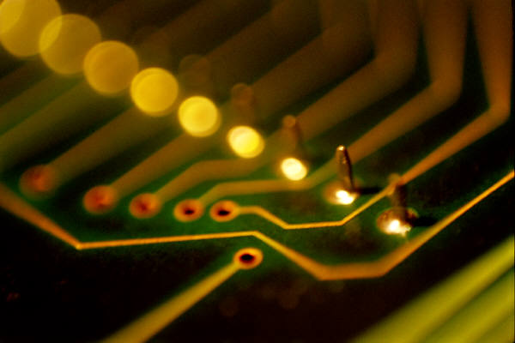
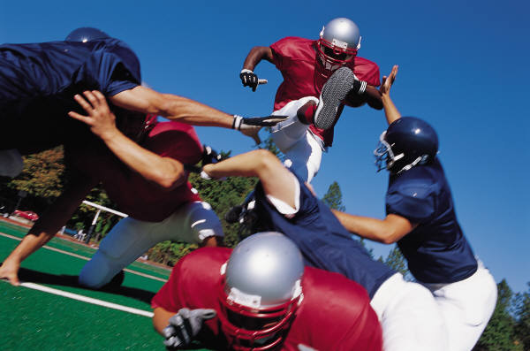


Other Applications of Graph Coloring
CPU Registers
Football games
Classroom/Final Schedules
Radio Network
Notes:
Here is a few more examples.
You can use graph colorings in Computer, Machine , sports , academic , tv / radio channels frequencies, etc
Of course there are many more.

Slide 20

Generalizations of
Graph Coloring
More constraints
  Colors used are actually numbers
  Colors assigned to adjacent vertices must differ by a certain amount
  Each vertex is assigned a set of colors not just one
Cell Phone Network
  Assigning channels to cell phones
Notes:
So that’s the basic definitions of graph coloring, my thesis is a much more difficulty type of graph coloring … it has many more constrains such as the colors are represented by numbers, and there are many colors assigned to a vertex, not just one and the colors assigned to adjacent vertices have to be different by different amount. In the classic graph coloring, only one color is assigned to a vertex and the adjacent vertices only need to have different color, but in my research, it must be different by an amount of intensity. And one example that makes use of this more complicated graph coloring is cell phone networks, assigning channels , many channels to a cell phone and some of them must be at least some frequencies apart from each other.
So that’s my thesis problem.

Slide 21

From Natural to Artificial Ants
Mimic natural evolution
Evolutionary Computations
  Evolutionary Algorithms
    Genetic algorithm
    Evolutionary programming
  Swarm Intelligence
    Ant systems
Ants
  Social insects
  Cooperative behaviors
  Great success on many problems
Notes:
Our approach for solving this problem is to combine both nature and machines (computers). Mimic from Nature slides in
Recently in the artificial intelligence field of computer science there has been a strong interest in using nature, biology to solve problems. Some examples are Evolutionary Computing, which is based on Darwin’s evolutionary theory : apes, monkeys evolve and become us. Examples of EC include genetic algorithms and genetic programming.
And insects based, which basically studies the behaviors of insects such as bees, ants. Insect based slides in
This thesis uses ANTS to solve the graph coloring problem. (Ants slides in)
Some features of Ants are they are a highly social insects. They live in a very sophisticated society, they cooperate, work together to achieve greats things.
There has been many successful in using Ants to solve mathematical, computer science problems.
So you can see computer science is not totally about computer, it is a study of many interesting things using computers.

Slide 22
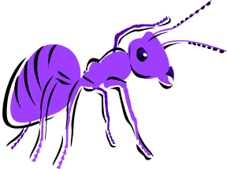
ABOGC Algorithm Highlights
Ant Based Optimization for Graph Coloring
Use a simple and quick method to find a valid coloring (which may not be of good quality)
while stopping criteria not met
end-while
    Ants are placed on the graph
    Ants move around the graph and collaborate to recolor the vertices so that fewer colors are used
Return the best valid coloring found
Notes:
DIAG: What shown are the steps of our algorithms which we called ABOGC (Ant Based Opt for Graph Coloring).
We start the algorithm with a very simple and quick method to find a valid coloring for the graph, this coloring is not optimized in anyway, it’s not even good, we just need something quick to start with.
Then it enters a loop which contains a colony of Ants attempting to improve the solution. These ants will travel around the graph, communicate with each others using pheromone, leaving tracks etc and they will color the vertex. We also give the ants the capability to fly, which means they are able to jump from one place to another . Basically we can do whatever we can imagine about in this research, because it is artificial intelligence.
After a while, we stop the loop and return the best coloring found.

Slide 23
Experimental Result
Implementation
  C++
  Machine: Pentium 4, 3.0 GHz, 2GB ram, Linux
Tested with over 100 standard instances (graphs)
Perform very well against other algorithms
  Mostly BETTER than other algorithms in both quality and efficiency (speed)
Notes:
That algorithm sounds like fair tale right ? Ants run around and work together attempting to solve something that would potentially take trillion of years for human to do. But it does work, we have done it and the outcomes are great.
We implemented it using …
We tested it on over 100 of different types of graphs, some graphs have over 100 vertices, so very large graphs.
The results are very good, it performs better than other algorithms in both quality and speed.
We have submitted our works to *the* Discrete Applied Math journal, a very prestigious Math journal and they like it. So it will probably appear in this journal soon.
We also submitted our results to the GECCO conference, so if everything is as what expected, we will present this again in Jun this year, in Seattle Washington.

Slide 24
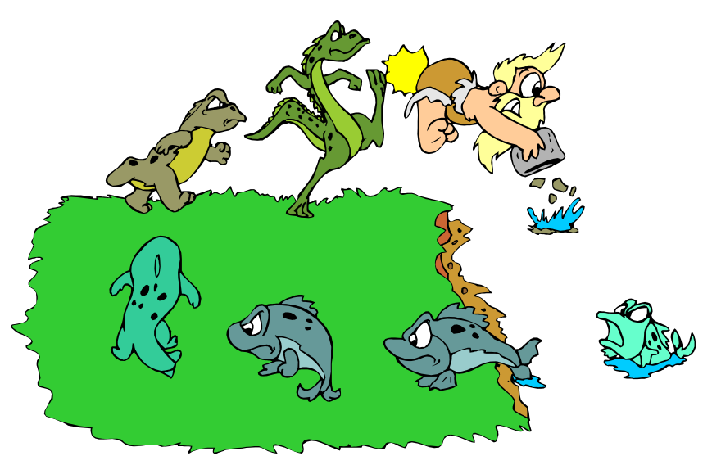
Conclusion
Graph coloring and its generalizations
  Difficult
  Many real world applications
ABOGC: ant based optimization for graph coloring
  Ant-based approach
  Ants cooperate to find solution
Competitive results
Future Directions
  Parallelism
Notes:
In conclusion, this research is about coloring , a very popular and useful model in daily life. And it is also very hard.
Our approach to solve the problem is based on nature, insects, specifically it uses Ants. The Ants cooperate with each other to solve problem.
We achieved very good results comparing to other algorithms and our works will probably and hopefully be published in very near future.
Our next step is to improve the algorithm by multiple of colonies of ants running on different computers to communicate and exchange data.
Ideas from nature, evolutionary and social insects are just theories. What we have done here is bring these theories into real practices, so that they are helpful in real life applications. What’s the next step ? It is to apply them into Military, critical life-death missions ! (pause)
Later today I will also have poster presentations about my other researches in the Navy using genetic algorithm and genetic programming, so if you’re interested in how Human evolved from Apes, please stop by.
That’s the end of the presentation. Thank you,

