Slide 1

UNCLASSIFIED MATERIALS
Reverse-engineering and
Exploiting Radars with
EVOLUTIONARY COMPUTING
CompSci Graduate Co-Op
ThanhVu H. Nguyen
Supervisor: Dr. James F. Smith, III
Naval Research Laboratory,
Washington, DC

Slide 2



GOAL: confuse the radar to approach the platform without being detected
Notes:
Goals: Reverse Engineer radar of the enemy and Exploit it

Slide 3
Problem Statement
Determine design specifications and design flaws for a system for which
  there are no design specifications present
  ii) invasive study is difficult or impossible
  iii) the system may not be disassembled

Slide 4
To Defeat the enemy, you must Know the enemy
Approach
Reverse-engineer the unknown system (digital logic) with Genetic Programming
Exploit the system with Genetic Algorithm
Notes:
Probably make this just 2 quick lines, get rid of the picture

Slide 5
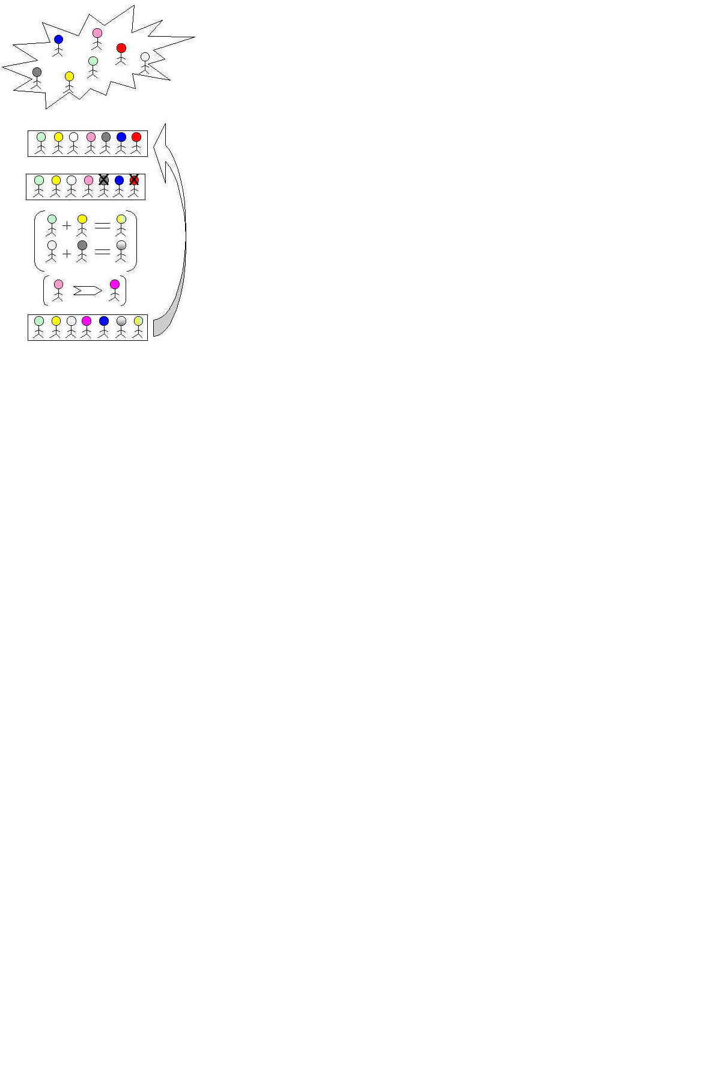
Evolutionary Algorithms
Darwin’s theory of evolution
  Natural selection/survival of the fittest [Selection]
  Reproduction by [recombination/Crossover] and [mutation]
Formulated as the basis of almost all evolutionary algorithms: GA, GP
Notes:
Probably need another page for this
Find stuffs like genetic programming poster, powerpoint online
REMOVE if seems too much, if remove this then remove next slide too (the overview of how things run)

Slide 6
Stop
Run
yes
Selection of individuals (proportional with fitness)
Replacement of the current population with the new one
Fitness evaluation (of each chromosome)
no
Reproduction (genetic operators)
Initial population creation (randomly)
Start
Terminate?
New generation

Slide 7
Reverse-Engineering with Genetic Programming
Data mine the design specification of the system using a data base consisting of
  Recorded system inputs and output measurements
Incorporate rules provided by experts into the data mining process
Use a genetic program (GP) as a symbolic data mining function to data mine the digital logic
Notes:
Cut this in half …. Then put right above of next slide
TODO: have a result page to show the final GP (tree) values and GA (string of numbers values)

Slide 8
Genetic Program Overview
STOP
Yes
Is there an effective program?
Initial Population of Computer Programs generated randomly from T and F
Input: T=Terminal set
F=Function set
…
No
Crossover: Select parental computer programs. Make children
Mutate: Select random node and grow a new routine
Selected Node
Replace node
with new
routine
Randomly Generate Routine
Select routines for exchange
Exchange routines

Slide 9
functions
chromosome (tree scheme)
AND2
AND3
Sig1
Sig2
Sig3
H1
OR2
OR3
SUM
H2
DELAY
SUM
Diff
H3
H3
H2
MAX
DIFF
genes
OR2
chromosome (prefix scheme)
Sig1
Sig2
Sig3
OR2 H3 DIFF SIG1 SUM SIG2 SIG3 H2 SUM SIG2 SIG3
terminals
Notes:
Have banner on top each of these slides , or banner right on them (see banner last page)

Slide 10
Sig1
Sig2
Sig3
Sig2
Max
Sum
Sum
AND2
Diff
H3
H3
H2
Reproduction
H1
Max
AND3
OR2
Notes:
I need to get one of the run logs to get some decent examples

Slide 11
Children
  Contains ‘good’ genes from parents
Sig1
Sig2
Sig3
Sum
Sum
Max
Diff
H3
H2
H1
AND3

Slide 12
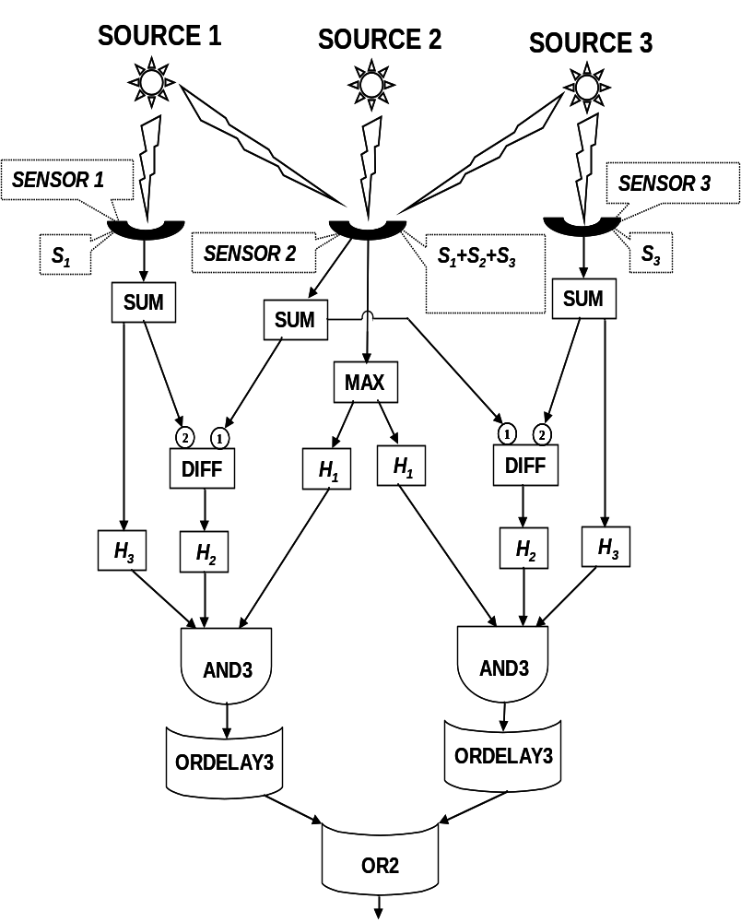
Digital Logic discovered by GP
Notes:
Converged after 60 generations

Slide 13
Genetic Algorithm Overview
Encoding
genes
chromosome
12
3
-4
-1
8
0
19
-2
Reproduction
Recombination (crossover) – exchanges parts of two chromosomes
Point choosen randomly
5
9
-10
-12
8
9
12
25
14
7
Mutation – changes the gene value
Point choosen randomly
-14
-3
18
21
22
-14
-3
18
22
-3
Notes:
Search for Genetic Algorithm presentation and steal some trees there

Slide 14
GA Based Automatic Defect Discovery
A GA used the digital logic data mined by the GP to automatically discover defects.
The DL plus expert rules were used to construct a fitness function for the GA
A significant design flaw in the digital logic was discovered within 300 GA generations.

Slide 15
Summary
A genetic program has been used as a data mining function to reverse engineer digital logic
A genetic algorithm has been successfully used to automate the discovery of design defects
References
  James F. Smith, III and ThanhVu H. Nguyen “Data-mining-based automated reverse engineering and defect discovery”, proc. SPIE vol. 5812, p. 232-242, data mining, intrusion detection, information assurance, and data networks security, 2005.
  James F. Smith, III and ThanhVu H. Nguyen “Genetic program based data mining to reverse engineer digital logic”, to be submitted

