Slide 1

Cooperative teams of Unmanned Aerial Vehicles
UNCLASSIFIED MATERIALS
CompSci Graduate Co-Op
ThanhVu H. Nguyen
Supervisor: Dr. James F. Smith, III
Naval Research Laboratory,
Washington, DC
Notes:
Ask Dr. Bui on a PPT he did for Ant

Slide 2
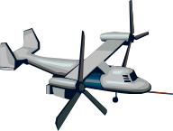
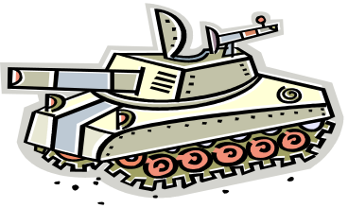
Interferometer
measures
index of refraction
Atmosphere layer
Electromagnetic wave emission from
Unknown Enemy location

Slide 3
PROBLEM DESCRIPTION: Determining the location of an electromagnetic source (EMS), generally a radar
APPROACH: Send UAVs to measure index of refraction in the atmosphere. Use Match Field Processing (MFP) method on those values to estimate the position of the EMS
Notes:
Just use the banner (title) cut the rest

Slide 4

Overview of UAV
Planning, Control and Post-Mission
Post-Mission Match Field Processing
Real-Time Control
Pre-mission Planning

Slide 5
Planning Phase
Planning Algorithm
  Determines optimal number of UAVs, optimal trajectories, UAV sampling patterns, and resource allocation prior to mission.
  Determines optimal path of each UAV, while routing UAVs around turbulence and other threats
  Takes into consideration the following constraints: fuel, battery life, risk, UAV cost, and importance of various points for sampling.

Slide 6
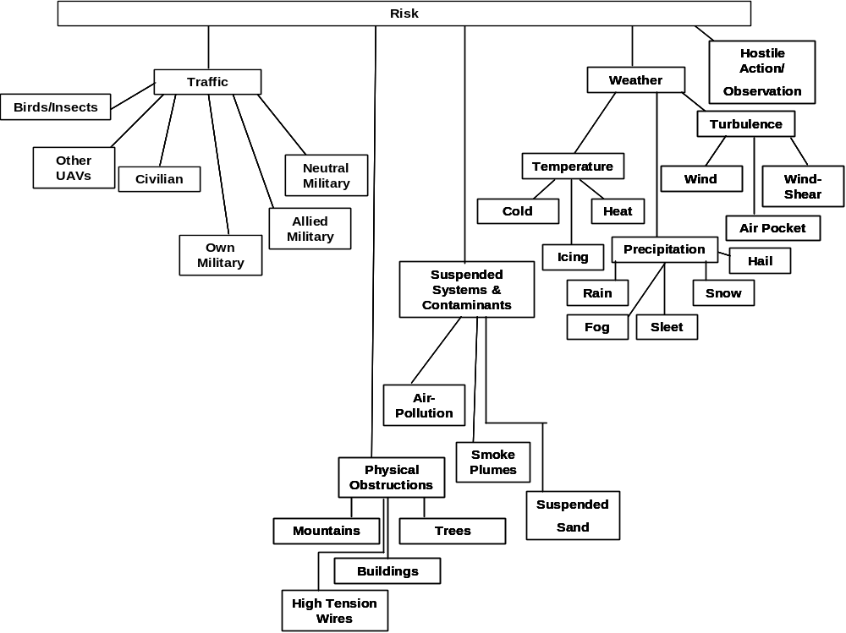

Slide 7
Assigning UAVs to Sample Locations of Varying Priorities
UAV 2
UAV 4
UAV 1
UAV 3
BASE
Red dot = highest priority,
yellow dots = intermediate priority,
green dots = lowest priority

Slide 8

PLAN PHASE
35
4,1
5,1
30
3,1
13,3
11,3
12,3
25
2,1
14,3
1,1
X Plane
20
15
6,1
7,1
10
8,2
UAV 1 path
UAV 2 path
9,2
UAV 3 path
5
Base
10,2
Taboo Region
Sample pt
(a,b)
Index, priority degree
0
0
5
10
15
20
25
30
35
Y Plane

Slide 9
Control Phase
Real-time control algorithm under development that allows
  new paths to be determined subject to changes in undesirable regions and regions desirable for sampling.
  UAVs automatically cooperate through a priority scheme
    UAVs automatically support each other if multiple regions must be measured to deal with extensive meteorological phenomenal
    UAVs automatically support each other during times of malfunctions or suspected reductions in sensor or other system reliability

Slide 10
CONTROL PHASE
14
UAV 1 path
UAV 2 path
(7,2)
Base
(8,2)
UAV 2 responses to help request.
12
Taboo points
Sample pt
(6,2)
(a,b)
Index, priority degree
(9,2)
10
.50
(5,2)
.75
new
8
1.0
Less dangerous taboo region therefore able to fly near
ALTITUDE (miles)
6
Old taboo regions
(4,1)
new
4
(3,1)
(2,1)
2
UAV 1 malfunctions, requests for help.
(1,1)
0
0
5
10
15
20
25
30
35
40
45
50
RANGE (miles)

Slide 11
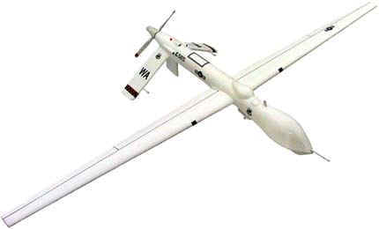
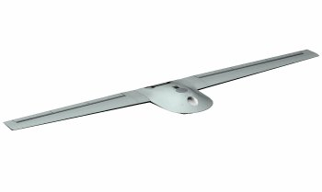
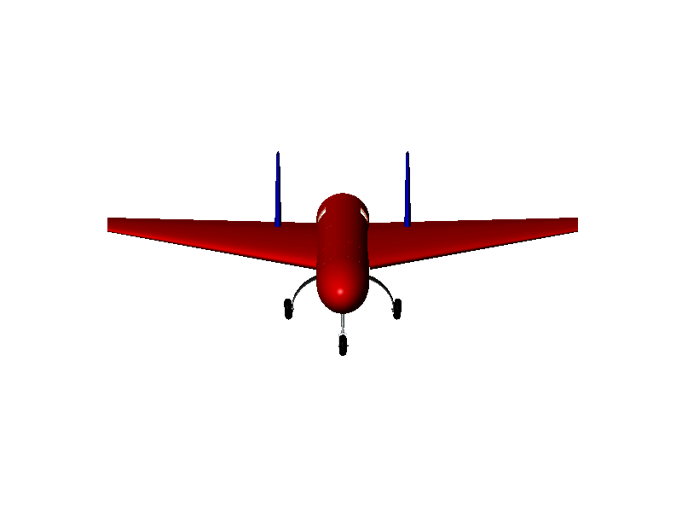
Priority for Providing Help
My priority for providing help is .50
I have discovered an extended weather system. Please help sample it.
My priority for providing help is .75

Slide 12
Fuzzy Decision Trees
Multiple Fuzzy concepts
  Risks
  Resources
  Mission Priorities
Decision trees and rules
  Assigning task load
  Choosing helper UAVs

Slide 13
Post-Mission Phase
Simple linear MFP processor (SLMFP)
Gradient MFP processor (GMFP)
Extended linear array MFP processor (ELAMFP)

Slide 14
Summary
Planning and control algorithms have been developed that allow multiple UAVs to facilitate the localization of electromagnetic sources using matched field processing
  3 phases: plan , control and post-mission
References
  James F. Smith, III and ThanhVu H. Nguyen “Distributed autonomous systems: resource management, planning, and control algorithms”, proc. SPIE vol. 5809, p. 65:76, signal processing, sensor fusion, and target recognition XIV, 2005
  James F. Smith, III and ThanhVu H. Nguyen “Resource Manager for an autonomous coordinated team of UAVs”, to be submitted

