Slide 1


Slide 2

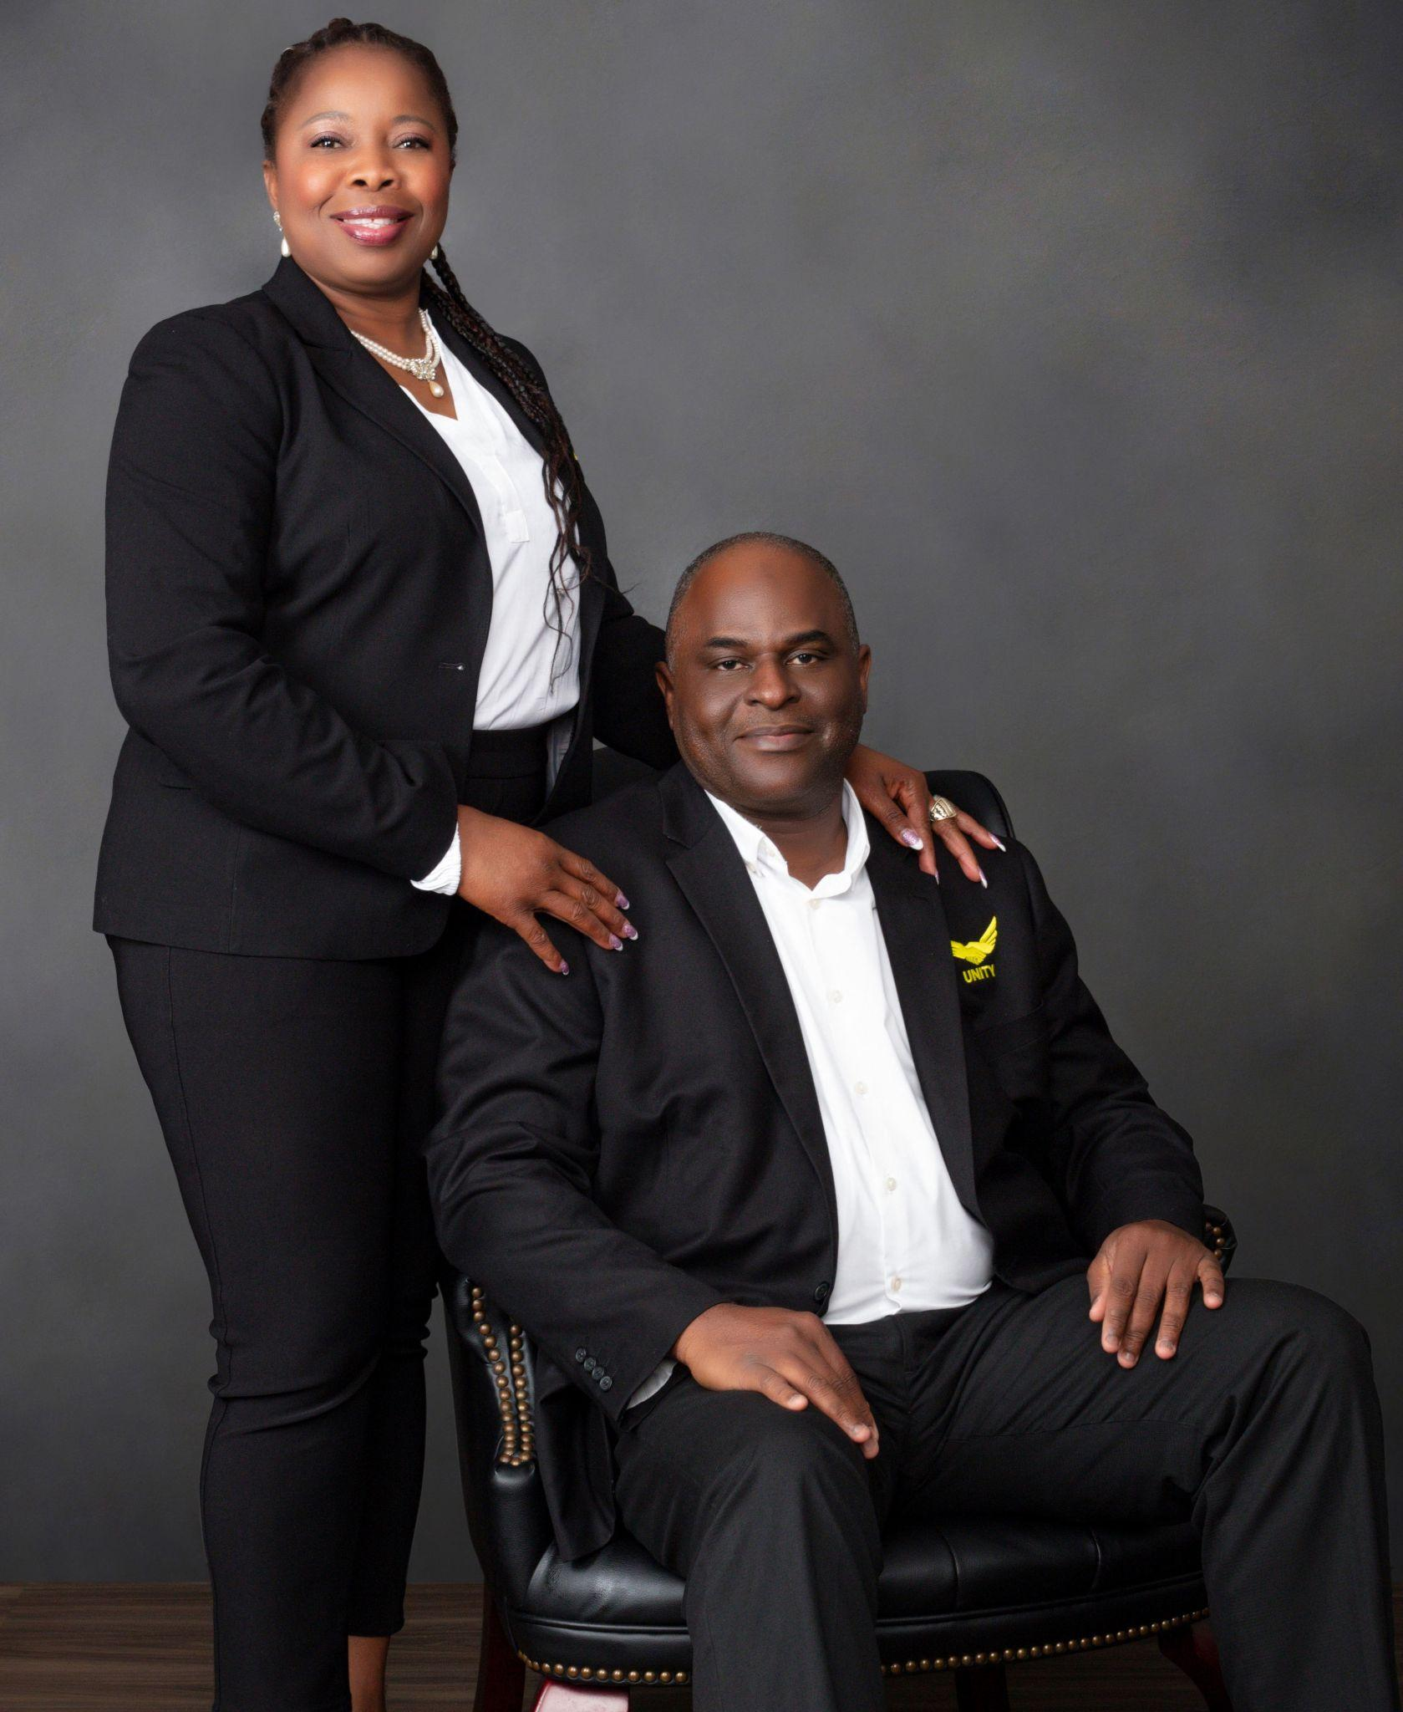
Syracuse

Slide 3
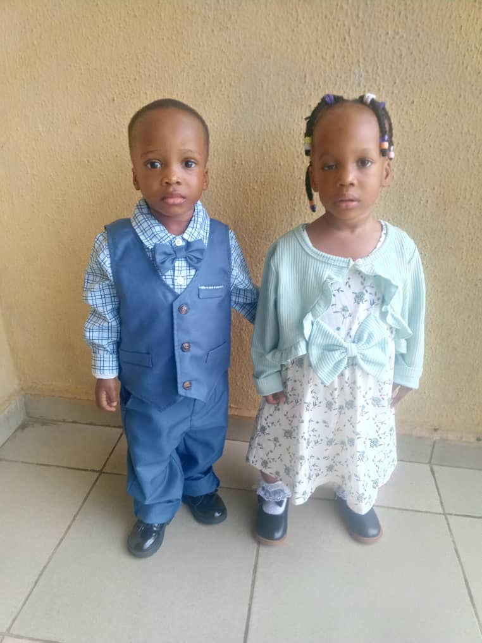
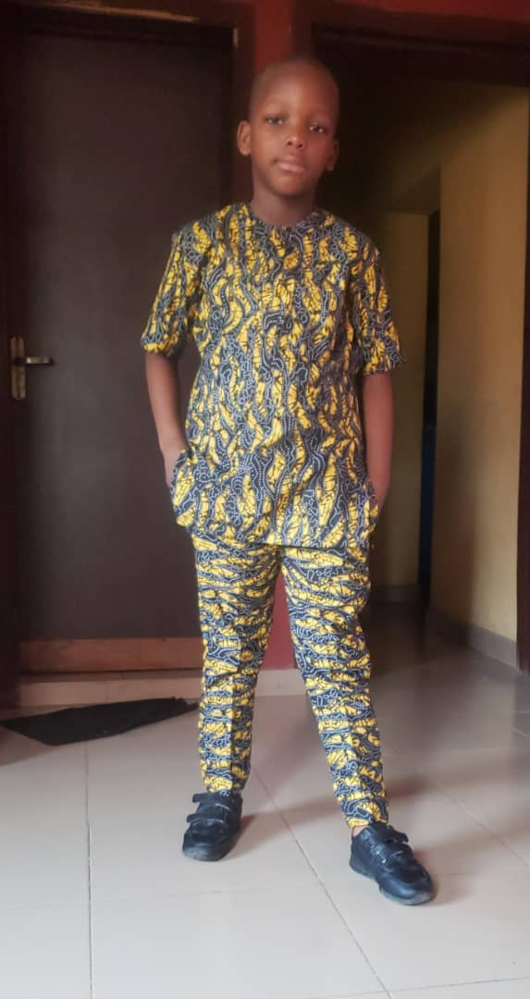
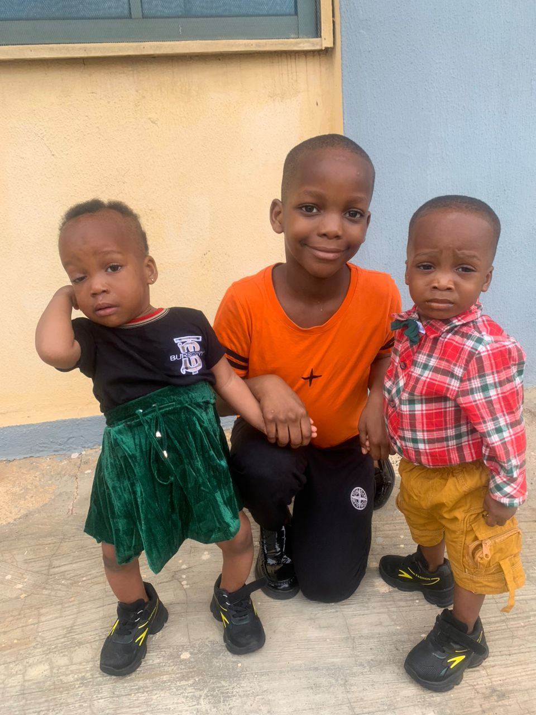
My Why?
Syracuse

Slide 4

OUR NON-PROFIT IS LIVE!!
Life Changers Education, Research and Medical Foundation (LCERMF) is Live!
www.lcermf.org
Share the news and support us to eradicate Malaria and provide Scholarship to the less privileged!

Slide 5
Joke of the Day
Have you heard the joke about yoga.
Nevermind its a bit of a stretch

Slide 6
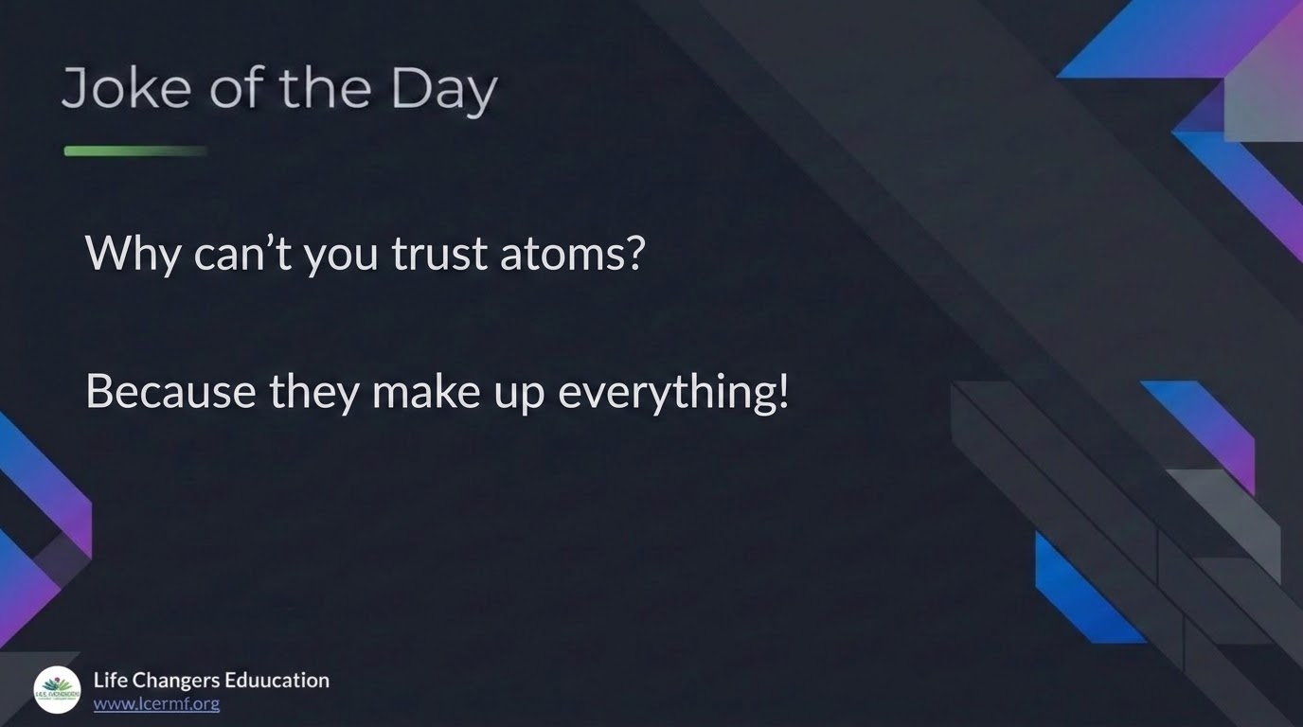

Slide 7


Slide 8
Joke of the Day
Why can't you trust atoms?
Because they make up everything!

Slide 9


Slide 10
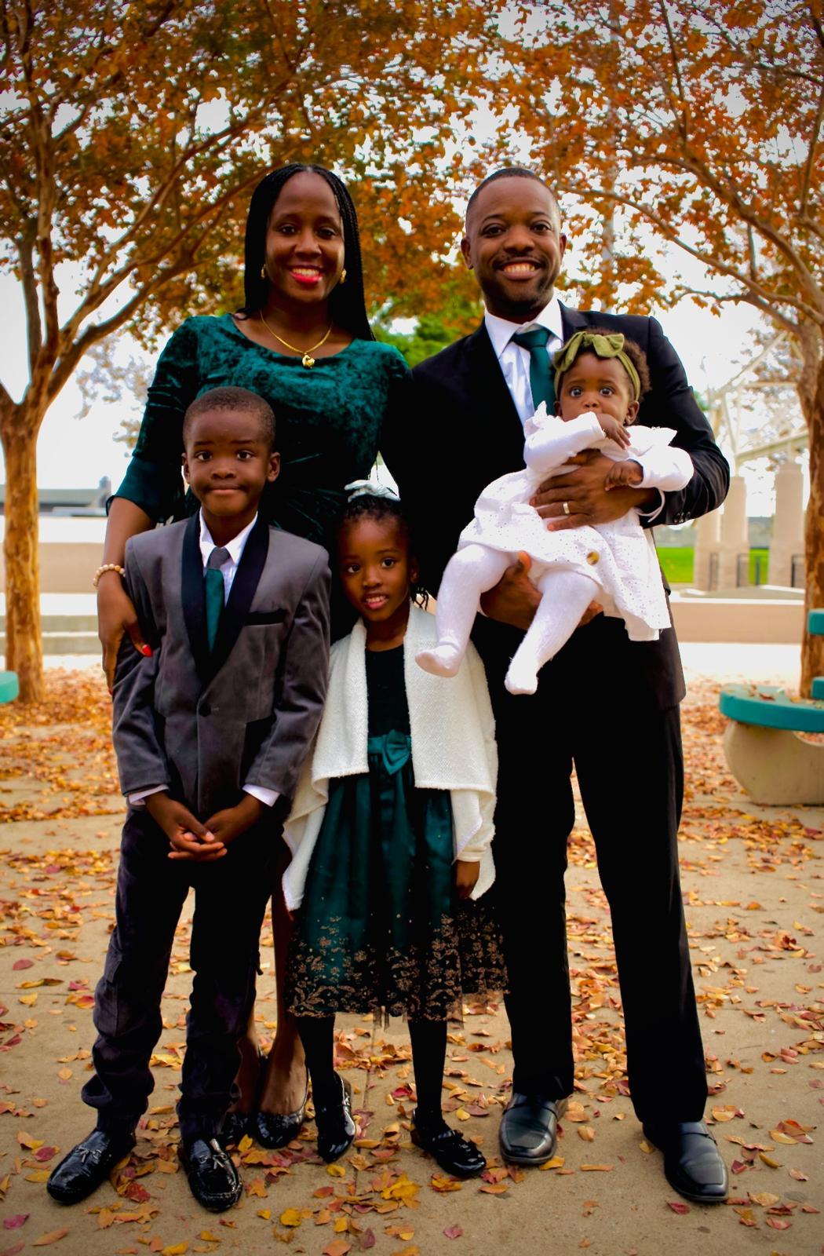
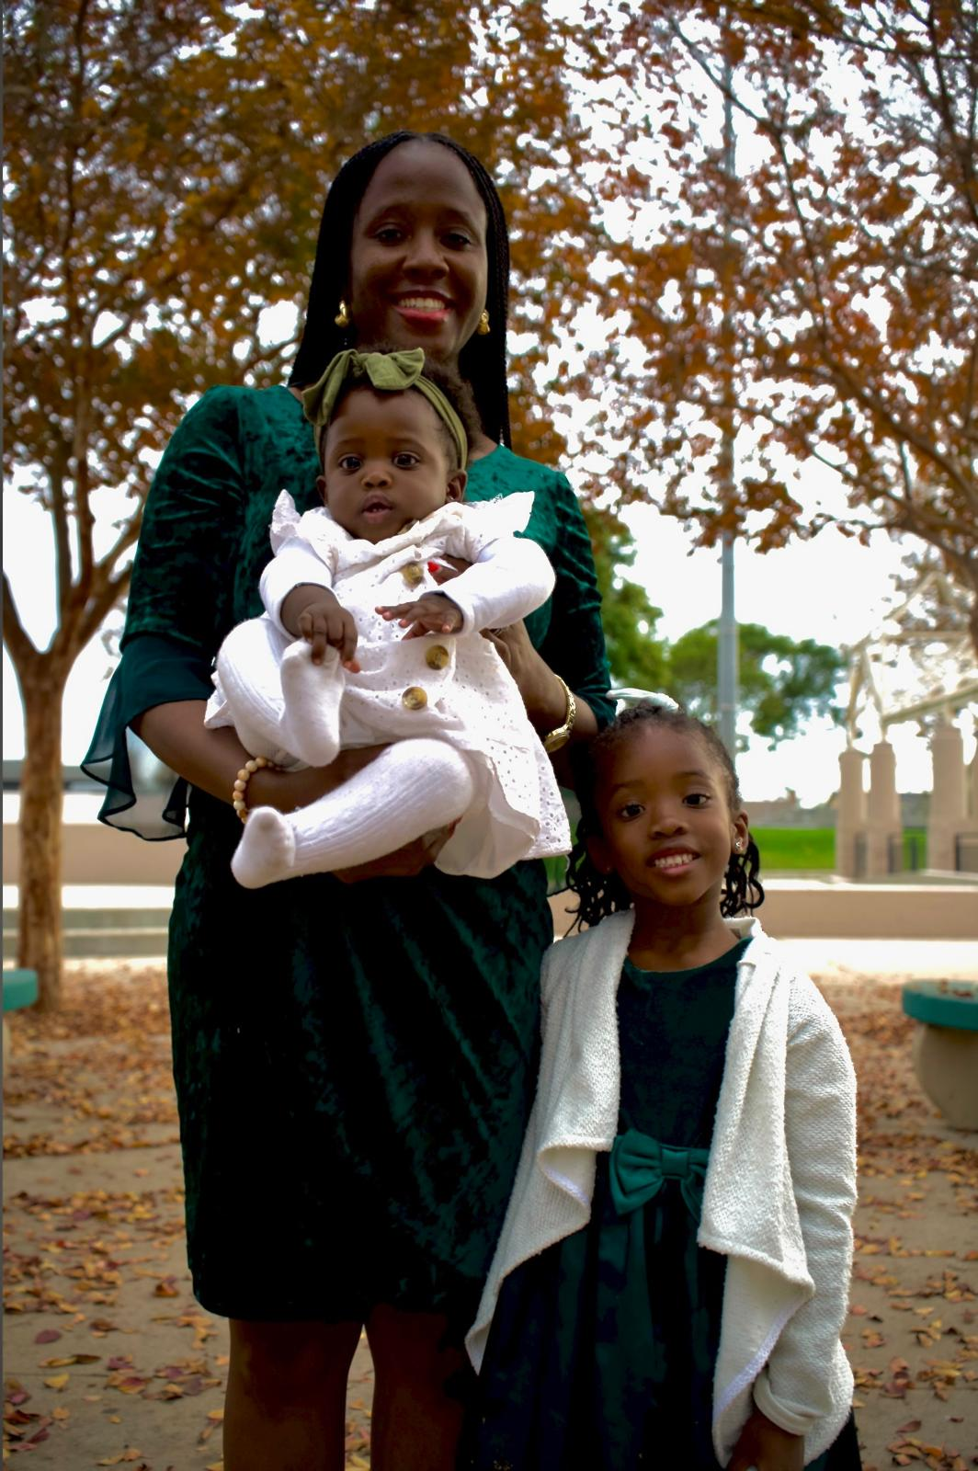

Slide 11


Slide 12


Slide 13
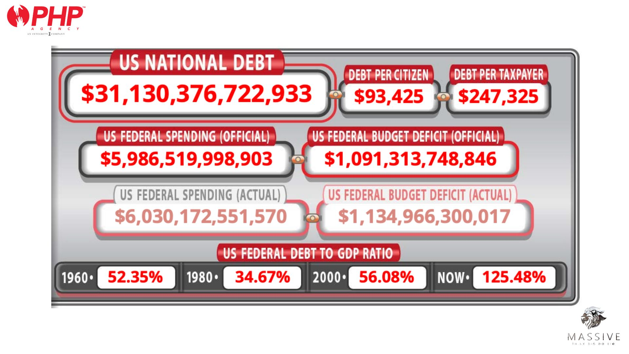

Slide 14


Slide 15


Slide 16


Slide 17


Slide 18



Juan Maldonando
Director of Field Training
Gene Chapman
SMD, Annuity Wholesaler

Slide 19


Patrick Bet-David
Founder CEO, PHP
Matt Sapaula
Senior Board Council, PHP

Slide 20


Slide 21


Slide 22


13 DAYS

Slide 23


Slide 24



5 HOMES
OF MONEY

Slide 25
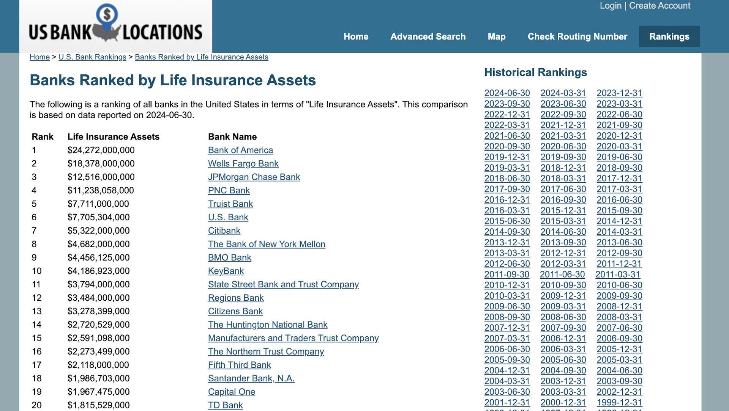


5 HOMES OF MONEY
F
V
V
V
I
Banks
Stock Market
Qualified Plans
Real Estate
Life Insurance
LIQUIDITY
SAFETY OF PRINCIPAL
TAX DEDUCTIBLE
TAX ADVANTAGE
GROWTH
SCORE
2/5
2/5
3/5
2/5
4/5

Slide 26
5 HOMES OF MONEY
F
V
V
V
I
Banks
Stock Market
Qualified Plans
Real Estate
Life Insurance
LIQUIDITY
SAFETY OF PRINCIPAL
TAX DEDUCTIBLE
TAX ADVANTAGE
GROWTH
SCORE
2/5
2/5
3/5
2/5
4/5

Slide 27


Slide 28


Slide 29


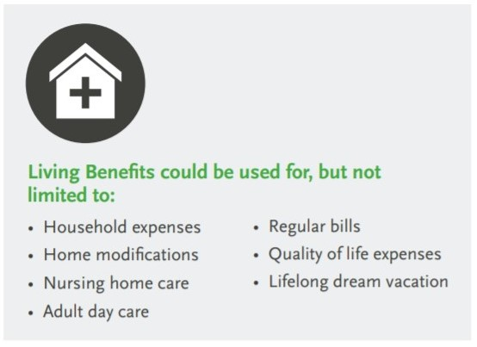
“1 in every 6–10 adults will experience a serious health condition before or during retirement.
The greatest risk isn’t just the illness — it’s the financial impact it can create for your family.”

Slide 30
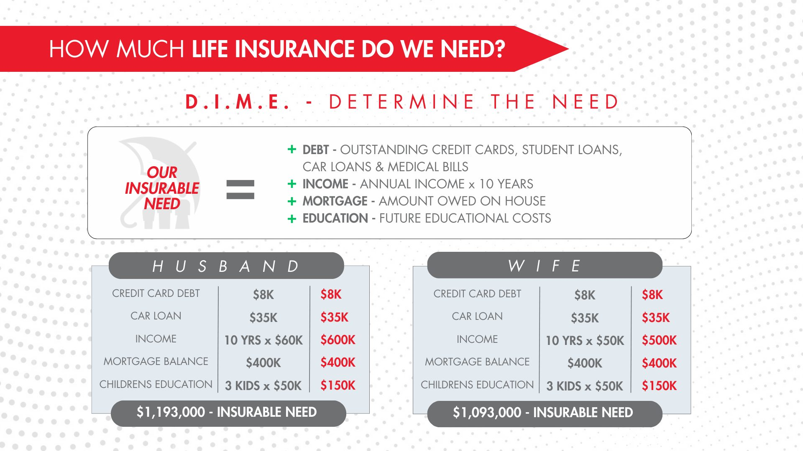

Slide 31
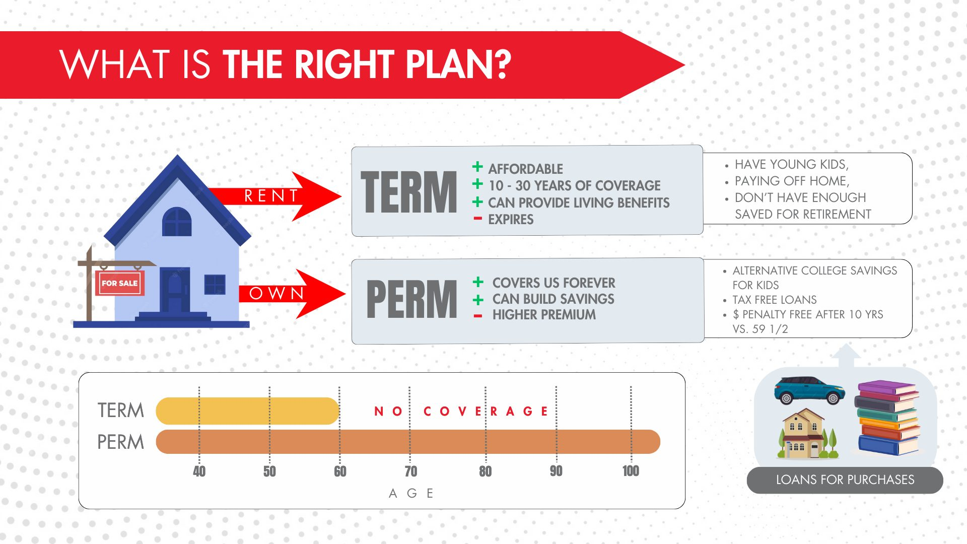

Slide 32

UNDERSTANDING LIFE INSURANCE
TERM
WHOLE
INDEX UNIVERSAL LIFE
10, 15, 20, 30 YRS
IUL
35 YR OLD BUYS A 30 YR TERM POLICY
@ AGE 65 POLICY EXPIRES
NOW WHAT?
WHOLE
2%-4%
S&P 500
2 OPTIONS:
Renew w/current company @ age 65
Purchase new policy with a different company
CASH VALUE
INS
INS/DB
CV
PERMANENT TO AGE 100
*Grows Slow
*High % Rate on Loans
*Loans decrease DB
*CV goes to
Insurance Co.
PERMANENT TO AGE 100+
*Growth based on the Market
*Principle Protected
*Family Receives both
*TAX FREE!!!
LIVING BENEFITS!
Either way…

Slide 33
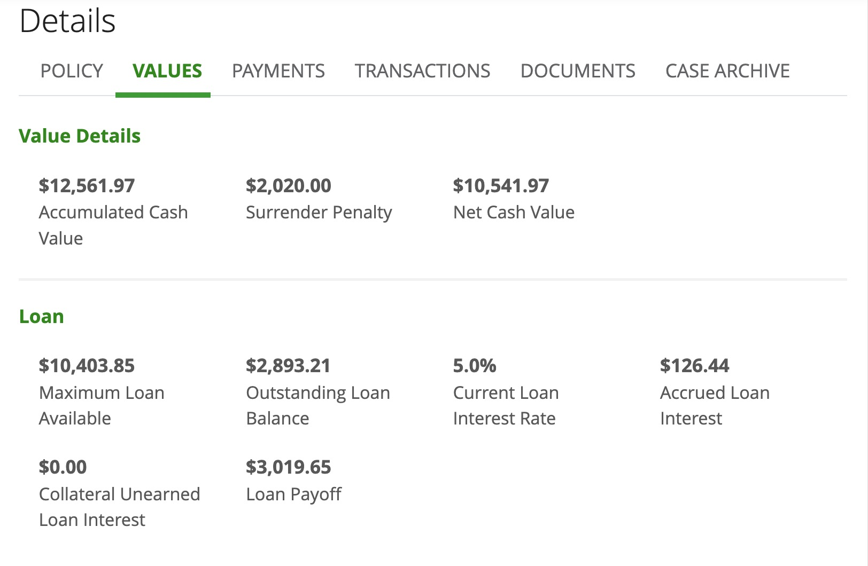

Slide 34
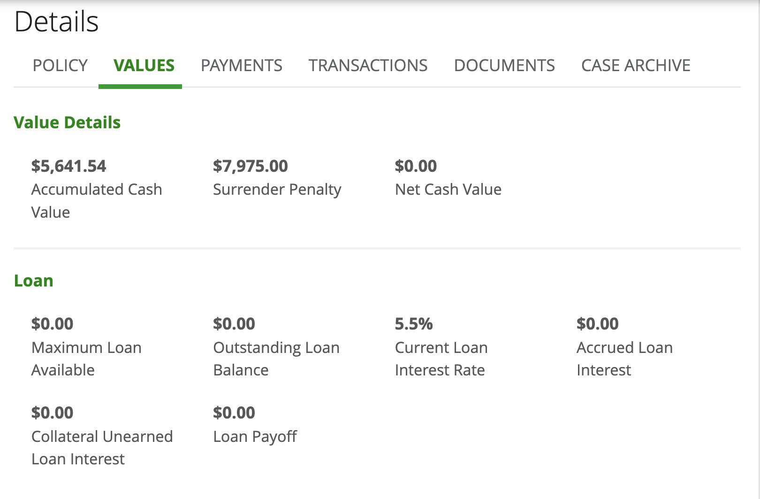
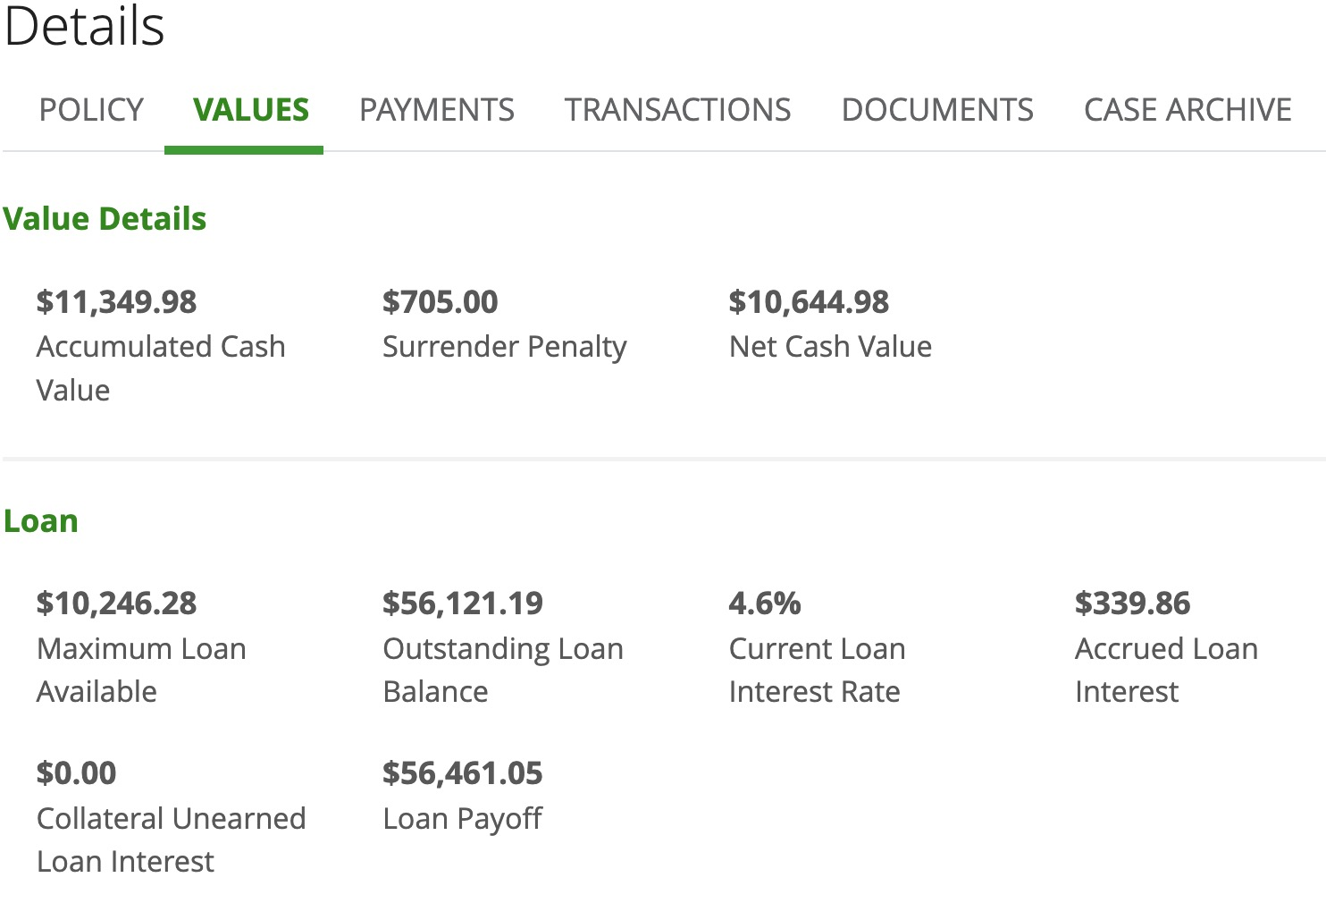

Slide 36
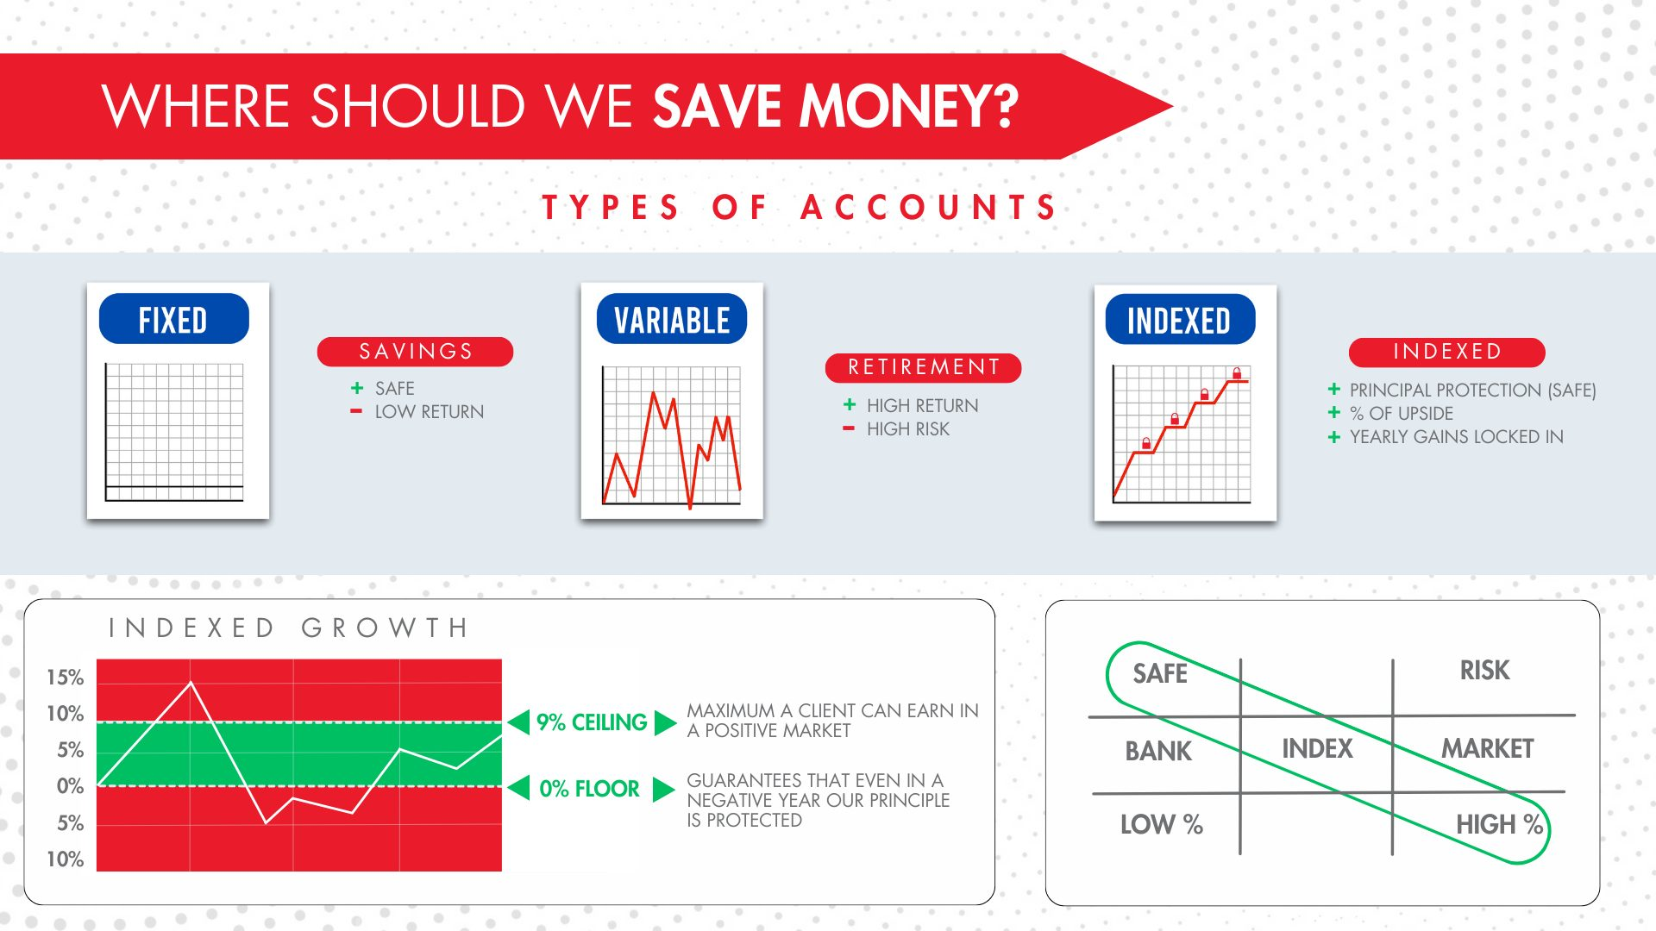

Slide 37
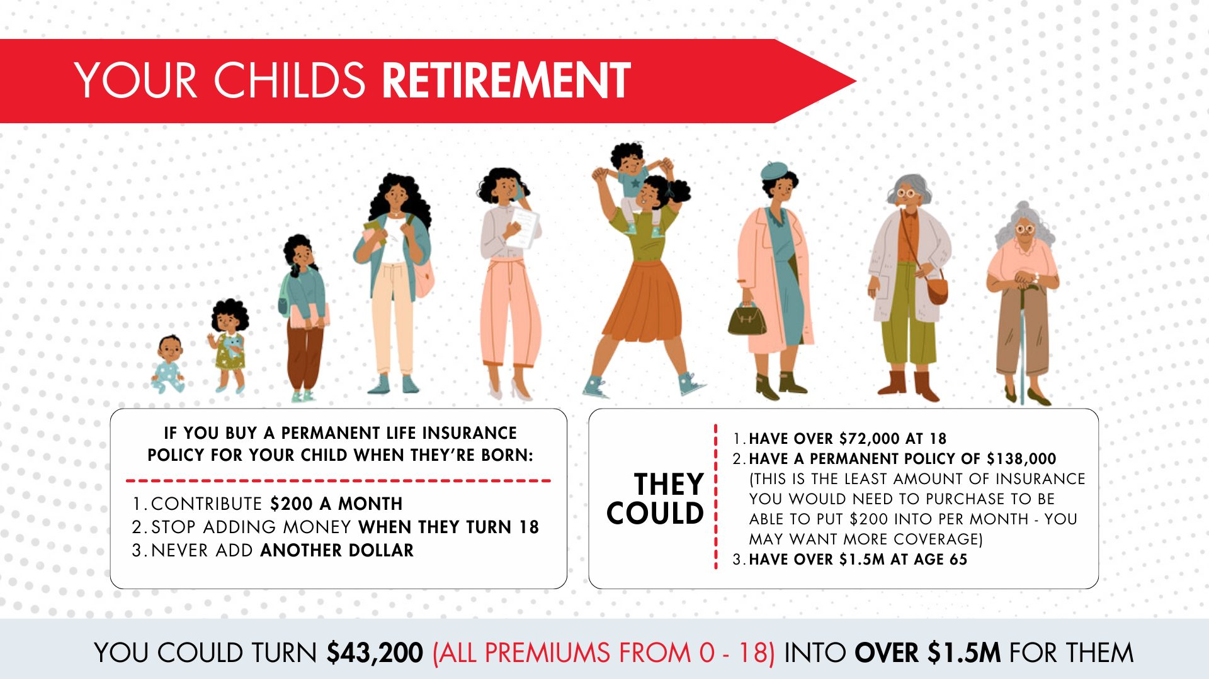

Slide 38
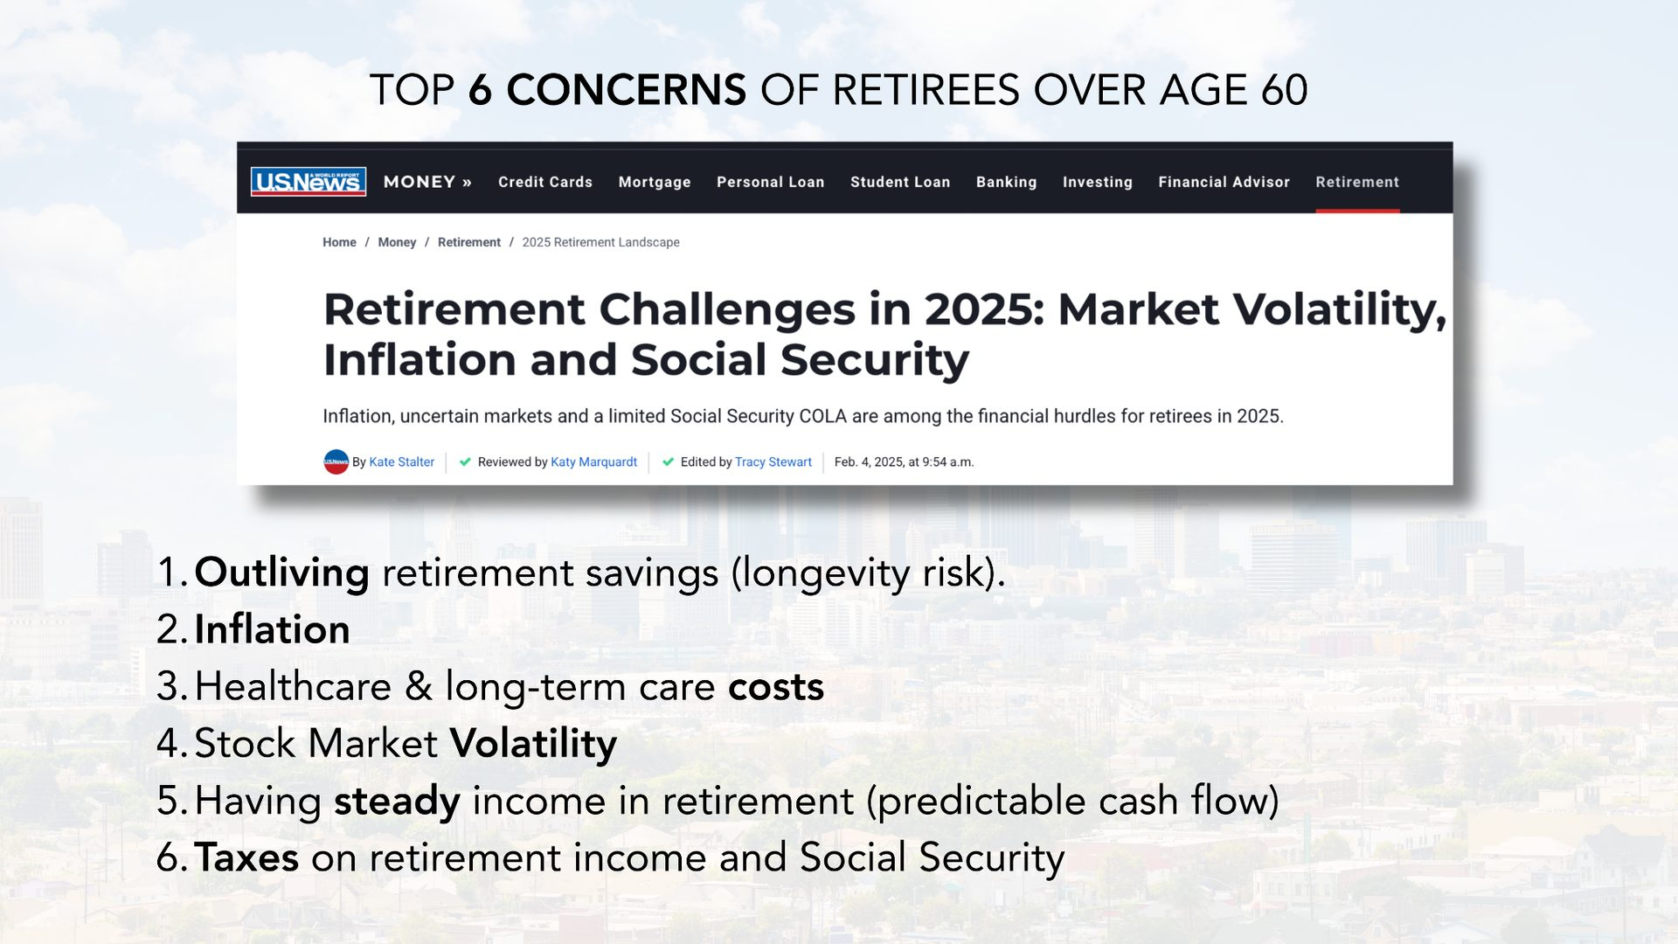

Slide 39


Slide 40


Slide 41
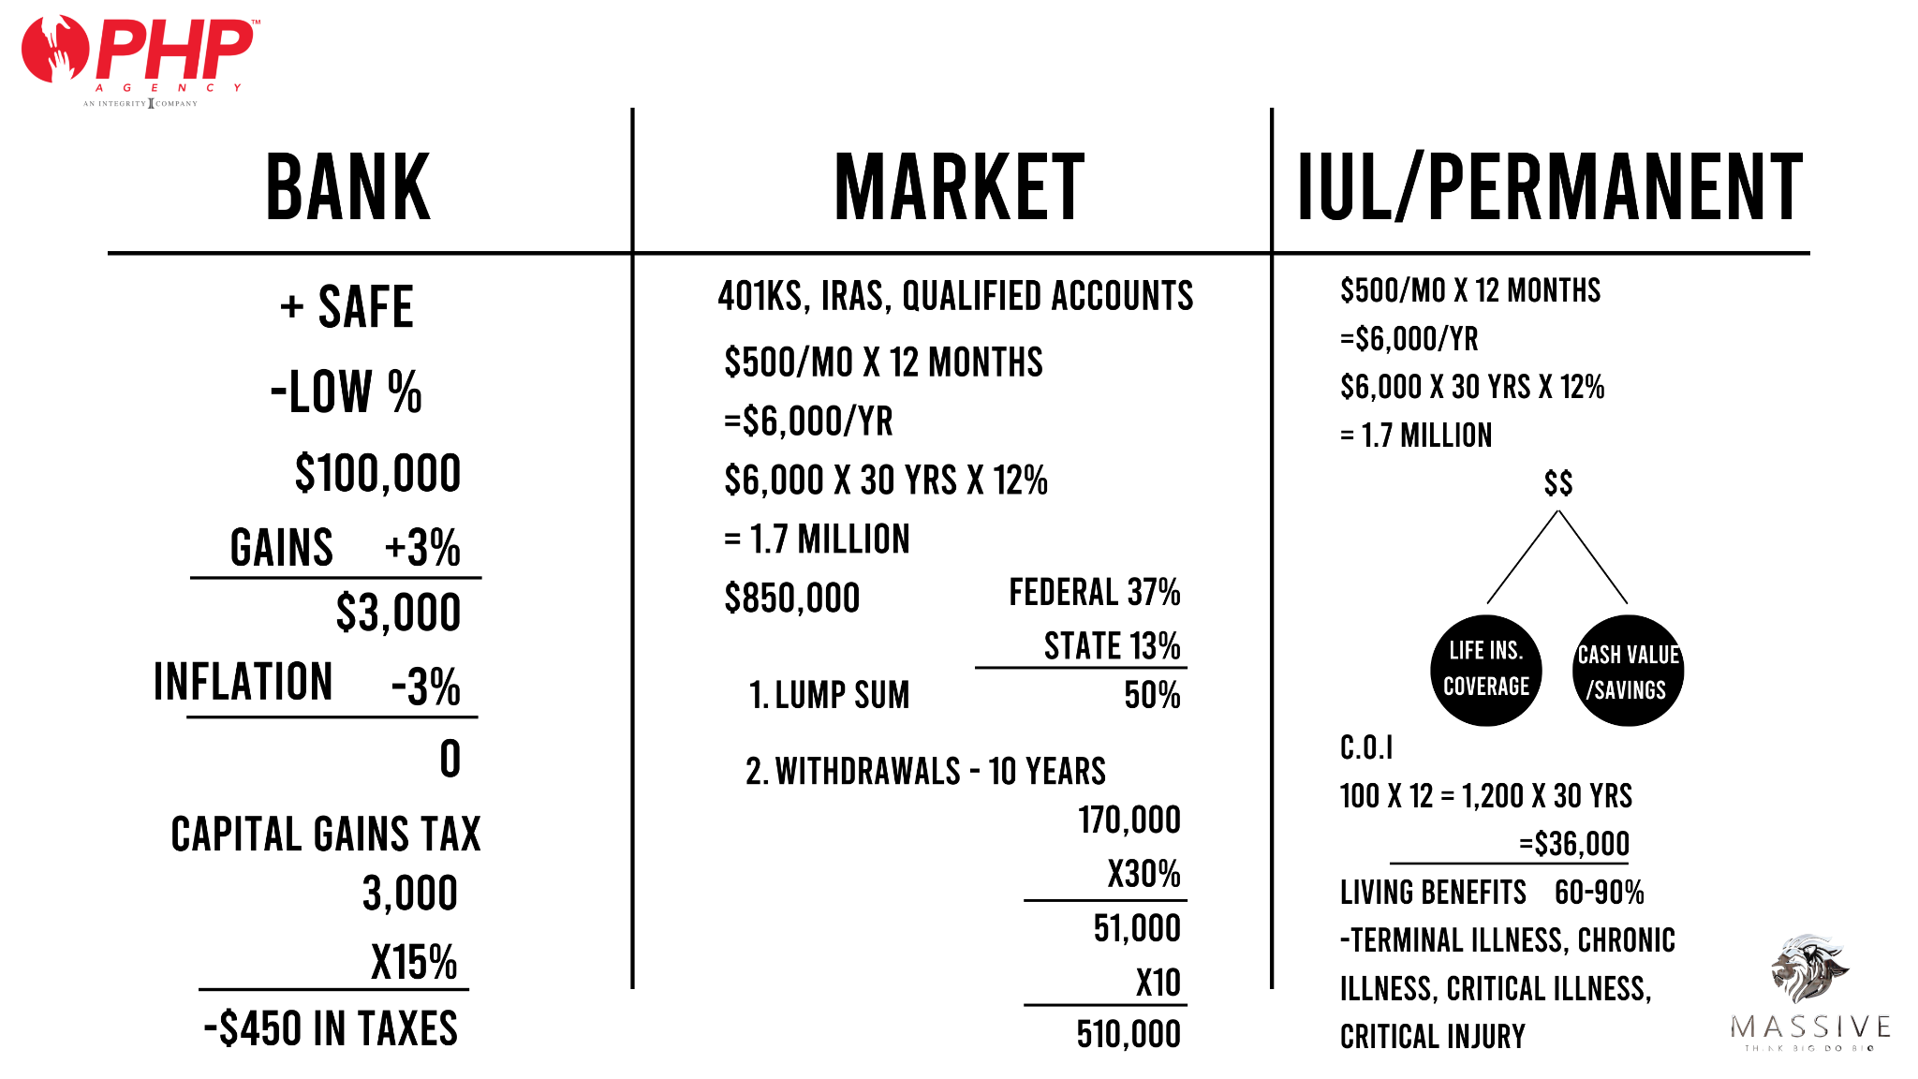
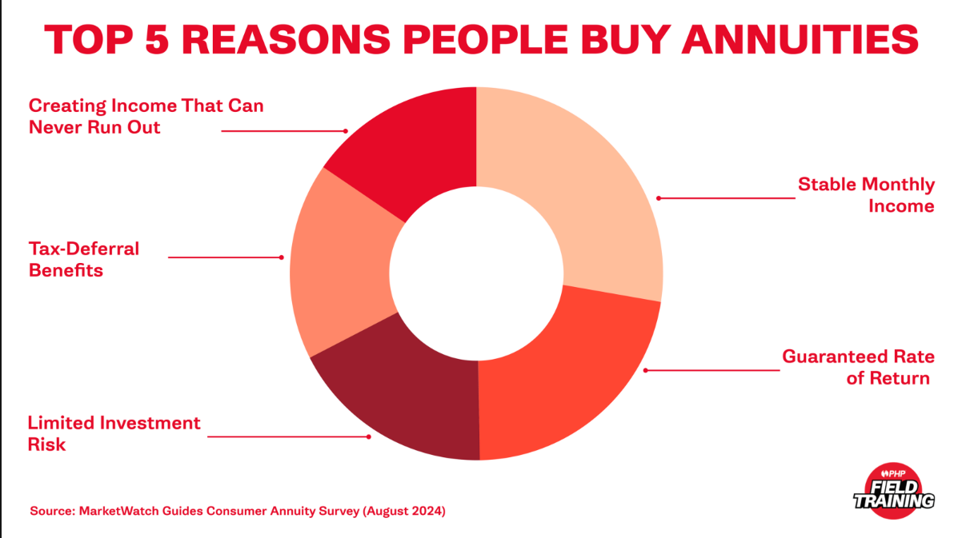


Slide 42
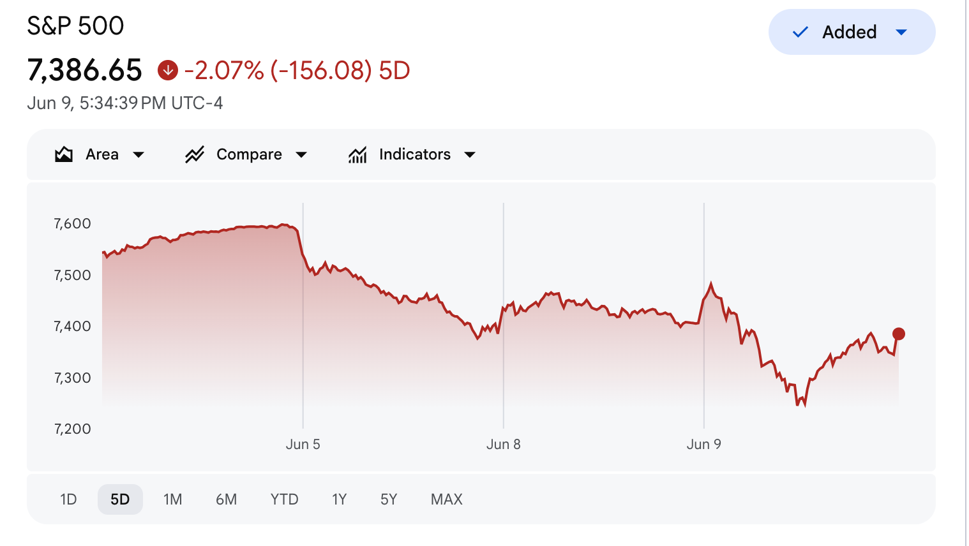

Slide 43
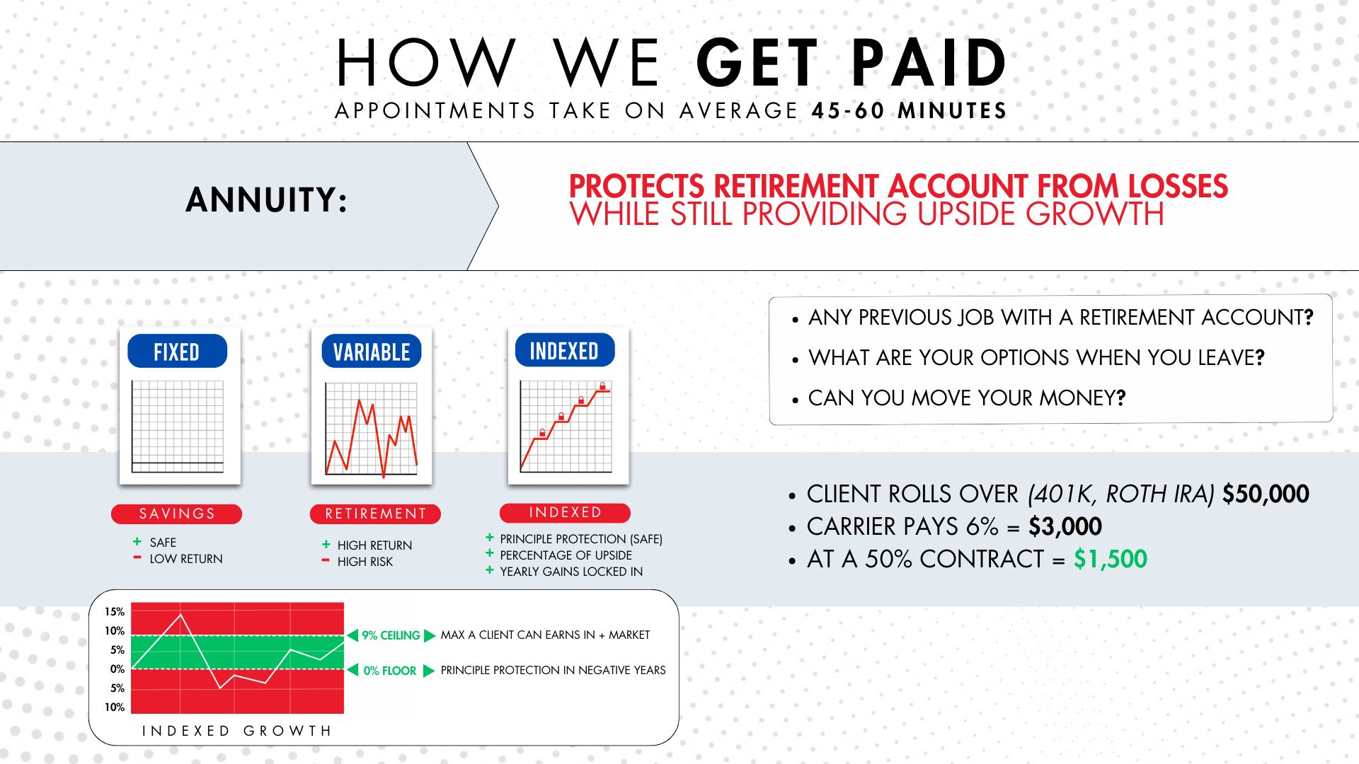

Slide 44
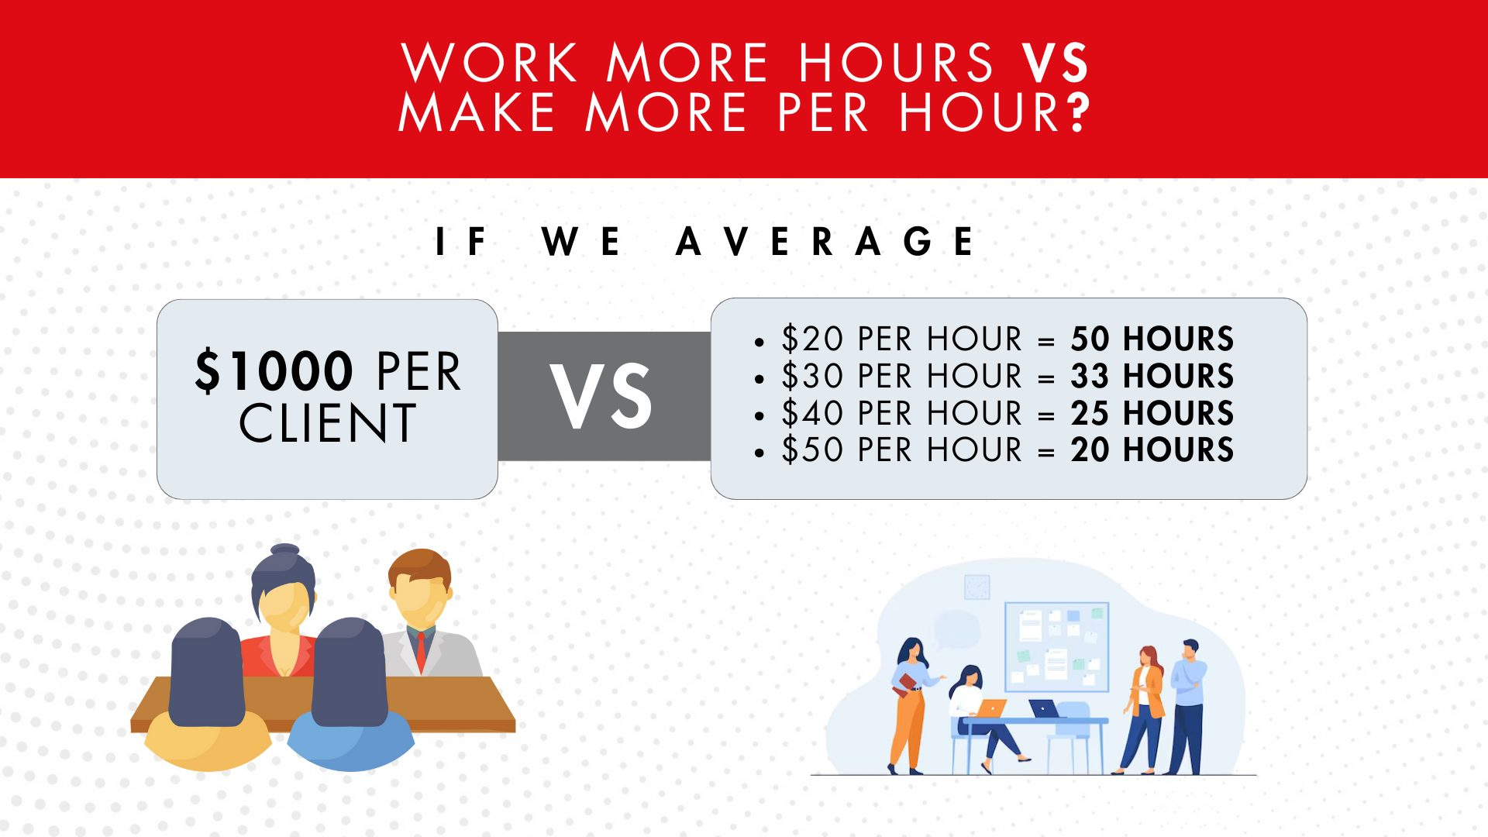
The Rich Don’t Work For Money, They Make Their Money Work For Them

Slide 45
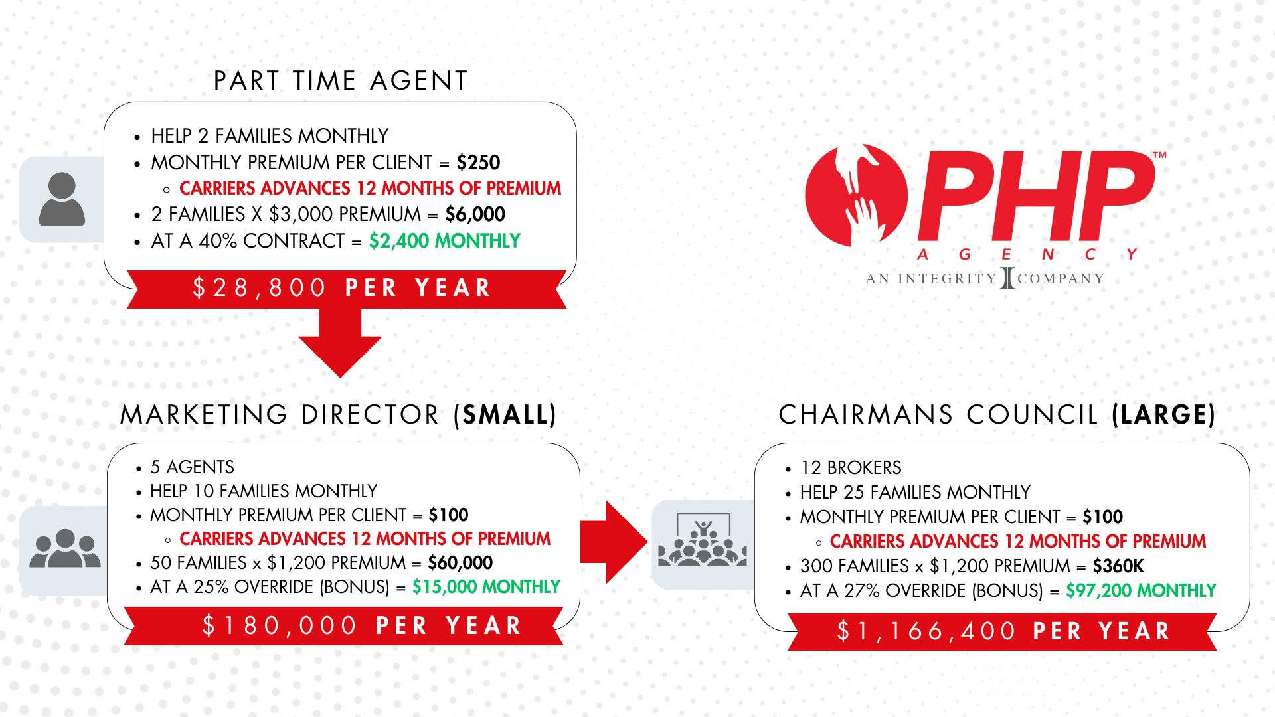

Slide 46
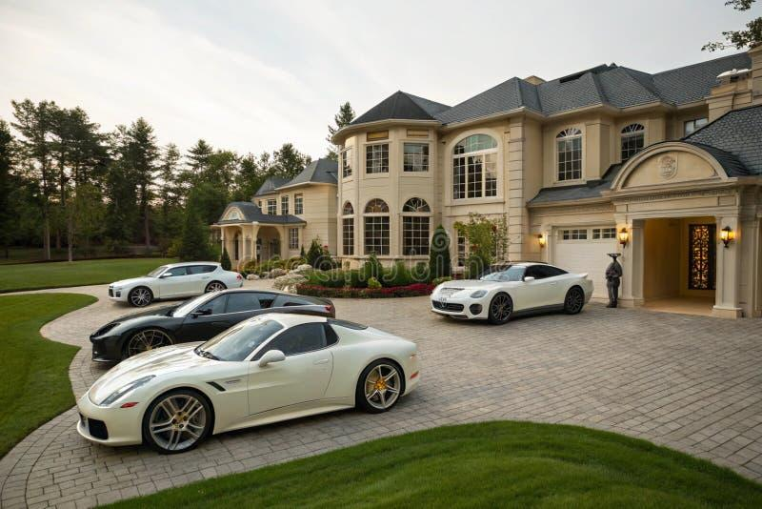
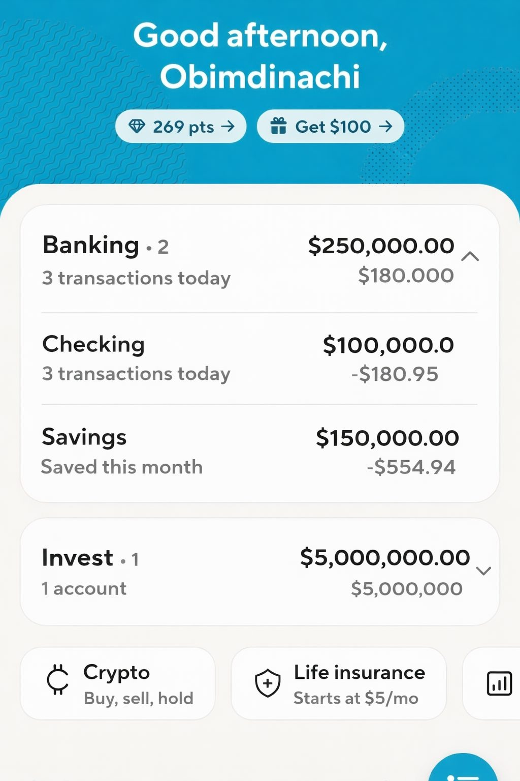
Rich people play the money game to win. Poor people play the money game to not lose.

Slide 47

Failure To Plan Is Planning To Fail

Slide 48

Failure To Plan Is Planning To Fail

Slide 49


Slide 50


$199
$31
$98
$328
$183
$70
$253

Slide 51
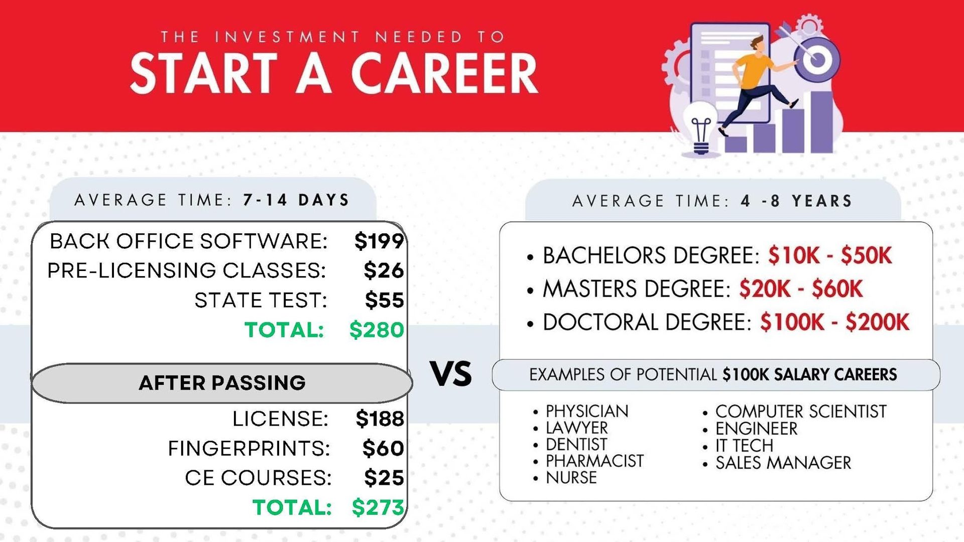


Slide 52
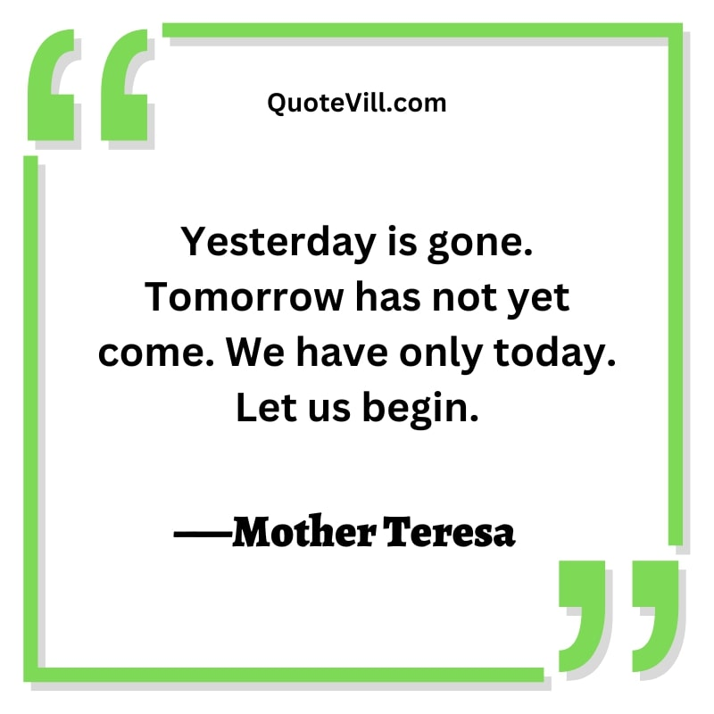

Slide 53



Slide 55








CONNECT WITH ME
www.lifechangersfs.com
@blengike
@blengike
714-360-5995
blengikephp@gmail.com
Blessing Ikejemba
@BlessingIkejemba
@blessingikejemba7

Slide 56
