Slide 1

MBA 440 Target Financial Analysis
Group 6
Ampong Deborah
Gould Maleigha
Idle Justin

Slide 2
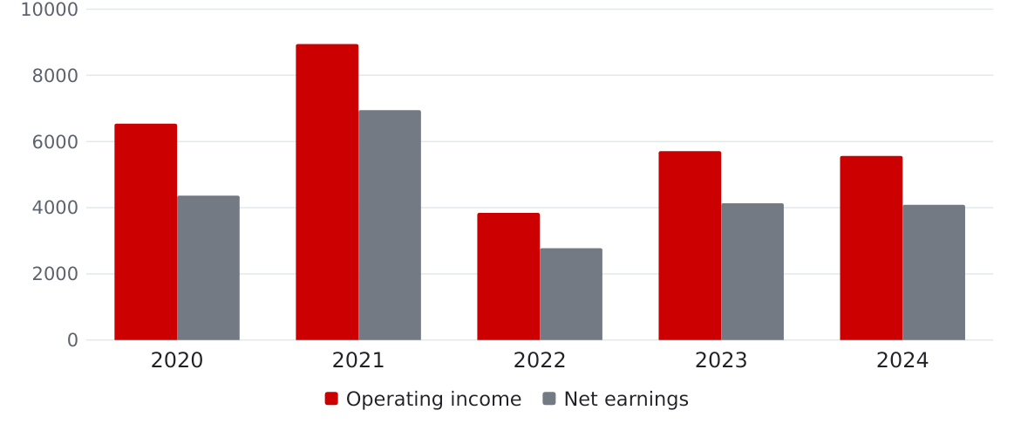
Target Corporation
Company overview Fiscal 2020–2024
General merchandise retailer with stores and digital channels
Operating income and net earnings ($ millions)
2024 net sales ($ millions)
$106,566
Total assets ($ millions)
$51,248 (2020)
$57,769 (2024)
Assets rose while 2024 net earnings remained below 2020.

Slide 3
Liquidity Analysis
Ratio | FY2020 | FY2021 | FY2022 | FY2023 | FY2024
Current Ratio | 1.03 | 0.99 | 0.92 | 0.91 | 0.94
Acid-Test Ratio | 0.50 | 0.35 | 0.22 | 0.29 | 0.32
Cash Ratio | 0.42 | 0.27 | 0.11 | 0.20 | 0.23
Current ratio fell below 1.00 in 2021 and remained below 1.00 through 2024
Acid-test and cash ratios reached their lowest levels in 2022, then improved in 2023-2024
Cash increased from $2.229 billion in 2022 to $4.762 billion in 2024, supporting the liquidity recovery.
Recommendation: Target should continue managing cash, inventory, and short-term obligations carefully to improve liquidity
Source: Target Corporation Forms 10-K, Fiscal Years 2020-2024.

Slide 4
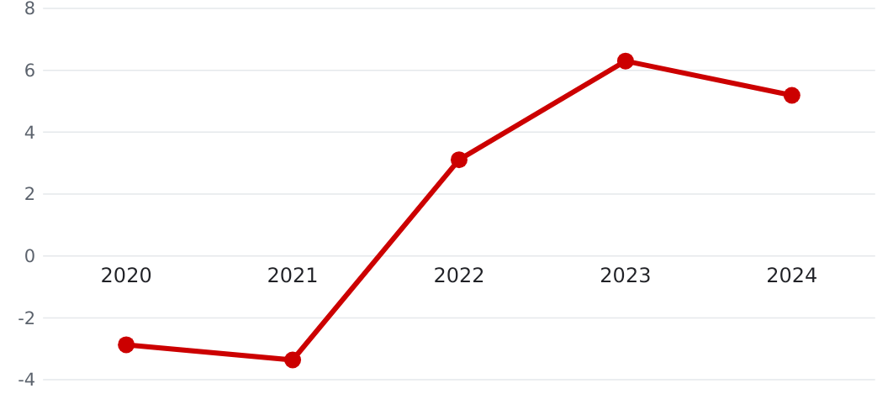
The cash conversion cycle turned positive
Efficiency analysis
Cash conversion cycle (days)
2024 average timing
Inventory on hand
58.75 days
Collect from customers
6.44 days
Pay suppliers
60.00 days
58.75 + 6.44 − 60.00 = 5.19 days
Shorten inventory time and review supplier payment timing.

Slide 5
Profitability recovered after a sharp decline in 2022
Profitability Analysis
Net Profit Margin and Return on Assets
Key profitability results
2021 Peak
Net Profit Margin: 6.64%
ROA: 12.91%
2022 Low
Net Profit Margin: 2.58%
ROA: 5.21%
2024 Recovery
Gross Profit Margin: 28.21%
ROE: 27.89%
Profitability partially recovered in 2023-2024 but remained below 2021 levels
Recommendation: Continue controlling costs and managing inventory while focusing on profitable sales growth

Slide 6
Market Analysis
Closing stock price on Jan 29, 2021 · Jan 28, 2022 · Jan 27, 2023 · Feb 2, 2024 · Jan 31, 2025
Ratio | FY2020 | FY2021 | FY2022 | FY2023 | FY2024
Stock price | $181.17 | $217.67 | $168.51 | $145.49 | $137.91
Price-to-Earnings | 21.0x | 15.4x | 28.2x | 16.3x | 15.6x
Price-to-Book | 6.28x | 8.00x | 6.91x | 5.00x | 4.28x
Market-to-Book | 6.28x | 8.00x | 6.91x | 5.00x | 4.28x
P/E moved opposite to EPS: lowest in FY2021 (EPS peak of $14.10), highest in FY2022 (EPS fell to $5.98)
P/B fell from 8.00x to 4.28x as the price dropped and book value per share rose to $32.19
P/B and M/B are identical: the same comparison, per share vs. whole company
Recommendation: Target should focus on growing earnings. EPS stayed about the same in FY2023–FY2024, but the stock price kept falling
Sources: Target Corporation Forms 10-K, FY2020–FY2024 (EPS, shares, equity); Yahoo Finance (closing prices).

Slide 7
DuPont Analysis
Ratio | FY2020 | FY2021 | FY2022 | FY2023 | FY2024
Profit Margin | 4.73% | 6.64% | 2.58% | 3.91% | 3.84%
Asset Turnover | 1.80 | 1.94 | 2.02 | 1.91 | 1.84
Debt/Assets | 71.82% | 76.16% | 78.94% | 75.74% | 74.61%
ROE | 30.25% | 54.15% | 24.75% | 30.81% | 27.89%
ROE fell from 54.15% in 2021 to 24.75% in 2022, alongside a sharp decline in profit margin.
Asset turnover increased in 2022, suggesting the ROE decline was driven more by lower profitability than asset utilization.
Recommendation: Focus on improving profit margins while maintaining efficient use of assets.

Slide 8
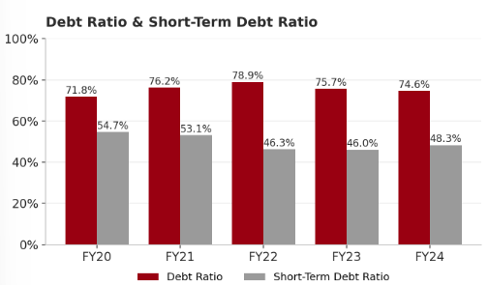
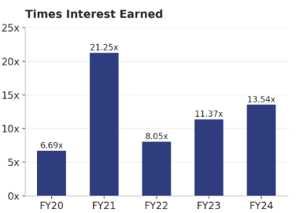
Debt Analysis
Ratio | FY2020 | FY2021 | FY2022 | FY2023 | FY2024
Debt Ratio | 71.8% | 76.2% | 78.9% | 75.7% | 74.6%
Short-Term Debt Ratio | 54.7% | 53.1% | 46.3% | 46.0% | 48.3%
Times Interest Earned | 6.69x | 21.25x | 8.05x | 11.37x | 13.54x
Debt ratio peaked in FY2022 after $7.19B (FY2021) and $2.65B (FY2022) in share repurchases reduced stockholders' equity
Short-term debt ratio fell as long-term debt rose to $16.0B; rose in FY2024 as $1.6B was reclassified as current
FY2020 TIE includes a one-time $512M early-repayment charge (about 14.1x excluding it), the FY2022 dip reflects inventory markdowns
Recommendation: Maintain times interest earned above about 10x and refinance the $1.6B of debt due within the year before repurchasing a large number of shares.
Source: Target Corporation Forms 10-K, FY2020–FY2024, SEC EDGAR.

