Slide 1
Valgrind, AVX-512, and Intel HPC Analysis Tools 7 August 2017 Scalable Tools Workshop, Granlibakken, Tahoe City, CA
Rashawn L. Knapp, Tatyana Mineeva, Supada Laosooksathit, Preeti Suman Intel, Software and Service Group (SSG) Clusters Systems and Runtimes [rashawn.l.knapp| tmineeva | supada.laosooksathit | psuman]@intel.com
Notes:
Today, I will briefly review what my group does in relation to CORAL, but mostly I will give an update on current work in progress to add AVX-512 vector support into Valgrind. I will also show case several HPC features of Intel’s performance tools suite.

Slide 2
Open-Source Tools Team: Executive Summary
Introduce team and goals
Tools – briefly
Valgrind – Adding AVX-512 vector instruction support
Intel HPC measurement and analysis tool offerings – quick overview
Summary and Next Steps

Slide 3















Open-Source Tools Team: Goals and Purpose
Our Role
Collaborations with Tool Owners
Enable Open Source HPC analyzers, ensuring these performance tools run well on Intel’s current and upcoming Xeon Phi platforms
CORAL
Theta - Knights Landing (KNL), 8.5 petaflops (PFLOPS)
Aurora – successor to Theta
Notes:
Everyone at STW knows the big picture. Only need to state the short story for STW: we work with these research institutions to promote performance tools for measurement and analysis of hpc applications and systems. Open pathways for the tool owners to get access to critical resources.

Slide 4
Open-Source Tools Team: Tools and Status
 | Tool | Description | Status
Low-level Foundation | Dyninst (UMD, UW) | Dynamic binary instrumentation tool | KNL, Intel/GCC compilers. Test suite Versions: 8.2.1 - 9.3.0; Verified: test suite
 | PAPI (UTK) | Interface to count CPU and off-core performance events | KNL, Intel/GCC compilers. Versions 5.4.1- 5.5.1; Verified: test suite
High-level Tools | TAU (UO) | Profiling and tracing tool for parallel applications, supports MPI and OpenMP; incorporates Dyninst and PAPI | KNL Intel/GCC Compilations with Intel MPI and Dyninst, PAPI. Version: 2.25.2
 | Score-P (VI-HPS) | Provides a common interface for high-level tools; incorporates Dyninst and PAPI | KNL: Intel/GCC compilers, Dyninst, PAPI, Intel MPI Version 3.0; working with TAU
 | Open|Speedshop (Krell Institute) | Dynamic Instrumentation tool for Linux: profiling, event tracing for MPI and OpenMP programs; incorporates Dyninst and PAPI | KNL, Intel/GCC compilers, Intel MPI, Dyninst, PAPI Patch to enable OSS installation with Intel compilers (Q1 ‘16) Version 2.2.*; Verified: in house benchmark suite
 | HPCToolKit (Rice) | Lightweight sampling measurement tool for HPC; incorporates Dyninst* and PAPI | KNL, Intel/GCC compilers, Intel MPI Versions 5.5.1
 | Darshan (ALCF) | IO monitoring tool | KNL, Intel/GCC compilers, Intel MPI Versions 3.1.3
Independent | Valgrind Base | framework for constructing dynamic analysis tools; includes suite of tools including a debugger, and error detection for memory and pthreads. | KNL, Intel/GCC compilers. Enabling AVX-512 support (in progress) Version: 3.13
 | memcheck | Detects memory errors: stack, heap, memory leaks, and MPI distributed memory. For C and C++. | KNL, Intel/GCC compilers. Version: 3.13; (AVX-512 support in progress)
 | helgrind | Pthreads error detection: synchronization, incorrect use of pthreads API, potential deadlocks, data races. C, C++, Fortran | KNL with Intel/GCC compilers. Version: 3.13
Tools table
Notes:
RK
Updated this table. Skip, if it seems time is short.
We now have built and tested all of these tools on Knights Landing (KNL). One of the most signifigant pieces of work we did this past year was to implement AVX-512 support into Valgrind for KNL.

Slide 5
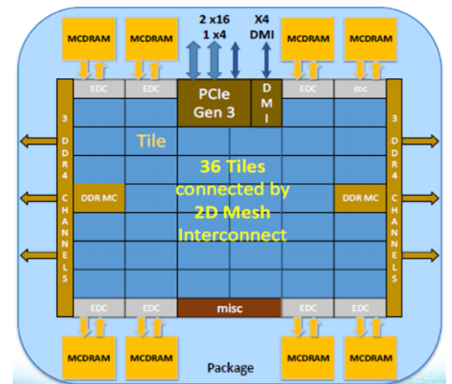
KNL Highlights
Knights Landing (KNL) Highlights
Intel(R) Advanced Vector Extensions 512 (Intel(R) AVX-512)
14-nanometer processor
The chip contains 36 Tiles, each with 2 cores, 2 Vector Processing Units (VPUs)/core and 1MB L2 cache; interconnected by 2D Mesh.
16 GB High Band Width Multi-Channel DRAM(MCDRAM) and 6 channels DDR4
Intel Omni-Path controller to support Intel Omni-Path Architecture (OPA)
The Knights Landing Processor
Notes:
Before presenting the development progress for AVX-512 enabling in Valgrind for KNL, let’s firs review a few of the highlights of this processor:
-Introduces AVX-512 vector extensions, which extend AVX2 instructions by doubling the register size from 256 bits to 512 and includes new instructions
-This was the first 14 nanometer processor
-It supports the Xeon ISA
-Large High bandwidth multi-channel dram (MCDRAM)
-Omni-Path

Slide 6
Enabling AVX-512 vector support into Valgrind: Approach
Under Nulgrind:
Set of AVX-512 microbenchmarks runs without crash - done
NAS IS benchmark runs without crash - done
Microbenchmark and NAS IS results are correct - done
Stretch goals - under Memcheck:
The benchmarks run without crash - in progress
The benchmark results are correct - in progress
Memory leaks in AVX-512 NAS IS benchmark are found correctly - done
Notes:
Valgrind is a widely-used open-source framework for binary analysis. It is designed for heavy-weight tasks, such as tracing memory leaks or race conditions. Valgrind doesn’t yet understand recently introduced subset of vector instructions, AVX-512, so it doesn’t work on new machines, for example, KNL.
AVX-512 is a set of 512-bit wide vector instructions. Its predecessor, AVX2, uses 256-wide vectors, and it is supported by Valgrind.
Valgrind consists of several components. The main one is Valgrind core, which recompiles the input binary at runtime. The binary analysis is done by another component, a Valgrind tool, and there are many tools for different analysis types.
The simplest tool, “Nulgrind”, does not do anything. It’s not what a typical user or developer uses, but it is quite helpful as a debugging tool for those who work on extensions to the Valgrind core, tools, or create new Valgrind tools. For these reasons, we incorporated it into our approach for extending the valgrind core and eventual additions to the memcheck tool.
Our steps to add AVX-512 to the Valgrind core were the following:
First: List all AVX-512 instructions from a relatively simple serial benchmark, NASA’s NPB IS, which we chose because when compiled with AVX-512 compiler arguments, the compiler will generate AVX-512 instructions in each of the four AVX-512 instruction classes: F, CD, ER, PF Foundation (F), Conflict-Detection (CD), Exponential and Reciprocal (ER), and Prefetch (PF).
Next, for each instruction from the list, we implemented the instruction and wrote a small micro-benchmark which only uses this AVX-512 instruction and possibly the instructions which already have their own tests;
Then, we run each test under Nulgrind, ensuring it does not crash and gives the expected results.
Once all the tests are completed and run correctly, we then run the NAS IS benchmark under Nulgrind, and make sure it does not crash and yields expected IS results.
These goals were achieved. The benchmark runs under Nulgrind or any other tool that does not instrument it - for example, Helgrind.
However, the real goal is that applications with AVX-512 instructions will not crash under Valgrind’s popular memcheck tool, which gives useful feedback to developers about memory errors in their codes. We the serial version of IS working under memcheck, but we have a ways to go to support the entire AVX-512 set of vector extensions. If the instructions are not supported in Valgrind, memcheck fails expectedly with errors about unrecognized instructions.

Slide 7
Valgrind overview
Support new registers
and features
Instructions of current basic block (up to AVX-2)
vpadd ymm1, ymm2, ymm3
Application code
Translate AVX-512 to IR
Add new IR if needed
Intermediate representation, “IR” (up to AVX-2)
Tool instrumentation
Analyze new IR
(not too much yet)
Translate new IR to assembly
Generated assembly
(SSE or a function call)
Notes:
Let’s give a high-level overview of how the Valgrind core works, which is much like a compiler in its own right:
It reads the assembly of a current basic block and translates each instruction of this assembly into intermediate representation, IR. If Valgrind does not know the current instruction, it crashes.
Then, optionally, a Valgrind tool parses the generated IR and instruments it. We have only just started working with memcheck.
Then, the IR is compiled into assembly and executed. Valgrind then begins working on the next basic block we should run, and this process repeats.
So, to support a new instruction set, we need to:
1. Add some background support of new AVX-512 features, which we describe on the next slide
2. Specify how to translate new instructions to existing IR or add new IR
3. Update the tools to analyze new IR correctly – we have started updating memcheck, but we are not yet finished.
4. Translate new IR into assembly.

Slide 8
AVX-512, new features
New instruction prefix, EVEX
New displacement encoding
512-bit wide registers
32 vector registers instead of 16
8 new opmask registers, k0-k7
Up to 4 instruction operands
Explicit rounding control specifier in each instruction
Embedded memory broadcast
511 256 | 255 128 | 127 0
ZMM0 | YMM0 | XMM0
ZMM1 | YMM1 | XMM1
… | … | …
ZMM31 | YMM31 | XMM1
Notes:
What is new in the AVX-512 extension:
A new instruction prefix. (Prefixes encode various instruction parameters).
A new displacement encoding. In fact, it is not new, it is a change of an existing displacement scheme, so it was an unpleasant surprise when an existing Valgrind displacement decoder suddenly stopped working for some instructions.
The main feature, 512-bit wide vector registers, named ZMM. Lower half of there registers can also be addressed as YMM from the previous extension, AVX-2, and the lowest quarter of these registers can be addressed as XMM from SSE extension. It means that if, for example, an SSE instruction puts something to XMM0, we must be able to read it from ZMM0.
And there are 32 vector registers; the previous limit was 16.
Also, there are 8 more registers, k0 - k7, for operation masking.
Adding any new registers to Valgrind is straightforward. Valgrind emulates all guest registers with a data structure, and uses offsets to address a specific register. So we chose to expand the structure and update the offsets.
- Instruction masking required some effort, more detail on the next slide.
The instructions can support up to 4 operands
We have not yet encountered explicit rounding control specifier in instructions or embedded memory broadcast. We think that the first feature will not cause an issue if encountered because Valgrind IR allows it currently.

Slide 9
AVX-512, adding instructions to Valgrind
Translate AVX-512 to existing (256 or shorter) IR
Perfect for legacy instructions and few new instructions.
Add new 512-bit IR
Used for most new instructions.
Translate new IR into assembly:
SSE instructions (at least 4 for AVX-512 instruction, usually 8)
Helper function + SSE to load parameters (at least 8 for AVX-512 instruction, usually 12)
Use conditional expressions
Notes:
After Valgrind adding support for the previous AVX-512 features, we are able to add new instructions.
The first step is translating an instruction to IR, existing or new.
The IRs explicitly specify data width. For many AVX-512 instructions, it is possible to use two existing 256-bit wide IRs; and we did this for many which had existing AVX2 IRs and a few new instructions as well. Valgrind lead developer, Julian, advised us to try adding new IRs
If we add new IR, we should also translate it into the host assembly, and, again, there are two options.
If the IR can be expressed through SSE instructions, we do it. As a result, one AVX-512 instruction is usually represented by at least 4 SSE instructions; usually by 8. We generate about the same amount of code as for 2 AVX-2 instructions, so it should have the same speed.
If not, we can write a C function that does what the instruction is supposed to do. Then we translate the IR to jump to the beginning of the function. We also use SSE to load function operands into registers, and to read the result from register. It requires at least 8 SSE instructions, usually takes 12, plus all the code in function, usually 8-16 serial instructions.
This approach is used to mask an instruction, after we calculate an unmasked result into a temporary variable. So, a masked AVX-512 instruction usually generates 12 vector and 16 serial instructions.
The conditional expressions are used in masking-like AVX-2 instructions. They would generate 8-16 comparisons and 8-16 serial instructions for masking, but they are quite difficult to debug

Slide 10
Valgrind Next Steps
Enable AVX-512 in Memcheck
Contribute the code to Valgrind – we have a partial patch w/o memcheck hooks submitted
Add the remaining instructions, test it on other benchmarks
Work on Valgrind performance on AVX-512 code
likely should get better performance if we create new IRs instead of breaking into AVX2 or SSE components.
Parallelism – Valgrind is not multi-threaded. Is there value in this?
Notes:
We plan to complete AVX-512 enabling by the end of this year.

Slide 11
NASA IS – Valgrind memcheck
Two versions of serial IS, class A: without and with AVX-512 compiler arguments
Compiler: Intel 2017 Parallel Studio, update 4
System: Knights Landing
Both return no memory errors:
$ valgrind –tool=memcheck ./is.A.x
==79209==
==79209== HEAP SUMMARY:
==79209== in use at exit: 0 bytes in 0 blocks
==79209== total heap usage: 1 allocs, 1 frees, 568 bytes allocated
==79209==
==79209== All heap blocks were freed -- no leaks are possible
==79209==
==79209== For counts of detected and suppressed errors, rerun with: -v
==79209== ERROR SUMMARY: 0 errors from 0 contexts (suppressed: 0 from 0)
Notes:
NASA NAS IS benchmark yields the same output under memcheck for the version compiled with AVX-512 compiler optimizations and without.

Slide 12
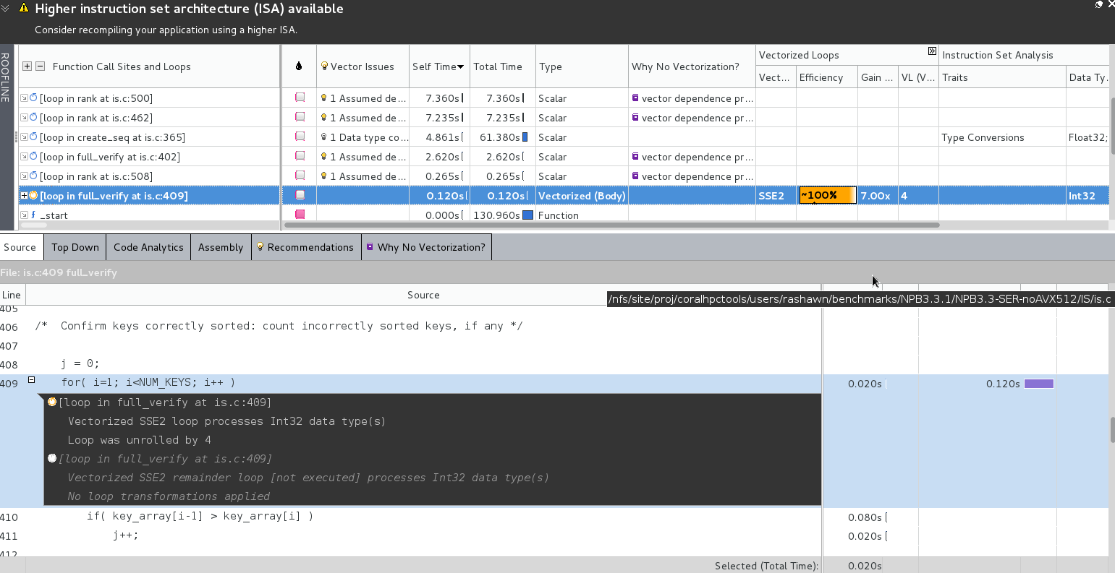
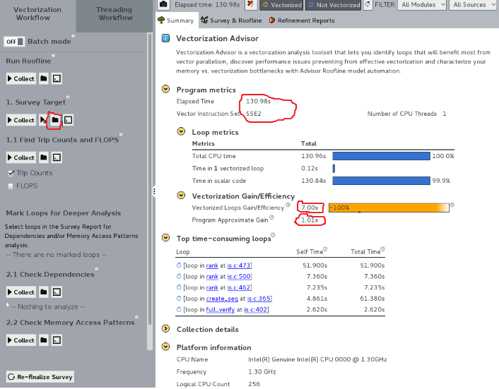
Intel Vector Advisor on IS Class C – no AVX-512
Summary View:
Elapsed time approx. 131 seconds
Vector Instruction Set: SSE
Vector Gain/Efficiency: 7.00x
Program approx. gain: 1.01x
View source by clicking on survey target folder to inspect loop gain and efficiency closer
Profile of hot loops and source location
$ source <pathTo>/advixe-vars.[csh|sh]
$ advixe-cl --collect survey --project-dir $me/IS-SER-C/advixe/2017_0805-noAVX-512 \
--search-dir src=$me/benchmarks/NPB3.3.1/NPB3.3-SER-noAVX512/IS -- ./is.C.x

Slide 13
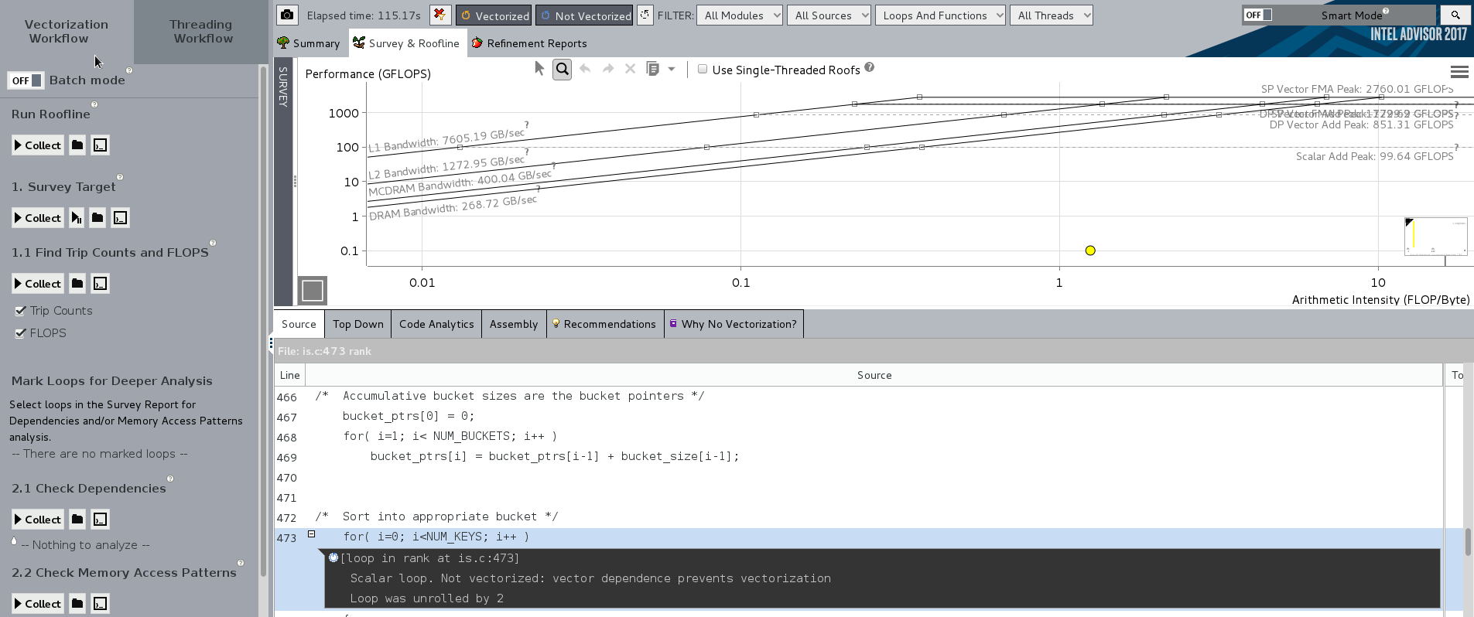
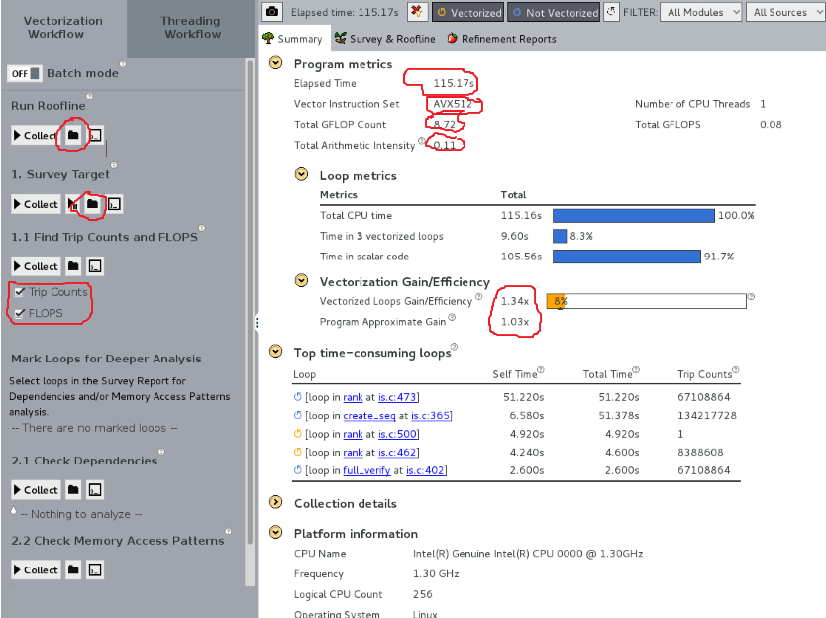
Intel Vector Advisor on IS Class C – AVX-512
Summary View:
Elapsed time approx. 115 seconds
Vector Instruction Set: AVX-512
Vector Gain/Efficiency: 1.34x
Program approx. gain: 1.03x
GFLOPS and AI
$ source <pathTo>/advixe-vars.[csh|sh]
$ advixe-cl --collect survey --project-dir $me/IS-SER-C/advixe/roofLineAVX-512 \
--search-dir \ src=$me/benchmarks/NPB3.3.1/NPB3.3-SER/IS -- ./is.C.x
$ advixe-cl --collect tripcounts \
-flops-and-masks --project-dir \
$me/IS-SER-C/advixe/roofLineAVX-512 \
--search-dir \ src=$me/benchmarks/NPB3.3.1/NPB3.3-SER/IS -- ./is.C.x

Slide 14
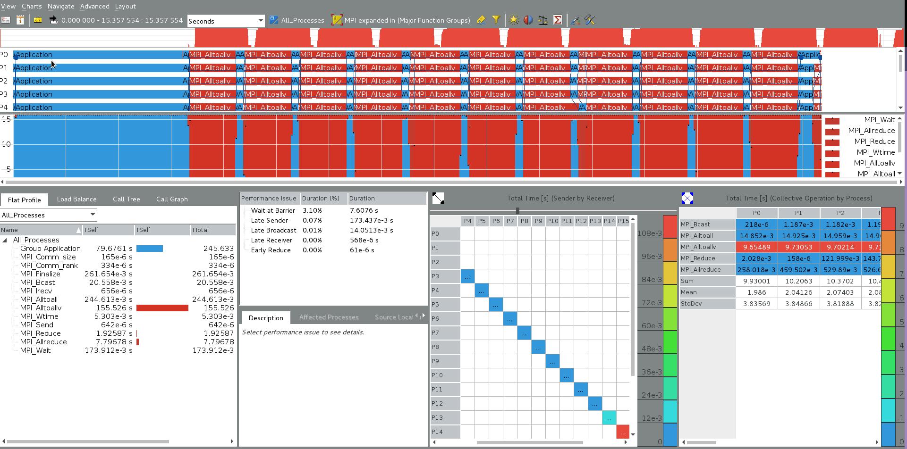
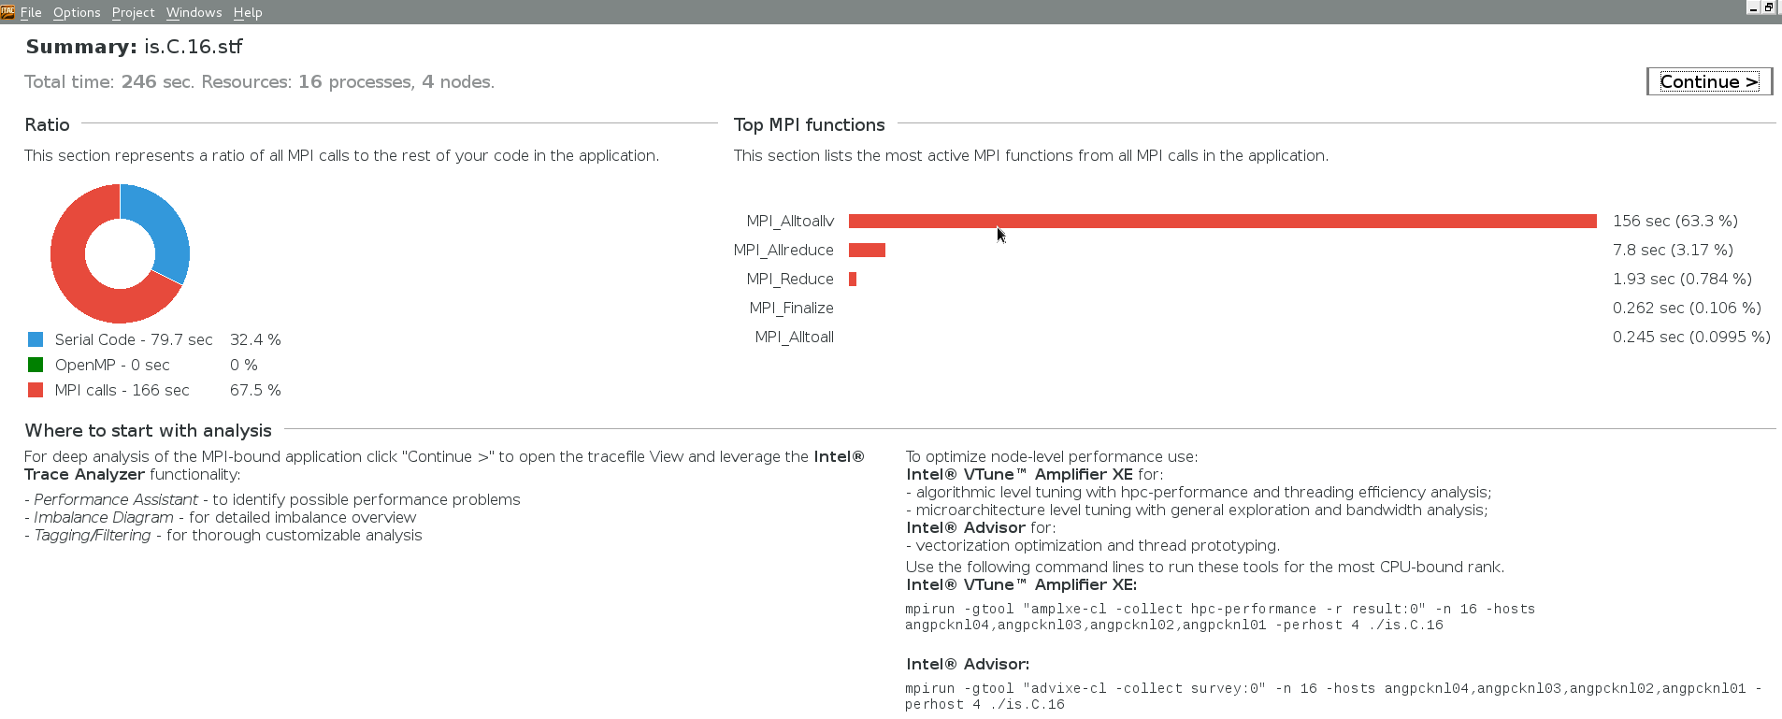
Intel Trace Analyzer and Collector on MPI IS Class C – AVX-512
Summary View:
Total time 246 seconds
16 P, 4N, 4ppn
A few other tool commands
Continue for Timeline and Trace view
246.0 /16.010 = 15.375
$ source <pathTo>/bin/psxevars.[csh|sh]
$ mpirun -n 16 -hosts \
<host1>,<host2>,<host3>,<host4> \
-perhost 4 -trace ./is.C.16
$ traceanalyzer is.C.16.stf &

Slide 15
Legal Disclaimer & Optimization Notice
INFORMATION IN THIS DOCUMENT IS PROVIDED “AS IS”. NO LICENSE, EXPRESS OR IMPLIED, BY ESTOPPEL OR OTHERWISE, TO ANY INTELLECTUAL PROPERTY RIGHTS IS GRANTED BY THIS DOCUMENT. INTEL ASSUMES NO LIABILITY WHATSOEVER AND INTEL DISCLAIMS ANY EXPRESS OR IMPLIED WARRANTY, RELATING TO THIS INFORMATION INCLUDING LIABILITY OR WARRANTIES RELATING TO FITNESS FOR A PARTICULAR PURPOSE, MERCHANTABILITY, OR INFRINGEMENT OF ANY PATENT, COPYRIGHT OR OTHER INTELLECTUAL PROPERTY RIGHT.
Software and workloads used in performance tests may have been optimized for performance only on Intel microprocessors. Performance tests, such as SYSmark and MobileMark, are measured using specific computer systems, components, software, operations and functions. Any change to any of those factors may cause the results to vary. You should consult other information and performance tests to assist you in fully evaluating your contemplated purchases, including the performance of that product when combined with other products.
Copyright © 2014, Intel Corporation. All rights reserved. Intel, Pentium, Xeon, Xeon Phi, Core, VTune, Cilk, and the Intel logo are trademarks of Intel Corporation in the U.S. and other countries.
Optimization Notice
Intel’s compilers may or may not optimize to the same degree for non-Intel microprocessors for optimizations that are not unique to Intel microprocessors. These optimizations include SSE2, SSE3, and SSSE3 instruction sets and other optimizations. Intel does not guarantee the availability, functionality, or effectiveness of any optimization on microprocessors not manufactured by Intel. Microprocessor-dependent optimizations in this product are intended for use with Intel microprocessors. Certain optimizations not specific to Intel microarchitecture are reserved for Intel microprocessors. Please refer to the applicable product User and Reference Guides for more information regarding the specific instruction sets covered by this notice. Notice revision #20110804

Slide 16
backup

Slide 17
More detailed Valgrind steps to add instruction
Check if the CPU supports AVX-512
Valgrind emulates guest registers with a data structure VexGuestAMD64State. Previously, it contained 16 256-bit vector registers. We updated it to 32 512-bit vector registers + 8 integer registers for masking. (The structure also holds other registers - rax, rcx, and so on; we didn’t modify these other registers).
Update implementation of XSAVE/XRSTOR instructions to match AVX-512 register layout
Detect and parse EVEX prefix. Minor update: variable type “Prefix” is changed from Int to Long, so that it can hold all EVEX parameters.
The IRs have different types. Usually we work with IRs with types “operation on the arguments” (unary operation, binary operation, and so on). There is another IR type, used for the arguments themselves. The arguments originally are guest registers or guest memory locations; in IR, they are represented as “virtual registers”. The virtual registers will be later mapped into actual host registers, and Valgrind only supports 128-bit (xmm) vector host registers. That is why Valgrind uses 2 virtual registers for an argument of AVX-2 (256-bit) instruction. For AVX-512, we had to add 2 more virtual registers for each instruction argument.
The mapping from an argument-type IR to its virtual registers is located in a data structure ISelEnv. We added two more virtual registers to the structure to support 512-bit wide instruction arguments.
Translate AVX-512 instructions to new IRs (file VEX/priv/guest_amd64_toIR.c, functions dis_ESC_0F__EVEX, dis_ESC_0F38__EVEX and dis_ESC_0F3A__EVEX)
Translate the new IRs into assembly (file VEX/priv/host_amd64_isel.c, mostly function iselDVecExpr_wrk_512)
Implement an additional IRs that masks the result of any 512-bit wide instruction.
(In progress) Analyze the new IRs in memcheck

