Slide 1
Continuous Clock SynchroniZation for Accurate Performance Analysis
Johannes Ziegenbalg
Scalable Tools Workshop, 07 August 2017

Slide 2
OUTLINE
Motivation
Challenges
One-Time Synchronization
Continuous Clock Synchronization
Multi-stage Synchronization
Conclusion

Slide 3
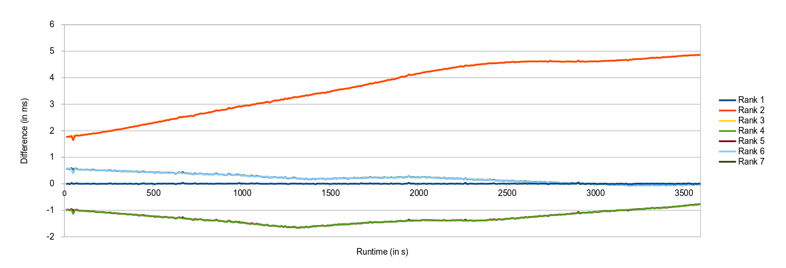
MOTIVATION
Accurate performance analysis
Lack of an system-wide timer
Different initial clock properties and changes over time

Slide 4

CHALLENGES
© Heinz Zak: Wolfgang Güllich climbing “separate reality”
Large initial timestamp differences
Differences in clock speed
Clock acceleration due to physical effects and NTP corrections
Notes:
Foto: Wolfgang guellich “separate reality” CC Heinz Zak

Slide 5
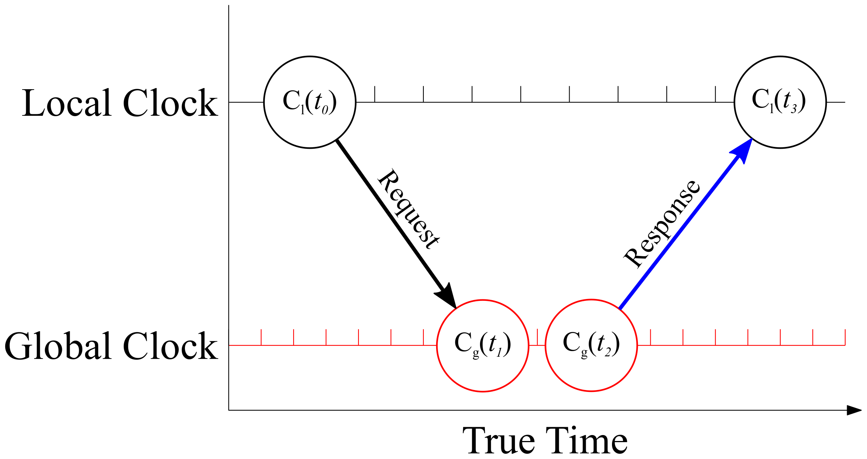
BASICS
Local clock requesting timestamps from global one
Intercept – the absolute time offset between two clocks
Slope – the speed difference of two clocks

Slide 6
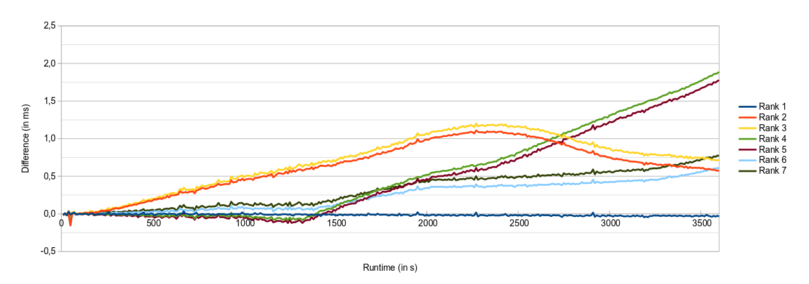
ONE-TIME SYNCHRONIZATION
Clock differences to Rank 0 after a single synchronization step in the beginning

Slide 7
CONTINUOUS SYNCHRONIZATION
Inject “clock-sync” Messages – attach Timestamps (t₀ - t₃)
Many measurement points over time
Compute slope/intercept of local clock

Slide 8
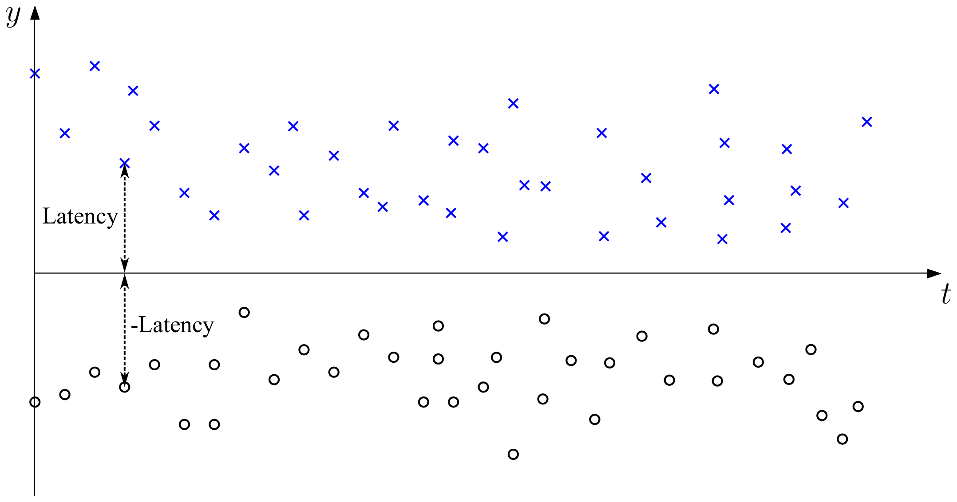
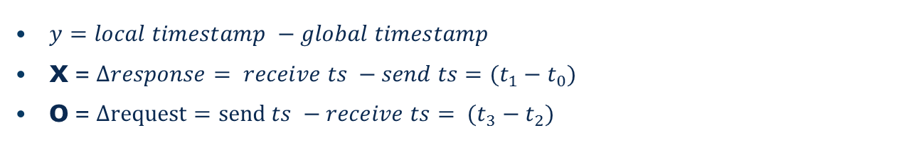
CONTINUOUS SYNCHRONIZATION – SYNCHRONOUS CLOCK
$y=local timestamp −global timestamp$
X = $∆response= receive ts −send ts=(t_{1}−t_{0})$
O = $∆request=send ts −receive ts= (t_{3}−t_{2})$

Slide 9
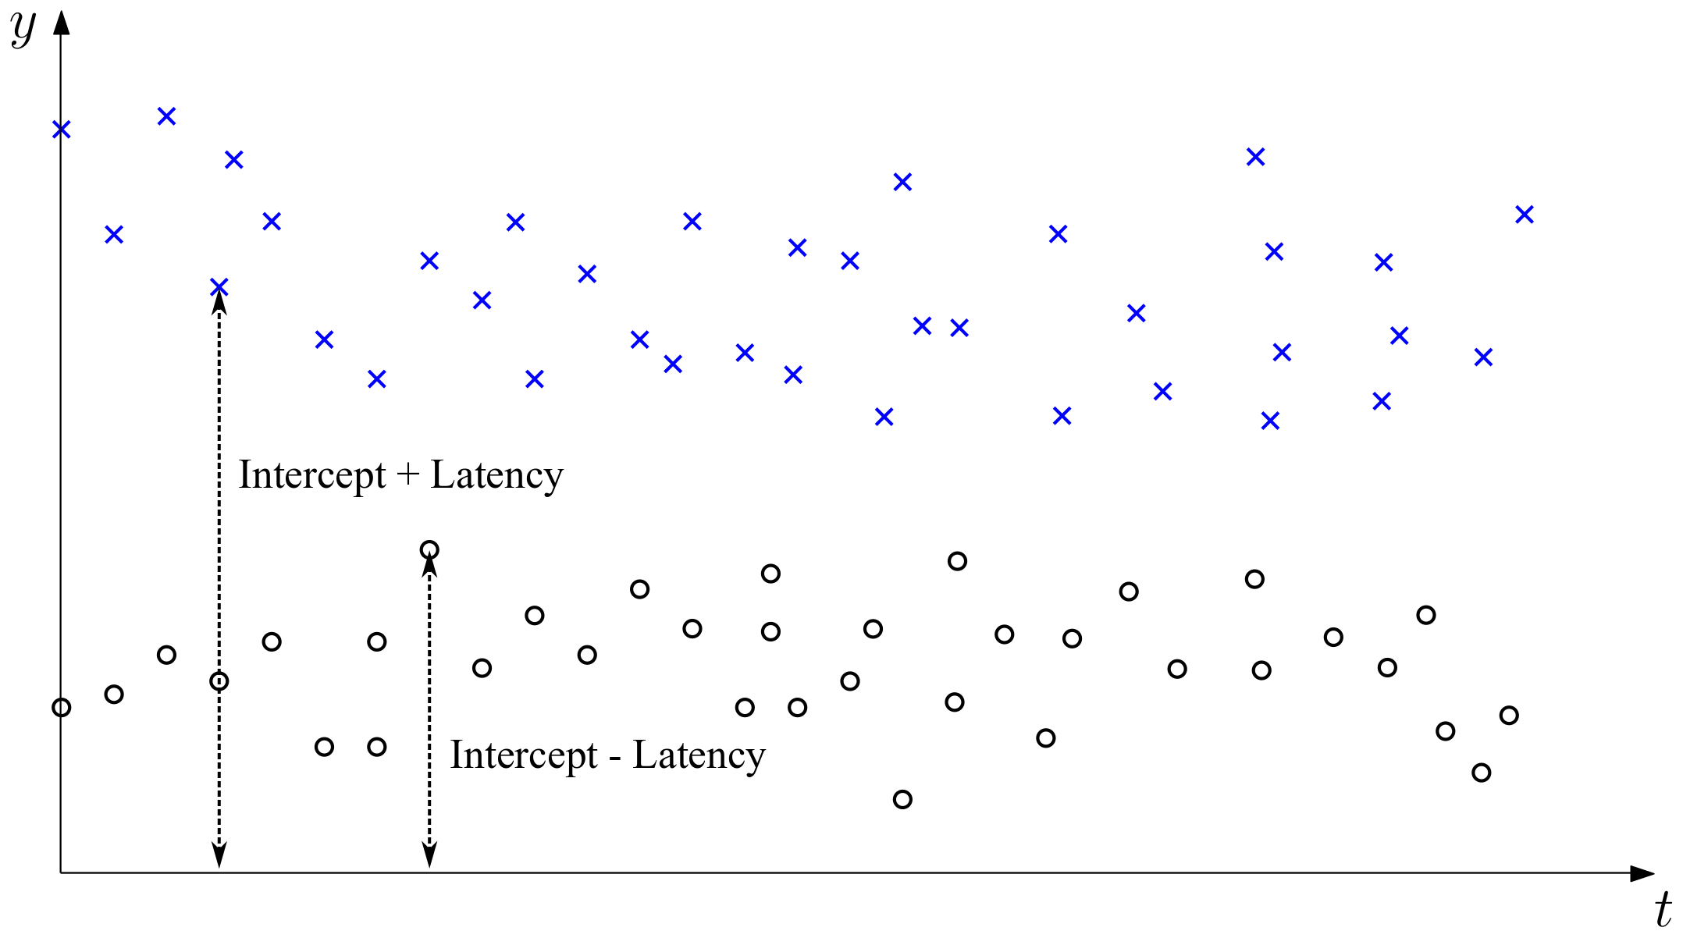
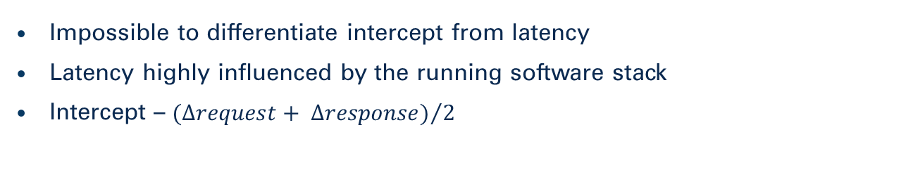
INTERCEPT COMPUTATION
Impossible to differentiate intercept from latency
Latency highly influenced by the running software stack
Intercept – ${(∆request+ ∆response)}/2$

Slide 10
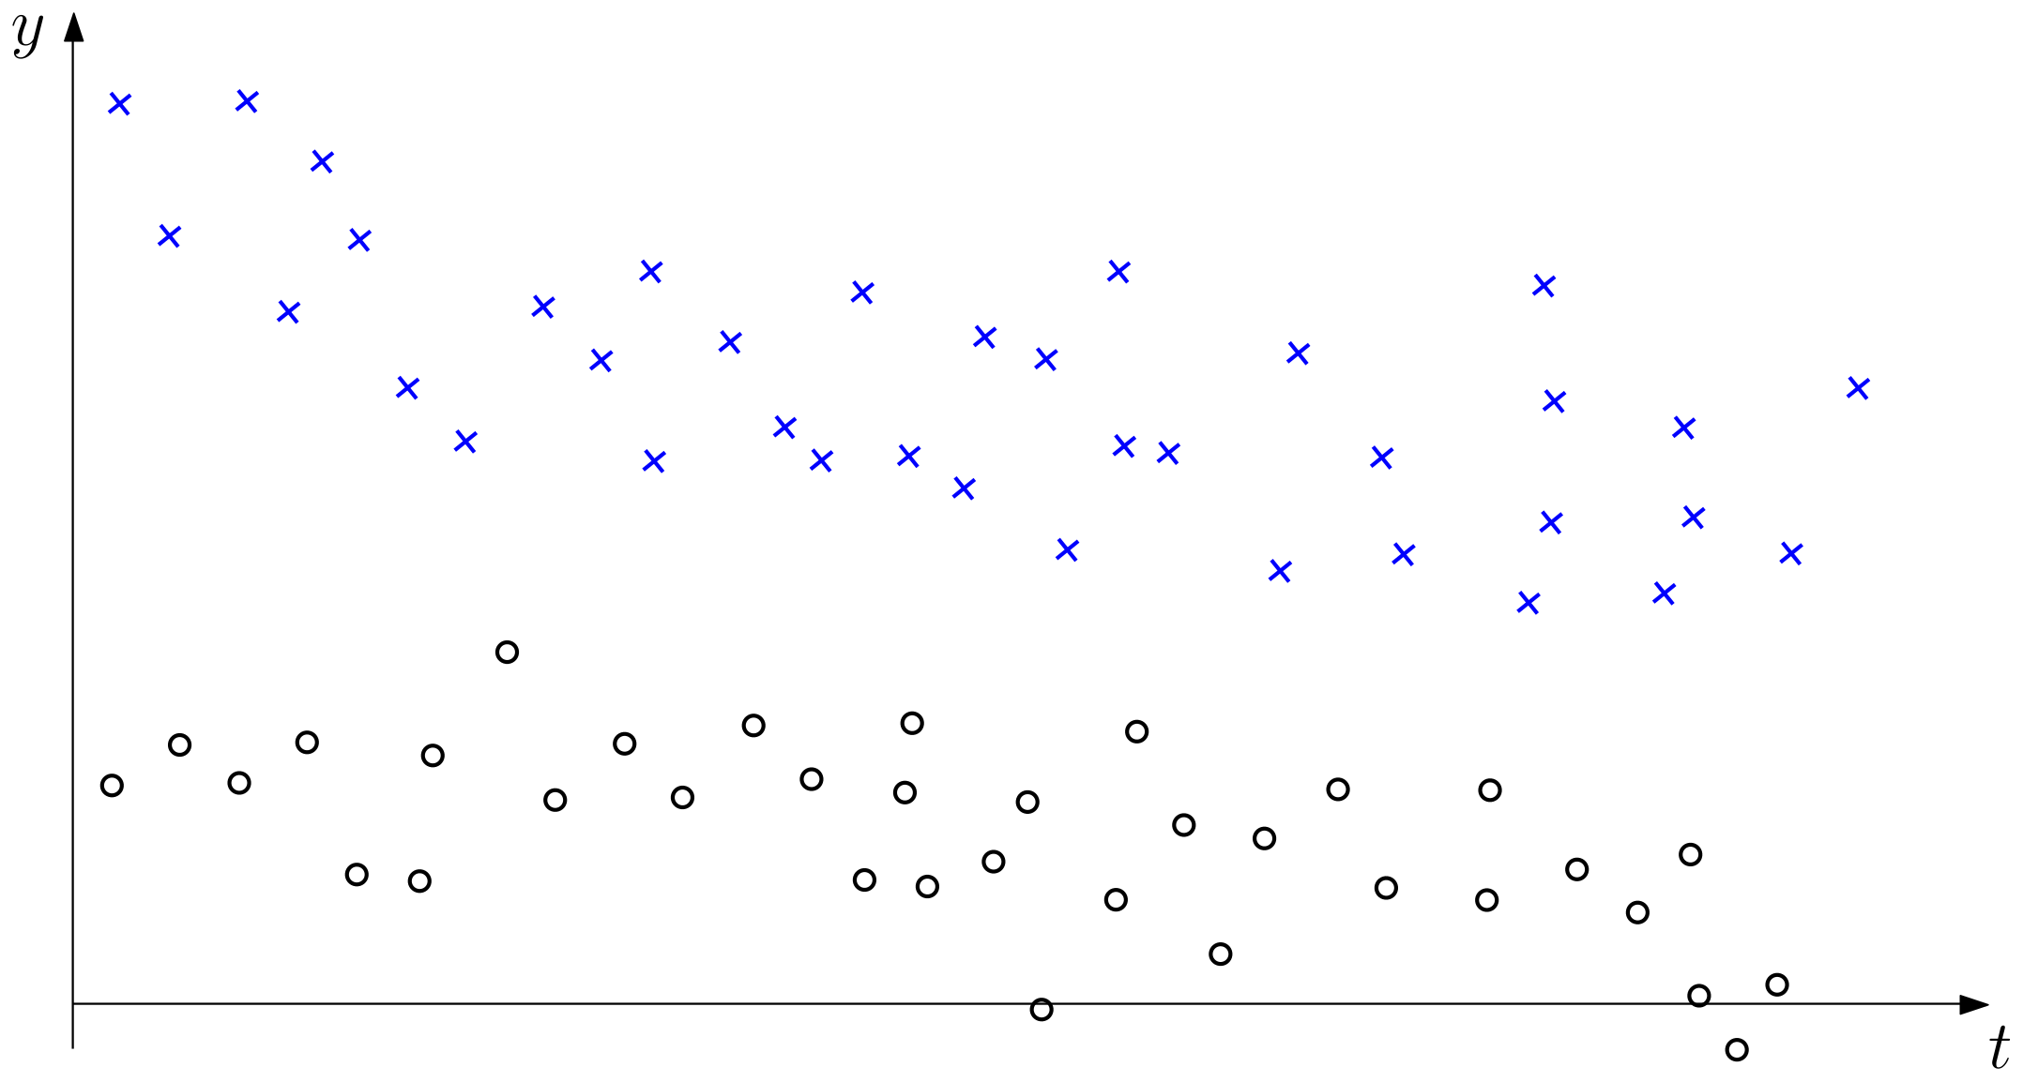
SLOPE COMPUTATION
Linear regression is not feasible – too complex
Consider only messages with lowest latency
Low latency messages defined by convex hulls

Slide 11
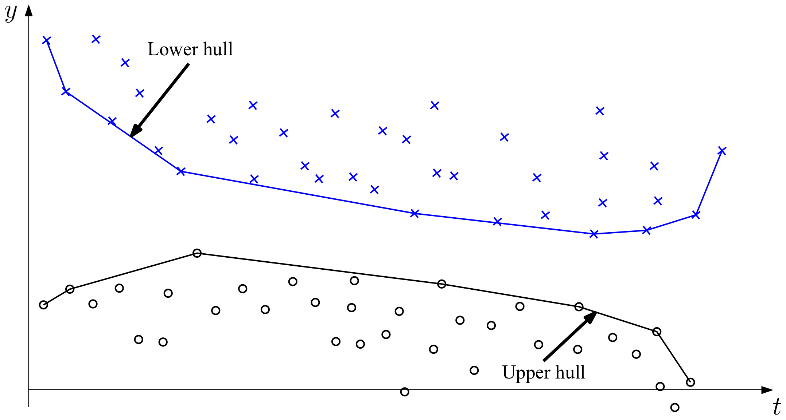
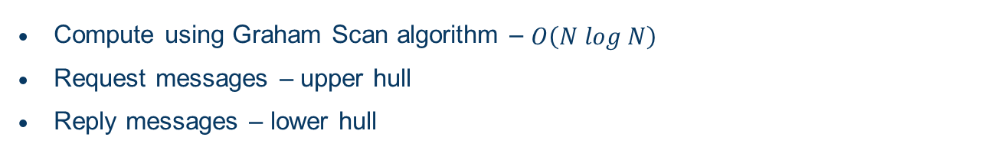
CONVEX HULL
Compute using Graham Scan algorithm – $O\left(N log N\right)$
Request messages – upper hull
Reply messages – lower hull

Slide 12
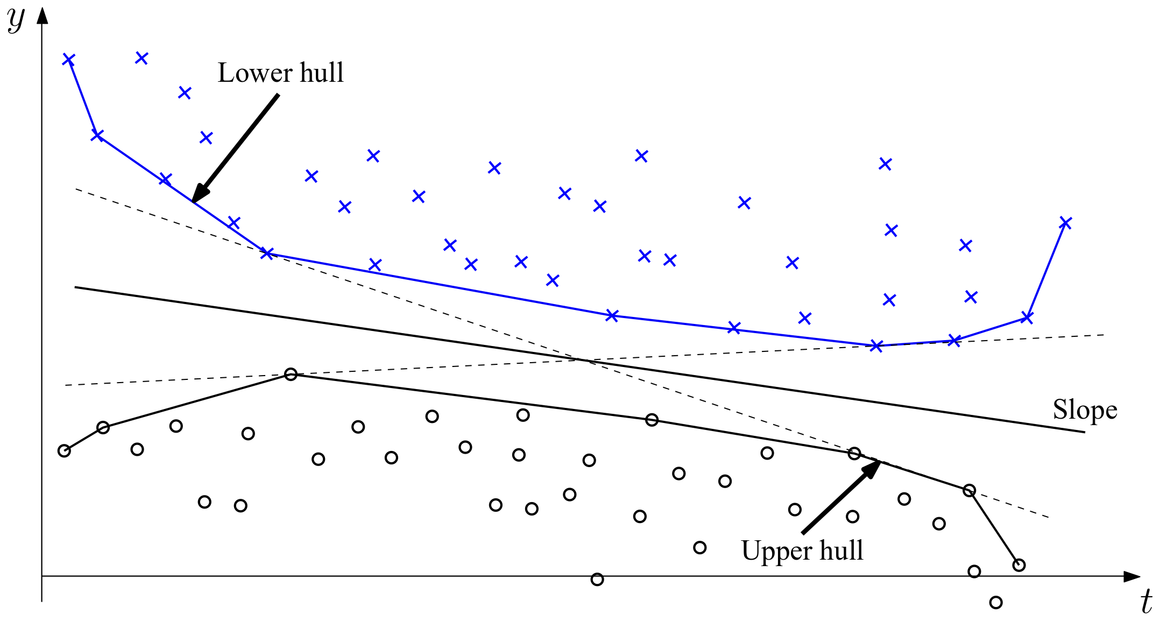
SLOPE SELECTION
Many possibilities
Compute tangents between polygons (convex hulls)
Slope of clock equals to slope of angle bisector

Slide 13
MULTI-STAGE SYNCHRONISATION
Global clock will become a bottleneck
Hierarchical arrangement of communication pairs
Loss of accuracy due to intermediate timestamp translation

Slide 14
CONCLUSIONS
Scalable infrastructure for synchronizing clocks
Synchronization during runtime
Adjust to clock effects – tradeoff accuracy vs. responsiveness
Works with long running applications

